Slide 1
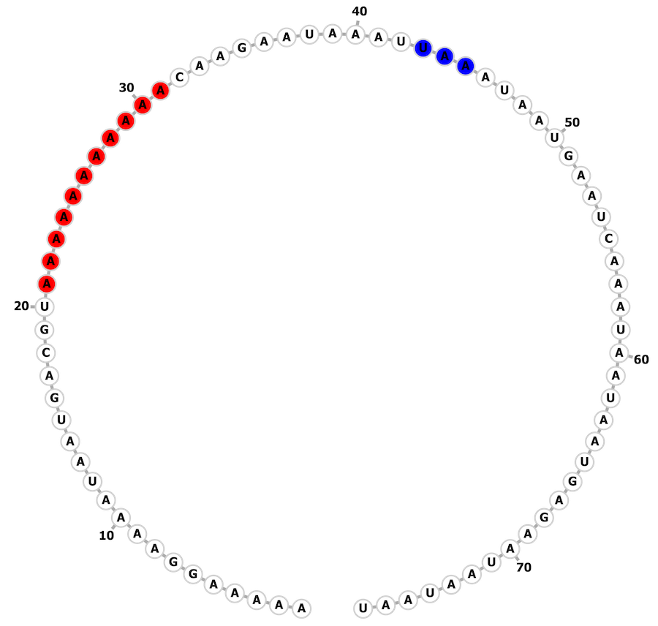
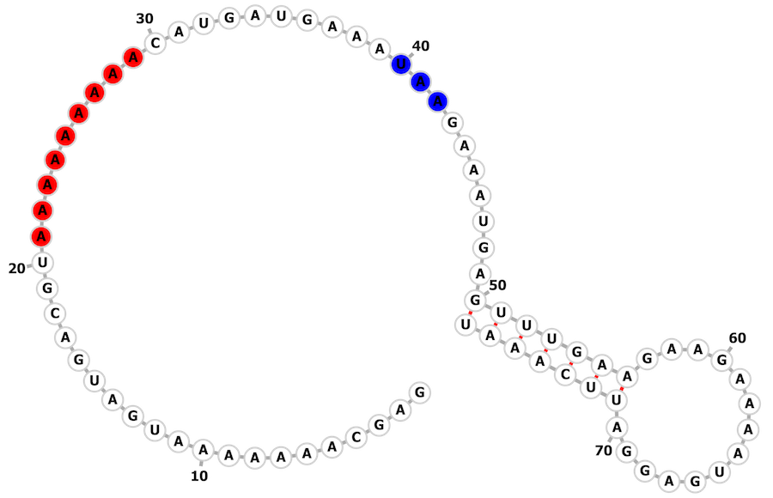
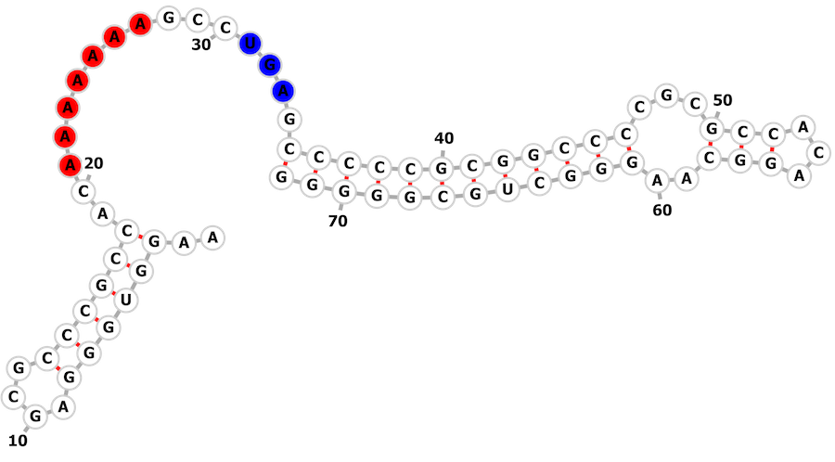
A
B
Methanocaldococcus fervens AG86
NC_013156.1:1122916-1122992(+)
Methanocaldococcus sp. FS406-22
NC_013887.1:1224237-1224313(+)
C
Delftia acidovorans SPH-1
NC_010002.1:6395640-6395711(-)

