Slide 1
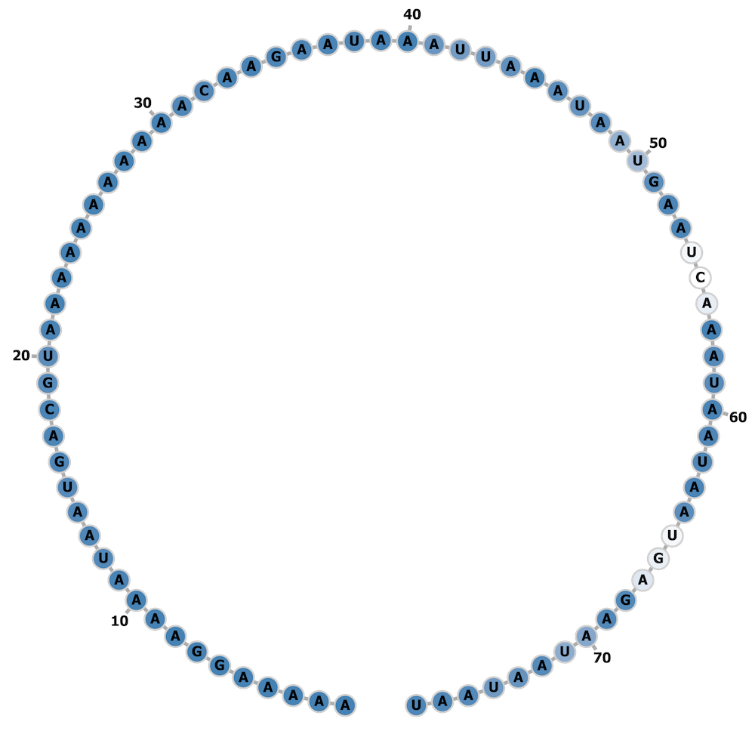
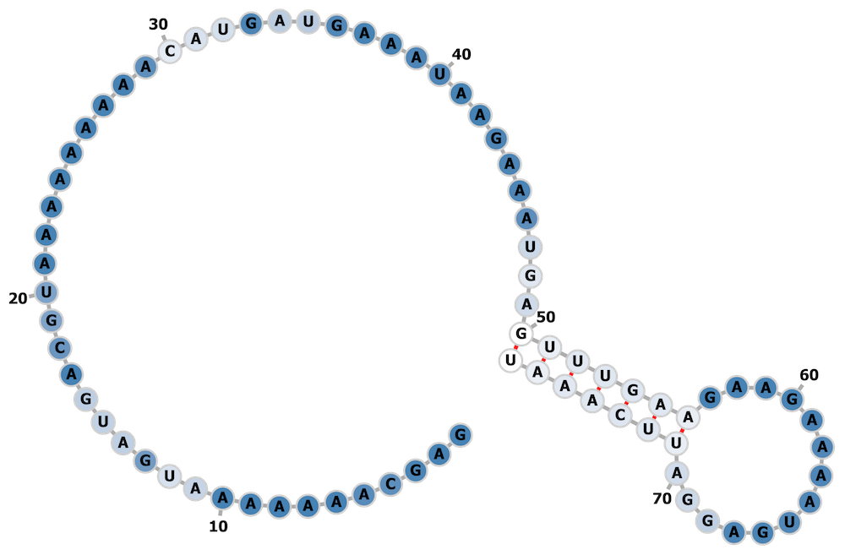
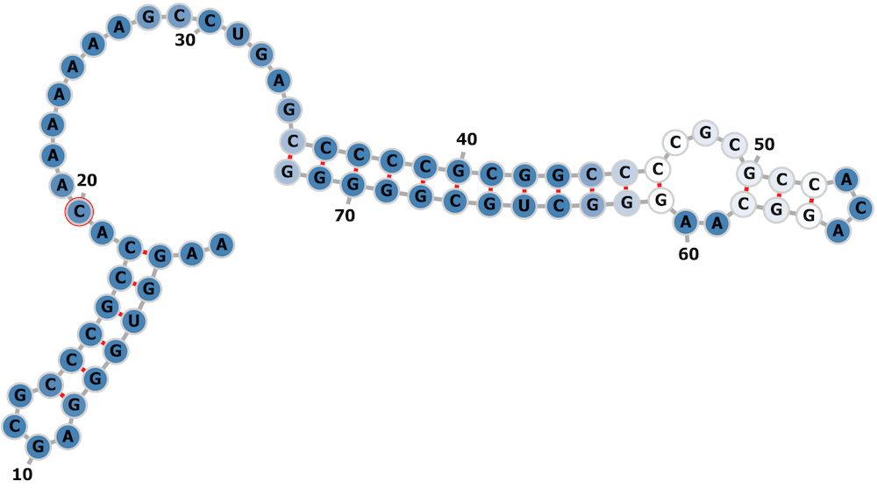
A
B
Methanocaldococcus fervens AG86
Methanocaldococcus sp. FS406-22
C
Delftia acidovorans SPH-1

