Slide 1


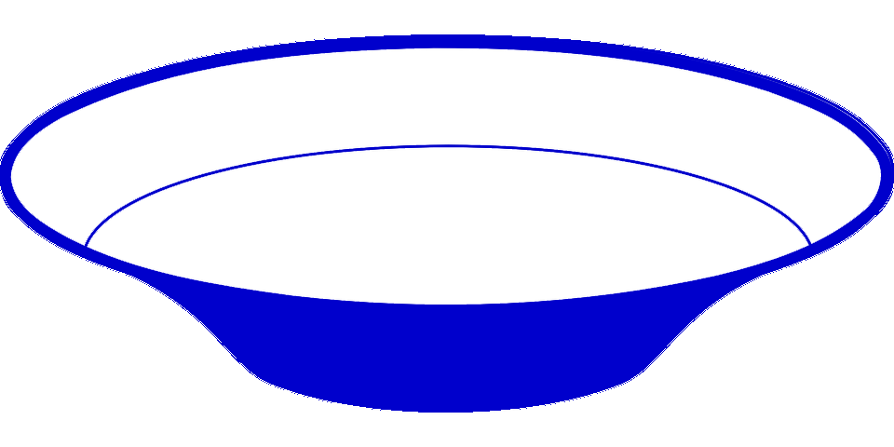


chlD
chlI
cobT
cobS
chlH
cobN
Mg-chelatase chlIDH
Co-chelatase cobNST
Production of Mg-/Co-chelatases | Genotype(s) [main taxa] (reference)
 | 1xchlH, 1xchlD, 1xchlI Proteobacteria Mg-chelatase: (Gibson et al. 1995)
 | 1xcobN, 1xcobT, 1xcobS, 1xchlH, 1xchlD, 1xchlI Proteobacteria Mg-chelatase: (Gibson et al. 1995) Co-chelatase: (Debussche et al. 1992)
 | 1xcobN, 1xchlH, 1xchlD, 1xchlI 1xcobN, 2xchlH, 1xchlD, 1xchlI Cyanobacteria Mg-chelatase: (Gibson et al. 1995) Co-chelatase: (Rodionov et al. 2003)
 | 1xcobN, 1xchlD, 1xchlI Actinobacteria Co-chelatase: (Rodionov et al. 2003)
 | 1xcobN, 1xfs-chlD Proteobacteria, Actinobacteria, Archaea Co-chelatase: (this study)
 | 1xcobN, 1xchlD Proteobacteria, Actinobacteria, Archaea Co-chelatase: (this study)
chlH
chlD
chlI
A
Mg-chelatase
chlH
chlD
chlI
cobN
cobT
cobS
B
Mg-chelatase
Co-chelatase
chlH
chlD
chlI
cobN
C
Mg-chelatase
Co-chelatase
D
chlD
chlI
cobN
Co-chelatase
fs-chlD
Frameshifting
cobN
E
Yes
No
Co-chelatase
chlD
Frameshifting
cobN
F
No
Yes
Co-chelatase
- chlD gene with a frameshifting signal
- fs-chlD gene with a frameshifting signal and a frameshift mutation

