Slide 1
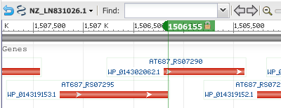
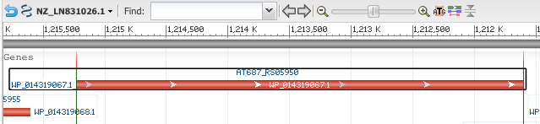
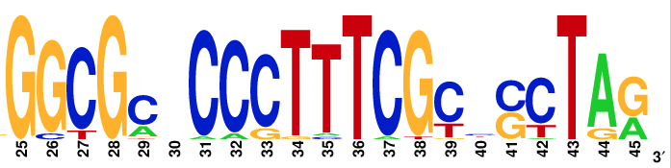
...
“AAA family ATPase "
“VWA domain-containing protein”
“cobaltochelatase
subunit CobN”
Transcription
chlD mRNA with frameshifted CDS
Corynebacterium diphtheriae
GGC_GCC_CCC_TTT_CGT_CCC_TAA
Logo obtained from the alignment of 28 Corynebacterium chlD genes
Proline
Phenyl- alanine
Stop codon

