Slide 1
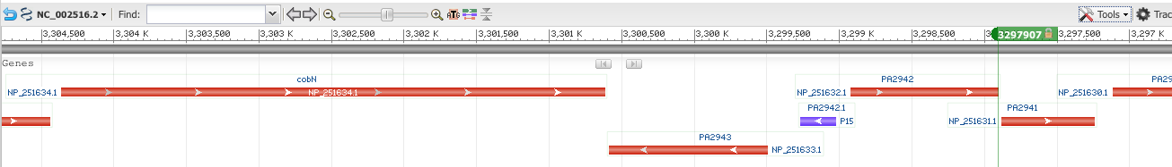
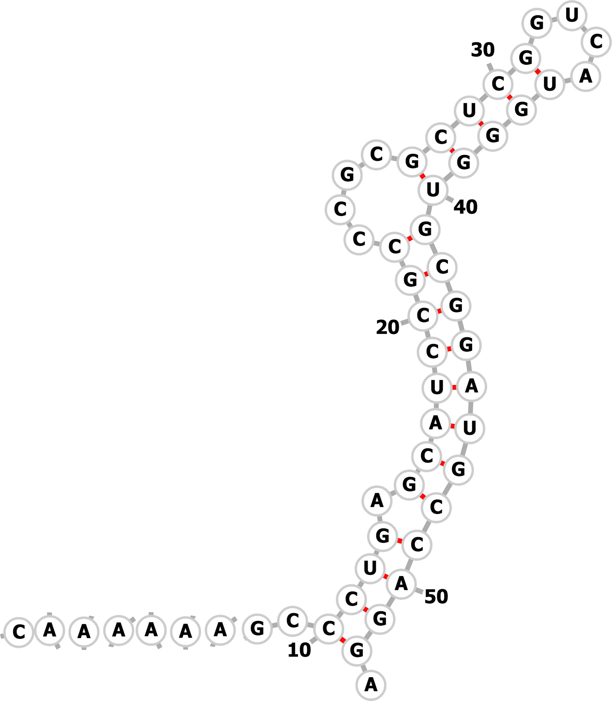
“cobaltochelatase subunit CobN”
(Large subunit)
“magnesium
chelatase"
“hypothetical protein”
Transcription
chlD mRNA with frameshifted CDS

