Slide 1
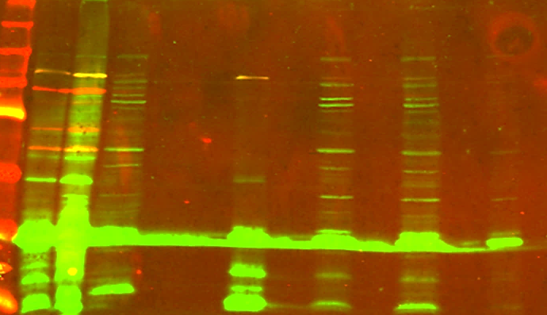
Composite blot
250kDa
150kDa
Recode product g6-7-8
100kDa
75kDa
50kDa
Recode product g6-7
37kDa
Termination product (g6)
25kDa

