Slide 1
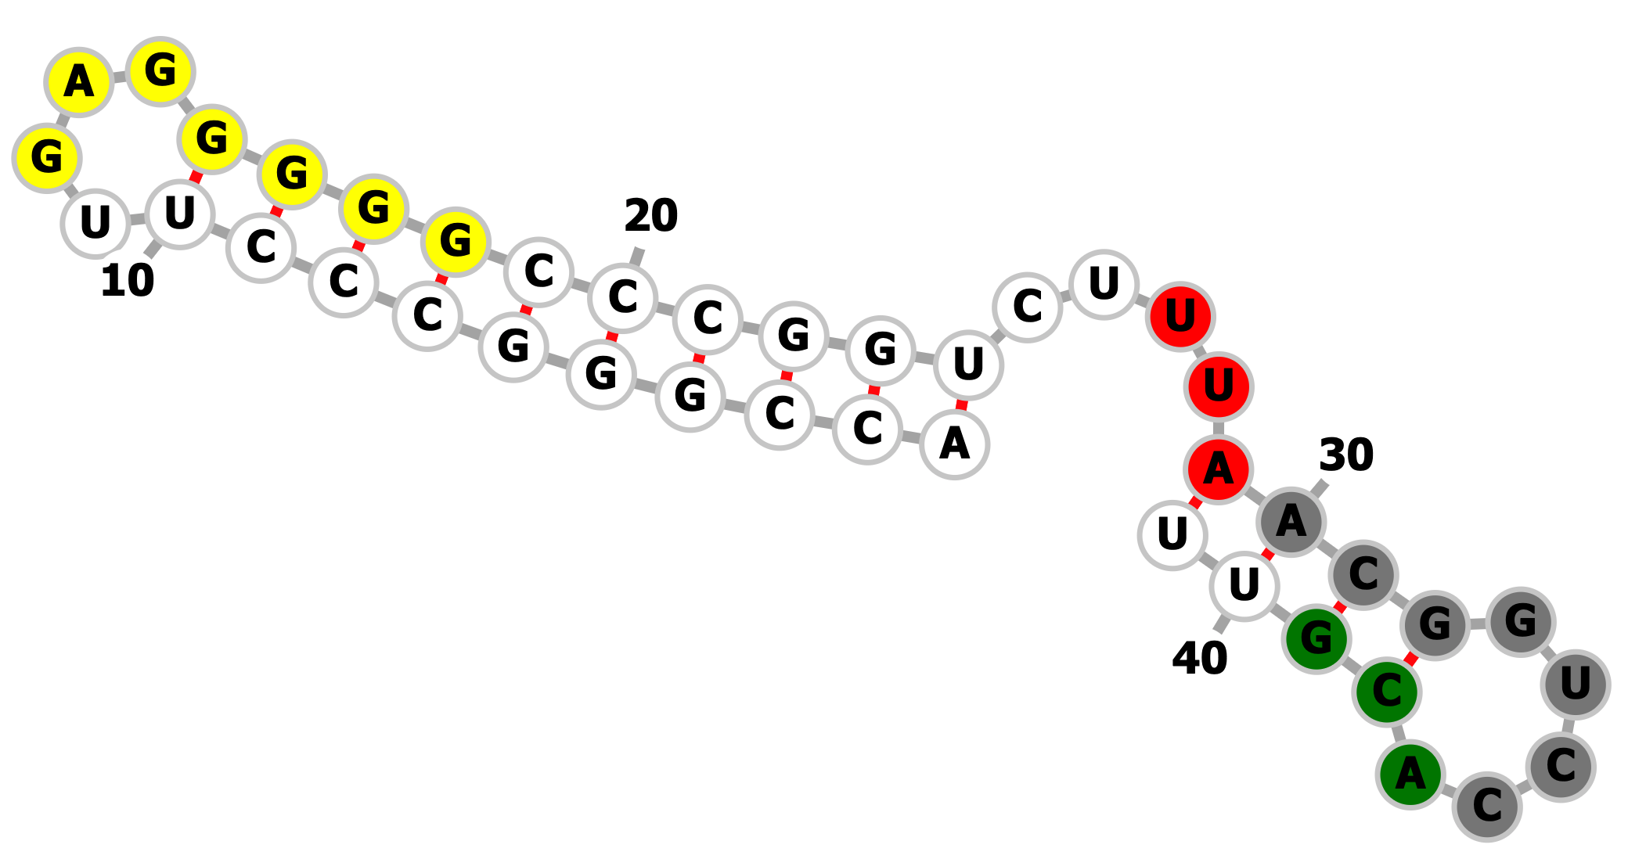
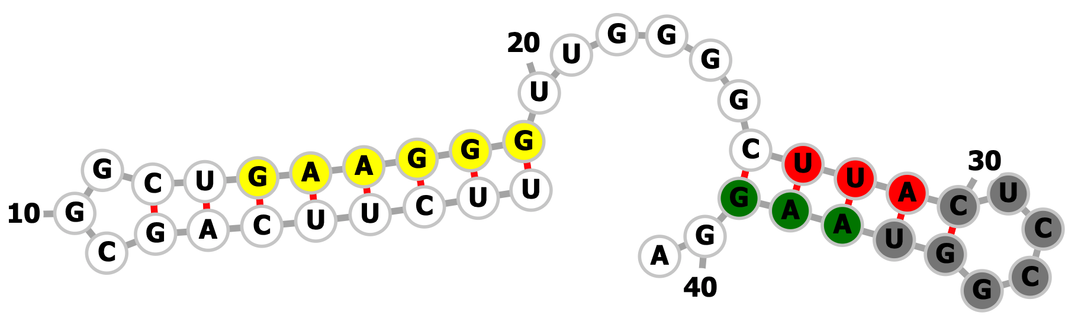
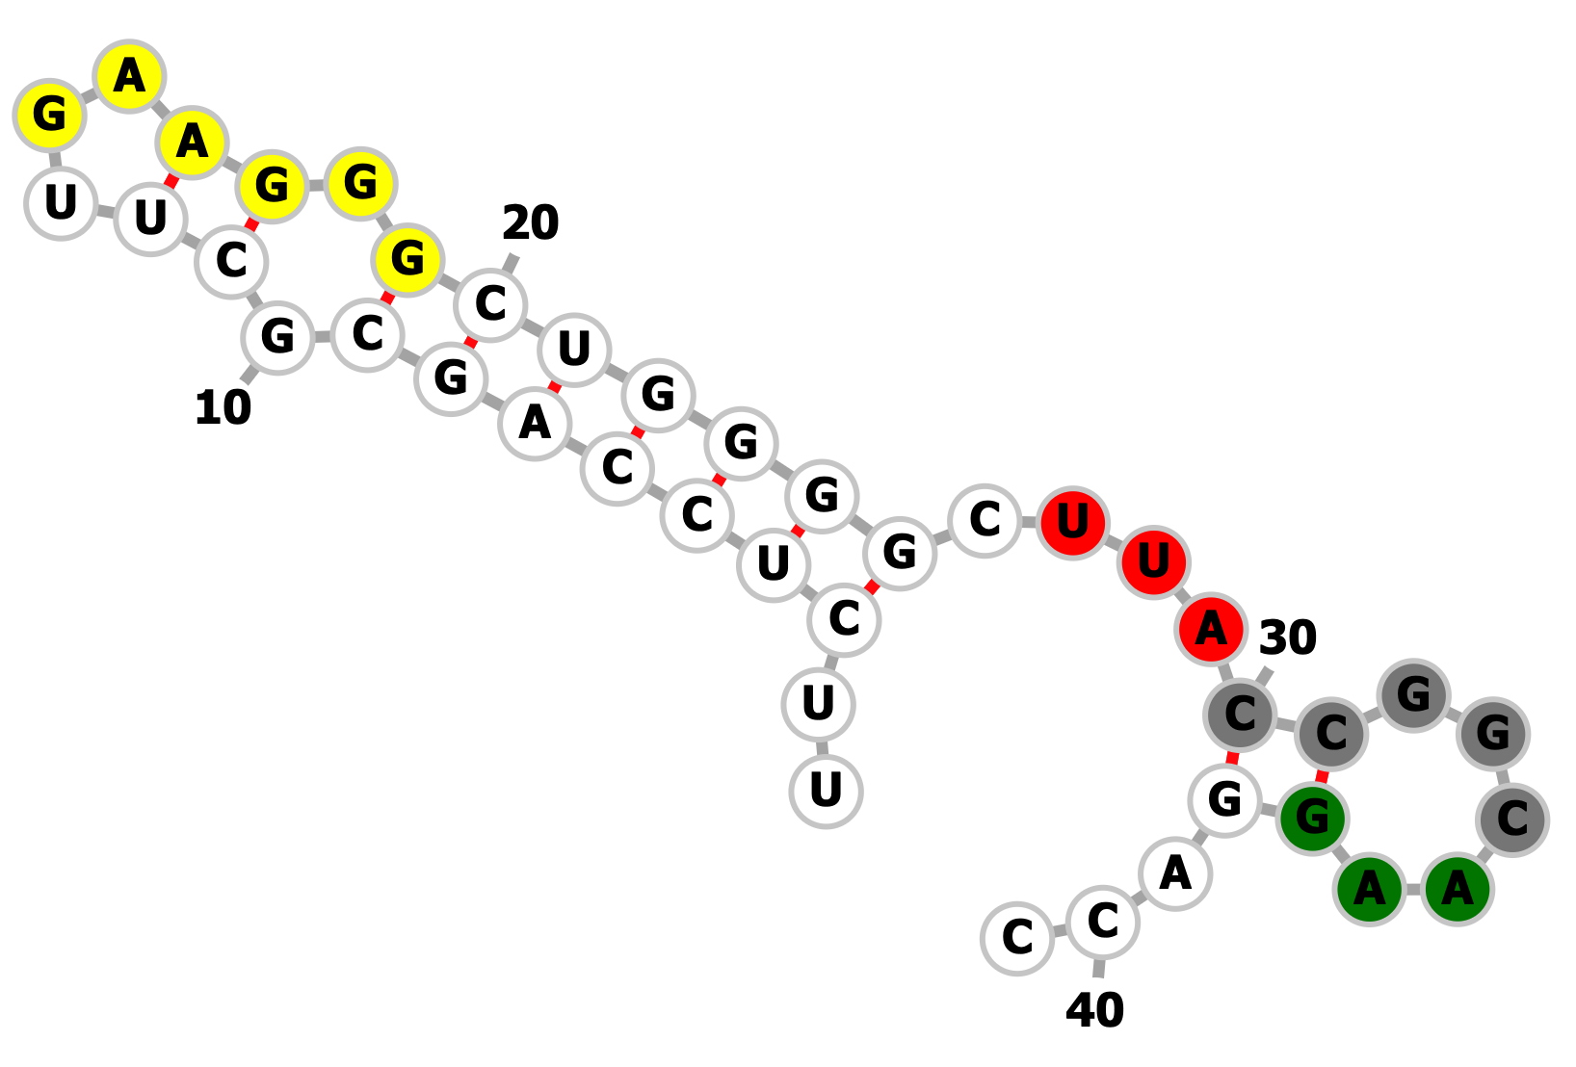
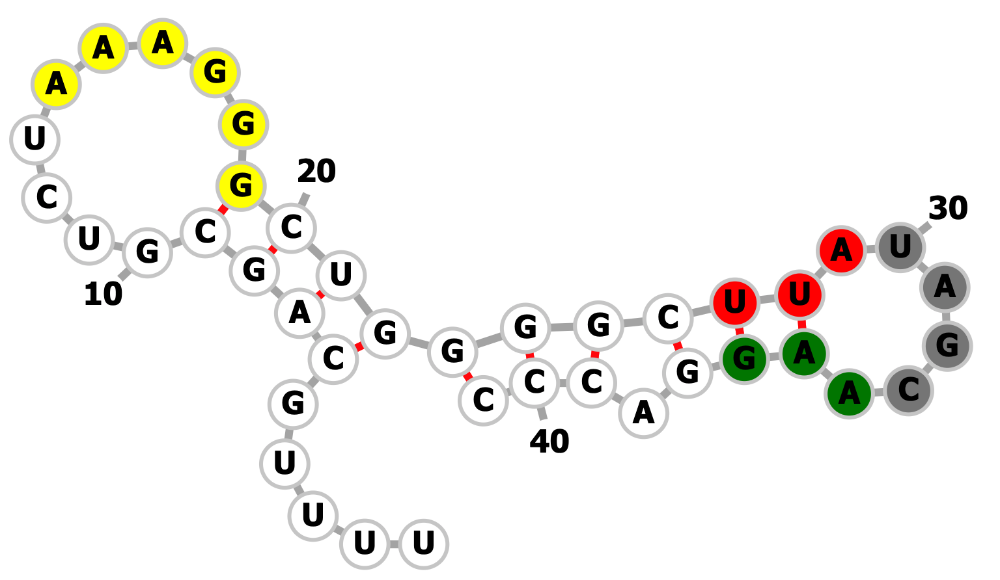
phiHau3 (g6/g7)
phiHau3 (g7/g8)
Streptomyces sp. C.1 (g6/g7)
Streptomyces catenulae (g6/g7)
Notes:
>phiHau 6-7
TTCTTCAGCGGCTGAAGGGTTGGGGC
TTA
CTCCGGTAAGGA
14-19:yellow
27-29:red
30-36:grey
37-39:green
>phiHau 7-8
ACCGGGCCCTTGAGGGGGCCCGGTCT
TTA
ACGGTCCACGTT
12-18:yellow
27-29:red
30-36:grey
37-39:green
>strepC1
TTCTCCAGCGCTTGAAGGGCTGGGGC
TTA
CCGGCAAGGACC
14-19:yellow
27-29:red
30-34:grey
35-37:green
>S_catenulae
TTTTGCAGCGTCTAAAGGGCTGGGGC
TTA
TAGCAAGGACCC
14-19:yellow
27-29:red
30-33:grey
34-36:green

