Slide 1
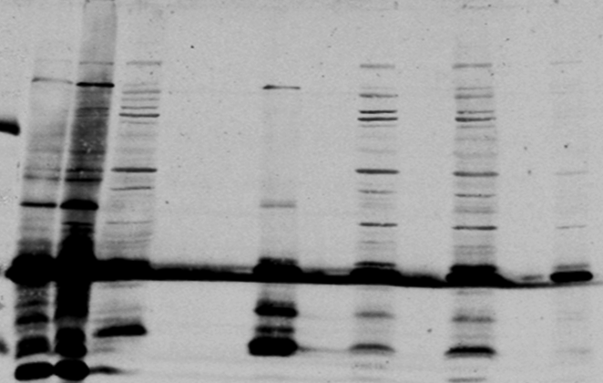
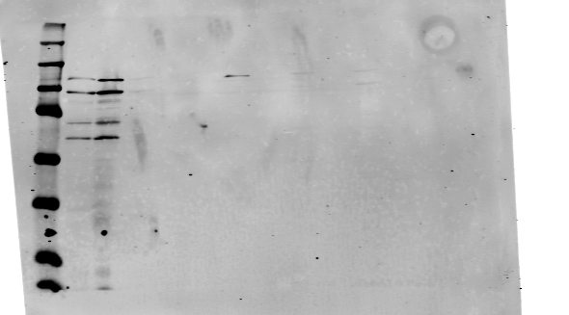
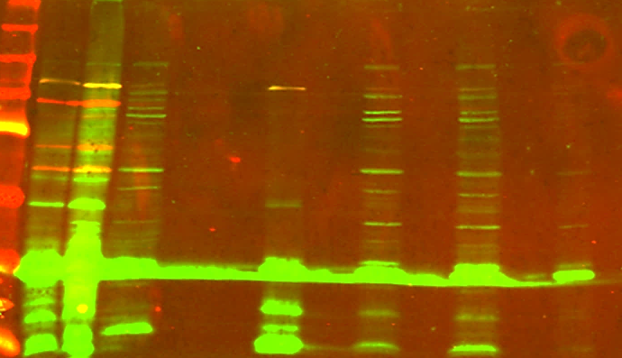
A
B
Anti - GFP blot
g6
g6
GFP
39.6 kDa
288bp
GFP beads - FT
GFP beads
SNAP beads - FT
SNAP beads
M
Pure Lysate
Pellet following lysis
+10 nts
Pre-lysis sample
g6/7
GFP
g6
g7
52.4 kDa
288bp
303bp
Recode product g6_7_8 - 113.2 kDa
+10 nts
+10 nts
75kDa
GFP
g6
g7
g8
SNAP/Ha
Recode product g6_7 - 52.4 kDa
φHau3
113.2 kDa
288bp
303bp
1062bp
Termination product (g6) - 36.9kDa
25kDa
Anti - Ha blot
150kDa
Recode product g6-7-8
100kDa
75kDa
50kDa
Composite blot
250kDa
150kDa
Recode product g6-7-8
100kDa
75kDa
50kDa
Recode product g6-7
37kDa
Termination product (g6)
25kDa

