Slide 1
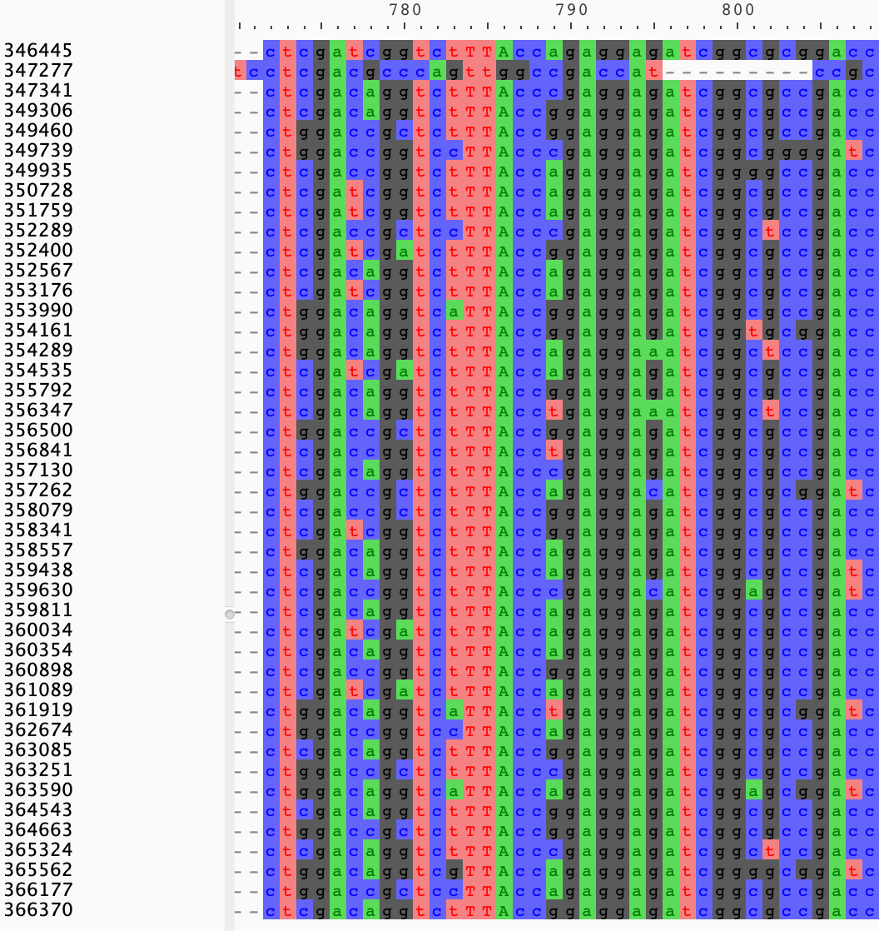
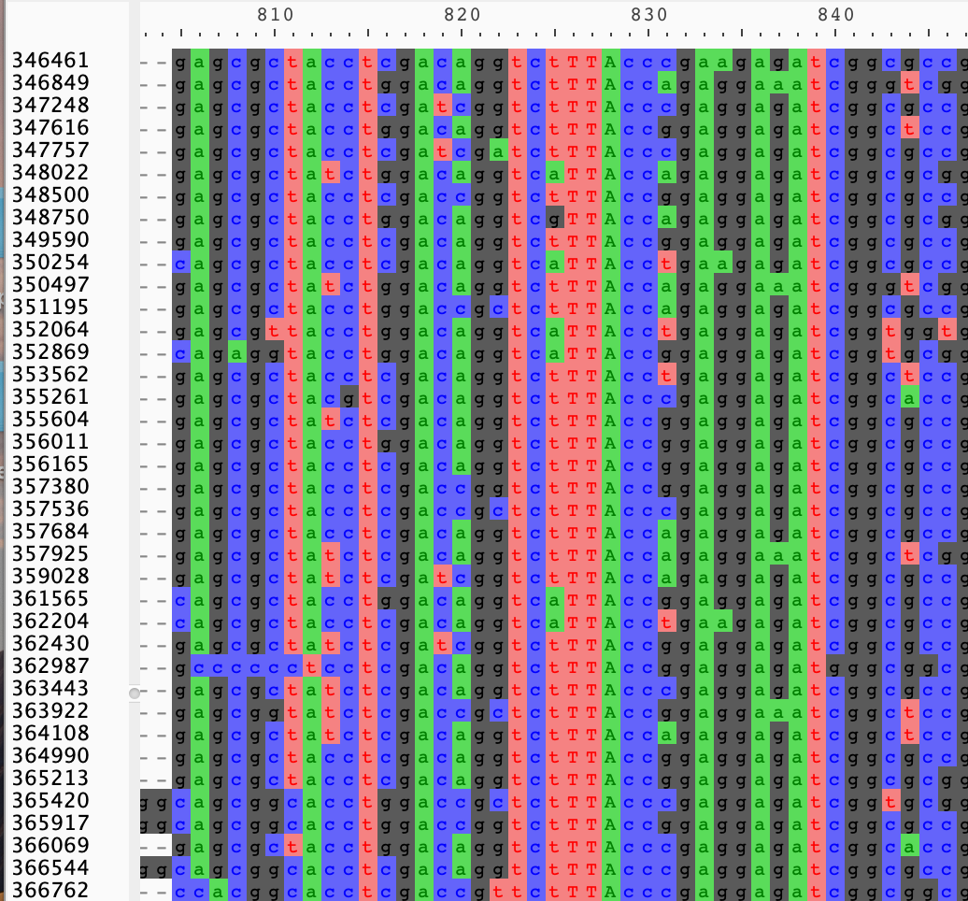
Cluster 1000074 arac family transcriptional regulator
Cluster 1000079 arac family transcriptional regulator

