Slide 1
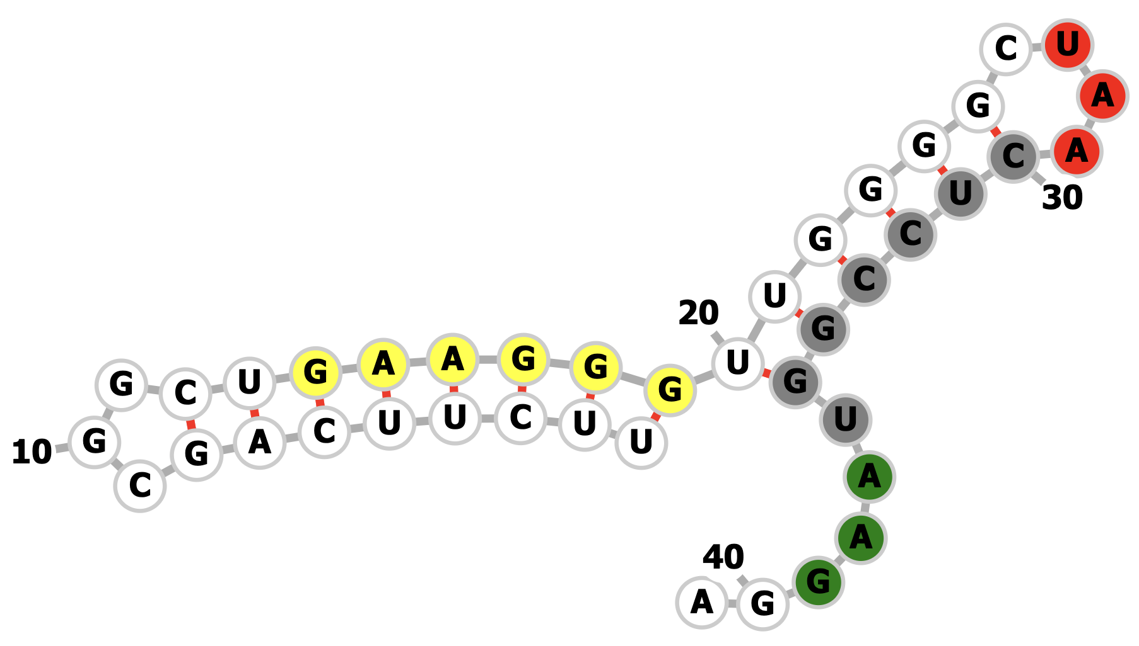
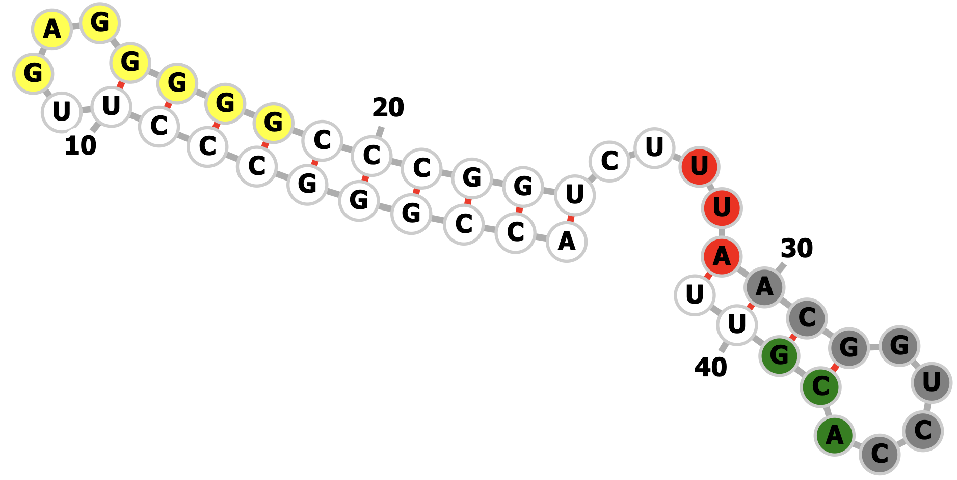
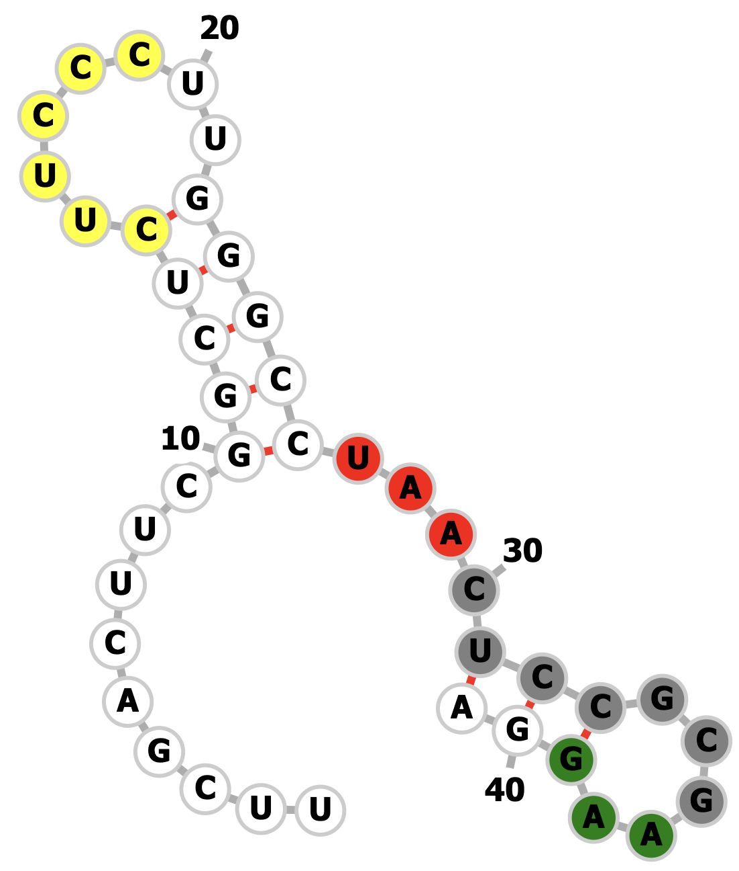
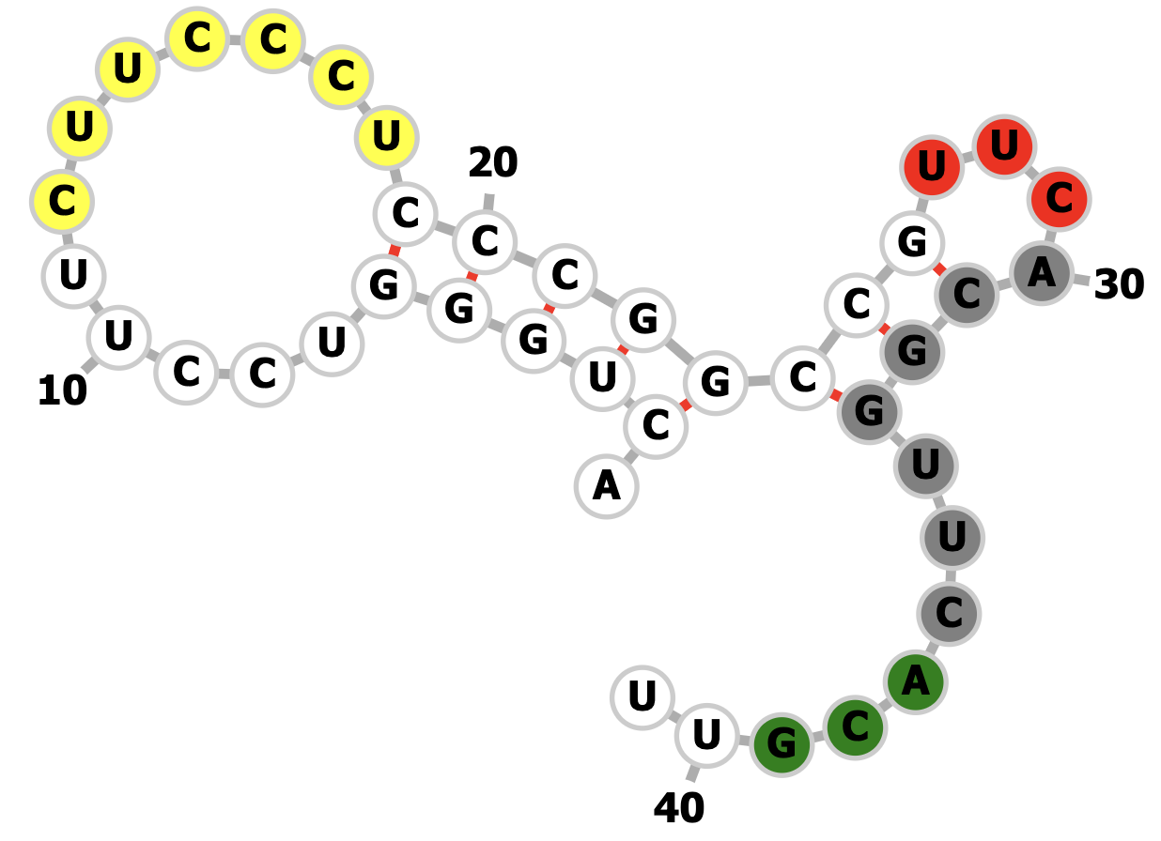
phiHau3 g7/g8
phiHau3 g6/g7
minimum free energy = -10.70 kcal/mol
minimum free energy = -22.80 kcal/mol
minimum free energy = -9.70 kcal/mol
minimum free energy = -8.40 kcal/mol
Notes:
Haug6/7
WT UUCUUCAGCGGCUGAAGGGUUGGGGCUAACUCCGGUAAGGA
Mut UUCGACUUCGGCUCUUCCCUUGGGCCUAACUCCGCGAAGGA
14-19:yellow
27-29:red
30-36:grey
37-39:green
Haug7/8
wt ACCGGGCCCUUGAGGGGGCCCGGUCUUUAACGGUCCACGUU
Mut acuggguccuucuucccucccggccgUUCACGGUUCACGUU
12-18:yellow
27-29:red
30-36:grey
37-39:green

