Slide 1
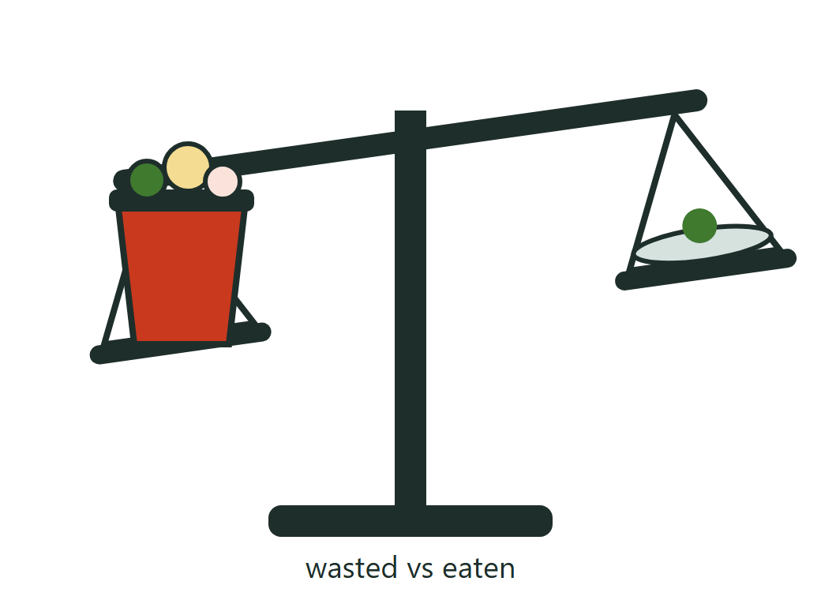
Good food dies in shared dorm fridges
1.05 bn
tonnes of food wasted worldwide in 2022
60%
of that waste came from households
79 kg
wasted at home per person each year
Source: UNEP Food Waste Index Report 2024
Why we chose it: in a shared fridge, food has no clear owner or date, so it is forgotten at the back.
Notes:
Start with the numbers, then bring it home: in a dorm, one fridge serves a whole floor. Nobody knows whose food it is or when it expires, so good food is thrown away.

Slide 2
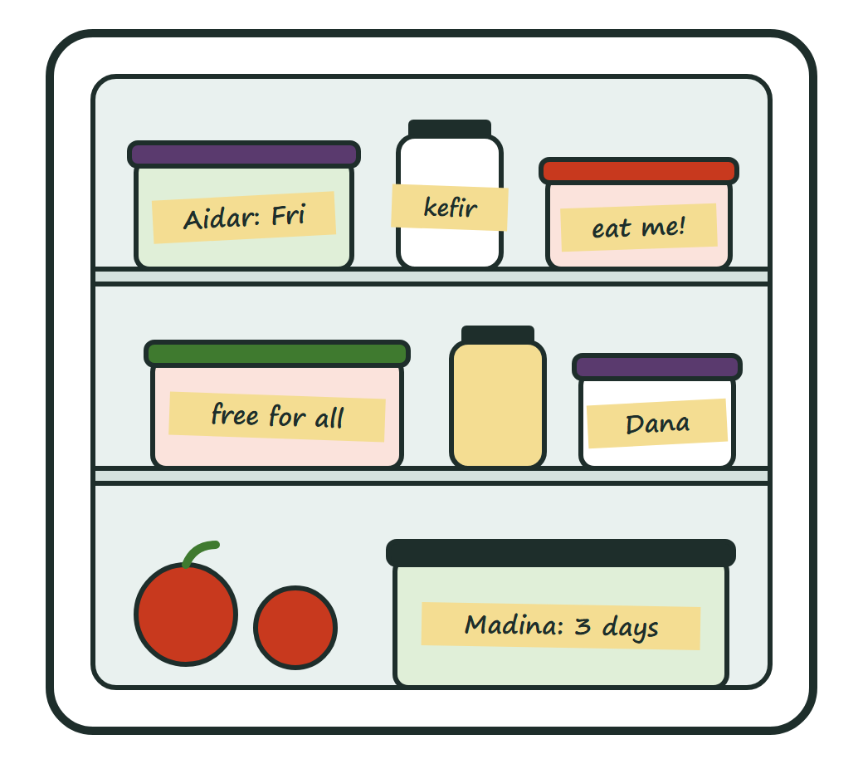
Soonish: the shared fridge that remembers
For: students who share a dorm fridge
Label: every item gets an owner and a date
Watch: the list warns two days before the date
Pass it on: mark food as up for grabs for the floor
How AI could help: suggest a cheap recipe from the food closest to its date.
Notes:
Explain the audience, then walk through the three habits. The original part is the up-for-grabs status: it gives neighbours permission to take food. The AI feature is only a proposal in Lab 1.

Slide 3
Who builds which page
Page | Purpose | Member
index.html | Homepage: the idea and the audience | Abdulaziz
problem.html | Food waste facts and sources | Abdulaziz
how-it-works.html | The three-step process | Abdulaziz
ai-rescue.html | The proposed AI feature | Abdulaziz
Next: Lab 2 adds our own CSS design and four more pages.
Notes:
Each member says what their page contributes. All pages share one navigation, and every page has an image with alt text and an external source.

