Slide 1

Amazon RCSA Report
Risk and Control Self Assessment for cybersecurity & Regulatory risks
Name: Vanya Sharma
UNI: vs2954
Operational Risk Management
March 24th, 2025

Slide 2
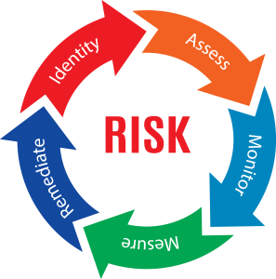
2. INTRODUCTION TO RCSA & AMAZON OVERVIEW
2.1 (a) What is RCSA
An RCSA is a systematic process for identifying, evaluating, prioritizing risks and controls within operations such as business units, audit or entity of an organisation.
The tool enables organisations to assess preparedness for potential challenges. Engaging in RCSA helps companies gain valuable insights into risk environment, ensuring appropriate controls are in place to mitigate potential issues and enhance operational resilience.
2.1 (b) Importance of RCSA
RCSAs empower organisations to proactively identify, assess and mitigate risks, ensuring operations align with strategic objectives. By ensuring all teams are focused on shared goals, the organisation will achieve its strategic objectives and maintain a proactive approach to risk management within the evolving industry.
2.1 (c) Key components of RCSA
Risk identification: Recognising potential threats to an organisation
Risk assessment: Risks need to be assessed to understand impact and likelihood
Risk monitoring: Track effectiveness of risk mitigation strategies
Risk measurement: Quantify potential impact and likelihood using probability and impact assessment
Risk remediation: Implementing strategies to address identified risks

Slide 3
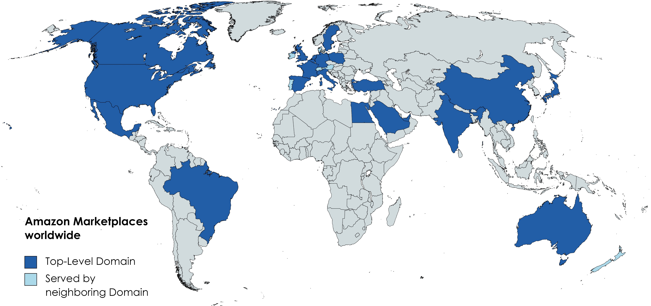
2. INTRODUCTION TO RCSA & AMAZON OVERVIEW
2.2 Amazon business overview
Why these two risks:
1. Cybersecurity threat (Advanced Persistent Threat to AWS): [Annexure A]
Amazon web service is backbone for its global businesses. The 10k report highlights a breach in AWS could lead to data loss, reputation damage, regulatory fines.
Cyber attacks, phishing make cybersecurity a priority for Amazon.
2. Regulatory and trade compliance (China and India operations):
Operations in China and India are dependent on regulatory frameworks. Localization mandates pose challenges to the business. [Annexure B]
The 10k report mentions- government regulations can lead to licensing issues, penalties.
Therefore, this report evaluates these 2 risks, assesses risk exposure, mitigation methods and residual risks under the RCSA framework.
Amazon is one of the world’s largest e-commerce, cloud computing, AI, company. It has over $500 billion in annual revenue as per the latest 10k filing. It serves millions of customers, making it the most dominant player.
As mentioned in the 10k filing, Amazon states variety of risks that could impact its performance and operations.
Amongst them, cybersecurity threats and regulatory compliance challenges were the key risks affecting the business.

Slide 4
Top-Down
Enables top
management
to make better
risk based decisions
3. RCSA PROGRAM DESIGN FOR AMAZON
3.1 Approach to RCSA
A hybrid approach is used for Amazon’s RCSA process, incorporating elements of both top-down and bottom-up assessments. This approach is selected because:
Top-down assessment: It provides strategic oversight from senior management and ensures risk identification aligns with business objectives. It is essential for large scale risks like regulatory compliance in China and India, requiring executive intervention.
Bottom-up assessment: It allows operational teams to capture day to day activities and risks with direct interaction with business functions. It is essential for cybersecurity threats where IT employees are first to detect anomalies.
Balanced View: Combining both perspectives, amazon ensures enterprise wide risks are effectively identified, assessed and mitigated as Amazon operates in multiple nations with varying risk landscapes.
Bottom-up
Drives robust
risk management
across the enterprise

Slide 5
3. RCSA PROGRAM DESIGN FOR AMAZON
3.2 Roles & Responsibilities
First Line of Defense (Business units)
The first LOD consists of business and operational teams responsible for managing risks and implementing controls. Their responsibilities as reflected in the RCSA table include:
Identifying and documenting risks:
Compliance & operations teams report potential cybersecurity threats and regulatory risks.
Control measures:
Implementing firewalls, AI threat detection, cyber security training for mitigating threats.
Ensuring regulatory compliance monitoring in China and India.
Monitoring:
Business units track KRIs
Second Line of Defense (Risk Management team)
The second LOD provides oversight, risk evaluation and policy enforcement, responsibilities including:
Risk assessment:
Review cybersecurity risk reports to determine likelihood of threats.
Evaluate regulatory risk exposure in China and India analysing changes in government policies.
Audit: Perform audits to ensure compliance with regulations
Risk mitigation:
Enhance vendor security audits and zero tolerance security adoption for cyber threats.
Strengthen government relations to manage regulatory challenges.

Slide 6
3. RCSA PROGRAM DESIGN FOR AMAZON
3.3 Frequency & Scope
RCSA to be reviewed quarterly to track emerging risks, assess controls and alignment with regulatory and cybersecurity regulations.
Annual assessments to evaluate high severity risks with board oversight.
Scope: Amazon’s global operations covered, ensures risks revolving around regulatory frameworks are continuously monitored.
3.4 Risk rating scale
Inherent risk:
The risks before applying controls, measuring the likelihood and financial impact [Annexure 1 (a),(b)] of the risk event without any mitigation controls in place.
(Refer to Annexure 2(a) for Inherent risk rating scale)
Residual risk:
Assesses risk after applying control measures, reflects remaining risk exposure.
(Refer to Annexure 2(b) for residual risk rating scale)
(Refer to Annexure 2(c) for inherent risk and residual risk rating heat map)

Slide 7
4.1 RISK 1- CYBERSECURITY THREAT
Risk name | Risk local description | Inherent risk rating | Control effectiveness | Residual risk rating | Action plan
ATP Cybersecurity attack (Business disruption, system failure) | Cyber criminals exploit the cloud infrastructure, vendor systems and gain unauthorized access using zero day vulnerabilities and weakness in security system. The breach results in data manipulation and AWS service downtime, impacting major clients and regulatory compliance. | Critical | Moderate | High | Implement zero trust security model Enhancing vendor security audits and enforcing stricter compliance Develop AI enabled anomaly detection to identify threats
(Refer to Annexure 3 for inherent risk, control effectiveness, residual risk rating justification)

Slide 8
4.2 RISK 2- LEGAL & COMPLIANCE RISK IN CHINA AND INDIA
Risk name | Risk local description | Inherent risk rating | Control effectiveness | Residual risk rating | Action plan
Regulatory compliance in China and India (Clients, products and business practices) | The PRC and India regulate Amazon’s business through foreign investment, internet, licensing and other regulations. Operating under complex third-part | High | Moderate | Medium | Strengthen government relations Diversify supplier base outside China to reduce dependency Improve compliance risk forecasting through AI analytics.
(Refer to Annexure 3 for inherent risk, control effectiveness, residual risk rating justification)

Slide 9
Conclusion and recommendation
Conclusion:
The RCSA program assesses 2 important operational risks Cybersecurity threat (Business disruption, system failure) and regulatory and third party trade compliance risks in China and India (Clients, products and business practices).
Both risks have potential to impact amazon’s operations and operational stability.
The cyber threats require amazon to maintain proactive security frameworks. Despite existing multi-layered controls, residual risks remain high.
Amazon’s operations in China and India face uncertainties, foreign ownership restriction and evolving trade policies. Amazon has implemented government strategies, alternative supply chain, yet regulatory environment remains unpredictable.
Given the high financial impact, continuous monitoring and risk mitigation is important.
Recommendations:
To strengthen amazon’s risk management and reduce residual risk:
ATP on AWS:
Enhance AI automation to detect anomalies and mitigate cyber threat before they escalate
Strengthen third party vendor and cloud partner audits- bi annual audits for all vendors who handle confidential data.
Regulatory and trade compliance:
Expand government relations, collaborate with government agencies to advocate favourable trade policies
Establish legal team to handle sudden regulatory enforcement actions, fines.

Slide 10
REFERENCES
Amazon 10-k report
https://riskcue.id/uploads/ebook/20211013112039-2021-10-13ebook112026.pdf
https://www.linkedin.com/pulse/risk-control-self-assessment-rcsa-strategic-imperative-zvy2f/
https://www.wolterskluwer.com/en/expert-insights/risk-and-controls-self-assessment-rcsa-best-practices#:~:text=Risk%20and%20Controls%20Self%2DAssessment%20(RCSA)%20is%20a%20cornerstone,operations%20align%20with%20strategic%20objectives
AI: ChatGPT- Report structure, Extracting financial data from 10k report, recommendations for report

Slide 11
Annexures

Slide 12
Annexure A
Bow-tie analysis- Cybersecurity threat
Regular cybersecurity awareness training
Phishing attacks on employees
Business disruption- AWS systems go offline
AI email filtering
ATP attack breaches AWS environment
Regular security patches
Exploitation of outdated software
Leakage of confidential customer data
Annexure B
Bow-tie analysis- Regulatory and third party compliance failure in China and India
Engage with local regulatory boy and legal advisors
Governments suddenly update data protection laws
Hefty fines and legal penalties
Dedicated regulatory monitoring team
Regulatory breach and compliance failure in China or India
Company policies not tailored to local laws
Operational disruption, license revocation
Develop region specific compliance strategies with local officers

Slide 13
Annexure 1 (a)
Annexure 2 (a)
Severity scale based on Amazon’s revenue ($500B+)
Inherent risk rating (IRR)
Severity | Financial impact
(1) Low | <$50M
(2) Medium | $50M-$500M
(3) High | $500M-$1B
(4) Critical | >$1B
Risk event | Severity | Frequency | Risk rating (Severity*Frequency)
ATP Cybersecurity attack | Critical (4) | Possible (3) | 12 (High risk)
Regulatory compliance in China and India | High (3) | Possible (3) | 9 (Moderate-high risk)
Annexure 2 (b)
Annexure 1 (b)
Residual risk rating (RR)
Frequency scale based on likelihood
Risk event | Severity | Frequency | Risk rating (Severity*Frequency)
ATP Cybersecurity attack | High (3) | Unlikely (2) | 6 (Moderate risk)
Regulatory compliance in China and India | Medium (2) | Unlikely (2) | 4 (Medium risk)
Likelihood | Occurrence
(1) Rare | Once in 10+ years
(2) Unlikely | Once in 5-10 years
(3) Possible | Once in 2-5 years
(4) Likely | Annually
(5) Certain | Multiple times a year
Annexure 2 (c)
Heat Map
Likelihood
Rare Unlikely Possible Likely Certain
<$50M
$50M-
$500M
$500M-
$1B
$1B
 |  |  | RC (RR)
 | CS (RR) | RC (IRR) | CS (IRR)
Key:
CS- Cybersecurity
RC- Regulatory compliance
IRR- inherent risk rating
RR- residual risk
Severity

Slide 14
Annexure 3
RATIONALE FOR RISK RATINGS
Justification of inherent and residual risk ratings
Risk Event | Inherent risk rationale | Control effectiveness rationale | Residual risk rationale
ATP Cybersecurity attack (Business disruption, system failure) | Critical: Amazon thrives on cloud infrastructure and AWS in global operations. An advanced cyberattack could result in massive service outage, data breaches. Past cases like Capital one’s AWS breach prove likelihood of such an attack. | Moderate effectiveness: Amazon has multilayered security, Ai anomaly detection and other compliance controls. However ATS attacks can bypass the systems. [Partially effective] | High: Evolving threats can still cause a data breach, could result in a financial impact of $500M to $1B.
Regulatory compliance in China and India (Clients, products and business practices) | High: Amazon relies on third-party relationships to operate in China and India, hence vulnerable to regulatory shifts. Government regulations pose risks with historical precedent in China (Alibaba, Didi). | Low- Moderate effectiveness: Amazon engages in regulatory compliance, government relations. However, these controls cannot completely eliminate regulatory uncertainty, as governments can change laws unpredictably. [Effective] | Medium: Market share loss and supply chain disruptions pose financial risk exceeding $1B.
Key:
Low
Medium
High
Critical

