Slide 1
Estimation of fat fraction considering T2* decay in liver after SPIO injection
Tomoyuki Okuaki^{1,2}, Kengo Yoshimitsu³, Ivan Zimine¹, Shutaro Saiki¹,
Marc Van Cauteren⁴, Toshiaki Miyati⁵
1, Philips Electronics Japan
2, Graduate School of Medical Science, Kanazawa University
3, Radiology, Faculty of Medicine, Fukuoka University
4, Philips Healthcare
5, Kanazawa University Graduate School of Medical Science University

Slide 2
Introduction 1
The incidence of Non-alcoholic fatty liver disease (NAFLD) is increasing.
Fat fraction estimation is very important for this disease, especially if non-alcoholic steatohepatitis (NASH) is suspected.
Estimation of fat fraction is affected by T2* decay, and because liver diseases are often accompanied by iron accumulation causing T2* shortening, it is important to take this effect into account ⁽¹⁾.
(1) Huanzhou Yu,et al, JMRI,2007;26:1153-1161

Slide 3
Introduction 2
The aim of this study was to determine the accuracy of fat fraction estimation combined with T2* estimation depending on the number of echoes acquired with a multi-echo gradient echo sequence with breath holding.

Slide 4
Method 1
11 volunteers with fatty liver of various degrees were performed on a 1.5T Achieva system (Philips Healthcare, BEST, NL) with eight channel phased array body coil after obtained informed consent.
Scan sequences were dual echo T1-weighted fast field and multi echo fast field gradient before and after superparamagnetic iron oxide particles(SPIO) administration.
Scans were repeated at 1,3,5,7 and 10 minutes after SPIO injection.

Slide 5
Method 2
Dual echo sequence
  Dual echo T1-FFE
  TR=100ms,TEs=2.15/4.2ms,FA=70, 204x256matrix
  scan time 18.2sec
Multi echo sequence
  multi echo FFE
  TR=48ms,TE=2.15ms,FA=20, ΔTE=2.15, 10echos, 128x128 matrix
  scan time 19.7sec

Slide 6
Calculation of fat fraction 1
Dual echo data
  Fat fraction = (S_{in} – S_{out}) / 2*S_{in}
Multi echo data
  S(te) = [(S_{w}*e^{-te/T2*})² +(S_{f}*e^{-te/T2*})²
  + 2* S_{w}*S_{f}*e^{-te/T2*} *cos(Δωte)]^{1/2}
  Fat fraction = S_{f} / (S_{w} + S_{f})

Slide 7
Calculation of fat fraction 2
For mFFE method, fat fraction maps were generated after signal fitting using different number of echoes (3,4,6,8, and 10echoes)
Fat fraction maps from dual echo data and mFFE data were compared before SPIO injection and for each acquired time point after injection.
For each time point fat fraction ratio (FFr) maps were calculated as post-contrast data divided by pre-contrast data. Average values across time points from manually placed ROIs (excluding big vessels) were used for comparison.

Slide 8
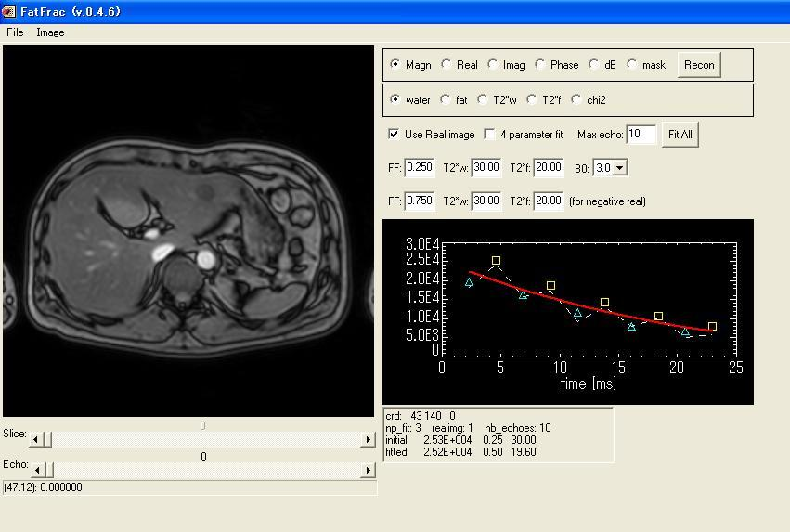
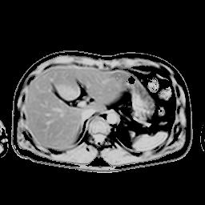
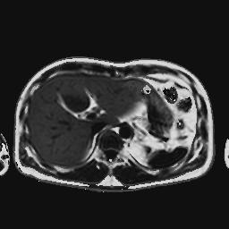
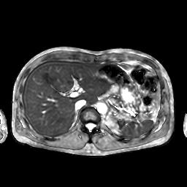
Fat fraction analysis tool
・Analysis of fat fraction considering
T2*decay
・Output maps: fat fraction, water
fraction, T2*water and T2*fat.
・Multi slice or 3D data
・3 or 4 parameters fitting model
・Initial values for fat fraction,T2*w
and T2*f.
・Flexible number of echoes
Water fraction image
Fat fraction image
T2* map (Water and Fat)

Slide 9
Result 1
A total of 12 ROIs were used for comparison
  dual echo method
    FFr = 0.32±0.28, by
  Multi echo method FFr ware following
    3 echoes (1.03 ± 0.11),
    4echoes (1.00 ± 0.07),
    6 echoes (1.04 ± 0.05),
    8 echoes (1.12 ± 0.08)
    10echoes (1.32 ± 0.05)

Slide 10
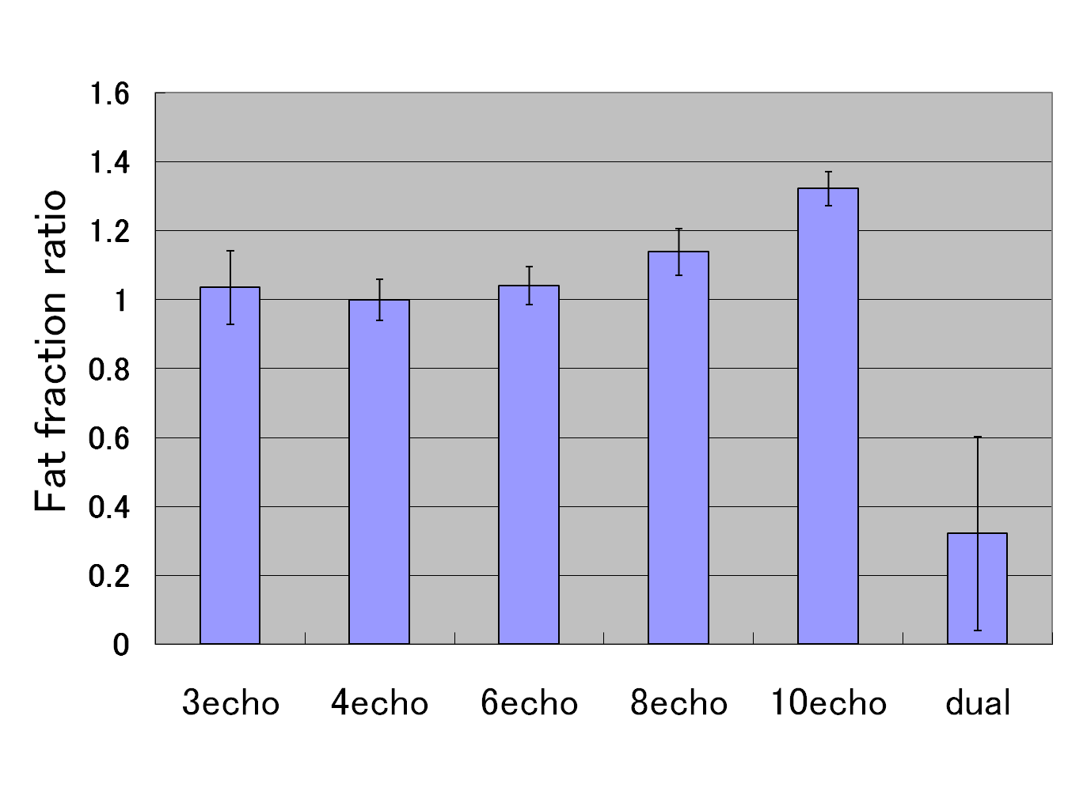
Fig.1 Fat fraction ratio
Comparison with each result that using different number of echoes for fitting

Slide 11
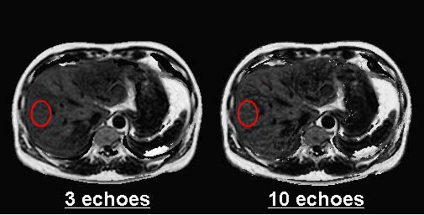
One case of result
Fat fraction image(10min after SPIO injection)
Left : using 3echoes for fitting, FFr =15.9%
Right : using 10echoes for fitting, FFr =18.4%

Slide 12
Result 2
Dual echo method
  Fat fraction is clearly underestimated because of unaccounted T2* decay.
Multi echo method
  The ratio stays close to expected 1.0 .
  The variance of mFFE data is significantly smaller compared to dual echo
  (Wilcoxon’s signed rank test, p<.0001).
  For different number of echoes, only data from 10 echoes was significantly larger than other datasets
  (Wilcoxon’s signed rank test, p<.0001).

Slide 13
Discussion 1
Accurate estimation of fat fraction consideringT2* decay is possible using mFFE method in the liver, even in patients with iron accumulation.
In case of very short T2*, signal at long TE is too small, consequently fat fraction estimation will be less accurate when using all echoes for fitting.

Slide 14
Discussion 2
Considering that abdominal imaging requires breath holding, i.e. short scan times, and that the results for 3, 4, 6, and 8 echoes are not significantly different.
The use of smallest number of echoes is justified.

Slide 15
Discussion 3
More echoes would be necessary for more complex signal modeling.
  (ex. considering multiple T2*).
However it is unlikely that acquisition of more than 6 echoes will be useful in practice.

Slide 16


