Slide 1
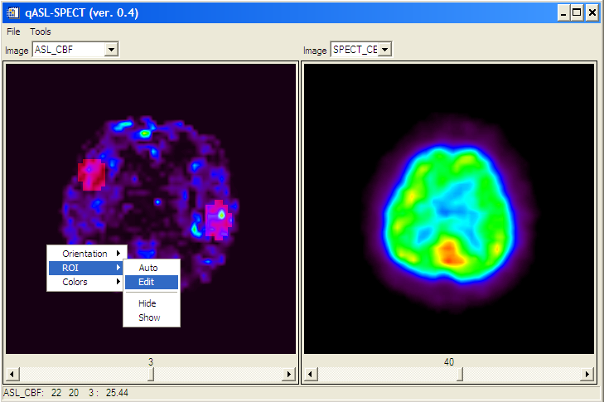
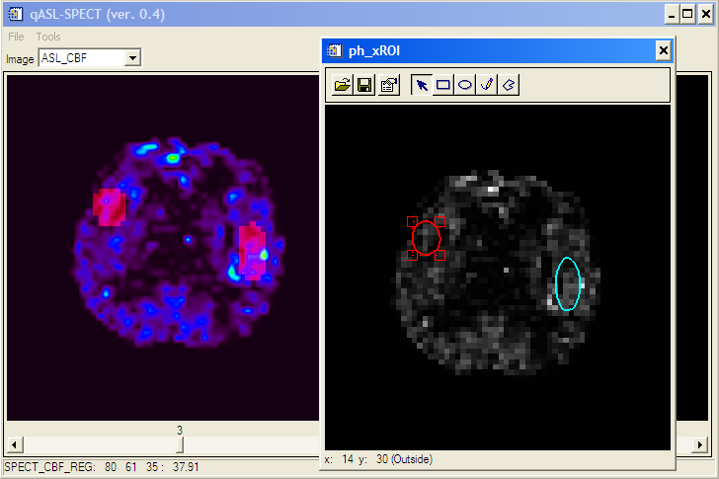
ROI selection:
Right click on the image
ROI->Auto or Edit
ROI editor:
Click on ROI to make it active
Small squares allow to resize the ROI
Click and drag near the ROI (but not in the square) to move it
Right click to delete a ROI
Tools: Save/Load current ROIs
ROI Types: square/ellipse/free hand/polygon
After editing, simply close the xROI window and changes should be reflected on the image display as semi-transparent red regions.
Tools->ROIs->Statistics for results

