Slide 1


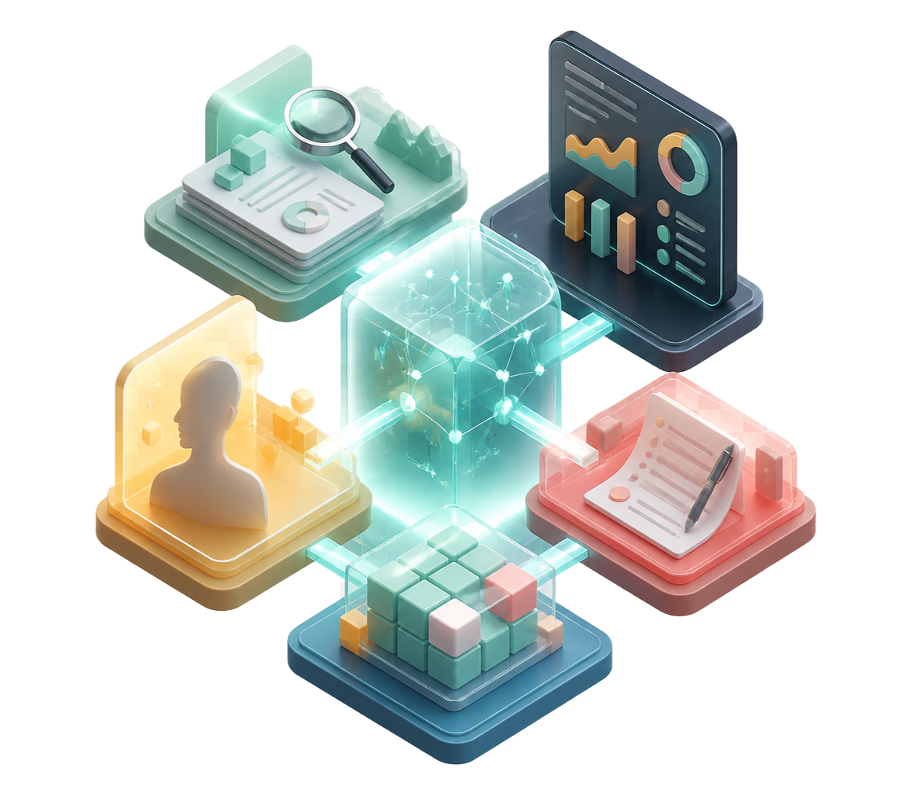
CONTEXT.SE
2026
AI PREP LAYER
Context.SE
Every demo, personalized. Every question,
anticipated.
The prep layer for technical, demo-led selling.
Hackathon pitch
01 / 06

Slide 2

01 / THE PROBLEM
Context.SE / 2026
The meeting moved up. The
prep didn't.
least
time
01
Reps walk in with a generic deck and a guess
02
Technical buyers ask different questions —
and the demo rarely adapts fast enough
The prep that decides whether a deal
moves forward gets the least time.
Our wedge: the personalization + rehearsal layer
$7B
$25B+
→
sales enablement
market today
headed past by 2034
Hackathon pitch
02 / 06

Slide 3



02 / THE SOLUTION
Context.SE / 2026
One prospect URL. A complete prep loop.
01
02
03
Live company
A personalized,
Rehearsal against
research
branded demo
the buyer persona
A conversation that pressure-tests
Signals, brand, and context
from the prospect URL.
Realistic data, shaped for the
meeting you are about to run.
the prep before the real
meeting does.
Context.SE turns scattered context into a meeting you are ready to run.
03 / 06

Slide 4

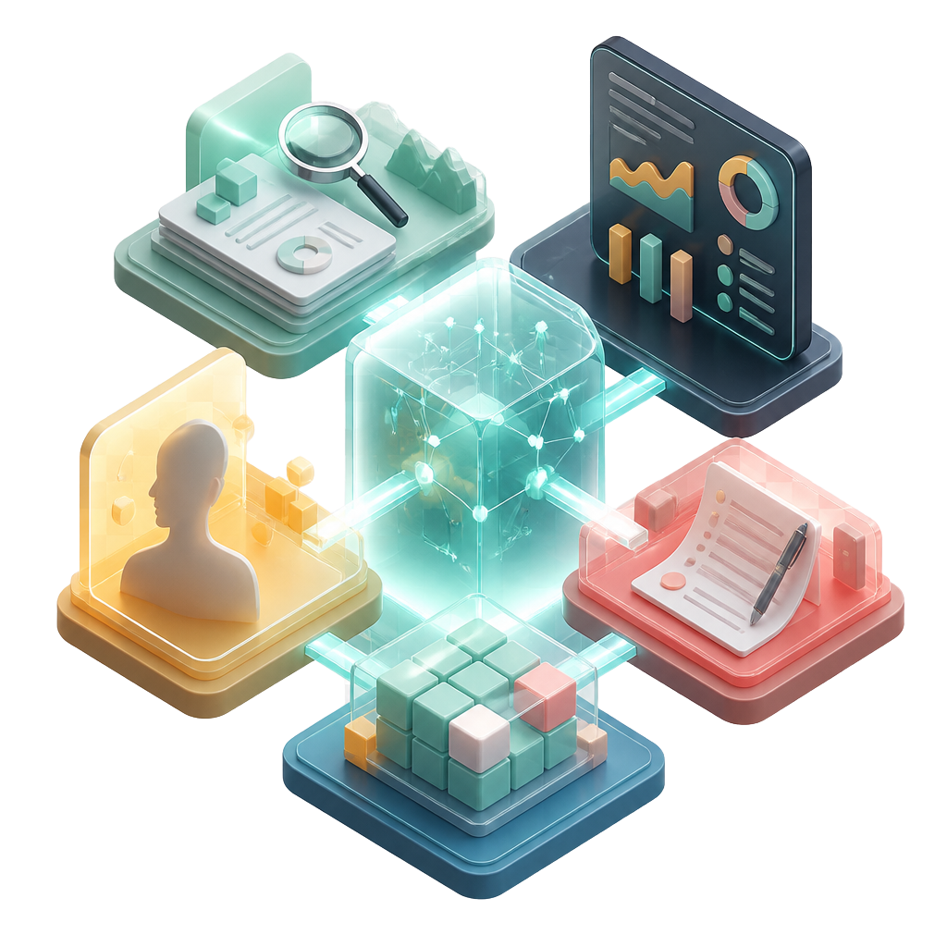
03 / THE DEMO
Context.SE / 2026
Research → build → rehearse → refine
prospect URL
01
Paste a prospect URL and watch relevant signals populate
02
Generate a branded demo with realistic data
03
Create a briefing doc for the meeting
04
Select the buyer persona you are about to meet
05
Simulate the conversation and surface the questions they are
likely to ask
06
Rewrite the brief and demo to answer them
buyer persona
One loop, before the room
04 / 06

Slide 5
04 / THE LEARNING LOOP
Context.SE / 2026
The feedback loop gets smarter after
every meeting.
01
Feed meeting minutes back into the buyer
INPUT
MODEL
persona
meeting
minutes
buyer
persona
02
Capture the language, objections, priorities,
and questions that actually came up
better
03
Continuously improve the feedback
feedback
Context.SE gives you next time
04
Every rehearsal makes the next demo more
relevant
Next meeting → sharper
questions → more relevant demo
The demo that already knows what they’ll ask.
05 / 06

Slide 6


05 / THE VISION
Context.SE / 2026
The context layer inside your
CRM.
01
When a meeting moves, CRM context is already
pre-imported
CRM CONTEXT
PRE-IMPORTED
02
Rehearse against every stakeholder in the room
meeting
persona
03
Let meeting minutes continuously sharpen each buyer
moved up
evolving
persona
next rehearsal
04
Start with one URL and one persona; grow into an always-on
already in context
rehearsal partner
Know the room before you walk into it.
The demo that already knows what they’ll ask.
Context.SE
06 / 06

