Slide 1
Parking Tickets Play
HackOn(Data) Challenge
Valerii Podymov
Toronto, 2016

Slide 2
Who is Valerii Podymov
PhD in Control and Communication Systems
Research Scientist with 20 years in Research & Development
20 patents on inventions in Electronics and Computing
Samsung awards in the Open Innovation area
Interests: Time Series Analysis, Statistics, Operations Research, Machine Learning

Slide 3
Problem to solve:
Maximizing parking tickets revenue
What factors contribute to the amount of parking tickets for the city of Toronto?
What kind of data we may use for that?

Slide 4
Factors Taken into Consideration
Time (daily, weekly, monthly, annual patterns)
Kinds of infraction
Proximity of places of interests
Good to capture:
Weather conditions
Mass events
Etc.

Slide 5
Available Data
Parking Tickets Open Data (2015)
Address Points (Municipal) - Toronto One Address Repository
Places of Interest and Toronto Attractions Open Data

Slide 6
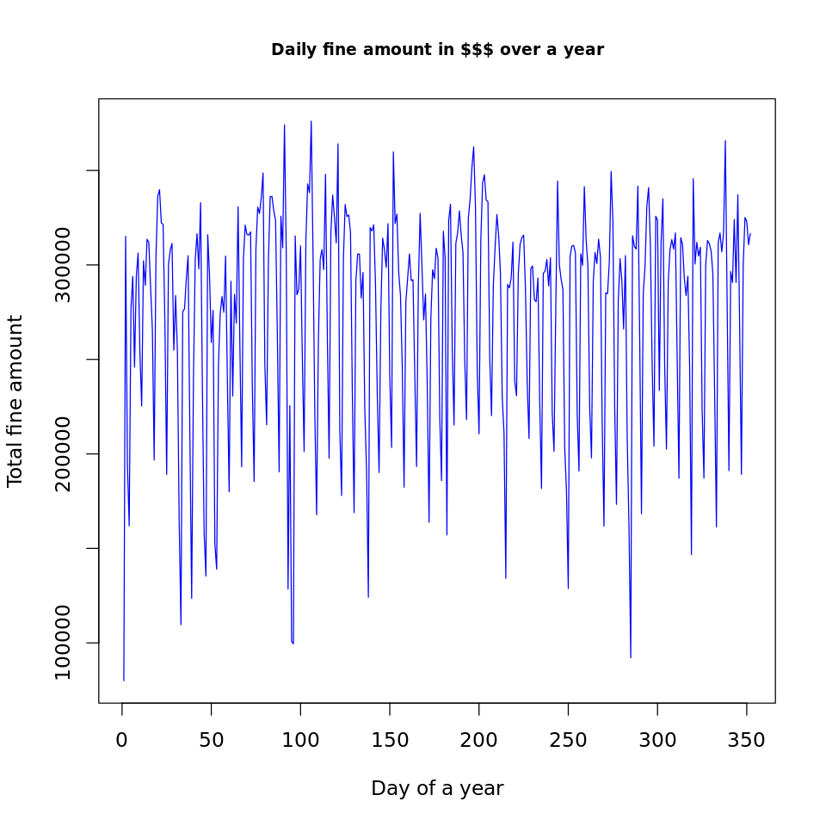
Findings – Annual Trend
Tops during weekdays
Bottoms during weekends

Slide 7
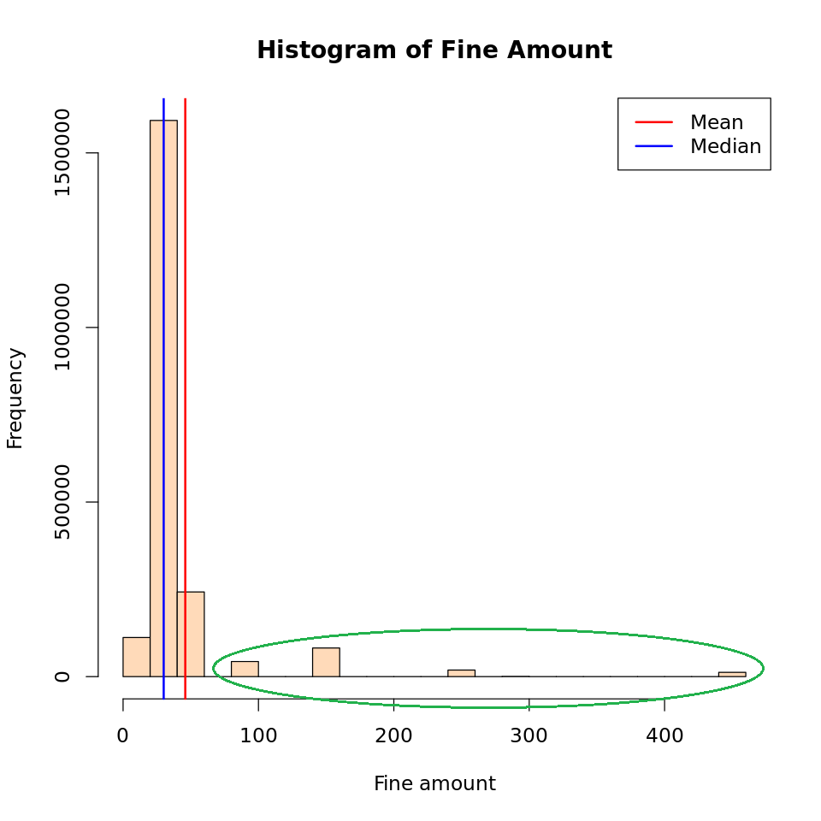
Findings – More about Days of Week
The average ticket amount is $6 higher on weekdays than on weekends
Chances to write an expensive ticket are much higher during weekdays

Slide 8
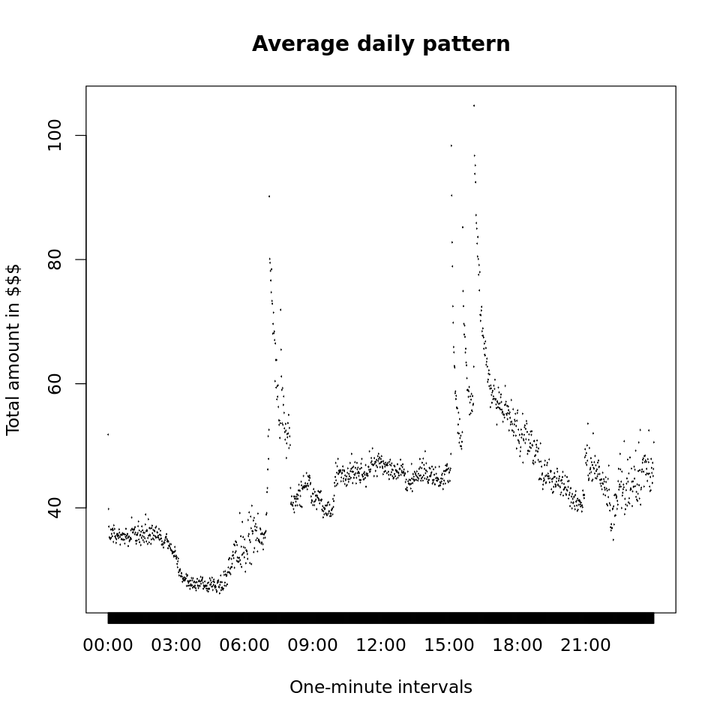
Findings – Time of Day
Most profitable time periods are before business hours and in the end of workday
Least profitable period of time is 3 to 6 a.m.

Slide 9
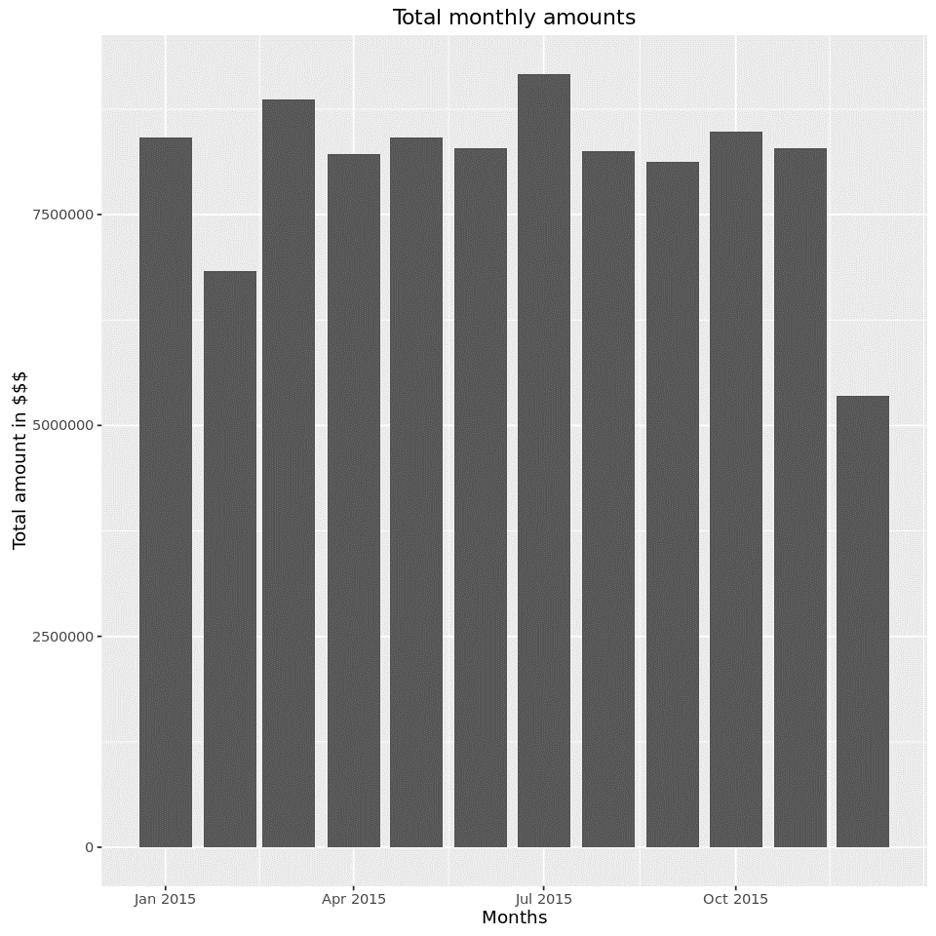
Findings – Months
December is the least profitable month as a holiday season
February is quite cold and snowy to suggest that many car drivers switch to using TTC

Slide 10
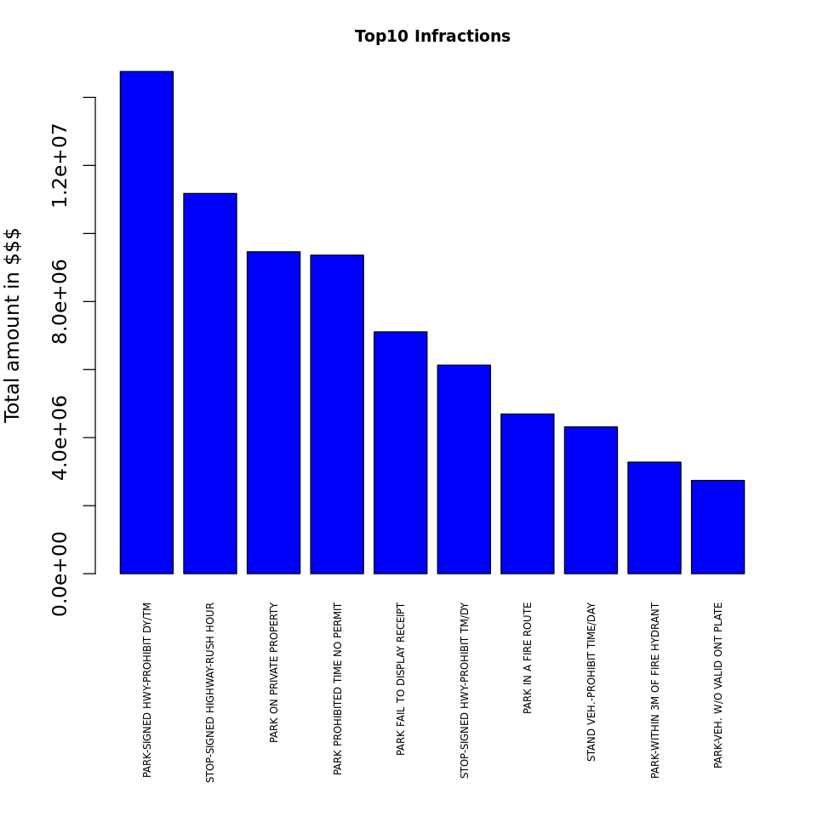
Findings – Most Profitable Infractions
Top3:
Parking in prohibited zone
Parking in prohibited time
Parking on private property
Specific for weekends:
Expired parking receipt

Slide 11
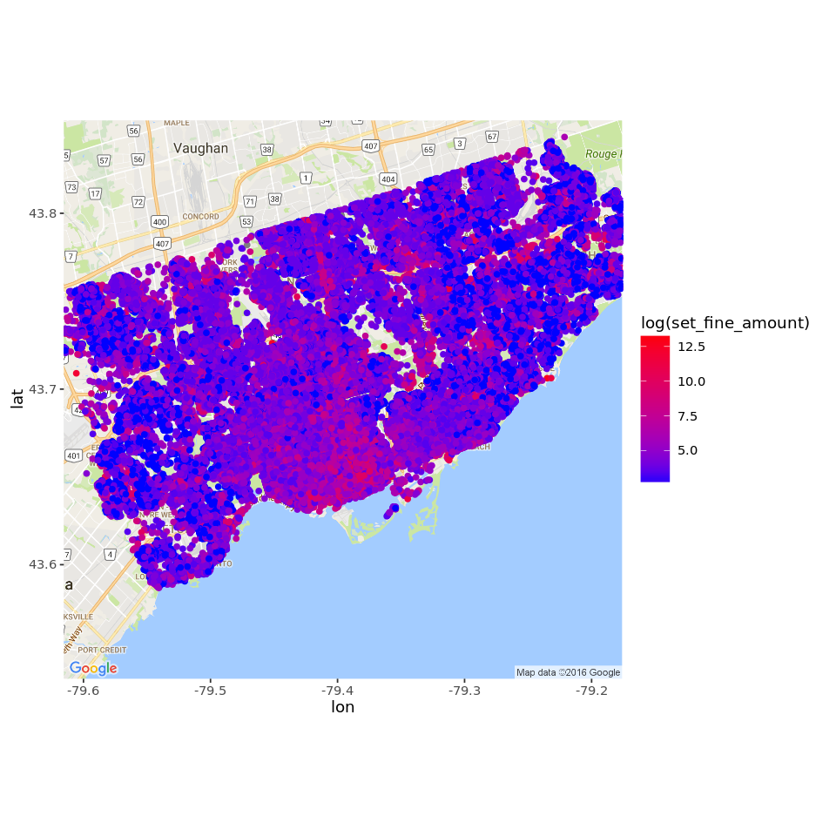
Findings – Geolocation

Slide 12
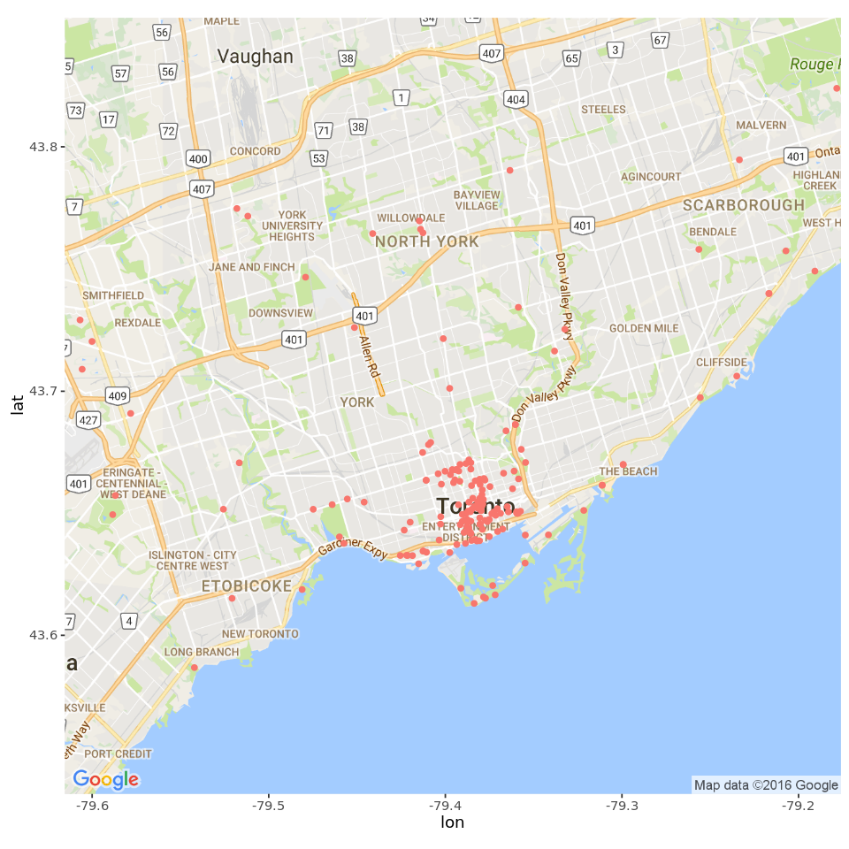
Findings – Geolocation

Slide 13
Conclusion – Factors that Matter
Time of day
Day of week
Month
Kinds of infractions
Proximity to places of interest

Slide 14
Further Research
How to take weather conditions and mass events into consideration? What data we need?
How to quantify an influence of the proximity to places of interests?
Optimal planning of limited parking enforcement resources to maximize tickets revenue

Slide 15
Thank you!

