Slide 1
TSP Approximation
Max Mancini | Seth Roper

Slide 2
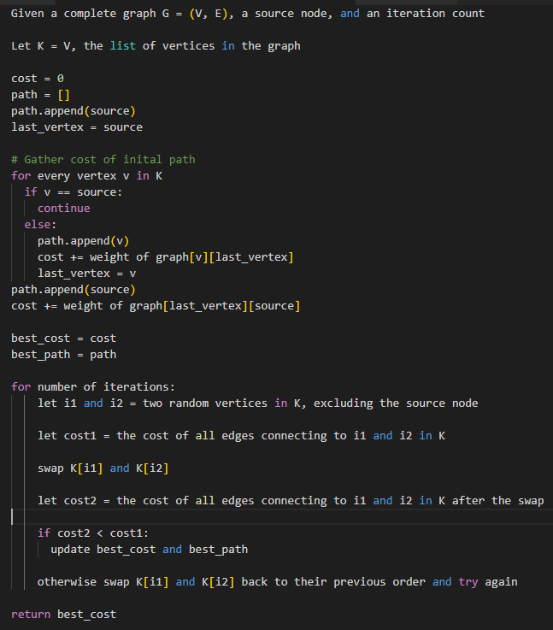
Pseudocode

Slide 3
Runtime Analysis
Runtime is dependent on iteration count.
This makes the runtime around O(N) where N is the iteration count.
Iteration count can be changed in this solution to make the program run faster/produce more accurate results.
For the bulk of our results testing, we set iteration count to 100000.

Slide 4
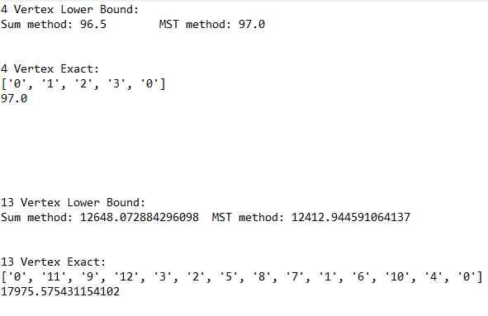
Lower Bound and Approximation Results
2 methods:
Sum of two cheapest edges leaving each vertex divided by 2.
Remove one vertex from the graph, compute MST. Take cost of MST + two cheapest edges leaving the removed vertex.
Accuracy depends on test case, MST method is typically more accurate (higher lower bound) but we use whichever is higher.
On small test cases, lower bound is often the optimal solution, and the approximation is also typically optimal.
Larger test cases increase the gap between the lower bound and results.

Slide 5
Runtime vs. Exact Solution
Iteration count set to 100,000
Test Case | Approximation | Exact
10 vertex | 0.38s | 0.33s
11 vertex | 0.38s | 3.62s
12 vertex | 0.38s | 42.80s
13 vertex | 0.38s | 566.15s
30 vertex | 0.38s | inf
1060 vertex | 0.59s | inf
Approximation runtime varies directly with iteration count which means it runs in nearly the same amount of time on all test cases with slight variation (generating random numbers on a higher vertex count take slightly more time etc.)
With iteration count set to 100000, approximation runs in under a second.
With iteration count set to 1000000, the approximation runs in around 4 seconds but produces much better results.
Iteration count set to 1,000,000 (more accurate results)
Test Case | Approximation | Exact
10 vertex | 3.8s | 0.33s
11 vertex | 3.8s | 3.62s
12 vertex | 3.8s | 42.80s
13 vertex | 3.8s | 566.15s
30 vertex | 3.8s | inf
1060 vertex | 5.9s | inf

Slide 6
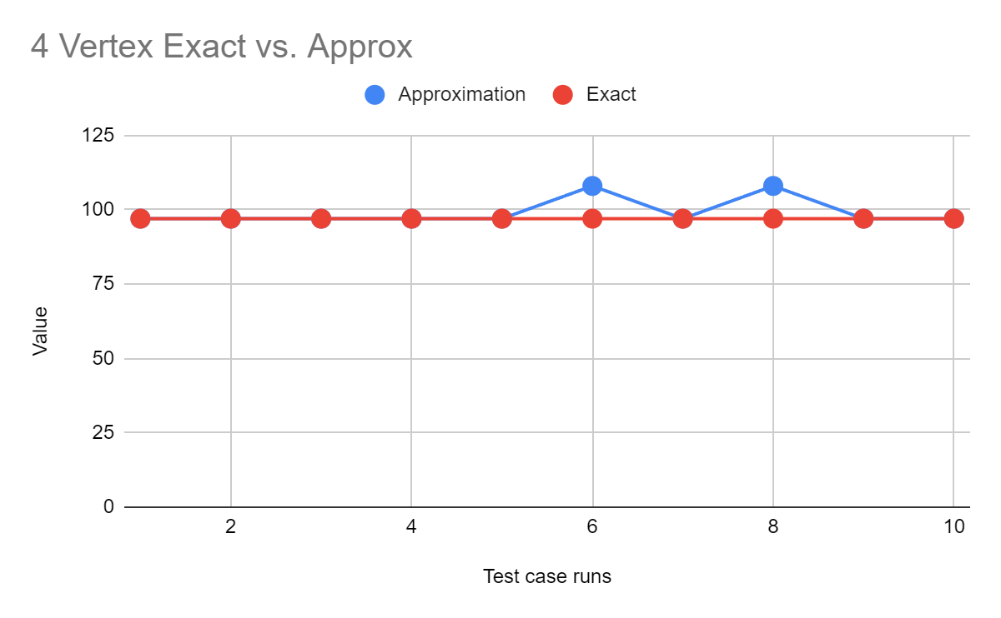
Results vs. Exact Solution
Occasionally, the approximation fails on inputs where using the exact solution would run instantly. (This was tested with a small iteration count)
Results vary depending on the test case, smaller test cases usually result in an extremely accurate approximation.
Very large test cases produce results that are extremely far off of the lower bound when using smaller iteration counts (ex. 1060 vertex provided case).
Results can be sharpened by increasing iteration count (i.e making more swaps).

Slide 7
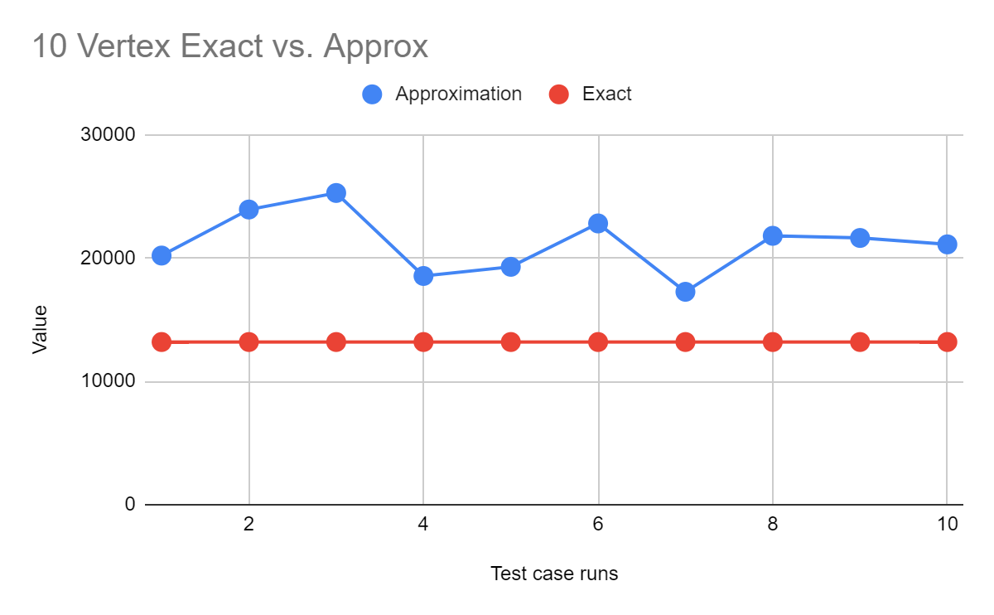
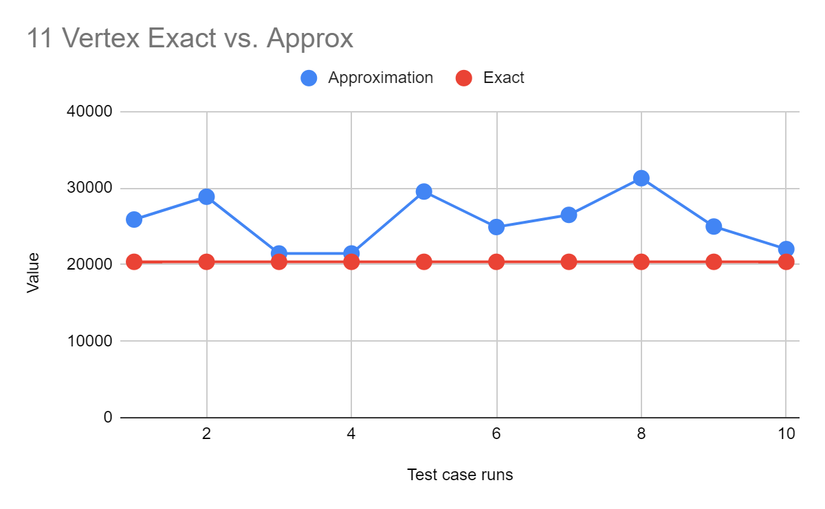
Test Case | Approximation | Exact
10 vertex | 0.38s | 0.33s
11 vertex | 0.38s | 3.62s
Time per run ->
Lower bound: 11985.50
Lower bound: 16390.10

Slide 8
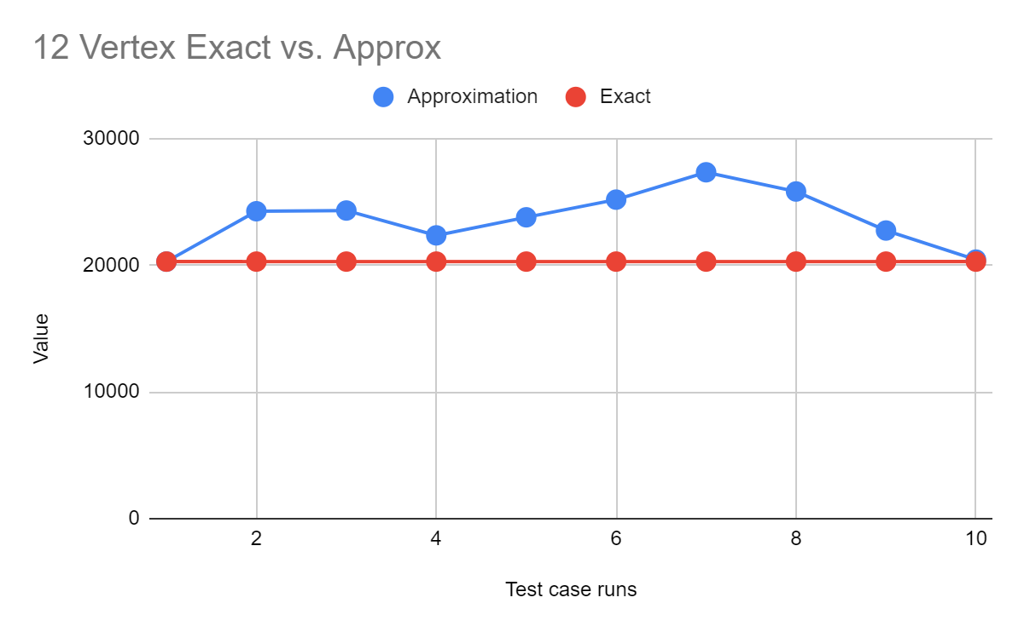
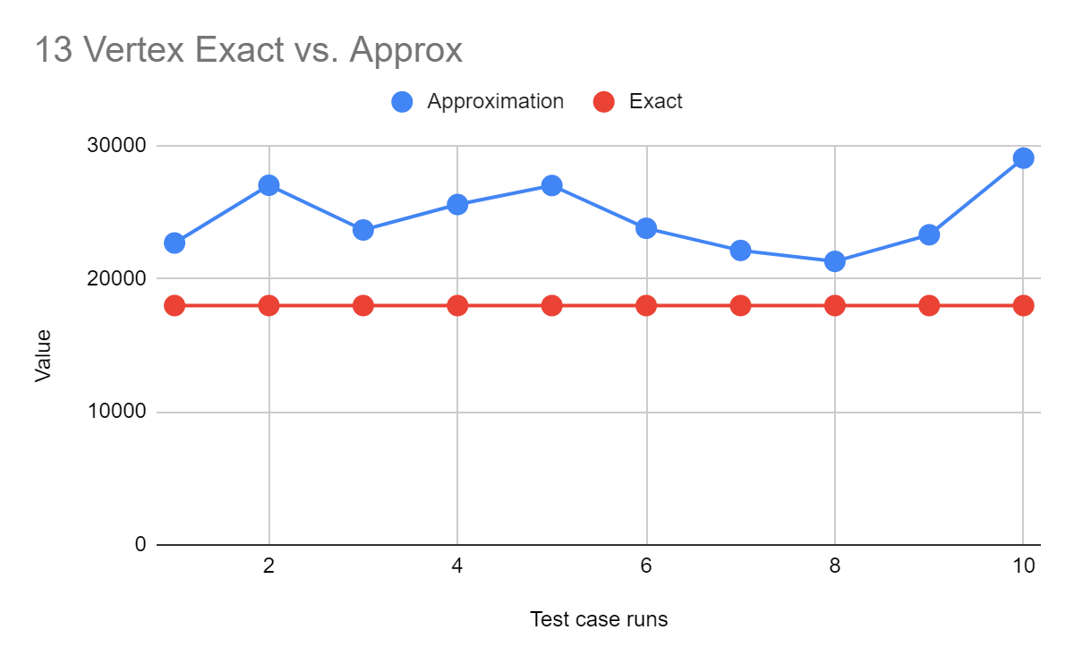
Test Case | Approximation | Exact
12 vertex | 0.38s | 42.80s
13 vertex | 0.38s | 566.15s
Time per run ->
Lower bound: 13275.09
Lower bound: 12648.07

Slide 9
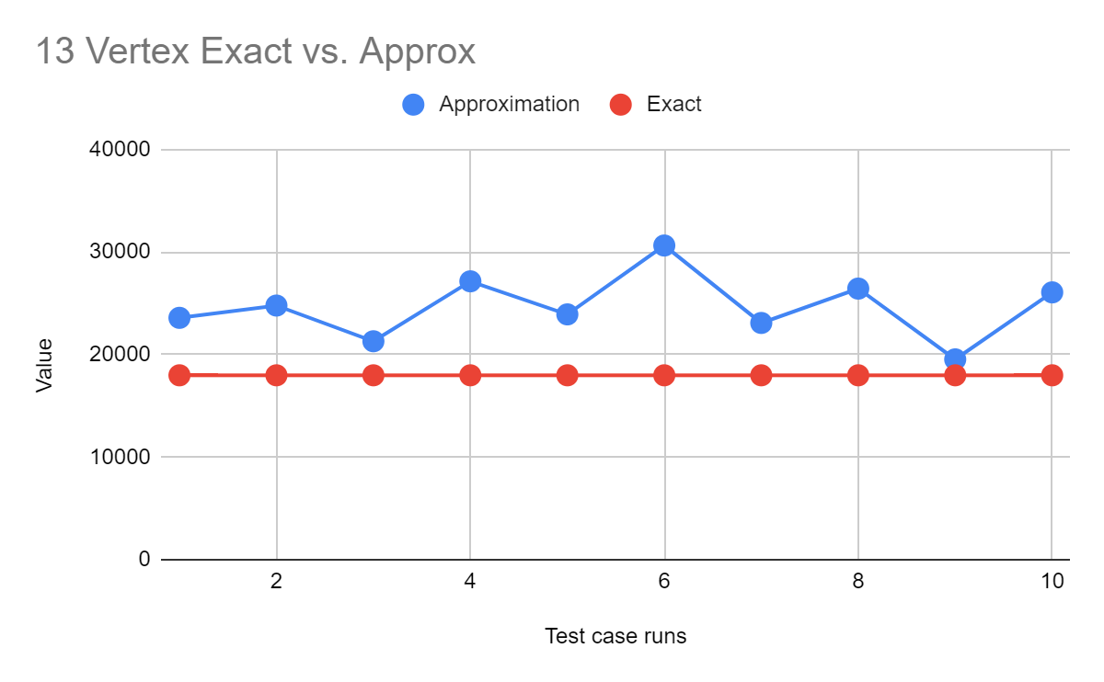
Iterations: 1,000,000
Runtime : 3.8s
Iterations: 100,000
Runtime : 0.38s

Slide 10
