Slide 1
AI agents create change faster
than teams can verify it.
The bottleneck moved from generation to delivery, review, and trust.
More output
Finite attention
Weak evidence
Large polished changes arrive quickly.
Maintainers still prove syntax, tests, dependencies, secrets, and design.
A passing conversation is not a reproducible delivery decision.
Problem: every pull request asks humans to rediscover facts a machine can establish first.
AIV Integrity Gate | Viquar Khan

Slide 2
Why existing solutions do not close the gap
02
Each tool remains valuable, but each owns a different layer
Compiler / type checker
SAST / secret scanner
LLM reviewer
Proves one build/type configuration, often late in CI.
Deep specialist analysis, usually separate reports and policy.
Contextual judgement, but non-deterministic and unsuitable as the only hard gate.
SDLC orchestrator
Policy engine
Human review
Sequences agents and humans; does not compute every code fact.
Decides allow/deny from facts; does not derive code evidence by itself.
Final judgement, but the scarcest and most expensive verification resource.
Missing layer: one protected, diff-scoped evidence receipt that composes these tools.
AIV Integrity Gate | deterministic evidence for agent-generated change
Viquar Khan

Slide 3
AIV turns untrusted change into verifiable evidence
03
One pinned policy, one immutable snapshot, one structured verdict
Check facts
Protect the yardstick
Parse, imports, package names, assertion evidence, secrets, design, and project rules.
Pin one policy commit; reject drift, ignored extras, symlinks, and path escapes.
Preserve the decision
Compose, do not replace
Bind request, config, sidecars, commit, findings, severity, and audit head.
Fold trusted SARIF in; send judgement-heavy questions to advisory model/human review.
AIV does not identify authorship. It asks whether the change is backed by objective evidence.
AIV Integrity Gate | deterministic evidence for agent-generated change
Viquar Khan

Slide 4
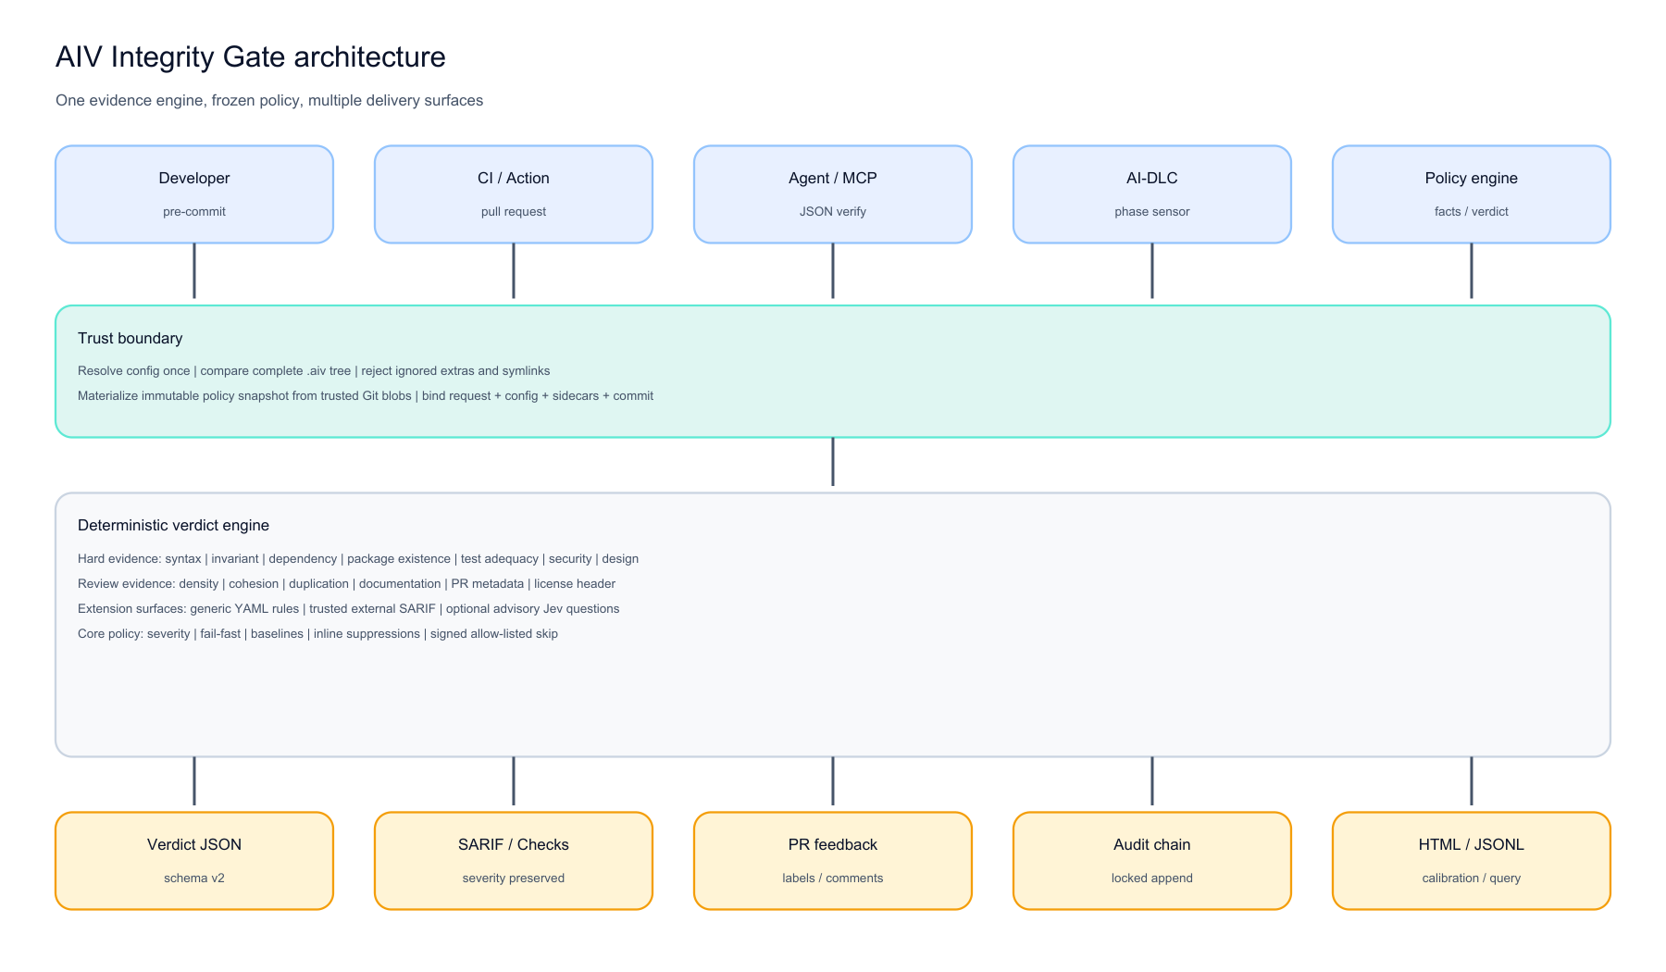
What is AIV? Complete product architecture
04
Five entry points, one trust boundary, sixteen gates, five evidence outputs
AIV Integrity Gate | deterministic evidence for agent-generated change
Viquar Khan

Slide 5
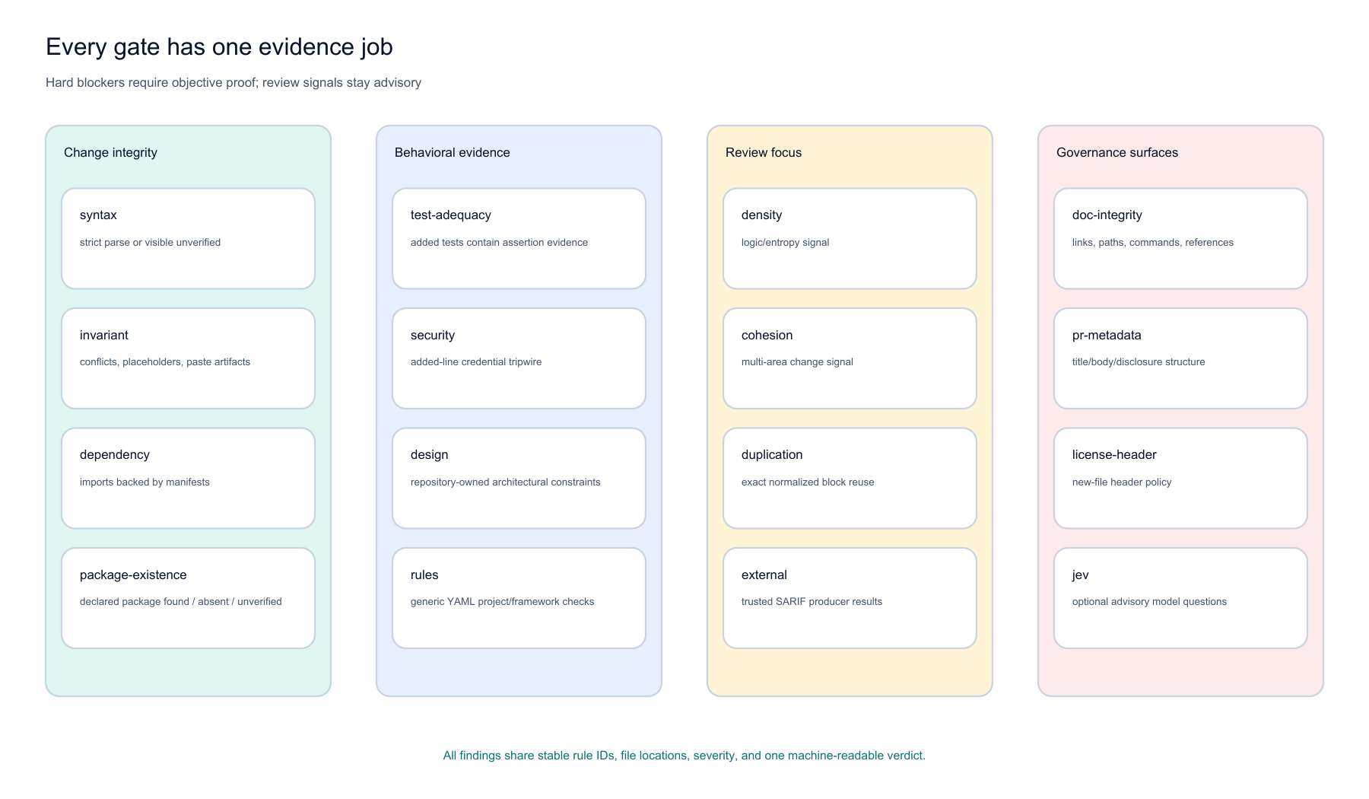
What gates exist, and where should each be used?
05
Hard evidence first; structural review signals advisory; governance surfaces opt-in
AIV Integrity Gate | deterministic evidence for agent-generated change
Viquar Khan

Slide 6
Where teams use AIV
06
One engine across local development, CI, agents, lifecycle, and governance
Before commit
Pull-request CI
Coding agents / MCP hosts
Catch parse failures, conflict/paste artifacts, assertion-free tests, and credential forms.
Require trusted policy; publish JSON, SARIF, Checks, comments, labels, and audit.
Send strict artifact JSON to aiv verify and consume schema-v2 verdict evidence.
AI-DLC phase boundaries
Architecture policy
Audit and calibration
Run advisory file feedback or fail-closed full-request sensors.
Enforce design constraints and generic YAML project/framework rules.
Verify hash-chain heads, generate HTML/JSONL, and use reviewer labels to tune severity.
AIV Integrity Gate | deterministic evidence for agent-generated change
Viquar Khan

Slide 7
Gate family 1: change integrity
07
Stop guaranteed breakage and invented dependencies first
syntax
hard / unverified
invariant
hard
Can the named parser read it?
Did edit artifacts enter source?
Strict RFC JSON and bounded Java/Python/JS/TS/Go validation. Unavailable parsers are visible and optionally blocking.
Conflict blocks, placeholders, elision lines, assistant chatter, provenance text, and tautology tests on added lines.
dependency
hard
package-existence
hard / external
Are imports backed locally?
Does the declared package exist?
Java and Python roots are compared with manifests, standard libraries, first-party packages, and reviewed allow entries.
New PyPI, npm, and Maven declarations are classified as found, absent, or unverified with bounded registry calls.
AIV Integrity Gate | deterministic evidence for agent-generated change
Viquar Khan

Slide 8
Gate family 2: behavioral evidence
08
Demand proof around tests, security, and design
test-adequacy
hard + advisory
security
hard, opt-in
Do added tests contain assertion evidence?
Did credential material enter added lines?
Assertion-free test functions block. Production changes without a conventional test remain an advisory review signal.
High-confidence vendor formats, private keys, assigned secrets, and keyword-bound entropy with project allow rules.
design
hard
rules
configurable
Does the change follow repository constraints?
Can the team express a new check in YAML?
Frozen YAML design rules enforce forbidden and required calls without letting the change edit its own policy.
Generic pattern, call-argument, and hollow-function rules; project packs stay under protected .aiv policy.
AIV Integrity Gate | deterministic evidence for agent-generated change
Viquar Khan

Slide 9
Gate family 3: review focus
09
Move scarce human attention to the riskiest parts
density
advisory
cohesion
advisory
Where is structure unusually thin?
Is the change spread across many areas?
Java logic density and configured entropy identify review targets; never used alone as proof of bad code.
Path-area and file-count signals focus architecture review without blocking legitimate broad changes.
duplication
advisory
external
configurable
Was an existing code block copied?
What do trusted analyzers already know?
Exact normalized windows compare added code with bounded workspace sources and name the existing location.
Run configured tools, ingest SARIF, filter to changed files, preserve severity, and expose missing/timeout states.
AIV Integrity Gate | deterministic evidence for agent-generated change
Viquar Khan

Slide 10
Gate family 4: governance surfaces
10
Make documentation, review metadata, and policy visible
doc-integrity
opt-in
pr-metadata
opt-in
Do instructions point to real things?
Did the change bring review context?
Local links, paths, cross-references, required terms, and complete commands across changed documentation.
Title, body, untouched template, and optional AI-assistance disclosure structure.
license-header
opt-in
jev
advisory, opt-in
Do new files carry approved markers?
Which calibrated questions need model judgement?
Project-defined headers on newly added source; generated, blank, excluded, and modified files are scoped out.
Optional yes/no decision-model questions are always advisory and declared as an external input.
AIV Integrity Gate | deterministic evidence for agent-generated change
Viquar Khan

Slide 11
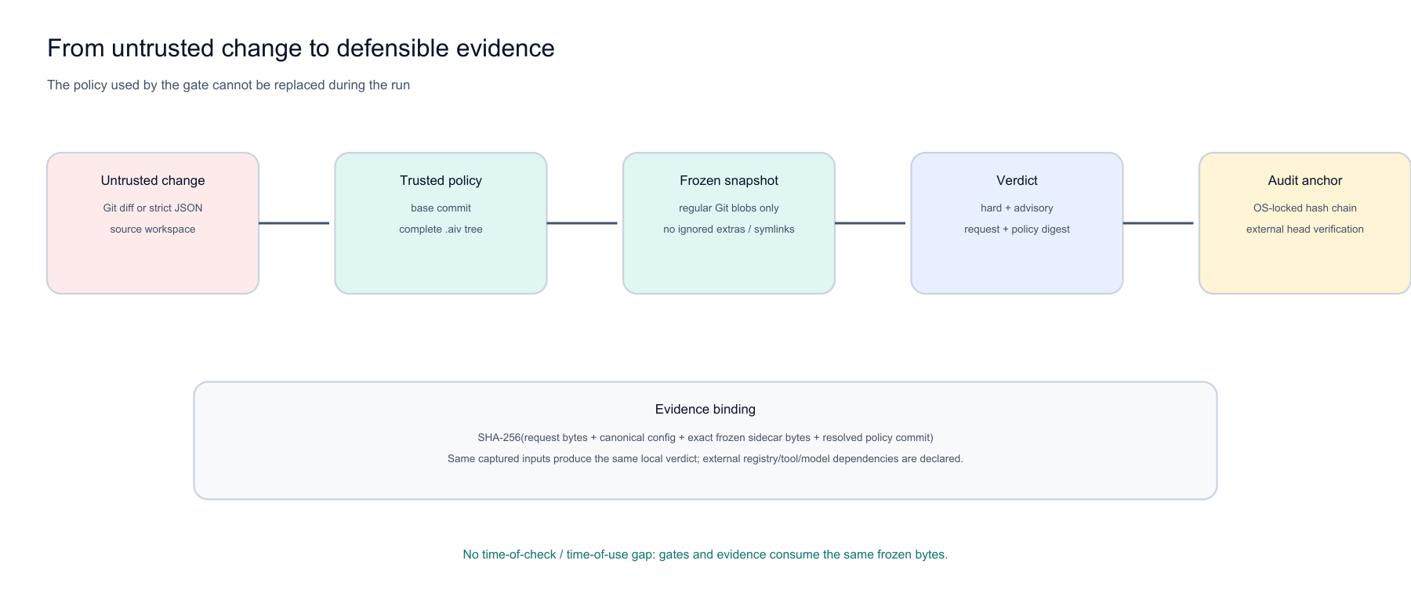
The gate cannot be edited from inside the change
11
One pinned commit, exact Git blobs, one immutable policy snapshot
AIV Integrity Gate | deterministic evidence for agent-generated change
Viquar Khan

Slide 12
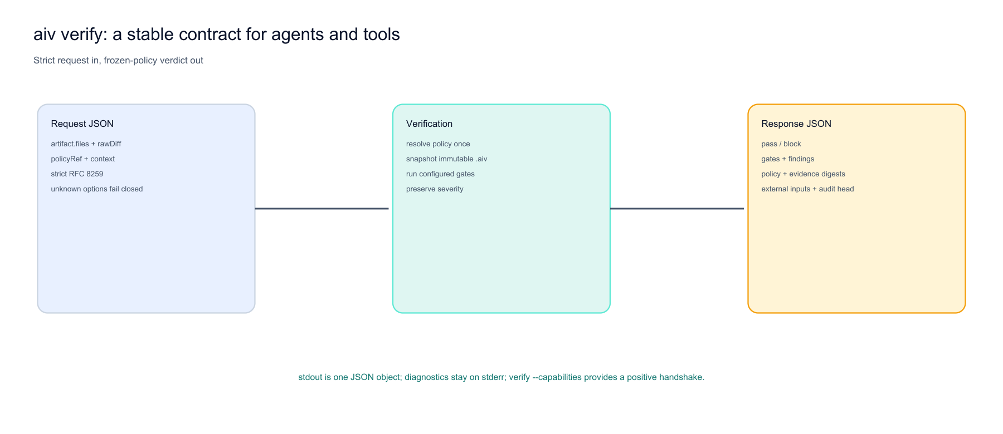
A stable contract for agents and tools
12
Strict JSON in; policy-bound verdict JSON out
AIV Integrity Gate | deterministic evidence for agent-generated change
Viquar Khan

Slide 13
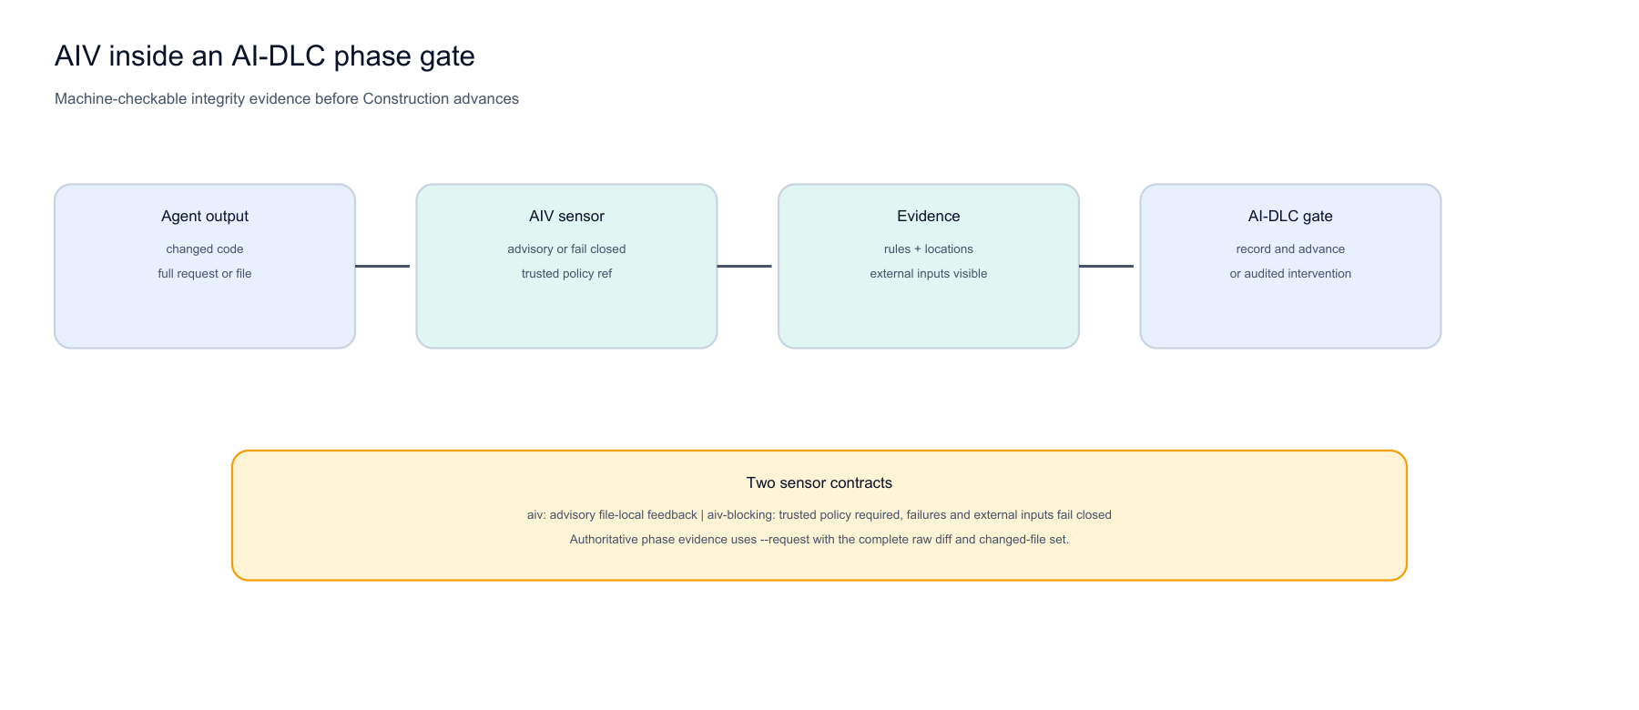
Native fit for AI-driven lifecycle gates
13
Advisory feedback or fail-closed evidence at an AI-DLC boundary
AIV Integrity Gate | deterministic evidence for agent-generated change
Viquar Khan

Slide 14
Integrate at the moment a change is produced
14
Use the same verdict across local, CI, agent, and lifecycle paths
Front door
Input
Output
pre-commit
staged diff
human report + exit
GitHub Action
pull-request diff
JSON, SARIF, Checks, labels, comments
aiv verify
strict JSON artifact
schema v2 verdict + evidence digest
AI-DLC sensor
file or full request
pass + violations, advisory or fail closed
OPA / policy host
verdict facts
allow / deny / route decision
AIV Integrity Gate | deterministic evidence for agent-generated change
Viquar Khan

Slide 15
Evidence survives the CI run
15
Verdicts become queryable, calibratable, and externally verifiable
Locked append
External anchor
Evidence report
Thread and inter-process locking serialize each hash-chain append.
Store the returned chain head outside the log to detect complete rewrites.
Generate static HTML plus JSONL for DuckDB and governance analytics.
Rule calibration
Proposal integrity
Pinned provenance
Join reviewer labels by stable rule/file/line and promote only with recorded evidence.
Apply template-driven checks to files, wiki pages, or issues; shipped KIP/FLIP/SPIP templates are examples.
Audit base_sha and policy_commit name the exact commit that supplied policy.
AIV Integrity Gate | deterministic evidence for agent-generated change
Viquar Khan

Slide 16
What is verified today
16
Product claims are tied to executable evidence
25
reactor projects
844
tests discovered
0
test failures / errors
0
critical / high review findings
• Full Maven clean verify succeeded; all configured coverage gates passed.
• AI-DLC adapter: 8 unit tests passed.
• 24 module READMEs and all local documentation links validated.
• Generated SVG and PNG product assets validated.
• Seven adversarial hardening loops ended with independent READY certification: Critical 0, High 0.
One OS capability-gated symlink test is skipped where Windows cannot create symbolic links; containment is enforced in code and reviewed statically.
AIV Integrity Gate | deterministic evidence for agent-generated change
Viquar Khan

Slide 17
Adopt in four controlled steps
17
Start advisory, prove fit, then enforce the objective checks
1
Observe
2
Calibrate
3
Protect
4
Enforce
Run doctor/advisory and collect findings.
Review rule fit and configure approved paths/thresholds.
Pin base policy, enable strict toolchains, require trusted config.
Make objective gates required; retain advisory review signals.
Success criterion: less reviewer time spent proving basic facts, with no hidden policy fallback or silent unverified state.
AIV Integrity Gate | deterministic evidence for agent-generated change
Viquar Khan

Slide 18
Designed for developers, not a governance portal
18
One jar, repository-owned policy, outputs your tools already consume
CLI workflow
Repository-owned
Configuration and rule packs live under protected .aiv policy.
$ Bootstrap: aiv init --workspace .
$ Run: aiv --diff origin/main --require-trusted-config
Explainable
Stable IDs, file/line, severity, message, and offline gate help.
$ Agent: aiv verify --policy-ref origin/main --require-trusted-policy
$ Explain: aiv explain <gate>
Composable
$ Audit: aiv audit verify <log> --expect-head <hash>
JSON, SARIF, GitHub, AI-DLC, external analyzers, and policy hosts.
AIV Integrity Gate | deterministic evidence for agent-generated change
Viquar Khan

Slide 19
Where AIV fits
19
Complement the tools you already trust
Compiler / type checker
whole-program correctness
AIV catches diff integrity first; external gate folds results into one receipt
SAST / secret scanner
deep repository analysis
AIV scopes added-line evidence and preserves their SARIF
LLM reviewer
contextual judgement
AIV supplies the reproducible facts; model advice stays advisory
SDLC orchestrator
sequence and human routing
AIV is the deterministic evidence step at each boundary
Policy engine
allow/deny logic
AIV computes code facts the policy engine cannot derive alone
AIV Integrity Gate | deterministic evidence for agent-generated change
Viquar Khan

Slide 20
Pilot one repository
20
Prove the gate in a real review flow before expanding
30-day pilot outcome
The ask
• Baseline the current findings in advisory mode.
• Select objective hard gates and repository rule packs.
• Enable trusted base-ref policy and machine reports.
• Measure findings acted on, suppressions, and review feedback.
• Decide expand, tune, or stop based on evidence.
Give AIV one repository, one workflow, and one maintainer feedback loop.
The product is ready for a controlled pilot. The evidence will decide the next investment.
AIV Integrity Gate | deterministic evidence for agent-generated change
Viquar Khan

Slide 21
Ship more agent-generated change.
Spend less human attention proving basic facts.
AIV Integrity Gate
Deterministic evidence. Frozen policy. Defensible verdict.
github.com/vaquarkhan/aiv-integrity-gate
Viquar Khan | vaquar.khan@gmail.com

