Slide 1
Massively Parallel Cloud Data Storage Systems
S. Sudarshan
IIT Bombay

Slide 2
Why Cloud Data Stores
Explosion of social media sites (Facebook, Twitter) with large data needs
Explosion of storage needs in large web sites such as Google, Yahoo
  Much of the data is not files
Rise of cloud-based solutions such as Amazon S3 (simple storage solution)
Shift to dynamically-typed data with frequent schema changes

Slide 3
Parallel Databases and Data Stores
Web-based applications have huge demands on data storage volume and transaction rate
Scalability of application servers is easy, but what about the database?
Approach 1: memcache or other caching mechanisms to reduce database access
  Limited in scalability
Approach 2: Use existing parallel databases
  Expensive, and most parallel databases were designed for decision support not OLTP
Approach 3: Build parallel stores with databases underneath

Slide 4
Scaling RDBMS - Partitioning
“Sharding”
  Divide data amongst many cheap databases (MySQL/PostgreSQL)
  Manage parallel access in the application
  Scales well for both reads and writes
  Not transparent, application needs to be partition-aware

Slide 5
Parallel Key-Value Data Stores
Distributed key-value data storage systems allow key-value pairs to be stored (and retrieved on key) in a massively parallel system
  E.g. Google BigTable, Yahoo! Sherpa/PNUTS, Amazon Dynamo, ..
Partitioning, high availability etc completely transparent to application
Sharding systems and key-value stores don’t support many relational features
  No join operations (except within partition)
  No referential integrity constraints across partitions
  etc.

Slide 6
What is NoSQL?
Stands for No-SQL or Not Only SQL??
Class of non-relational data storage systems
  E.g. BigTable, Dynamo, PNUTS/Sherpa, ..
Usually do not require a fixed table schema nor do they use the concept of joins
  Distributed data storage systems
All NoSQL offerings relax one or more of the ACID properties (will talk about the CAP theorem)

Slide 7
Typical NoSQL API
Basic API access:
  get(key) -- Extract the value given a key
  put(key, value) -- Create or update the value given its key
  delete(key) -- Remove the key and its associated value
  execute(key, operation, parameters) -- Invoke an operation to the value (given its key) which is a special data structure (e.g. List, Set, Map .... etc).
Notes:
-> http://horicky.blogspot.com/2009/11/nosql-patterns.html

Slide 8
Flexible Data Model
ColumnFamily: Rockets
Key
Value
1
Name
Value
name
Rocket-Powered Roller Skates
toon
Ready, Set, Zoom
inventoryQty
5
brakes
false
2
Name
Value
name
Little Giant Do-It-Yourself Rocket-Sled Kit
toon
Beep Prepared
inventoryQty
4
brakes
false
3
Name
Value
name
Acme Jet Propelled Unicycle
toon
Hot Rod and Reel
inventoryQty
1
wheels
1

Slide 9
NoSQL Data Storage: Classification
Uninterpreted key/value or ‘the big hash table’.
  Amazon S3 (Dynamo)
Flexible schema
  BigTable, Cassandra, HBase (ordered keys, semi-structured data),
  Sherpa/PNuts (unordered keys, JSON)
  MongoDB (based on JSON)
  CouchDB (name/value in text)
Notes:
.

Slide 10
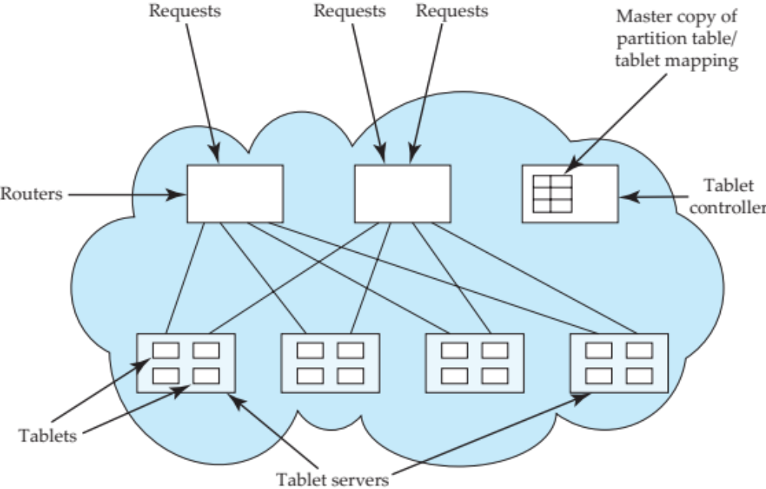
PNUTS Data Storage Architecture

Slide 11
CAP Theorem
Three properties of a system
  Consistency (all copies have same value)
  Availability (system can run even if parts have failed)
    Via replication
  Partitions (network can break into two or more parts, each with active systems that can’t talk to other parts)
Brewer’s CAP “Theorem”: You can have at most two of these three properties for any system
Very large systems will partition at some point
  ➔Choose one of consistency or availablity
  Traditional database choose consistency
  Most Web applications choose availability
    Except for specific parts such as order processing

Slide 12
Availability
Traditionally, thought of as the server/process available five 9’s (99.999 %).
However, for large node system, at almost any point in time there’s a good chance that a node is either down or there is a network disruption among the nodes.
  Want a system that is resilient in the face of network disruption

Slide 13
Eventual Consistency
When no updates occur for a long period of time, eventually all updates will propagate through the system and all the nodes will be consistent
For a given accepted update and a given node, eventually either the update reaches the node or the node is removed from service
Known as BASE (Basically Available, Soft state, Eventual consistency), as opposed to ACID
  Soft state: copies of a data item may be inconsistent
  Eventually Consistent – copies becomes consistent at some later time if there are no more updates to that data item

Slide 14
Common Advantages of NoSQL Systems
Cheap, easy to implement (open source)
Data are replicated to multiple nodes (therefore identical and fault-tolerant) and can be partitioned
  When data is written, the latest version is on at least one node and then replicated to other nodes
  No single point of failure
Easy to distribute
Don't require a schema

Slide 15
What does NoSQL Not Provide?
Joins
Group by
  But PNUTS provides interesting materialized view approach to joins/aggregation.
ACID transactions
SQL
Integration with applications that are based on SQL
Notes:
-> No JDBC
-> Data integrity at the application layer

Slide 16
Should I be using NoSQL Databases?
NoSQL Data storage systems makes sense for applications that need to deal with very very large semi-structured data
  Log Analysis
  Social Networking Feeds
Most of us work on organizational databases, which are not that large and have low update/query rates
  regular relational databases are the correct solution for such applications

Slide 17
Further Reading
Chapter 19: Distributed Databases
And lots of material on the Web
  E.g. nice presentation on NoSQL by Perry Hoekstra (Perficient)
    Some material in this talk is from above presentation
  Use a search engine to find information on data storage systems such as
    BigTable (Google), Dynamo (Amazon), Cassandra (Facebook/Apache), Pnuts/Sherpa (Yahoo), CouchDB, MongoDB, …
    Several of above are open source

