Slide 1
Modern Databases
NoSQL and NewSQL
Willem Visser
RW334

Slide 2
Relational DBs Cannot Handle Web-Scale
or can they?
  To be honest the jury is out on this one
NoSQL
  An attempt at using non-relational solutions
NewSQL
  Scaling relational DBs

Slide 3
The NoSQL Movement
Not Only SQL
  It is not No SQL
  Not only relational would have been better
Use the right tools (DBs) for the job
It is more like a feature set, or even the not of a feature set

Slide 4
Definition from nosql-databases.org
Next Generation Databases mostly addressing some of the points: being non-relational, distributed, open-source and horizontal scalable. The original intention has been modern web-scale databases. The movement began early 2009 and is growing rapidly. Often more characteristics apply as: schema-free, easy replication support, simple API, eventually consistent /BASE (not ACID), a huge data amount, and more. So the misleading term "nosql" (the community now translates it mostly with "not only sql") should be seen as an alias to something like the definition above.

Slide 5
NoSQL http://nosql-database.org/
Non relational
Scalability
  Vertically
    Add more data
  Horizontally
    Add more storage
Collection of structures
  Hashtables, maps, dictionaries
No pre-defined schema
No join operations
CAP not ACID
  Consistency, Availability and Partitioning (but not all three at once!)
  Atomicity, Consistency, Isolation and Durability

Slide 6
Advantages of NoSQL
Cheap, easy to implement
Data are replicated and can be partitioned
Easy to distribute
Don't require a schema
Can scale up and down
Quickly process large amounts of data
Relax the data consistency requirement (CAP)
Can handle web-scale data, whereas Relational DBs cannot

Slide 7
Disadvantages of NoSQL
New and sometimes buggy
Data is generally duplicated, potential for inconsistency
No standardized schema
No standard format for queries
No standard language
Difficult to impose complicated structures
Depend on the application layer to enforce data integrity
No guarantee of support
Too many options, which one, or ones to pick

Slide 8
NoSQL Presentation
Introduction to NoSQL by John Nunemaker
  http://glennas.wordpress.com/2011/03/11/introduction-to-nosql-john-nunemaker-presentation-from-june-2010/
  Added it to our pages at
    Movie http://www.cs.sun.ac.za/rw334/nosql.mp4
    Slides: http://www.cs.sun.ac.za/rw334/whynosql.pdf

Slide 9
NoSQL Options
Key-Value Stores
This technology you know and love and use all the time
  Hashmap for example
Put(key,value)
value = Get(key)
Examples
  Redis (my favorite!!) – in memory store
  Memcached
  and 100s more

Slide 10
Column Stores
Not to be confused with the relational-db version of this
  Sybase-IQ etc.
Multi-dimensional map
Not all entries are relevant each time
  Column families
Examples
  Cassandra
  Hbase
  Amazon SimpleDB

Slide 11
Document Stores
Key-document stores
  However the document can be seen as a value so you can consider this is a super-set of key-value
Big difference is that in document stores one can query also on the document, i.e. the document portion is structured (not just a blob of data)
Examples
  MongoDB
  CouchDB

Slide 12
Graph Stores
Use a graph structure
  Labeled, directed, attributed multi-graph
    Label for each edge
    Directed edges
    Multiple attributes per node
    Multiple edges between nodes
  Relational DBs can model graphs, but an edge requires a join which is expensive
Example Neo4j
  http://www.infoq.com/articles/graph-nosql-neo4j

Slide 13
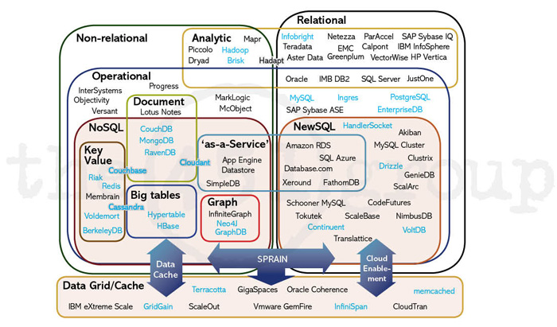
/

Slide 14
451 Group Report (Not Free) http://blogs.the451group.com/information_management/2011/04/15/nosql-newsql-and-beyond
SPRAIN Characteristics
  Scalability – hardware economics
  Performance – MySQL limitations
  Relaxed consistency – CAP theorem
  Agility – polyglot persistence
  Intricacy – big data, total data
  Necessity – open source
All NoSQL and NewSQL evaluated according to SPRAIN

Slide 15
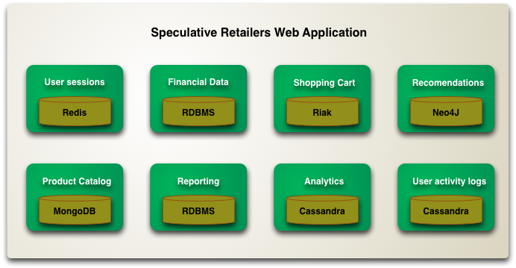
Polyglot Persistence
Using different DB technologies for different storage requirements
http://martinfowler.com/bliki/PolyglotPersistence.html

Slide 16
NewSQL
Just like NoSQL it is more of a movement than specific product or even product family
The “New” refers to the Vendors and not the SQL
Goal(s):
  Bring the benefits of relational model to distributed architectures, or,
    VoltDB, ScaleDB, etc.
  Improve Relational DB performance to no longer require horizontal scaling
    Tokutek, ScaleBase, etc.
    “SQL-as-a-service”: Amazon RDS, Microsoft SQL Azure, Google Cloud SQL

Slide 17
1 Year From Now
NoSQL and NewSQL terms will no longer be there
Focus will be on how to map problems onto solutions
  Whether it is SQL, NoSQL, NewSQL hopefully will be irrelevant

