Slide 1
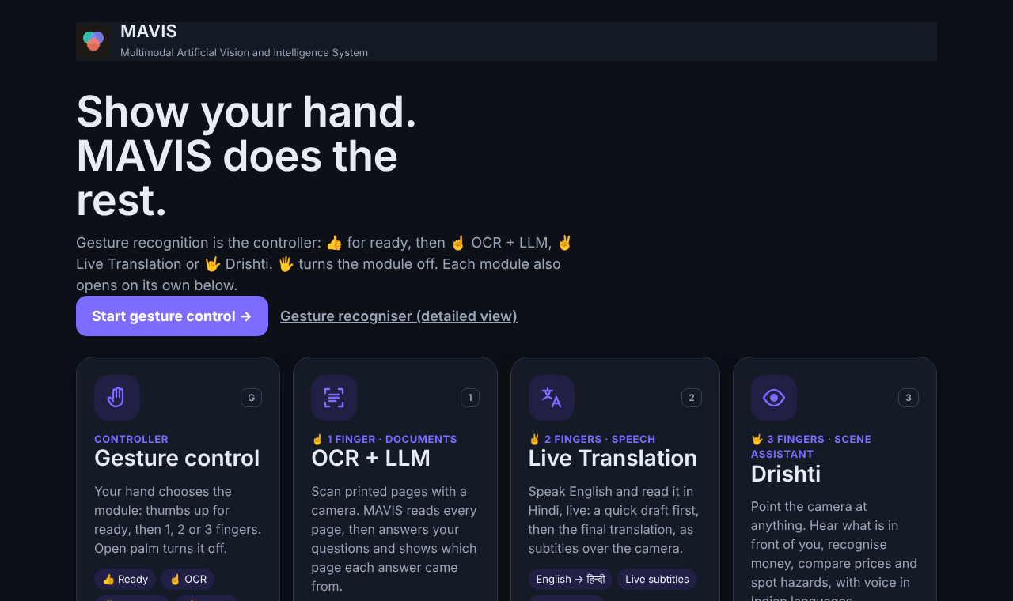
MAVIS
Multimodal Assistance for Vision, Interaction, and Speech
One laptop. The user’s hand chooses the help: read a document, translate speech live, or describe the scene.
Varad Chipkar (2023800011) · Yogita Aher (2023800003) · Harshvardhan Singh Deora (2023800015)
Guide: Prof. Suhas Kakade · Dept. of Computer Science and Engineering, SPIT · 2026–27
Notes:
Introduce MAVIS: one product on one laptop where the hand chooses which assistance runs. Introduce the team and guide.

Slide 2




Why we built MAVIS
1 · The spark
2 · Our question
3 · Who needs it most
4 · The product
Meta’s AI glasses
Can software do it on a CPU?
Drishti: help for the visually impaired
MAVIS: one system, one hand
A camera and AI that see the world with you
Read, translate and describe — hands-free
But they need special hardware
No smart glasses, no GPU
Runs on an ordinary laptop
Works locally, cloud only as backup
Describe the scene, spot hazards
Recognise currency and colours
Voice in English + 8 Indian languages
Read documents (OCR + LLM)
Translate speech live (English → Hindi)
Gestures choose the tool
Notes:
The idea started from Meta’s AI glasses: a camera and AI that see the world with you. We asked whether that experience could be pure software on an ordinary CPU laptop, without special hardware or a GPU, working locally. With Drishti we focused on the people who need it most, visually impaired users. MAVIS then brings document reading, live translation and scene assistance together, chosen by a hand gesture.

Slide 3
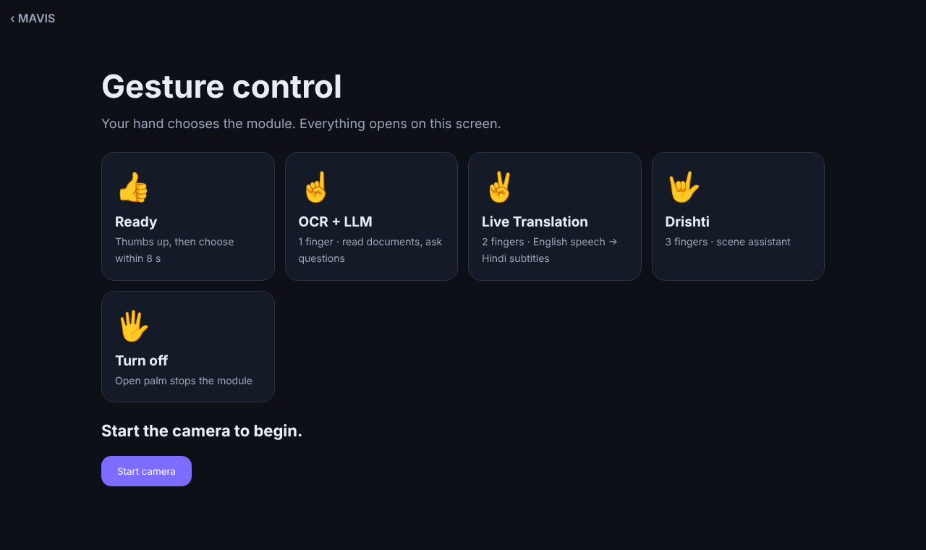
The idea: the hand is the controller
Gesture | What it does
Thumbs-up | Ready — choose within 8 s
One finger | Opens OCR + LLM
Two fingers | Opens Live Translation
Three fingers | Opens Drishti
Open palm | Turns the module off
Chosen module opens on the same screen and starts by itself
A small live hand view stays in the corner
Only deliberate, held gestures change the state
Notes:
Gesture recognition is not a separate mode any more; it is the controller of the whole product. State machine: idle, ready for 8 seconds, active.

Slide 4
Architecture
Gesture recognition = controller
Laptop camera → MediaPipe Hands → classifier → stabiliser → module controller
1 finger · OCR + LLM
2 fingers · Live Translation
3 fingers · Drishti
Capture → RapidOCR → Gemma 3 4B answer with verified quote
Whisper → LocalAgreement-2 → opus-mt drafts → NLLB-200 finals
COCO-SSD → hazard scoring → SmolVLM narration → voice
Ollama · optional DroidCam phone app
Own Python 3.10 worker process
On-device models in the browser
Hub (Python 3.11): one launcher · routing · laptop camera and mic for every module · one colour scheme · started by run.bat · 0 original files changed
Notes:
One Python hub on the laptop. The controller decides which module runs; modules do not know about each other. Each component is reached through its own public boundary, so none of its code was changed.

Slide 5

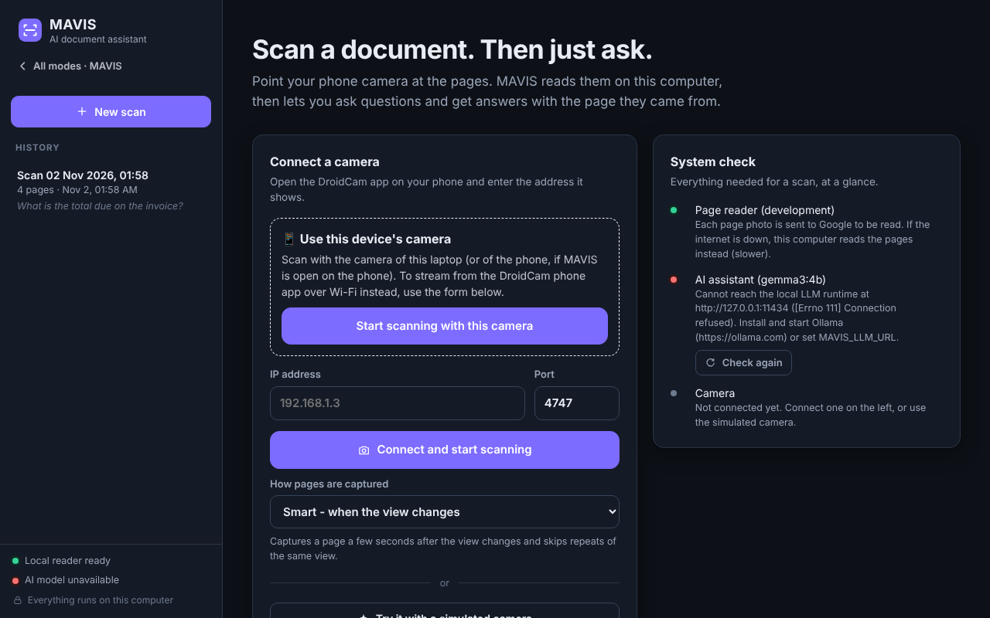
Module 1 · OCR + LLM
ONE FINGER · DOCUMENTS
Captures a page when the view settles; sharpest frame, repeats skipped
Reads with RapidOCR PP-OCRv5 (best of 12 engines tested)
Answers with Gemma 3 4B, running locally in Ollama
Cites page and exact quote; each quote is checked against the scan
Camera: this laptop, or the DroidCam phone app over Wi-Fi (IP + port)
Notes:
Answers are marked verified only when their quoted evidence is found in the scanned text. The laptop camera path works by the hub acting as a DroidCam stream, so the module’s own scanning runs unchanged.

Slide 6

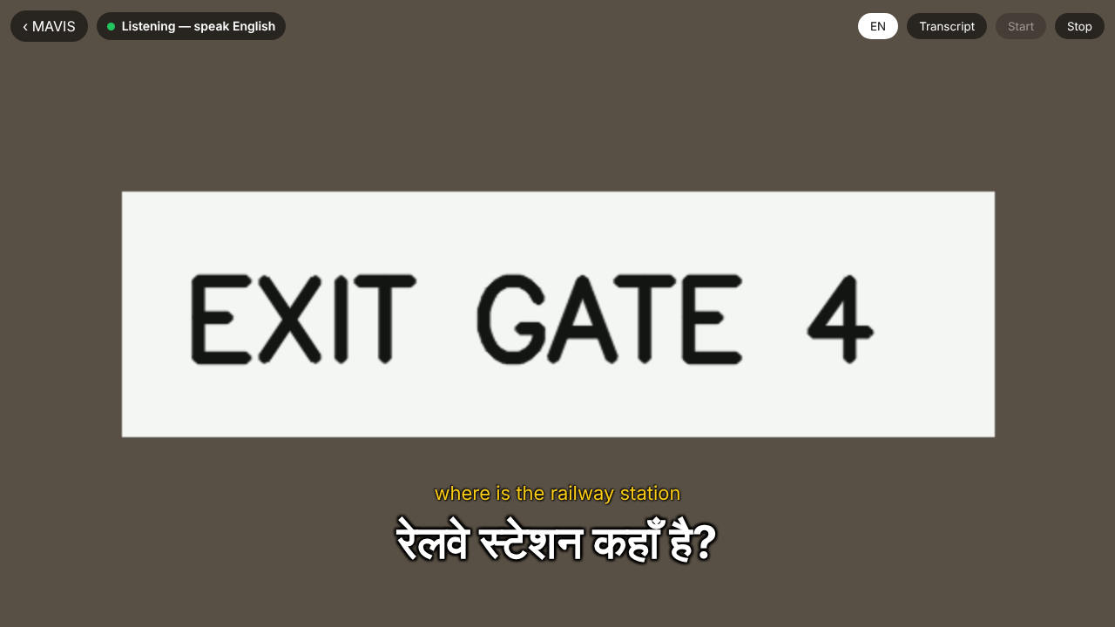
Module 2 · Live Translation
TWO FINGERS · ENGLISH → HINDI
Listens to the laptop microphone; Silero VAD finds speech
Whisper tiny transcribes; LocalAgreement-2 keeps stable words
MT3-C schedules quick opus-mt Hindi drafts
NLLB-200 gives one final translation per sentence
Shown as film-style subtitles over the live camera; starts by itself
Notes:
Runs in its own Python 3.10 worker process through the package’s host API, so its heavy models stay isolated from the rest of MAVIS.

Slide 7
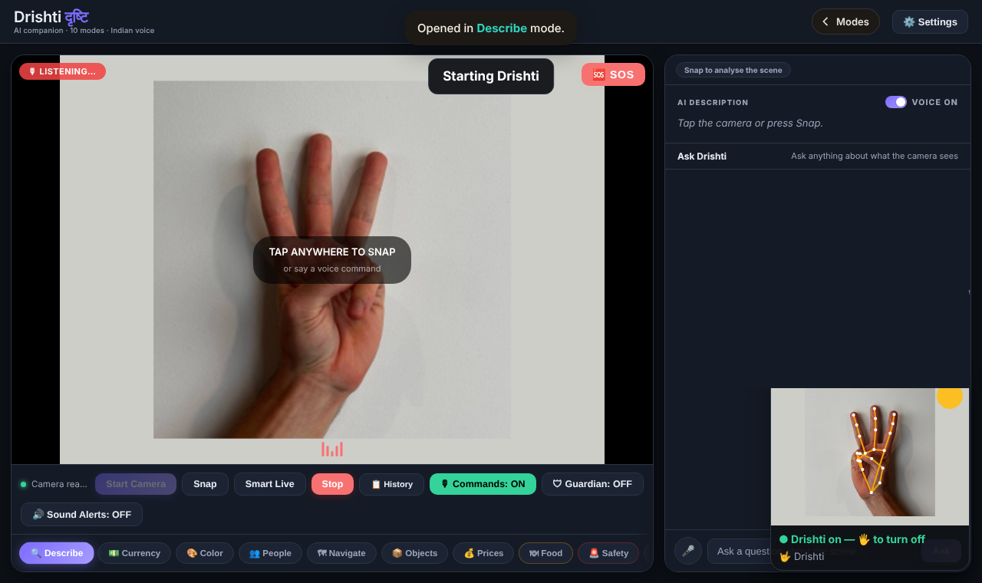
Module 3 · Drishti
THREE FINGERS · SCENE ASSISTANT
Detects objects on the device with COCO-SSD
Scores hazards with fixed rules: position, distance, in path
SmolVLM describes the scene; answers are spoken aloud
Voice in English and eight Indian languages
11 modes kept (Describe, Currency, Colour, Navigate…); Read Text and Translate removed
Notes:
Safety judgements come only from the rule-based stage, never from the language model. Opens in Describe mode with the camera already running.

Slide 8
Results: nothing lost, everything tested
314
402
13.1 ms
5.8 s
original files unchanged (SHA-256 check)
tests pass: 112 gesture, 149 OCR, 120 translation, 21 new
server time per gesture frame (frames every 66 ms)
camera start → Drishti running, in the end-to-end test
Real hand photos (HaGRID): all five controller gestures recognised, confidence 0.79–1.00; a fist is rejected
Demo laptop: translation models load in 13.4 s, then live speech gives Hindi subtitles
run.bat alone starts Ollama, the hub and the browser
Notes:
5 OCR and 3 translation tests are skipped by their own suites. End-to-end: thumbs-up at 2.1 s, three fingers opened Drishti at 5.8 s, open palm closed it at 10.7 s.

Slide 9
Results by module
OCR + LLM
23 of 23 live pages read, 0 errors · 3.2 s mean OCR per page
Live Translation
Streaming WER 24.3% (fixed-buffer 14.3%) · BLEU 31.42 · Hindi draft ≈ 5 s, final ≈ 2.5 s after the last word
Drishti
Black-book benchmark: RapidOCR chosen for zero hallucinations even though docTR was faster.
12 of 12 hazard scenarios scored as expected · hazard engine ≈ 0.03 ms per call
Notes:
Module numbers are from each member’s black book. Streaming costs about 10 points of WER compared with the fixed buffer; that trade-off is reported openly.

Slide 10
Conclusion and future work
WHAT WE ACHIEVED
FUTURE WORK
Four systems became one product controlled by the hand
Each module opens and starts by itself; open palm turns it off
One look, one launcher, one start command (run.bat)
No component’s code changed; all original tests still pass
3 research papers: 2 drafted for ICONSIP 2027, 1 in preparation
User study with visually impaired users and Hindi listeners
Keep translation loaded so subtitles start within a second
Native-speaker review of the Hindi output
Labelled test sets for Drishti and for document QA
A gesture to switch modules directly
Notes:
Close, then move to the live demo: run.bat, Gesture control, thumbs-up, then one, two and three fingers, open palm to turn each off. Then questions.

