Slide 1

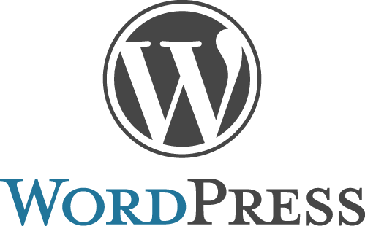

Slide 2
Overview
What is CMS ?
Overview of WordPress
Wordpress Versions
How to install
Themes
Plugins
Menus
Widgets

Slide 3
Prerequisites
Laptop(computer) and Internet connection.
Wamp or xampp server(local server).
PHP version 5.2.4 or greater.
My SQL version 5.0 or greater.
Wordpress package.

Slide 4
What is a CMS?
A content management system or CMS for short is an application with the ability to create, modify and publish digital content.
A content management system consists of two major components:
A content management application (CMA). The CMA can be referred to as the graphical user interface (GUI) that lets a user create, modify, remove and publish content without ever needing to have knowledge of HTML or other programming languages.
A content delivery application (CDA). The CDA is responsible for the back-end services that manage and deliver content after it is in the CMA.
Other features worth mentioning are:
SEO-friendly URLs
Online support and communities
User/group functions
Various templates and designs
Installation wizards and upgrades/updates
The three most popular content management systems in
the world are WordPress, Joomla, and Drupal.

Slide 5
What is WordPress?
WordPress:
Is a dynamic content management system. (CMS) A tool to help you build a website.
Like Microsoft Word, Open Office or Pages help you create documents.
Creates web pages (HTML) dynamically
For basic usage it requires minimal knowledge of web programming or markup languages (HTML, PHP, JavaScript etc.).
Allows users to create website content easily
WYSIWYG editor.

Slide 6
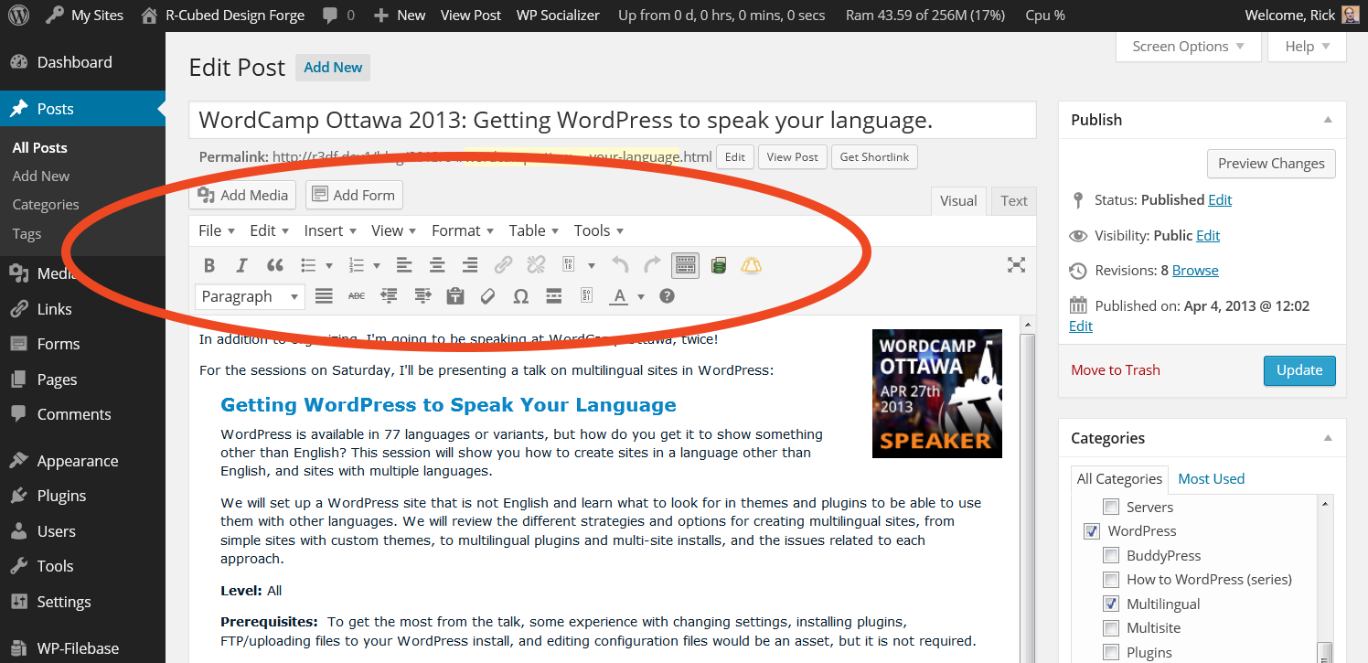
WordPress is WYSIWYG
Looks similar to a lot of word processing applications.
This image shows the WordPress post editor with an extended editor plugin added (TinyMCE Advanced)

Slide 7
What is WordPress continued…
WordPress:
The first version of WordPress was released May 27, 2003
Matt Mullenweg and Mike Little co-founded WordPress.
Is currently the most popular CMS in use on the Internet.
Runs millions of websites.
Stats suggest WordPress sites represent as much as 25% of the worlds websites.
Needs a web server with PHP and MySQL to run.
Hosting service for public sites.
Local server to run it on your pc/laptop.

Slide 8
WORDPRESS - Is it really free?
WordPress is free:
The core WordPress software is free:
As in open source.
Freedom to use it as you want, even to change it.
As in $$$.
But that does not necessarily mean a free website.
Possible expenses:
Domain names.
Hosting.
Plugins.
Themes.

Slide 9
WordPress versions
WordPress.com
1. Often referred to as “.com” WordPress.
Note: This not at all related to using or not using “.com” domains for your website.
WordPress.org
2. Regular
3. Network or Multisite
We need to be aware of which one we are talking about, reading about or using, there are some differences.

Slide 10
1. WordPress.com
WordPress.com is a service (by Automattic)
They provide WordPress AND Hosting
Free for basic site:
somename.wordpress.com
Has limitations compared to self hosted:
Added costs for customizing
Limited ability to customize
Many things covered in this presentation you can’t do on WordPress.com – like add plugins

Slide 11
2. WordPress.org
Home of the open source version of WordPress.
Free! – Just download it
Related things that may cost:
A web host (self-hosted)
A domain
Some WordPress / Web knowledge
Limitations:
None!

Slide 12
3. WordPress.org networks or multisite
The third version of WordPress is multisite (network).
Was once known as WPMU, a separate program.
Allows multiple websites on one install.
It need not be obvious to users that it is one install.
Limited version of what WordPress
Needs some knowledge to set-up.

Slide 13
WORDPRESS –SETUP(CONFIGURATION) STEPS
BASIC STEPS :
Step 1: Install local server(WAMP or XAMPP).
Step 2: Start server.
Step 3: Wordpress package Copy from source and past in www directory.
Step 4: Open PHP my admin and create database.
Step 5: Open wordpress package in browser(localhost/your folder name)
(configure according to your database name and password ).
Step 6: Run and install
Step 7: Login in admin panel ( localhost/your folder name/wp-login.php).
Step 8: Visit front site and enjoy with wordpress.

Slide 14
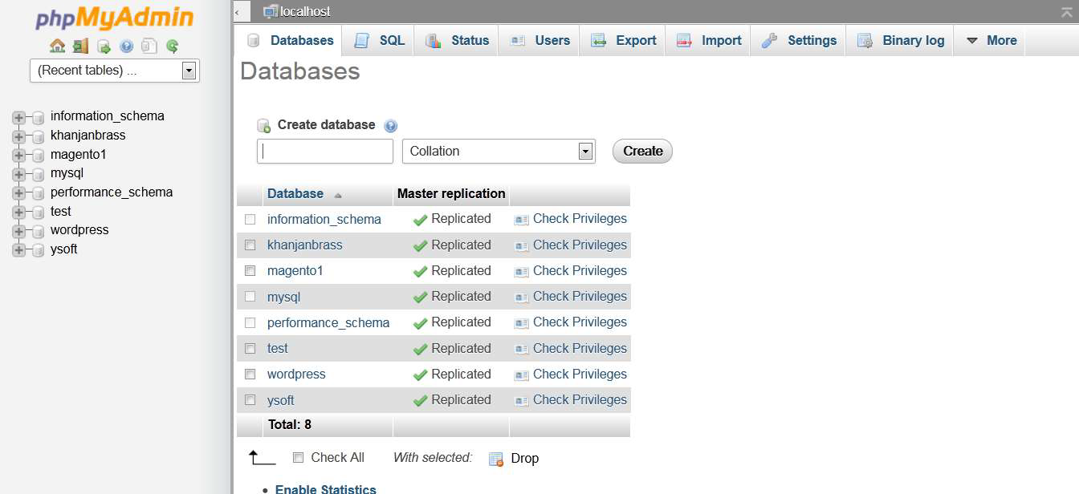
READY FOR CREATE a SITE
STEP 1: Already install in my laptop
STEP 2: Start server
STEP 3: Copy package in directory
STEP 4: Create database

Slide 15
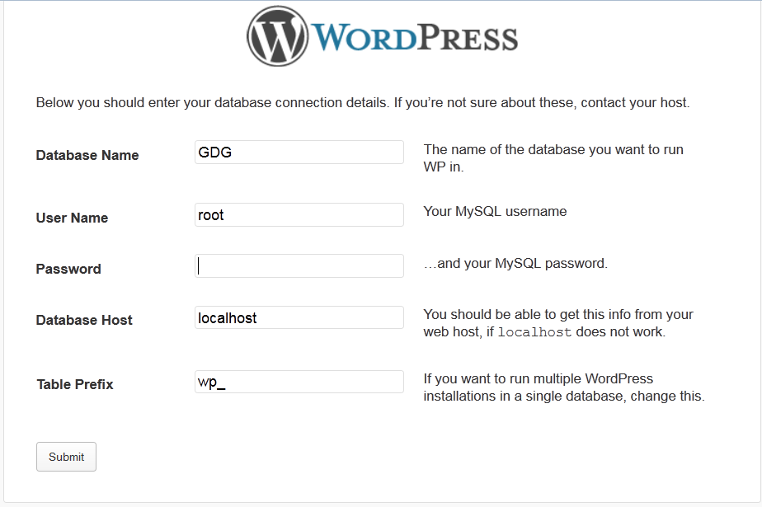
STEP 5 :Set Database Name and Password

Slide 16
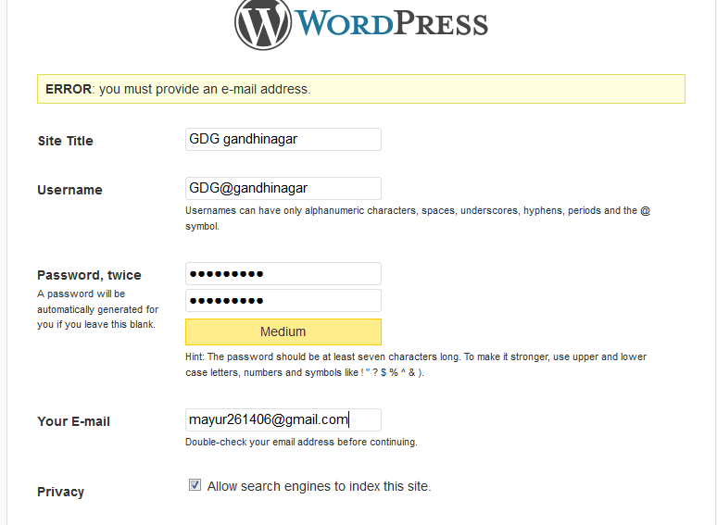
STEP 6: Run and install

Slide 17
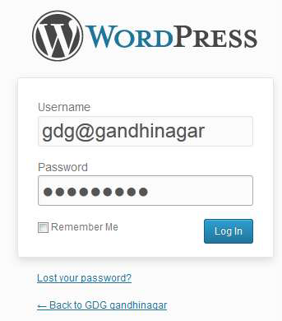
STEP 7: Login in admin panel with user
name and password

Slide 18
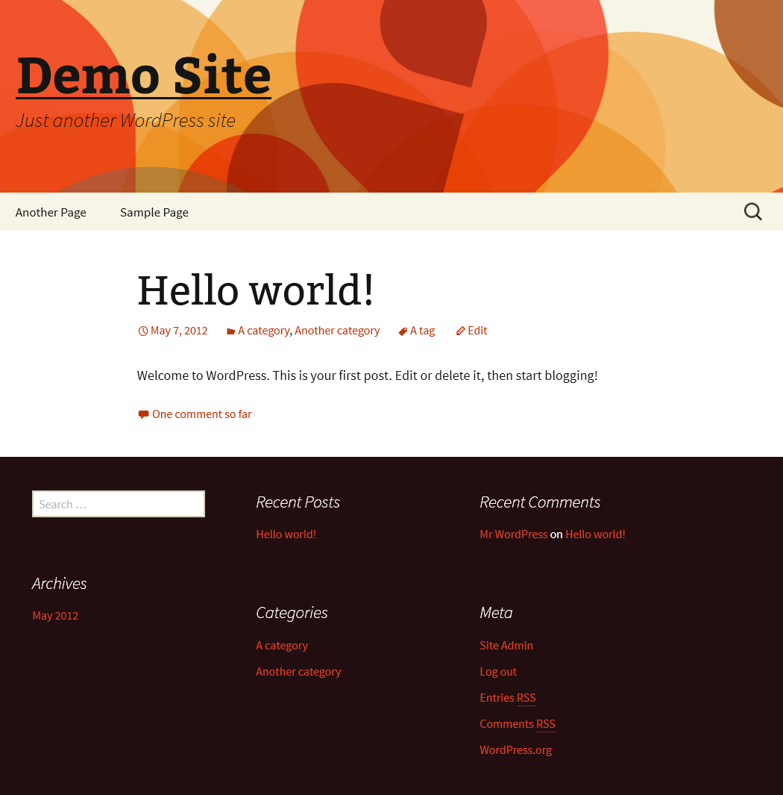
STEP 8: Visit your site

Slide 19
WordPress front-end WordPress has 2 interfaces for users: the front-end
The part of the site that your site visitors see.
"public" part of your site.
Default Twenty Fourteen theme.

Slide 20
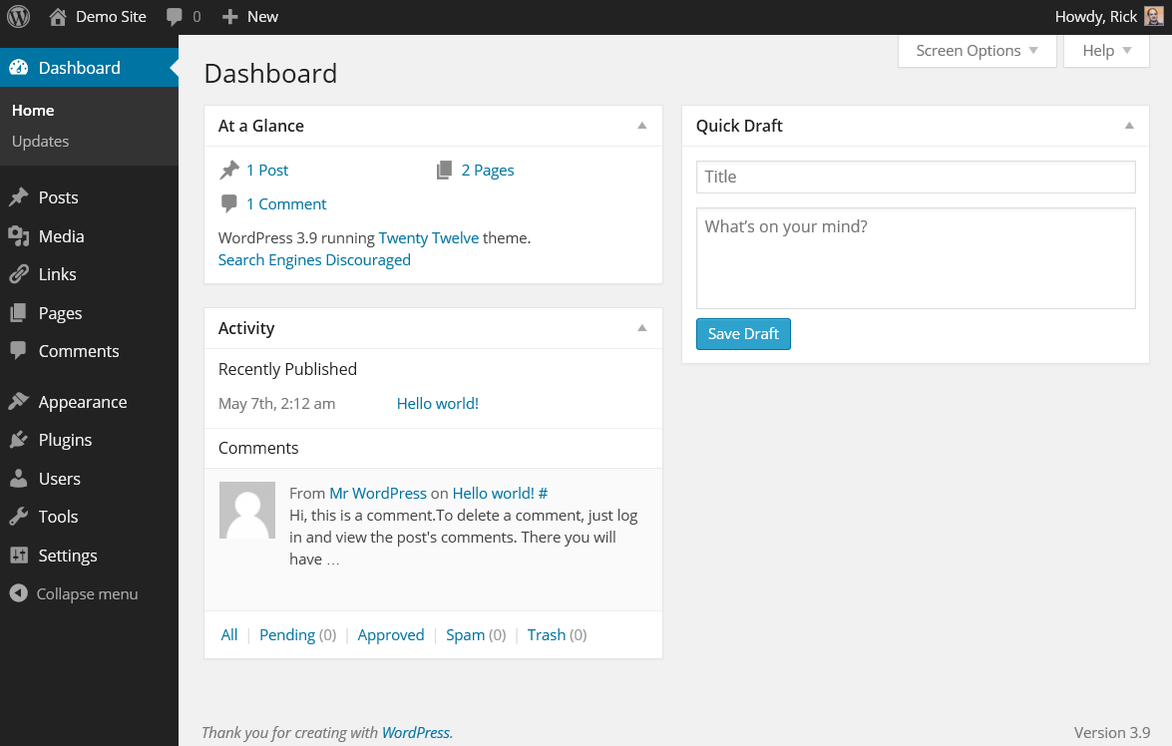
WordPress back-end, admin or “dashboard”
WordPress back-end or “dashboard” Where you manage the site.

Slide 21
Posts and pages
Posts and pages are the basic content holders for a WordPress site.
Posts:
Individual pieces of a collection of content. Usually used for blogs or similar types of content.
Each content piece is associated with a date: URL: your-domain/2008/11/30/post-title.
Posts have categories and tags.
Pages:
Are individual static stand alone content blocks.
Good for things like an About page. (any web site pages)
Usually in site menus.
Do not use tags or categories.
Not tied to date. URL: domainname.com/page-title/

Slide 22
WordPress - Media Library
Media Library consists of the images, audios, videos and files that you can upload and add to the content when writing a Post or Page. Here you can view, add, edit or delete any media related objects if not needed.
Step (1) − Click on Media → Library in WordPress.
Step (2) − You can view media files like images, audios, videos. Click on Add Media button.
Step (3) − The Upload New Media page gets displayed.
Step (4) − You can view a bar as shown in the following screenshot.

Slide 23
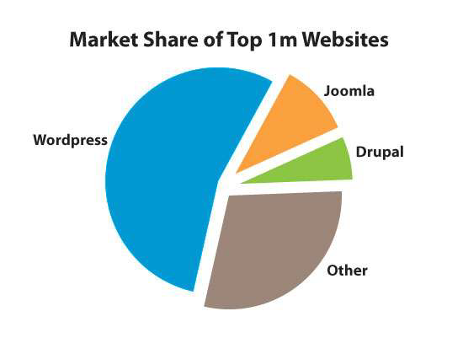
WORDPRESS THEME
A WordPress theme is a set of files that determine the look and feel of your WordPress-powered website.
Themes include information about the general layout of the site, and other content such as graphics, header, footer and logo.

Slide 24
Menus
The WordPress Dashboard provides navigation menu that contains some menu options such as posts, media library, pages, comments, appearance options, plugins, users, tools and settings on the left side.
Defining a Menu
Login to the WordPress Dashboard.
From the 'Appearance' menu on the left-hand side of the Dashboard, select the 'Menus' option to bring up the Menu Editor.
Select Create a new menu at the top of the page
Enter a name for your new menu in the Menu Name box
Click the Create Menu button.

Slide 25
Adding Widgets
Widgets allow you to change the layout and the content of your site simply and quickly.
Widgets can be accessed from the dashboard, under Appearance section.
You will see a list of available widgets. On the side, you have areas where you can place your widgets. By default you should have the Primary Sidebar, a Content Sidebar, and a Footer Widget Area. However, the number of widgets depends on the WordPress theme you are using.

Slide 26
WORDPRESS PLUGIN
Plugin is a collection of code files that adds one or more features to your web site.
WordPress has a database of over 26,000 plugin
Plugins are utilities which provide additional functionality to your application.
To install a plugin you just need to put the plugin files into the wp-content/plugins directory. Once a plugin is installed, you may activate it or deactivate it from the Plugins menu in your WP administration.

Slide 27
Updating WordPress Site
WordPress handles small updates itself, so you don't have to worry about it. The larger ones will give you the option to update at your chosen time. Meanwhile you can look at the features of the update or put your site on maintenance mode.
There are three things you must always update on your WordPress site: WordPress itself, themes and plugins. You can update your site from the Update section in the navigation bar.
It is very important to keep your whole WordPress site up to date. That is because when a plugin or a theme is updated, you may get new functionalities and bug fixes. It is also a crucial part to keeping a WordPress website secure and fast.

Slide 28

IT Software / Hardware / Networking
Training & Placement Services
For any help -
Mail : help@solman.in
WhatsApp : 77 44 93 7000
1st Lane, Shahupuri, Kolhapur

