Slide 1




GAYATRI VIDYA PARISHAD COLLEGE FOR DEGREE AND PG COURSES(A)
(Affiliated to Andhra University | Accredited by NAAC Visakhapatnam-530054.
BLUEJACKING TECHNOLOGY
Department of Computer APPLICATIONS
Guide: Prof. I. S. Pallavi Student: V. Sumanth
Director of MCA Reg No: PG222302063
Department of Computer Applications Course: MCA 4th sem
1

Slide 2
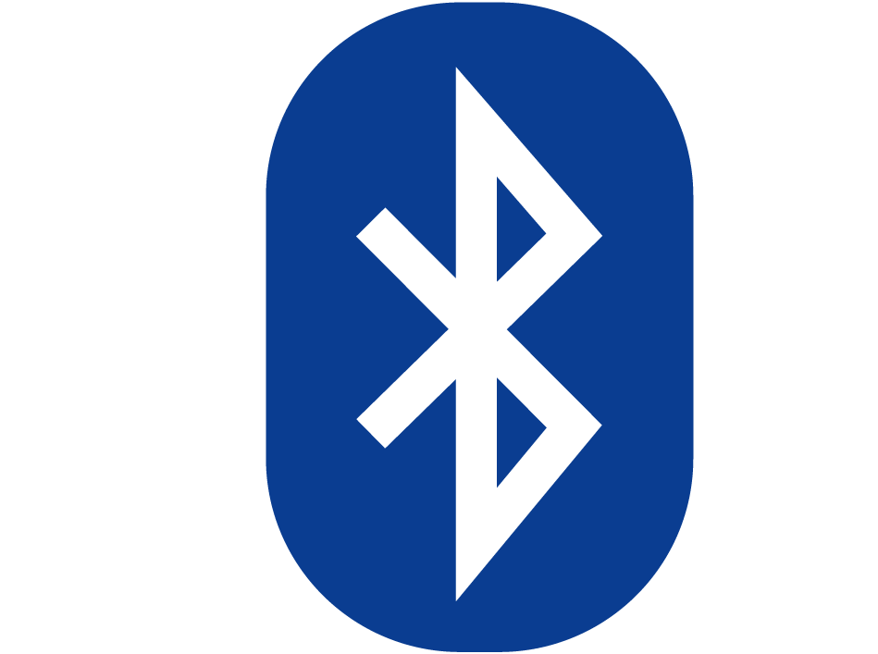
Contents
Introduction
History of Bluejacking technology
Purpose of Bluejacking technology
Applications
Features
Advantages and Disadvantages
Limitations of Bluejacking technology
Legal implications
Real-time Examples
Conclusion
2

Slide 3
INTRODUCTION TO BLUEJACKING TECHNOLOGY
Bluejacking, a term coined in the early 2000s, refers to the practice of sending unrequired messages or data over Bluetooth connections to nearby devices. It exploits the broadcasting feature of Bluetooth technology, commonly found in mobile phones, laptops, and other portable devices. Unlike other forms of cyber-communication, bluejackers don't establish a paired connection with the target device, allowing them to remain anonymous.
The primary purpose of bluejacking is typically harmless, often serving as a means of surprise for the recipient. Messages can range from simple greetings or jokes to more creative content like images or business cards. However, bluejacking underscores potential accessibility in Bluetooth-enabled devices, highlighting the importance of maintaining secure connections to prevent more malicious forms of cyber-attacks
3

Slide 4
INTRODUCTION TO BLUEJACKING TECHNOLOGY
Although bluejacking itself is not naturally malicious, it raises ethical and legal concerns regarding privacy and unauthorized communication. Users can reduce the risk of bluejacking by setting their devices to "non-discoverable" mode, thereby preventing them from receiving unsolicited messages from unknown devices.
In summary, bluejacking represents a unique situation in the realm of cyber-communication, blending elements of fun and surprise with important considerations regarding security and privacy in the digital age.
4

Slide 5
WHAT IS BLUEJACKING TECHNOLOGY ?
Bluejacking utilizes Bluetooth technology to send unsolicited messages or data to nearby Bluetooth-enabled devices. Bluetooth is a wireless communication technology standard used for short-range communication between devices, typically within a range of about 10 meters (30 feet).
Bluetooth-enabled devices, such as smartphones, laptops, tablets, and wearable devices, can establish connections with other Bluetooth devices for various purposes, including file sharing, audio streaming, and peripheral device connectivity.
5

Slide 6
WHAT IS BLUEJACKING TECHNOLOGY ?
Bluejacking takes advantage of Bluetooth's broadcasting feature, which allows devices to send out information to other Bluetooth-enabled devices within range without requiring a paired connection. Bluejackers can exploit this feature to send messages, typically for fun or as a prank, to unsuspecting recipients.
It's important to note that bluejacking itself doesn't involve any specialized technology beyond Bluetooth-enabled devices and the built-in features of Bluetooth communication. It's essentially a form of communication that leverages the existing capabilities of Bluetooth technology for unsolicited messaging purposes
6

Slide 7
HISTORY OF BLUEJACKING TECHNOLOGY
The term “Bluejacking" is believed to have originated from a man named Jack in 2003 who discovered a way to send unsolicited messages to nearby Bluetooth-enabled devices in a London department store. He named this practice “Bluejacking," combining "Bluetooth" and "hijacking.“
Following its discovery, Bluejacking quickly gained popularity among early adopters of Bluetooth-enabled devices, particularly mobile phones. People began experimenting with sending various types of messages, such as greetings, jokes, and even flirtatious remarks, to unsuspecting strangers in public places like malls, restaurants, and public transportation.
Bluejacking garnered significant media attention as reports of these unsolicited messages spread. It was often portrayed as a harmless prank or novelty, capturing the public's imagination and sparking curiosity about the possibilities of Bluetooth technology.t6
7

Slide 8
HISTORY OF BLUEJACKING TECHNOLOGY
The rise of Bluetooth-enabled devices, including smartphones, laptops, and PDAs, contributed to the spread of bluejacking. As more people acquired these devices, the potential audience for bluejacking messages grew.
Bluejacking enjoyed a period of popularity during the mid-2000s as a strange and relatively warm form of communication. However, as awareness of Bluetooth security vulnerabilities increased, and mobile operating systems implemented severe security measures, instances of bluejacking began to decline.
While bluejacking is less common today than it was in its early years, it remains a notable chapter in the history of mobile communication and Bluetooth technology. It serves as a reminder of the importance of security awareness in an increasingly interconnected world and the potential for creative and unexpected uses of technology.
8

Slide 9
PURPOSE OF BLUEJACKING TECHNOLOGY
Bluejacking is often done for fun, amusement, or as a form of entertainment. Sending unexpected messages or greetings to nearby Bluetooth-enabled devices can elicit surprise, laughter, or curiosity from recipients.
Bluejacking can serve as a means of social interaction, allowing individuals to connect with strangers in public spaces without direct interaction. It can spark conversations or create a sense of camaraderie among individuals who receive bluejacking messages.
Bluejacking provides an opportunity for individuals to express their creativity and originality by crafting interesting or humorous messages to send to unsuspecting recipients. It allows for spontaneous and unconventional forms of communication.
9

Slide 10
PURPOSE OF BLUEJACKING TECHNOLOGY
In some cases, bluejacking has been used as a marketing or promotional tool by businesses or organizations. Sending promotional messages or advertisements to nearby Bluetooth-enabled devices can attract attention and generate interest in products, services, or events.
Bluejacking demonstrates the capabilities of Bluetooth technology and showcases its potential for communication in everyday scenarios. It highlights the ease with which devices can connect and exchange information wirelessly within a short range.
10

Slide 11
APPLICATIONS OF BLUEJACKING
Businesses can use bluejacking as a form of proximity marketing to send promotional messages or advertisements to Bluetooth-enabled devices in their locality. For example, retailers can send special offers or discounts to shoppers passing by their stores, encouraging them to enter and make purchases.
Event organizers can utilize bluejacking to promote upcoming events or conferences by sending event details, schedules, and location information to attendees or potential attendees who are in close proximity to the event venue.
Bluejacking can facilitate networking and social interaction in crowded public spaces, such as conferences, concerts, or festivals. Attendees can exchange contact information, share social media profiles, or engage in group chats using bluejacking messages.
11

Slide 12
APPLICATIONS OF BLUEJACKING
Tourism agencies, hotels, and tourist attractions can leverage bluejacking to provide visitors with relevant information, maps, or guided tours. Bluejacking messages can offer insights into nearby landmarks, historical sites, or points of interest, enhancing the visitor experience.
Bluejacking can be used as a means of emergency notification in situations where traditional communication channels may be unavailable or ineffective. Authorities or organizations can send urgent alerts, evacuation instructions, or safety information to people in affected areas during emergencies or disasters.
12

Slide 13
APPLICATIONS OF BLUEJACKING
Brands can use bluejacking to engage with customers in innovative ways, such as conducting surveys, gathering feedback, or providing interactive experiences. By initiating conversations with customers through bluejacking messages, brands can foster brand loyalty and customer satisfaction.
13

Slide 14
FEATURES FOR BLUEJACKING TECHNOLOGY
Bluejacking allows individuals to send messages anonymously to nearby Bluetooth-enabled devices without establishing a paired connection. This anonymity preserves the sender's identity and adds an element of surprise to the communication.
Bluejacking messages are typically pleasant and cannot access or modify the recipient's device beyond displaying the received message. This ensures that bluejacking does not interfere with the normal functioning of the device or compromise its security.
Bluejacking operates within the range of Bluetooth signals, which is typically around 10 meters (30 feet). The limited range restricts communication to devices in close proximity, ensuring that messages are only sent to nearby devices.
14

Slide 15
ADVANTAGES OF BLUEJACKING
Marketing and Promotion: Bluejacking can be used as a marketing or promotional tool. Businesses may use bluejacking to send promotional messages or advertisements to nearby Bluetooth-enabled devices in order to attract potential customers to their products or services. For example, a retailer might send discount coupons or promotional offers to potential customers in close proximity to their store.
Networking and Social Interaction: Bluejacking can also facilitate networking and social interaction in certain contexts. For instance, individuals at a conference or event may use bluejacking to exchange contact information or connect with others who are nearby. This can be particularly useful in situations where traditional methods of networking, such as exchanging business cards, may not be feasible or convenient.
15

Slide 16
ADVANTAGES OF BLUEJACKING
3.Information Sharing: Bluejacking can be used to share information or content with others in close proximity. For example, students in a classroom or colleagues in a meeting may use bluejacking to quickly share documents, presentations, or other files without the need for an internet connection or email. This can enhance collaboration and productivity in certain situations.
4.Fun and Entertainment: Bluejacking can simply be used for fun or entertainment purposes. Some people enjoy sending amusing or playful messages to strangers or friends in public places using bluejacking. While this may not have any practical purpose, it can provide entertainment value for those involved.
16

Slide 17
ADVANTAGES OF BLUEJACKING
5.Awareness and Education: Bluejacking can also be used to raise awareness about Bluetooth security vulnerabilities and educate users about the importance of securing their devices. By demonstrating how easily devices can be targeted and accessed via Bluetooth connections, individuals may become more vigilant about their device security and take steps to protect themselves against potential threats.
17

Slide 18
DISADVANTAGES OF BLUEJACKING
Invasion of Privacy: Bluejacking involves sending unasked messages or data to Bluetooth-enabled devices without the consent of the recipient. This can be viewed as an capture of privacy, as it mess into the personal space of individuals without their permission.
Annoyance and Disturbance: Bluejacking messages, particularly when sent repeatedly or inappropriately, can be annoying and disruptive to recipients. Constantly receiving unwanted messages can be frustrating, especially in environments where people expect privacy or quiet, such as in public transportation, libraries, or workplaces.
18

Slide 19
DISADVANTAGES OF BLUEJACKING
3.Security Risks: Bluejacking exploits credulity in Bluetooth technology, which can potentially be used for malicious purposes beyond simple pranks or marketing. For instance, attackers could use bluejacking techniques to deliver malware, scams, or other malicious content to unsuspecting users, compromising the security of their devices and personal information.
4.Ethical Concerns: Bluejacking raises ethical questions about consent, respect for personal boundaries, and the responsible use of technology. Sending unsolicited messages to strangers without their consent disregards their autonomy and right to privacy, and can contribute to a culture of digital harassment or cyberbullying.
19

Slide 20
LIMITATIONS FOR BLUEJACKING TECHNOLOGY
Bluejacking's effectiveness is limited by the short range of Bluetooth signals. Communication can only occur within close proximity to the target device, typically within 10 meters, which restricts its reach.
Bluejacking messages are generally plesant and cannot access or modify the recipient's device beyond displaying the received message. It lacks the capability for more advanced interactions or data manipulation.
Bluejacking is primarily a one-way form of communication. While recipients can receive and view messages, they cannot respond directly through the bluejacking method.
20

Slide 21
LIMITATIONS FOR BLUEJACKING TECHNOLOGY
Bluejacking highlights security vulnerabilities in Bluetooth-enabled devices, raising concerns about unauthorized access and potential risks. While bluejacking itself is typically harmless, it underscores the importance of securing Bluetooth connections to prevent more malicious forms of cyber-attacks, such as bluesnarfing or bluebugging.
Depending on jurisdiction, bluejacking may have legal implications related to privacy, harassment, or unauthorized communication. Engaging in bluejacking activities without consent may violate laws or regulations, necessitating caution and ethical considerations.
21

Slide 22
LEGAL IMPLICATIONS OF BLUEJACKING TECHNOLOGY
In many jurisdictions, bluejacking may infringe upon privacy laws. Sending unsolicited messages or files to someone's device without their consent could be considered an invasion of privacy.
Bluejacking could also potentially violate harassment laws, especially if the messages sent are offensive, threatening, or of a harassing nature. It's essential to emphasize that even though bluejacking may seem harmless, it can still have legal consequences if it crosses the line into harassment.
Sending copyrighted material or proprietary information through bluejacking could lead to legal issues related to intellectual property rights infringement. Emphasize the importance of respecting copyrights and avoiding the unauthorized distribution of copyrighted material.
22

Slide 23
REAL TIME EXAMPLES OF BLUEJACKING TECHNOLOGY
The Bluetooth Billboard Hack:
In 2014, a group of hackers known as "Team Anonymous" hacked into a digital billboard in Jakarta, Indonesia, using bluejacking techniques.
They gained access to the billboard's Bluetooth connection and started broadcasting their own messages and images, including political statements and memes, to people passing by.
This incident highlighted the vulnerability of Bluetooth-enabled devices to unauthorized access and manipulation
23

Slide 24
REAL TIME EXAMPLES OF BLUEJACKING TECHNOLOGY
Bluetooth Marketing Campaigns:
Some companies have used bluejacking techniques for marketing purposes, sending promotional messages or coupons to Bluetooth-enabled devices in close proximity to their stores or events.
While these campaigns are generally harmless and opt-in, they demonstrate how bluejacking can be used as a tool for targeted advertising.
24

Slide 25
REAL TIME EXAMPLES OF BLUEJACKING TECHNOLOGY
Bluejacking Competitions:
In some cases, bluejacking competitions or challenges are organized, where participants compete to see who can send the most creative or humorous messages to nearby Bluetooth devices.
These events serve to raise awareness about the vulnerability of Bluetooth technology and encourage participants to think creatively about cybersecurity risks
25

Slide 26
CONCLUSION
In conclusion, bluejacking, while often seen as harmless fun, reveals significant concerns about our digital safety. It's like a playful poke at the potential risks of our Bluetooth devices. From silly messages to more serious privacy invasions, bluejacking highlights the need for caution in our tech-savvy world. It's important for everyone to understand the risks and take steps to protect themselves. Whether it's setting our Bluetooth to "hidden" mode when not in use or being mindful of the messages we receive, each action helps keep us safer. Bluejacking reminds us that even innocent actions can have consequences. By staying informed and proactive, we can navigate the digital landscape more securely. Let's create a culture where cybersecurity is everyone's responsibility. Together, we can minimize the risks of bluejacking and other online threats, making our digital world a safer place for all.
26

Slide 27
THANK YOU

