Slide 1
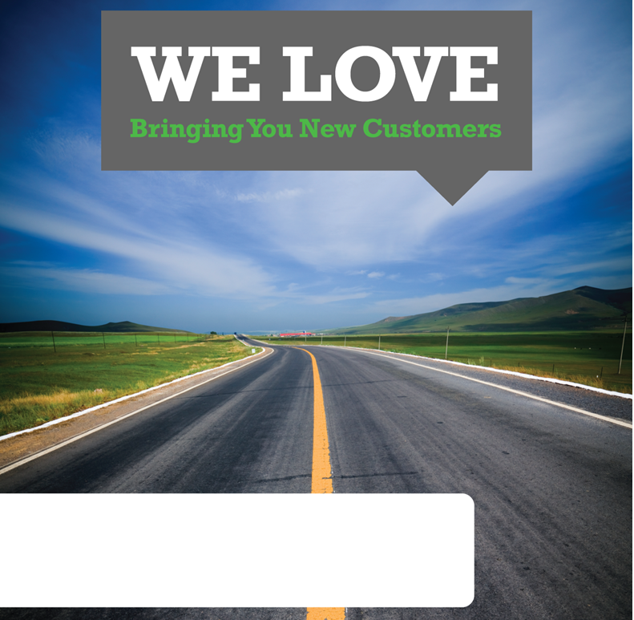
[COMPANY NAME, CONTACT NAME]
Sales Rep Name, Today’s Date (602) 444-1700, Sales.RepName@gannett.com

Slide 2
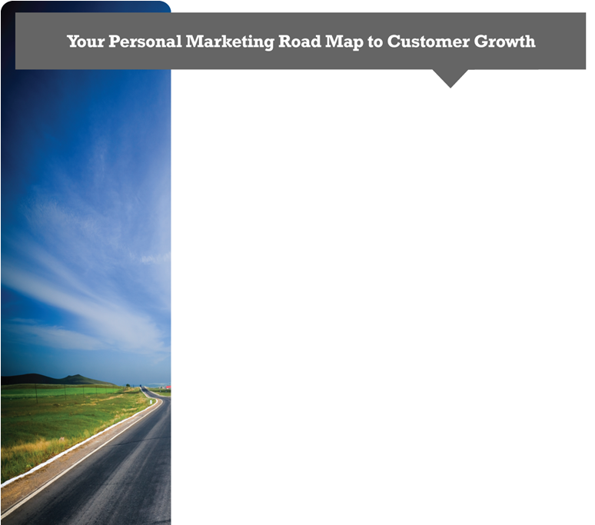

The Benefits of Online Marketing
70% of potential customers search online for solutions
without ever checking traditional print media
Manage customer relationships and receive feedback
Track effectiveness of marketing campaigns
Effective solutions for any kind of business
Online Marketing Goals for Your Business
Increase number of conversions/sales
Increase volume of visitors/clicks
Increase click through rate (CTR)
Decrease cost per acquisition (CPA)
Attract relevant and targeted leads
Increase your brand awareness and online presence
Establish a local presence on Google Places
Improve social media management and customer
interaction

Slide 3
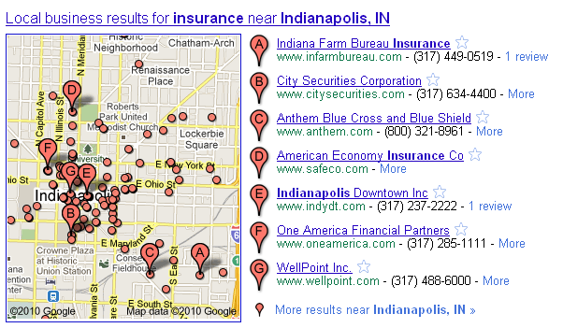
Online Map Optimization
Optimize your Maps/Locals listings to attract new local clients
Makes other aspects of marketing campaign more effective (SEO, PPC, Social, etc…)
5 City Focus with keyword research and optimization
What It Can Do For Your Business
Help local customers find you
Concise listing of services, hours, products
Achieve visibility at top of searches
Optimized listings on Google/
Yahoo/Bing
20 citations / month
Monthly review of analytics
& performance
Video slideshow to improve
rankings
Call tracking phone number
Optimized for mobile browsers
Your listing here!

Slide 4
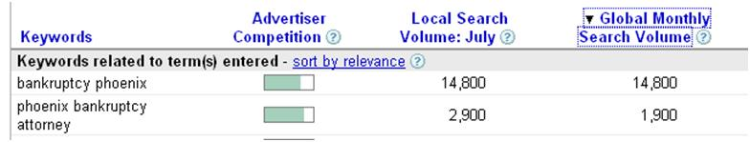
Pay-Per-Click (PPC)
Our Pay-Per-Click packages drive targeted traffic to your website by placing ads in prominent locations on search engines like Google and Bing. We will manage your sponsored/paid search keyword listings and create strategic ads to drive traffic to your website!
What It Can Do For Your Business
Rapid acquisition of new customers
Track performance of ad campaigns
Allows refinement of ad campaigns and multi-variant testing (ask about pricing)
How It Works!
Ads appear in prominent locations on search engines and trusted partner sites
We’ll create a microsite landing page optimized for conversion.
Controlled use of your ad-budget
Reporting available to determine Cost Per Acquisition

Slide 5

Search Engine Optimization
Our SEO (Search Engine Optimization) services help your website rank higher in the natural (i.e., organic) search results of Google, Yahoo!, and Bing for selected, targeted, conversion-oriented keywords.
What We Do:
Keyword research and strategy
Identify key root words, brand terms, etc
Content optimization
Meta-tags
Header tags
Strategic info display
Reporting
Link building and development
What It Can Do For Your Business
Establish your company as an authority in your industry
Drive your website up the rankings on search engines
Help local and national companies find your business
Increase traffic (hits)

Slide 6
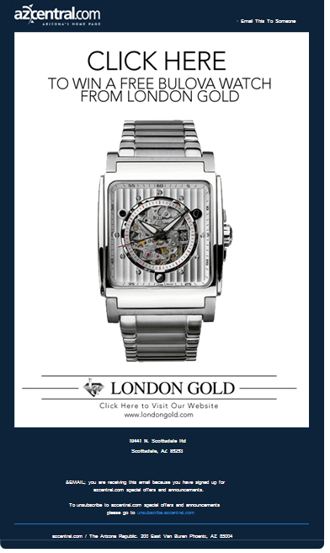
E-mail Blasts
What It Can Do For
Your Business
Increase new business sales
Protect existing customers from your
competitors
Reach out to your demographic
Why It Works!
Consumers are taking a variety of offline actions as a result of permission-based email communications. 53% of Americans make offline purchases as a result of an email ad.
Deliver e-newsletter directly to
clients
Opt-in email list suggestion
Creative/Ad copy assistance
Avoid spam filtration systems

Slide 7
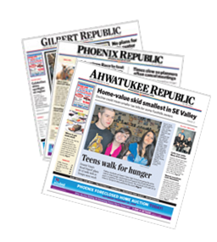
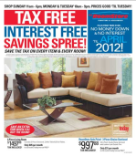
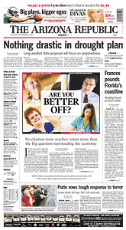
Newspaper and Local Print Media
What It Can Do For
Your Business
Deliver ads through local print media
such as the Arizona Republic, La Voz, etc…
Exposure to tens of thousands of new
customers in your community!
Protect your existing customers from competitors
Target ads by location and demographic
Eye-catching quarter-page and eighth-page ads
Brand & promote your business in the local community
Drive new customers to your store through a special promotion or event
Why It Works!
Readers rely on local community newspapers to stay informed on the latest news
and information in their community.
Residents look to the community section for local stories and information
The Arizona Republic reaches more than 1.5 Million or
50% of Phoenix adults
ROP- ROP Print, or “Run-of-Paper”, are the ads you
see throughout the main section of your newspaper
Community Print- Community Print ads run in the
“Community” section of your local newspaper
Flyers- Target your best areas by zip code for special events and promotions.
Available Print Sizes :
ROP: 1/16th and 1/8th page ads available
Community Print: 1/8th, 1/4 and 1/2 page ads available
Black and White or Color Ads Available.

Slide 8
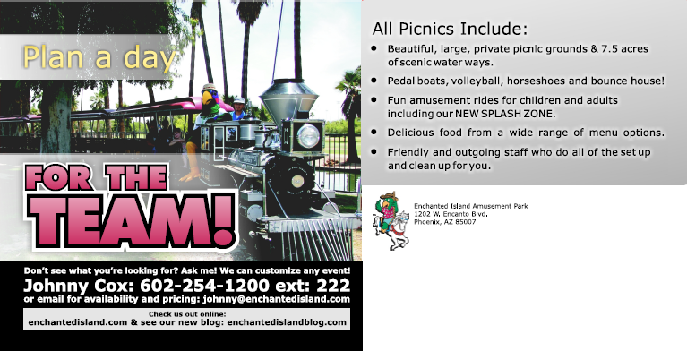
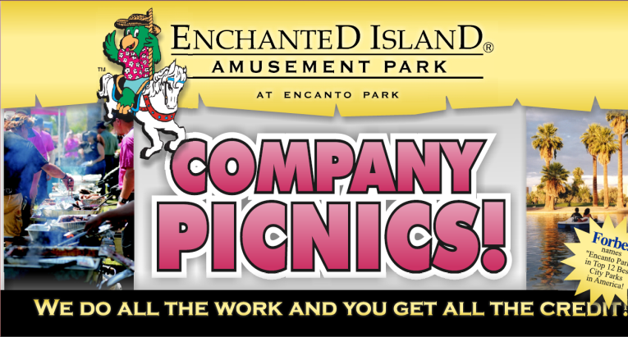
Direct Mail
What It Can Do For
Your Business
Deliver ads directly to potential clients at their home or business address
Offer the flexibility to effectively target
Users using demographic and regional targeting
Create an advertising message that doesn’t have to compete in the same space as competitors
Brand & promote your business in the local community
Why It Works!
Gannett’s graphic designers create an attractive and targeted ad for your business
Residents and homeowners are more likely to have expendable income
Response times via direct mail are rapid, making projecting the final results of a mailing quick and easy

Slide 9
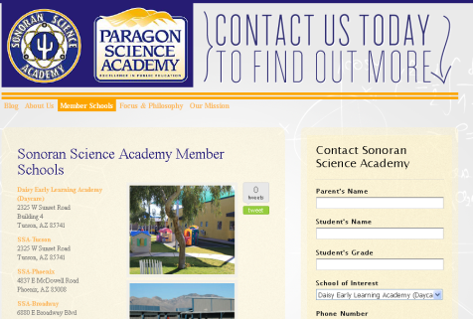
Custom Website Design
What It Can Do For
Your Business
Present your clients with an effectively branded, efficient message that emphasizes turning visitors into paying clients or customers
Create a website with a professional appearance, sensible navigation, and content optimized to target potential customers
Anticipate and meet the needs of potential website visitors
Provide an instant visual presentation of your business
Reach your customers and provide information 24 hours a day, 365 days a year.
Gain better insights into how consumers behave when viewing your products
Upgradeable design allows your web presence to grow as your business expands

Slide 10
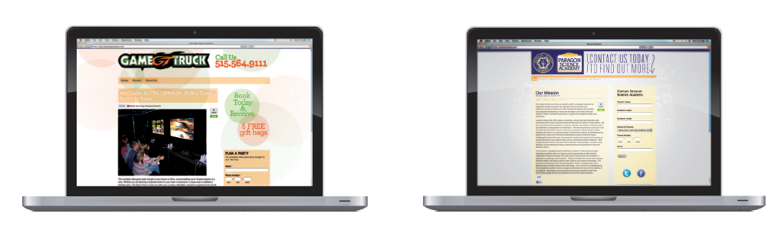
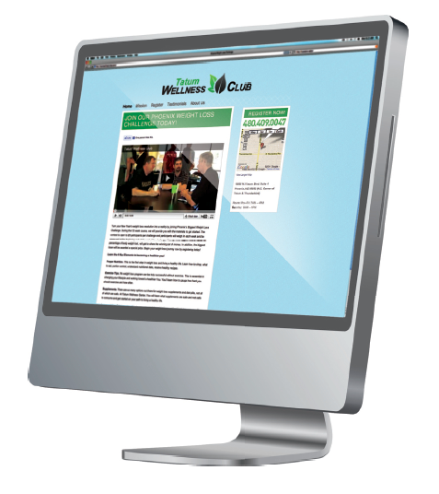
Template Website Design
What It Can Do For
Your Business
Local Search Optimized
Compelling About Us Page
Lead Generation Optimized
Strong Call to Action
Mobile Enabled
Social Media Plug-Ins
Video Montage
Content Management System
Google Analytics Installed

Slide 11
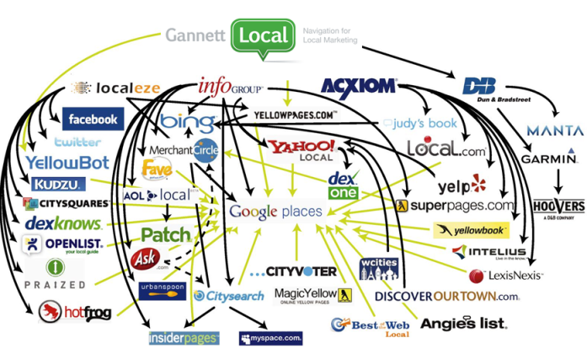
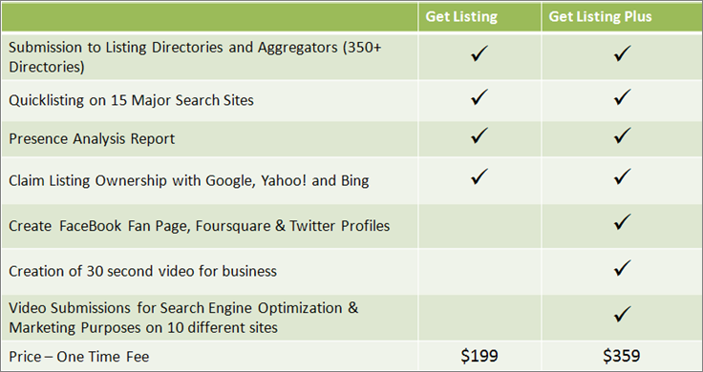

Quick-View Guide to My Local Listing & My Local Listing Plus
Google’s most trusted source of business data….is…Google
59% of mobile searches are directed at finding businesses
How Does Google Assess Prominence? Citations are essential.
Name, Address, Phone Number (NAP) crawled in structured format on other websites
Maintenance, Popularity, and Accuracy
Linking Video to your site increases your chance of being on the first page by 50%
PRODUCT FEATURES:
Distributed to over 350+ directories across the web & All Major Search Engines
Ownership of local business listings on Google, Yahoo, and Bing
Creation/ Claiming of Facebook, Twitter, and Foursquare profile
Simple, Low Cost, and Low Risk Start to Online
Corrects all invalid, outdated, or incorrect data online
Comprehensive reporting
Businesses listed with enhanced data have more ways to be found
Starts an online presence for the client, and helps to familiarize them with online, and online with them

Slide 12
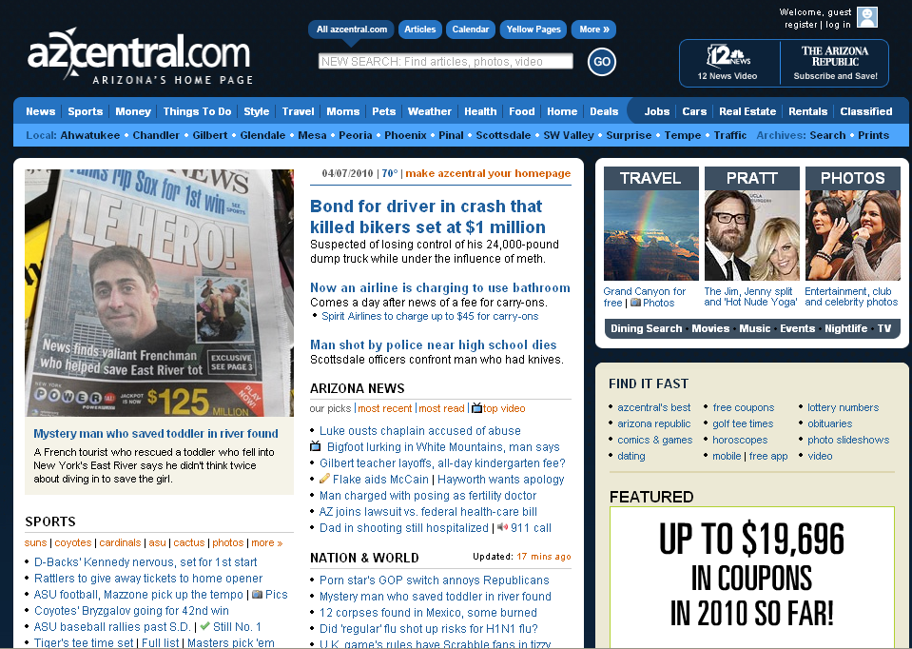
Azcentral.com Banner Ads & Business Profiles
Advertise on the local websites your
customers already visit.
Target by zip-code, Age or Gender
What It Can Do For Your Business
Brand & promote in the local community
Drive new customers to your store through a special promotion, event, etc.
Protect your existing customers from competitors
Be found when searching through AZCentral.com Yellow Pages
Why It Works!
Reaching more than one out of three online adults (34%) every month, azcentral.com has more visitors than any other local news/information Web site in the Phoenix market!

Slide 13

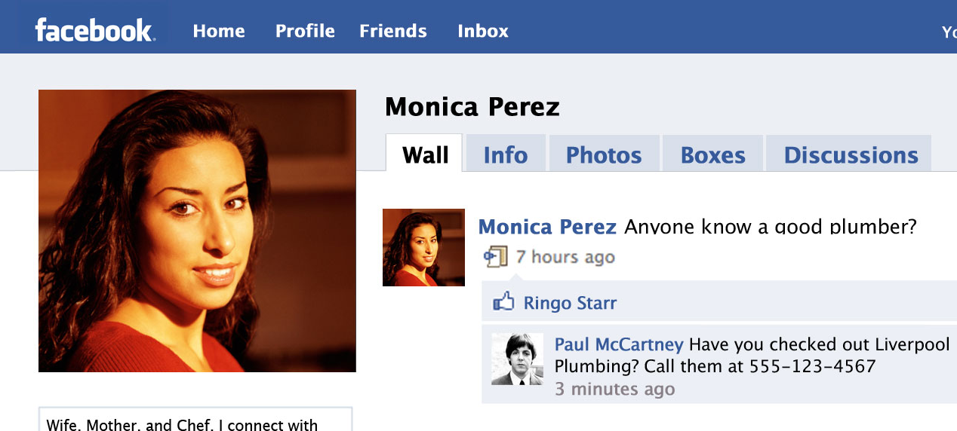
Social Media Presence
“What was that plumber you used?”
THIS
Has Become THIS
Does this sound like you?
“I just don’t have the time to manage all of this.”
“I have a limited budget and think I can do this myself, I just need help.”
“I have tried Twitter and Facebook, but didn’t see the results. I must be doing something wrong”
Social Media Presence
We get you on the social web.
We claim your Twitter, Foursquare, and Facebook accounts. Brand each channel to the business with needed business info and include a custom landing page on your Facebook Fan Page. We will learn as much about your business as we can. Specifically about your culture, product, and uniqueness. We will build content for your review each month and broadcast these details of the business.
We also promote coupons and deals that are pre-approved on all channels.
Full Voice - $495/mo. (12mo. w/ 6mo. Review)

Slide 14
Marketing Campaign:
Product 1 | $Price 1
Product 2 | $Price 2
Product 3 | $Price 3
Subtotal
Package Discount (You Save)
Monthly Total
Recommended Monthly Strategy Dominant: $X,XXX
Term: 6 Months

