Slide 1
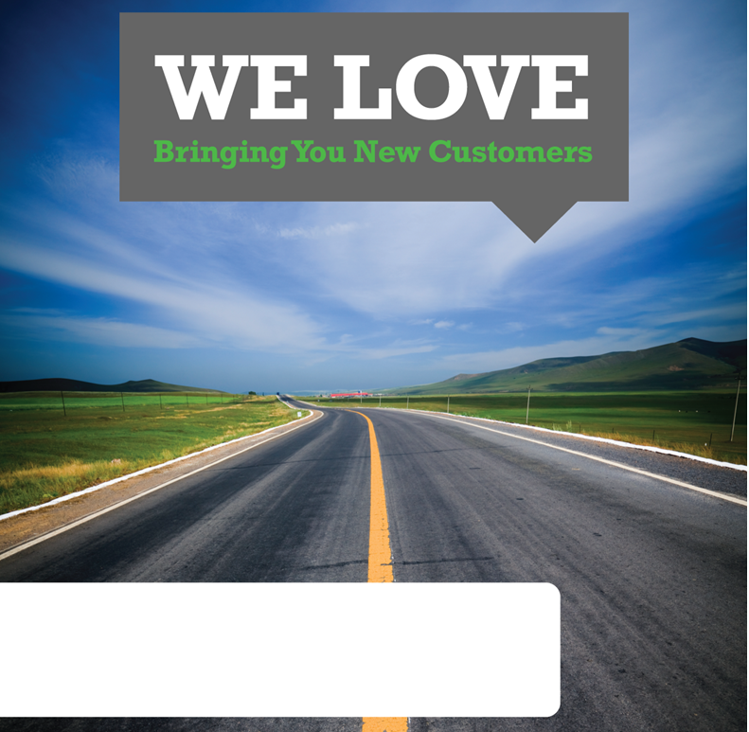
[COMPANY NAME, CONTACT NAME]
Sales Rep Name, Today’s Date (602) 444-1700, Sales.RepName@gannett.com

Slide 2
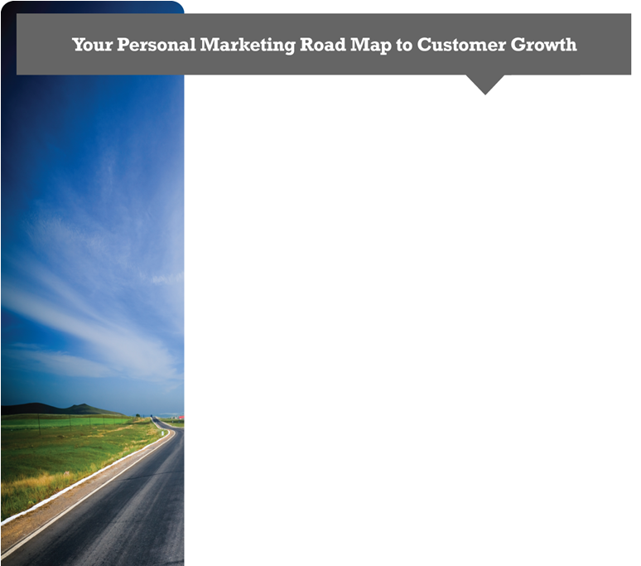
The Benefits of Online Marketing
The importance of online marketing for modern businesses can’t be overstated. More people than ever are turning to online searches for the products and services they need, with studies showing that up to 70% of potential customers search online for a solution without ever checking traditional sources such as the Yellowpages, and 90% of these users never make it past the first page. Search Engine Optimization, Google Maps Optimization, Social Media Marketing, Print Ads, and Pay-Per-Click (PPC) are the best methods to reach these potential customers and will prove invaluable to your business.
Online Marketing Goals
Increase number of conversions/sales
Increase volume of visitors/clicks
Decrease cost per acquisition (CPA)
Attract relevant and targeted leads
Increase your Brand Awareness and online presence
Establish a local presence on Google Places
Improve Social Media Management and Customer Interaction
Google Map Optimization
We leverage our Gannett-owned websites (azcentral.com, usatoday.com, cars.com, careerbuilder.com, et al) and optimize your Google Profile Page- so you show up on the first page of Google’s Local Search Results. Unlike PPC, this area takes some time to develop and optimize. You should expect to see your firm’s listing to show up on the first page within a couple months. We will focus on keyword search term groups (example: Living Trusts, Wills, Estate Planning, etc.) with a 5 city focus (example: Phoenix, Scottsdale, Mesa, Gilbert, Chandler)
Search Engine Optimization and Pay-Per-Click (SEO & PPC)
With our integrated SEM (Search Engine Marketing) & PPC platform, we will manage your sponsored/paid search keyword listings on Google, Yahoo, MSN, Facebook and Ask.
Email Blasts
We deliver your message to interested potential clients who are seeking your services or product. We’ll recommend the best opt-in email lists for your best prospects, and guide you towards the best creative process.
Print Media Delivery
The community sections of top newspapers, like The Arizona Republic, are among the most popular places people go for local news and to see ads from businesses like yours. We’ll get your ad in front of thousands of new customers in your area

Slide 3

Marketing Campaign:
Product 1 | $Price 1
Product 2 | $Price 2
Product 3 | $Price 3
Subtotal
Package Discount (You Save)
Monthly Total

