Slide 1

[GannettLocal, Under $750 Proposal Preparation]
Ryburn Ross, 5/11/2011 (602) 444-1753, Ryburn.Ross@gannett.com

Slide 2
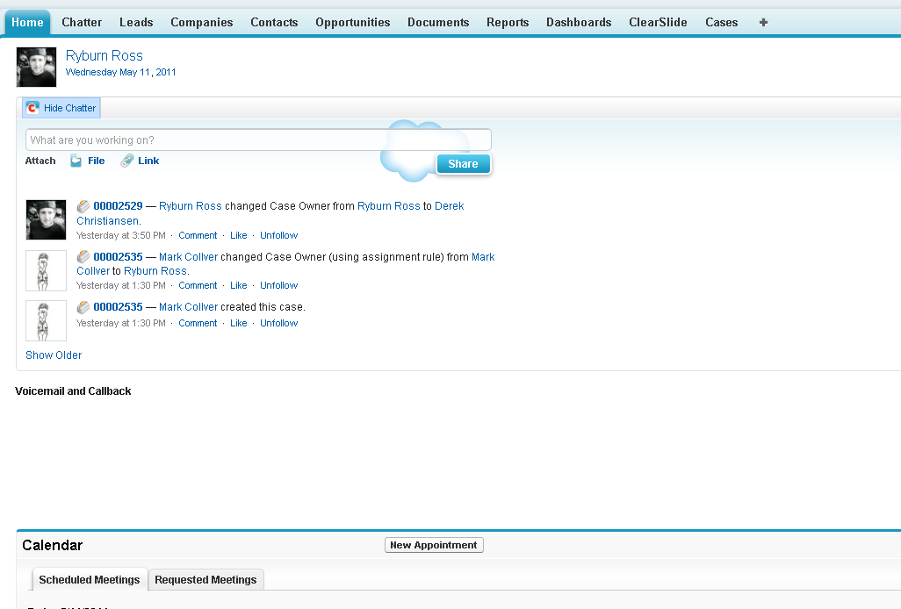

Slide 3
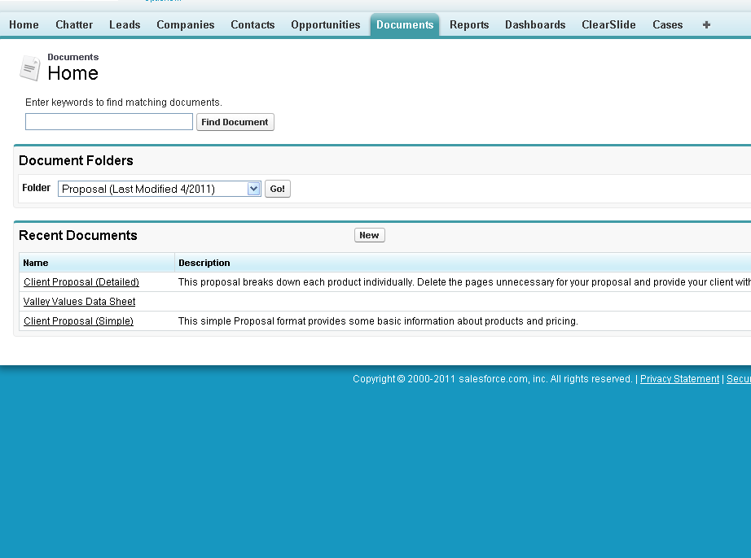

Slide 4
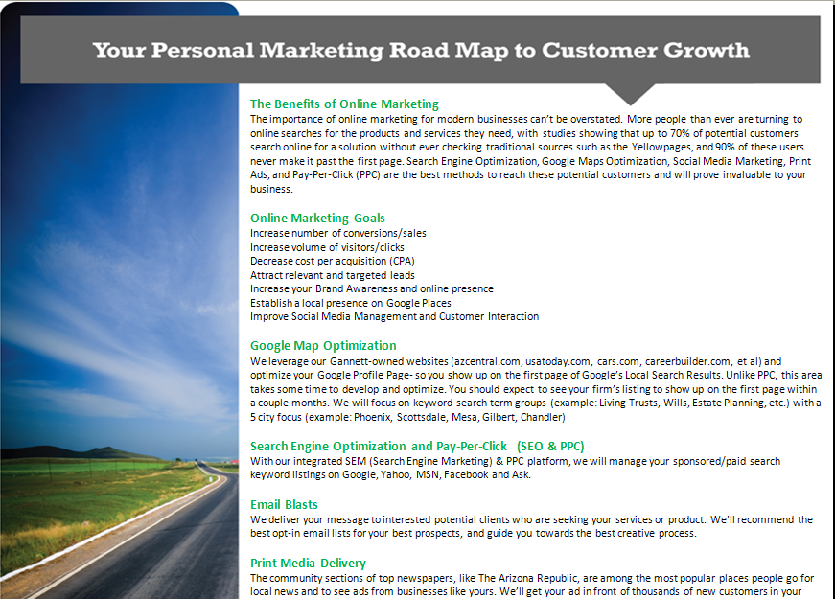
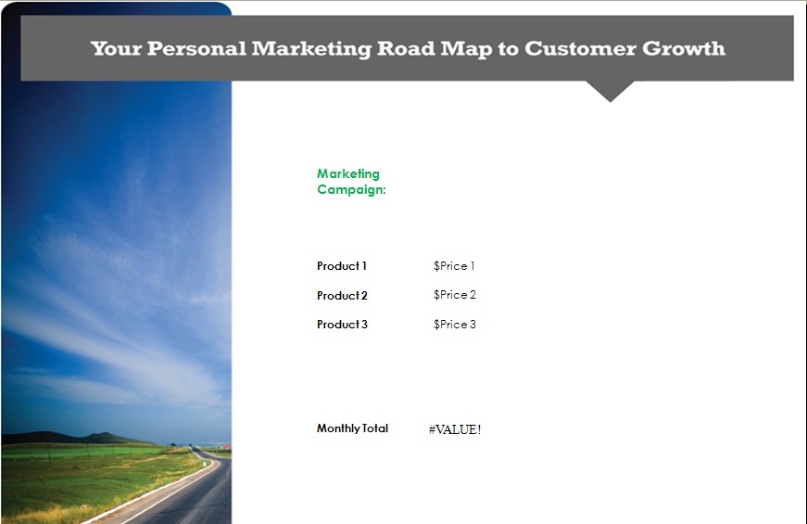
Client Proposal (Simple)
Simple Process: Simply Delete out the Products you aren’t pitching or add in ones you are.
Text Only

Slide 5
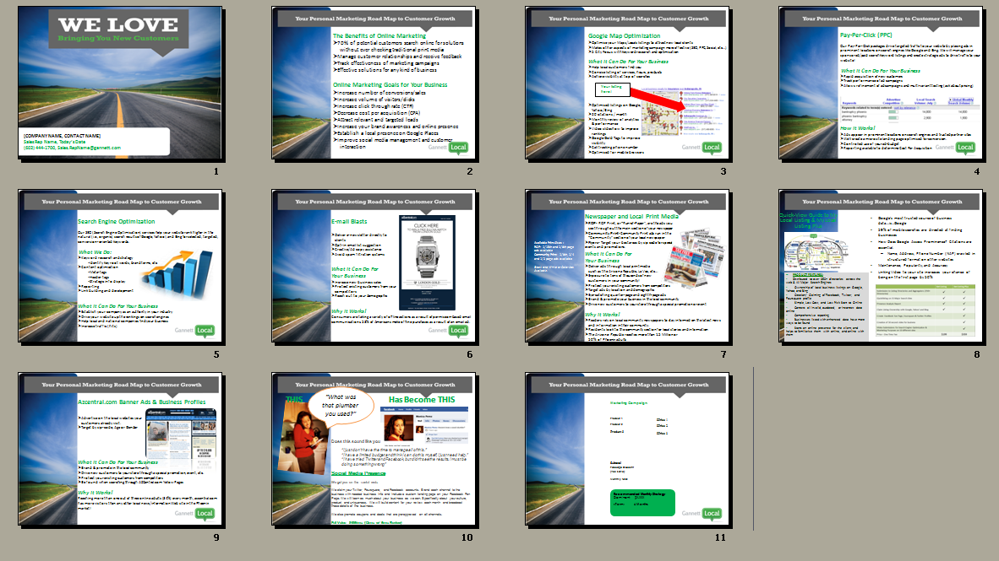
Client Proposal (Detailed)
Provides one slide for each product offering from Gannett
Simply go through and delete product slides that you will not be pitching the client
Slides incorporated in Proposal Template:
Benefits and Goals Maps Optimization Pay Per Click
Email Blasts Newspaper/Print Media Search Engine Optimization
My Local Listing AZCentral Banner Ads Pricing/Quote
Social Marketing

Slide 6

Let’s Work an Example:
Phil the Painter
Has an existing website
attractive, good conversion system, not ranking for keywords
No local presence
Has been managing his own PPC campaign with
disappointing results
Primary Business comes from two sources:
External painting for independent homeowners
Internal painting for construction companies
After talking with the Client, you find out his budget is $700/mo, and his primary concerns are ranking better for homeowners to find his business, and acquiring more contracts with construction contractors (B2B).

Slide 7

Direct Mail
Social
My Local Listing
PPC
Email Blasts
What Should We Pitch to this Client?
SEO
AZCentral Banner Ads
Maps+
Newspaper and Print Media

Slide 8
One Possible Package Offering:
Search Engine Optimization
$445/mo for 5 pages, 5 keywords per page, optimize for homeowners searching for painting contractors
-Meets the client’s need to rank higher, solving one of his pains
Pay-Per-Click Advertising
$250/mo Ad-spend budget to be used on LinkedIn to market his B2B services to home construction contractors
-Meets the client’s need to gain exposure with construction companies by targeting decision makers, solves his “pain” of having a disappointing self-run PPC campaign.
My Local Listing(Plus)
Directory Submission & Local/Social Profile creation service
-For Local companies and service providers, an effective local presence can be essential to new client acquisition and establishing a local presence. This product meets a need the customer may not even know he has.

Slide 9
Step 1: Eliminate Product Slides not being presented:
X
X
X
X
X

Slide 10
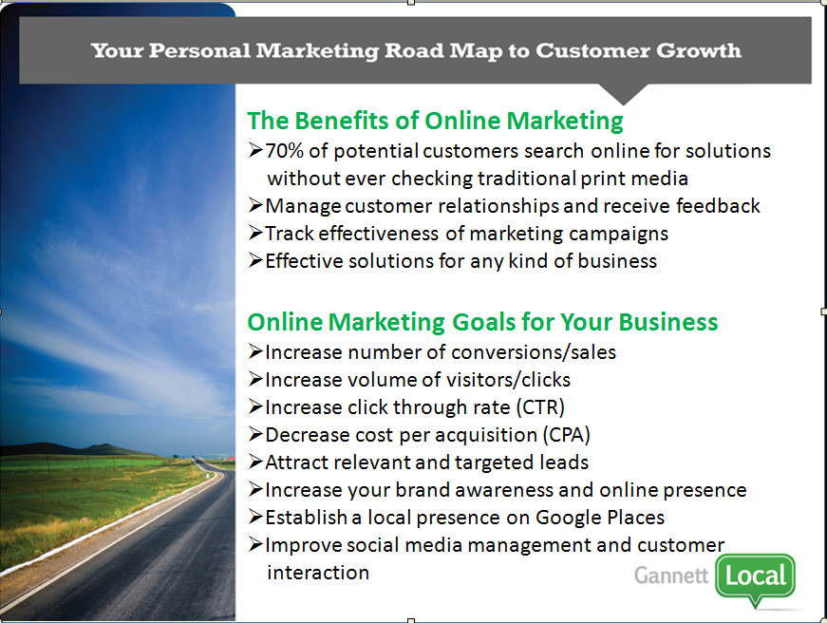
Step 2: Personalize Slides
Enter correct client & salesperson info on the cover slide
Modify “Benefits/Goals” Slide (P2)- generally just remove talking points but you may want to add in content as well if you believe it will improve your pitch
or more effectively resolve your customer’s pains

Slide 11
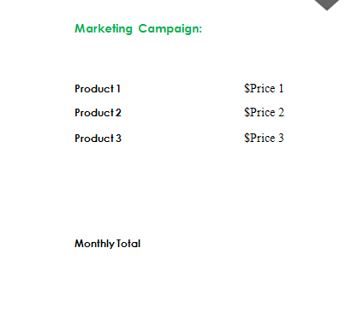
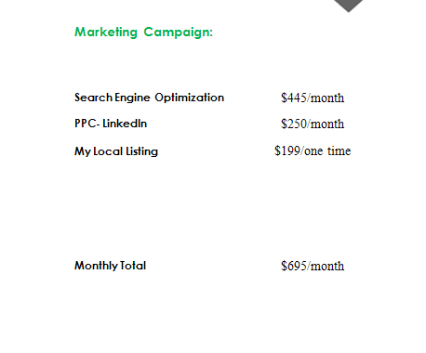
Step 3: Complete pricing to finish proposal
Enter the quote pricing on the final slide of the proposal
You will need to calculate the “monthly total”
Take care to educate the customer on one-time upfront costs, if applicable (My local listing, in this example)

