Slide 1

Q:
How can a small, local business effectively reach new customers online?

Slide 2
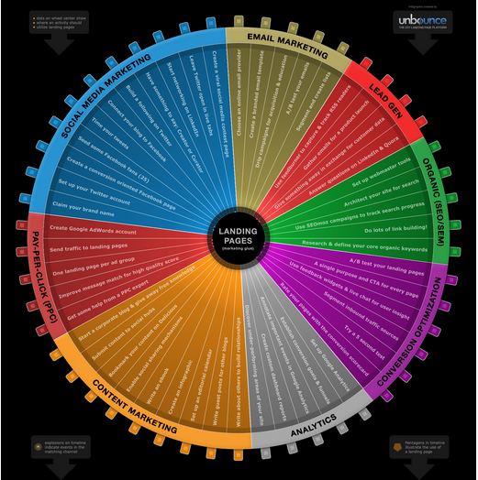
Increase the Company’s digital presence with a comprehensive & well executed online strategy
A:

Slide 3




Pay Per Click
Search Engine Marketing

Slide 4
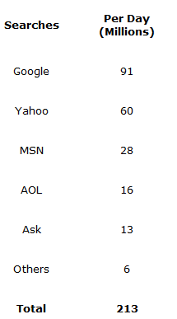

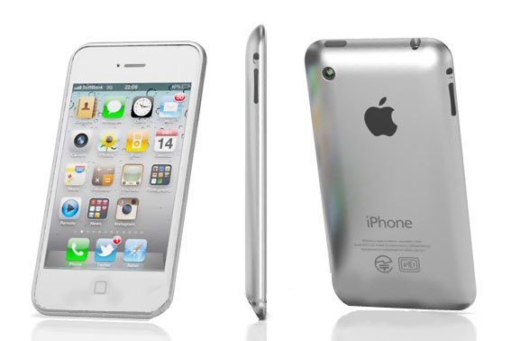
“20% of search is location related”
-Google
Figures taken from a 2006 ComStat report
“53% of Mobile searches have local intent”
-Microsoft

Slide 5
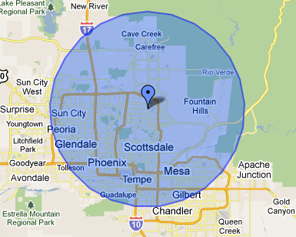
Text ads displayed on the Google search engine for relative search queries.
E.x.: A Pizzeria in Phoenix, Arizona would want to target searches for “phoenix pizza restaurant”.
The positioning of the Ads is determined by a bidding system & the overall Quality Score of the ad.
We can target:
Searcher’s Intent
Geographic location of searcher
Time of day when to show the ads

Slide 6
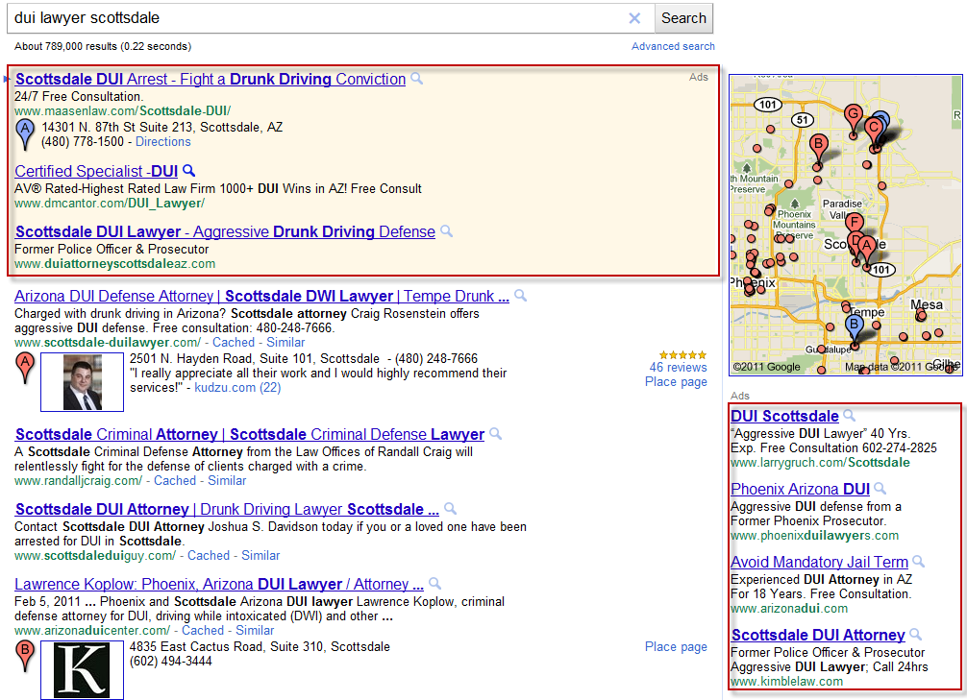
Search Engine Results Page
SERP:

Slide 7
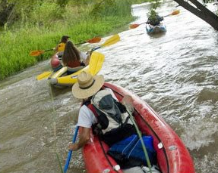
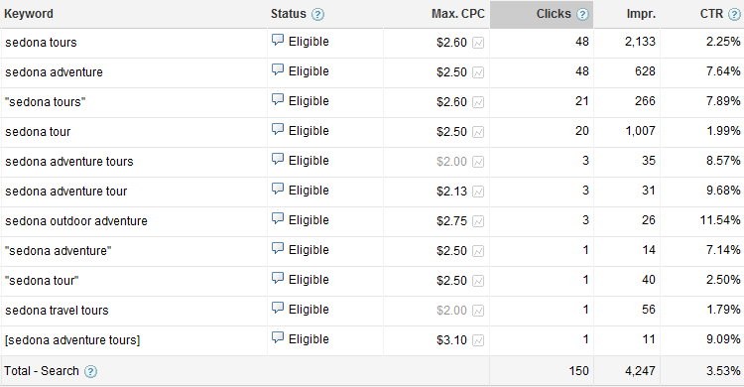


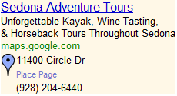

Case Study:
Sedona Adventure Tours
The types of searches we are targeting for
The keywords we are actively bidding upon to reach these searches
The ad text intended to peak the users interest and click through the ad

Slide 8

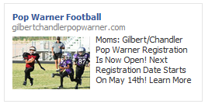
Facebook Advertising
Display Ads (Images & Copy) with can be segmented by:
Age
Geography
Sex
Relationship Status
Partner Preference
Interests
Associated Groups
The ads run on either a CPM or CPC model.
CPM: Cost Per 1,000 impressions or 1,000 social users who had the potential to see your ads
Good strategy for branding or image
CPC (Cost Per Click): The highest bid you are willing to pay for a social user to click on your ad. This is typically the best strategy to increase volume of traffic, conversions, or to prompt social interaction.

Slide 9
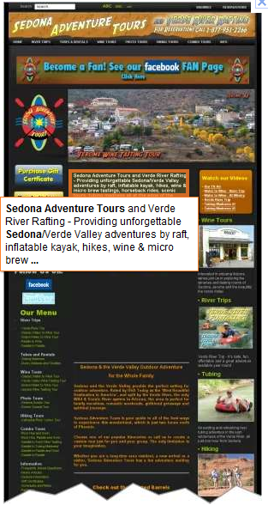
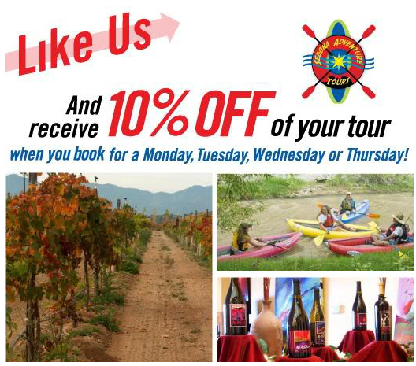
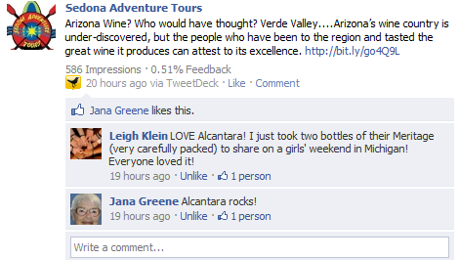
Case Study: Sedona Adventure Tours
Goals for campaigns can vary….
2. Try to spark social interaction & conversation on the FB wall
3. Encourage a conversion on the FB page. Ex.: A “Like”, Filling out a forms for contests or registrations, or a coupon.
1. Visits to a microsite or website for a conversion

Slide 10


Advertising
Low volume of click overall, but very high refined and high quality clicks.
You can target by:
Geography
Company
Job Title
Industry Groups
Gender
Age
Great for Job Recruitment, Hard to reach B2B Industries, referral programs, & the top decision makers of companies.

Slide 11
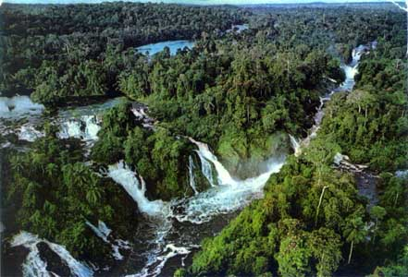
Client Retention & Satisfaction
The campaigns that find the most success are for clients with extensive digital packages.
Think of the digital world as an ecosystem; PPC both compliments and is assisted by other marketing vehicles.

Slide 12

Case Study: Sedona Adventure Tours All Encompassing Campaign
Through the leverage of a full social media package, Google Adwords & FB PPC, & SEO Sedona Adventures was able to field over 300 calls in April.

