Slide 1
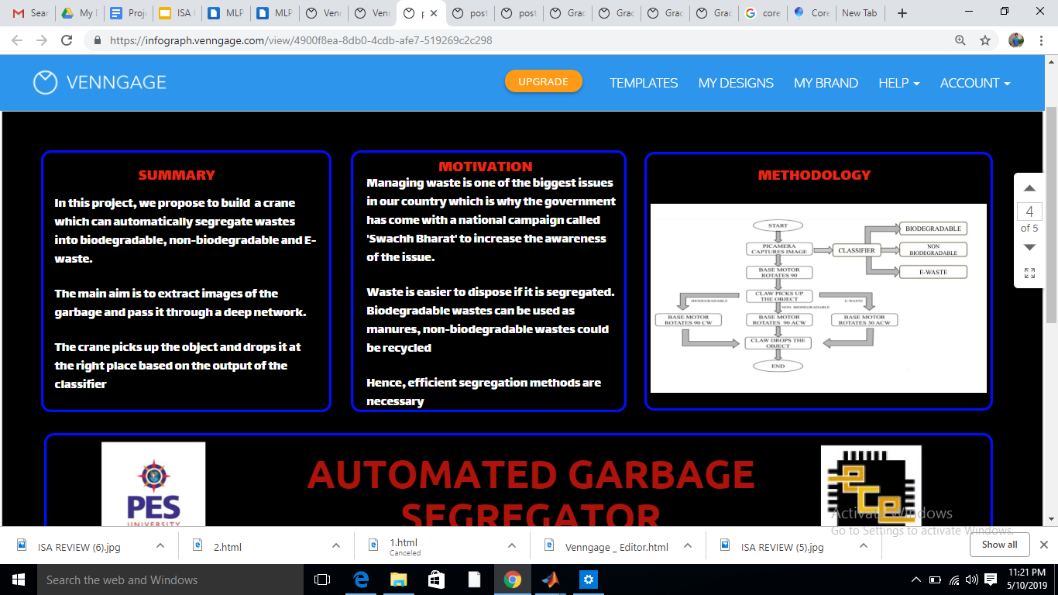

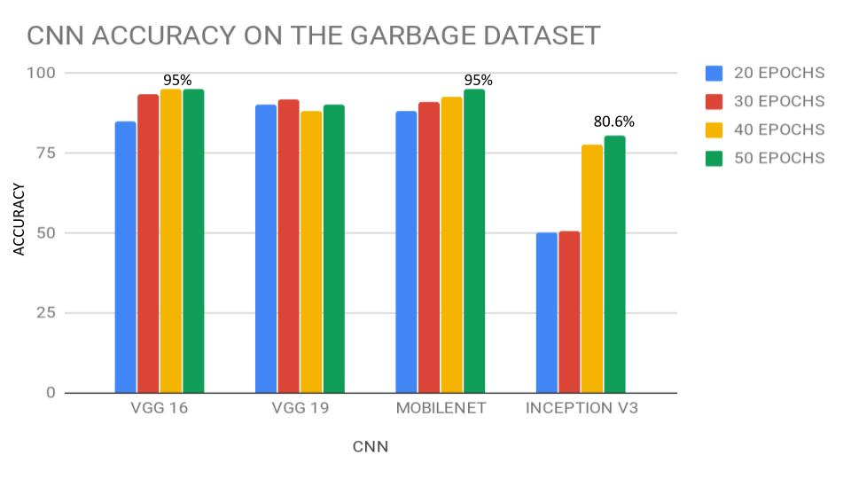
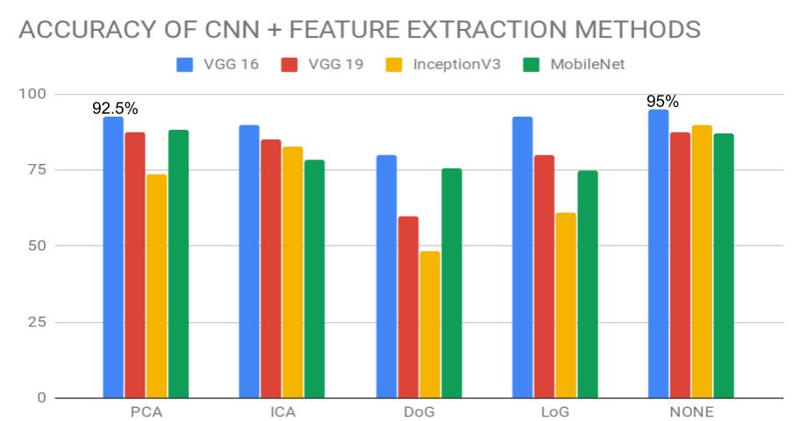
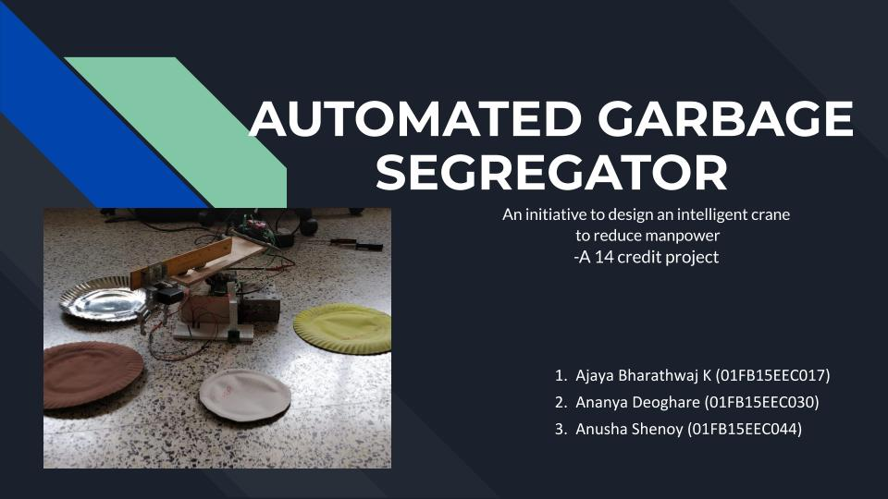
SUMMARY
MOTIVATION
THEORY AND METHODOLOGY
In this project, we propose to build a crane which can automatically segregate wastes into biodegradable, non-biodegradable and E-waste.
The main aim is to extract images of the garbage and pass it through a deep network.
The crane picks up the object and drops it at the right place based on the output of the classifier
Managing waste is one of the biggest issues in our country which is why the government has come with a national campaign called 'Swachh Bharat' to increase the awareness of the issue.
Waste is easier to dispose if it is segregated. Biodegradable wastes can be used as manures, non-biodegradable wastes could be recycled
Hence, efficient segregation methods are necessary
CNN is used as a classifier because its deep and has large number of layers making it "highly accurate"
CNN pre-trained on imagenet were used using "transfer learning"
AUTOMATED GARBAGE
SEGREGATOR
RESULTS
CONCLUSION
AUTHORS
1) CNNs perform best without any feature extraction methods
2) Among the CNNs, VGG16 out performs the others
3) VGG16 performs the best on the garbage dataset
1) Ajaya Bharathwaj K
(01FB15EEC017)
2) Ananya Deoghare
(01FB15EEC030)
3) Anusha Shenoy
(01FB15EEC044)
Under the guidance of
Dr Koshy George
Professor, Department of ECE
PES UNIVERSITY
BEST ACCURACY = 95%
BEST ACCURACY = 95%

