Slide 1
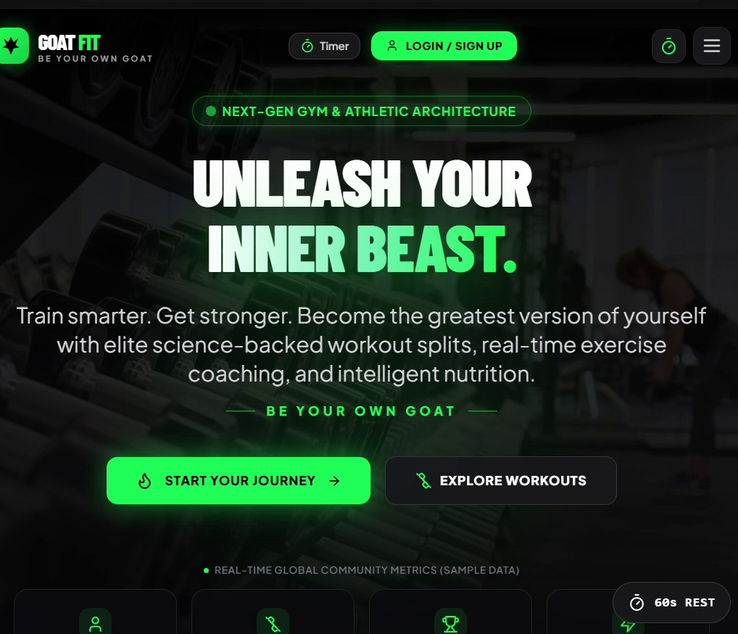
NEXT-GEN GYM & ATHLETIC ARCHITECTURE
GOAT FIT
Be Your Own GOAT
A science-backed fitness web app that combines elite workout splits, real-time exercise coaching and intelligent nutrition tracking in one place.
Product walkthrough | October 2026
Notes:
Introduce GOAT FIT: a web-based fitness platform for beginners and experienced lifters.

Slide 2
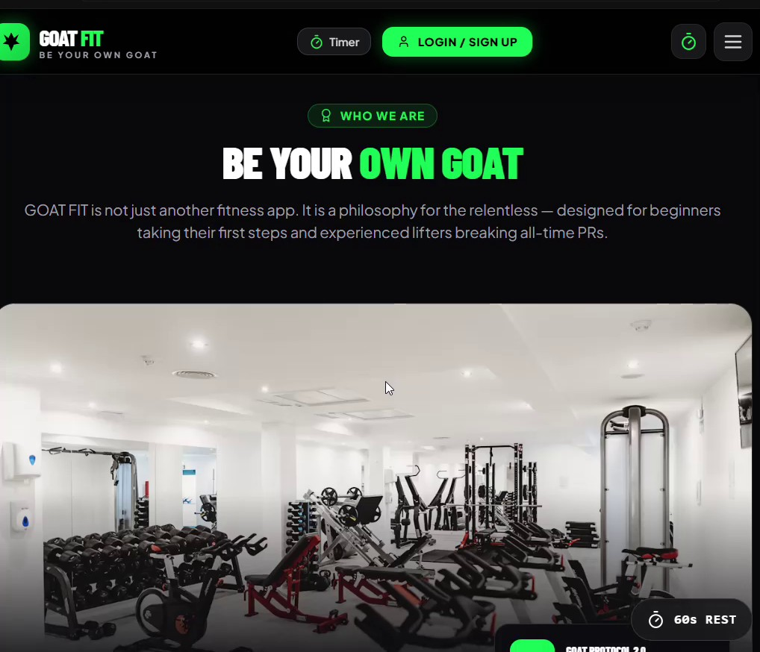
Who We Are
GOAT FIT is positioned as a philosophy for the relentless, not just another fitness app
Built for beginners taking their first steps and experienced lifters chasing all-time PRs
Core promise: train with purpose, eat with conviction and track with precision
Brand tagline "Be Your Own GOAT" puts ownership of results in the athlete's hands
Dark, high-contrast neon-green interface keeps focus on the workout, even in a dim gym
Community-driven: sample real-time global metrics show athletes, workouts and milestones
Notes:
Philosophy-first positioning: not just another fitness app.

Slide 3
Platform Features at a Glance
Workout Programs
Exercise Library
TDEE & Macro Calculator
Science-structured splits for hypertrophy, strength and longevity, filterable by muscle group and difficulty.
Barbell bench, deadlift, squat guides plus a Common Form Mistakes section on every exercise.
Turns body stats and goals into daily calories and a protein, carb and fat split.
Hydration Tracker
Weekly Split Planner
60s Rest Timer
Tap-to-log glasses toward a 2000 ml daily goal, saved in the browser and reset at midnight.
Plan Push, Pull and Legs days, mark sessions done and watch weekly adherence.
A floating rest timer is always one tap away, so rest periods stay consistent.
Notes:
Six pillars of the product.

Slide 4
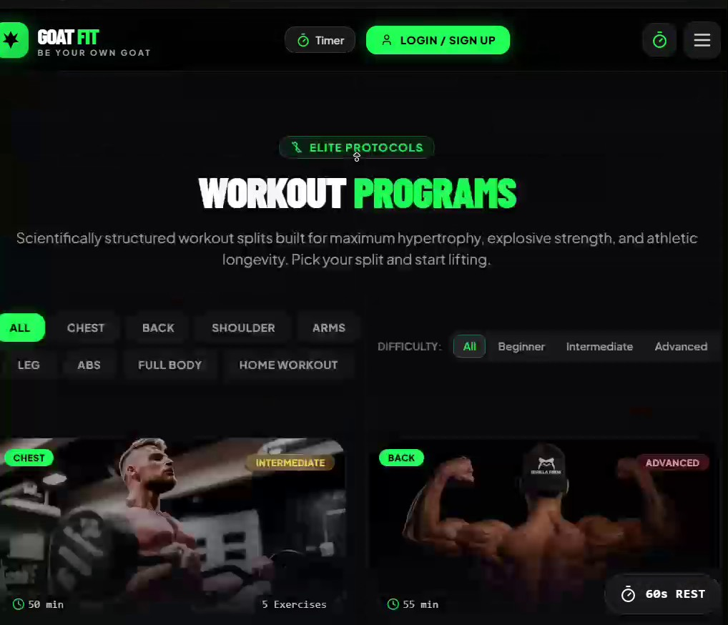
Workout Programs
Scientifically structured splits built for maximum hypertrophy, explosive strength and athletic longevity
Filter tabs: All, Chest, Back, Shoulder, Arms, Legs, Abs, Full Body and Home Workout
Difficulty selector: Beginner, Intermediate and Advanced
Each card shows a muscle-group tag, a level badge, session length (about 50 to 55 min) and exercise count
Photo-led cards make it quick to scan and pick the right session
Home Workout option keeps training possible without a full gym
Notes:
Filters and program cards.

Slide 5
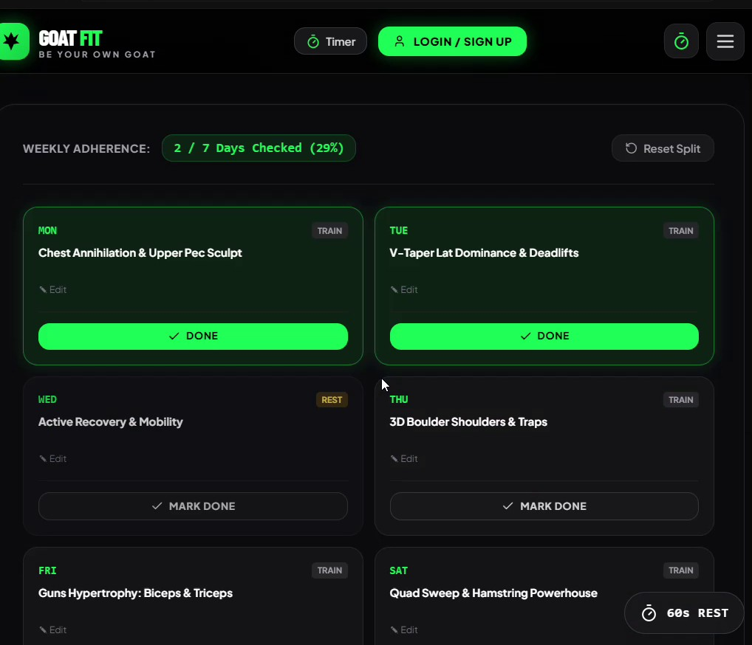
Weekly Split Planner
Weekly adherence bar counts completed days (for example 2 of 7, 29%) with a one-tap reset
Mon: Chest Annihilation & Upper Pec Sculpt
Tue: V-Taper Lat Dominance & Deadlifts
Wed: Active Recovery & Mobility (rest day)
Thu: 3D Boulder Shoulders & Traps
Fri: Guns Hypertrophy (Biceps & Triceps); Sat: Quad Sweep & Hamstring Powerhouse
Every day has an Edit option and a Done / Mark Done button
Notes:
Adherence tracker with sample split.

Slide 6
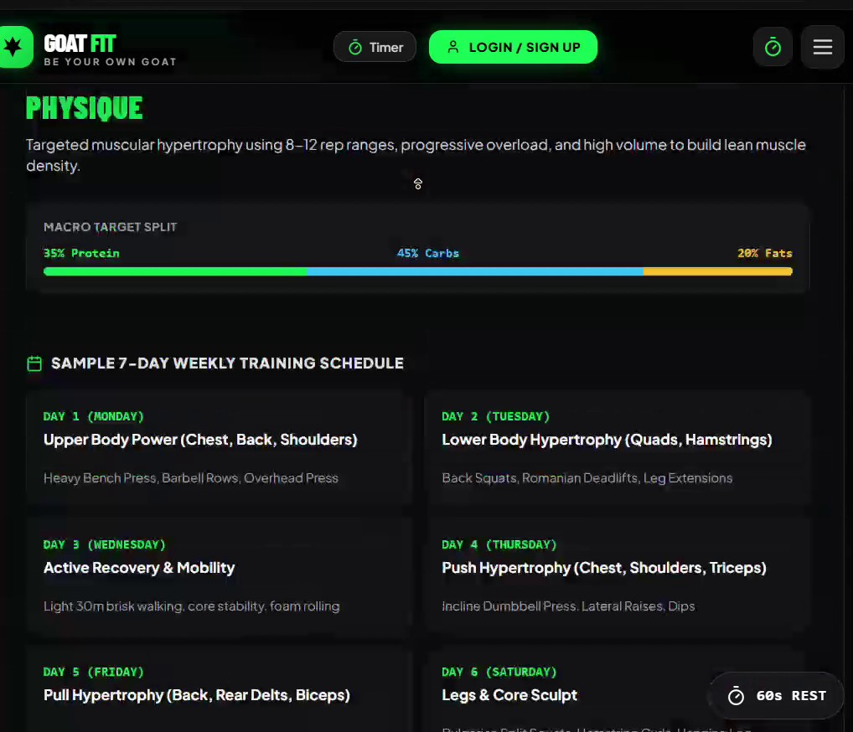
Training Schedule & Macro Targets
Physique plan: 8 to 12 rep ranges, progressive overload and high volume to build lean muscle density
Macro target split: 35% protein, 45% carbs, 20% fats
Day 1 Upper Body Power; Day 2 Lower Body Hypertrophy
Day 3 Active Recovery & Mobility (light walk, foam rolling)
Day 4 Push Hypertrophy; Day 5 Pull Hypertrophy; Day 6 Legs & Core Sculpt
Each day lists the key lifts, so there is no guesswork in the gym
Notes:
Sample 7-day schedule and macro split.

Slide 7
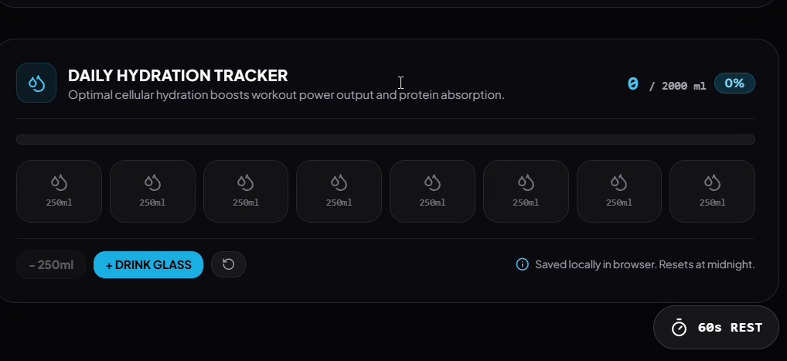
Nutrition & Hydration
Calculator outputs daily calories plus protein, carbs and fats in grams
Smart recommendation: spread protein evenly across 3 to 4 meals to keep muscle protein synthesis elevated
Hydration tracker: 8 tap-able glasses of 250 ml toward a 2000 ml goal with a live percentage
Why it matters: good hydration supports workout output and protein absorption
Data is stored locally in the browser and resets at midnight, so nothing to sign up for
Hydration tracker screen
Notes:
TDEE calculator and hydration tracker.

Slide 8
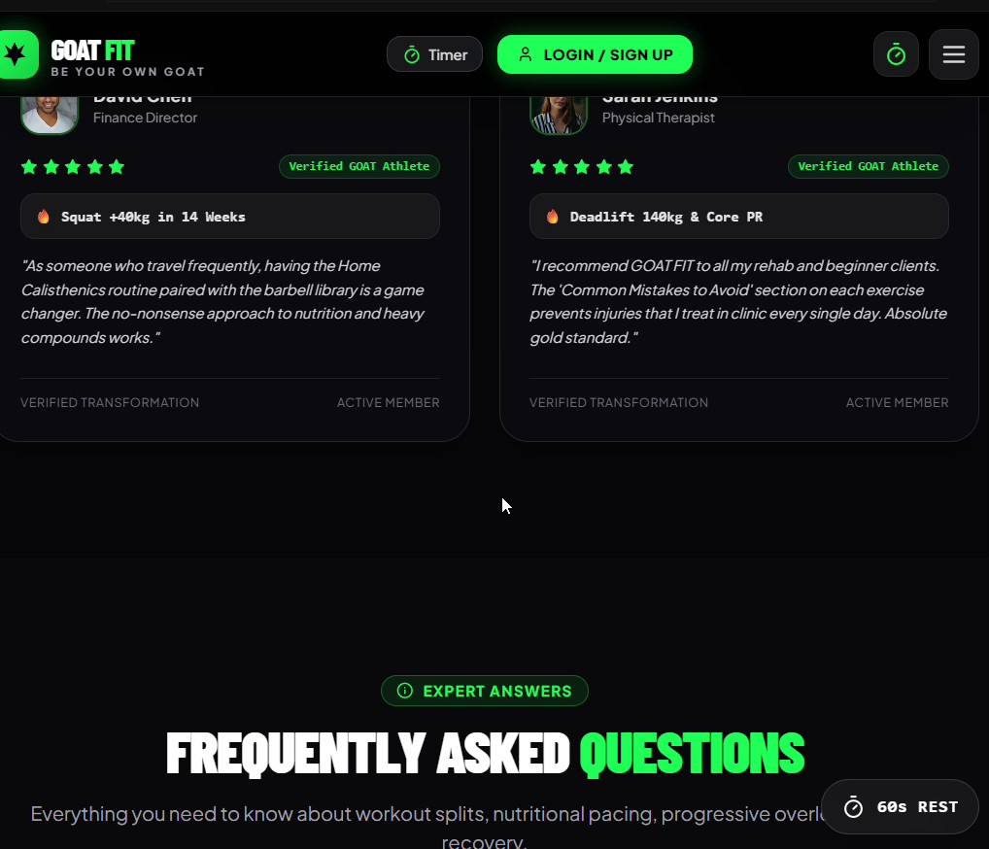
Community & Social Proof
David Chen, Finance Director
Verified GOAT athlete. Squat up 40 kg in 14 weeks; says the barbell library and no-nonsense nutrition plan work for a busy travel schedule.
Sarah Jenkins, Physical Therapist
Deadlift 140 kg and a core PR. Recommends it to rehab clients and beginners because the Common Mistakes section prevents injuries.
An Expert Answers FAQ covers workout splits, nutritional pacing and progressive overload.
Notes:
Testimonials and FAQ.

Slide 9
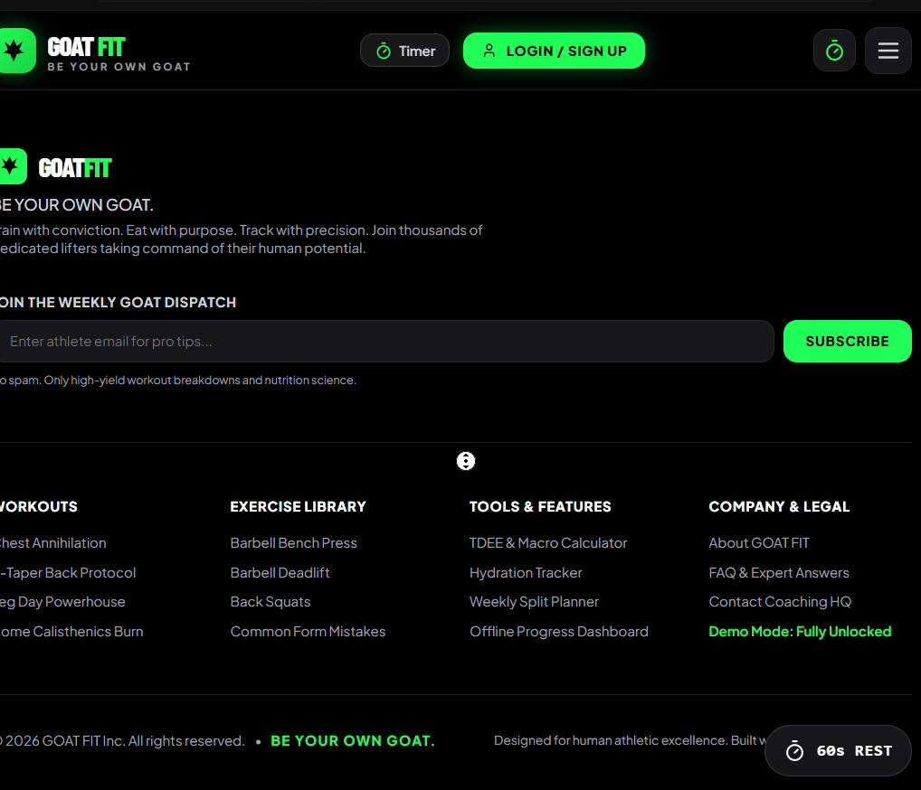
Platform Structure & Resources
Workouts: chest, back, leg-day and home calisthenics programs
Exercise Library: bench press, deadlift, squats and form mistakes
Tools & Features: TDEE & macro calculator, hydration tracker, weekly split planner, offline progress dashboard
Company & Legal: About, FAQ & expert answers, Contact Coaching HQ, Demo Mode (fully unlocked)
Weekly GOAT Dispatch: free newsletter with high-yield workout breakdowns and nutrition science, no spam
Notes:
Footer navigation and newsletter.

Slide 10
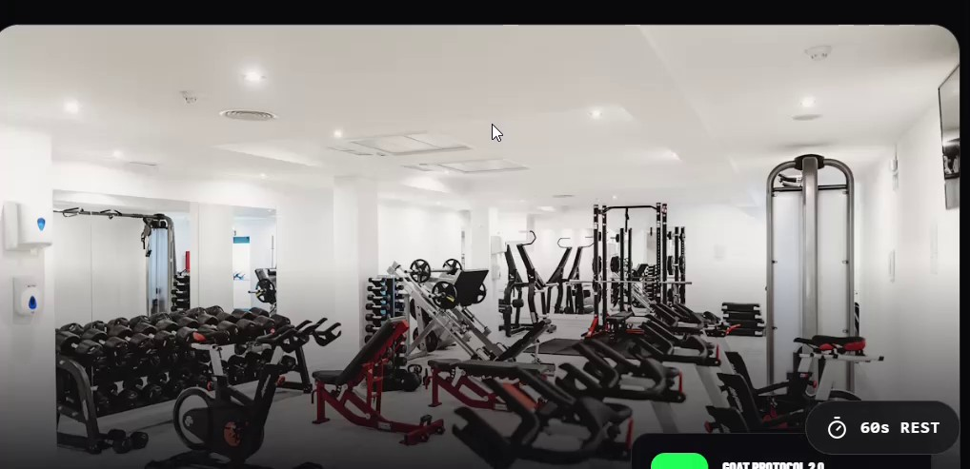
Why GOAT FIT & Next Steps
All-in-one: programs, planner, nutrition and hydration in a single fast web app
Science-backed: progressive overload, rep ranges and macro targets built in
Beginner to advanced: filters and difficulty levels fit every athlete
Next steps: add progress charts, sync across devices and expand the exercise library
START YOUR JOURNEY >
Notes:
Close with the call to action.

