Slide 1


Parking Management Project: HTML Implementation
This presentation outlines the development of a parking management project implemented using HTML. The project focuses on creating a system for vehicle registration and information retrieval based on license plate numbers. The scope covers the front-end HTML structure for the user interface, aiming to create a functional parking management system. This presentation will guide you through the project architecture, form design, JavaScript integration, and code examples.
by Varad Fegade

Slide 2
Project Architecture & Data Structure
HTML Forms
Local Storage
Data Fields
HTML forms are used for vehicle registration, including fields for license plate, vehicle type, and owner details. These forms provide the user interface for entering vehicle information.
Local Storage is used for temporary storage of vehicle data, primarily for demonstration purposes. This eliminates the need for a back-end database in the basic version.
Key data fields include licensePlate (string, unique), vehicleType (string), ownerName (string), and contactNumber (string). These fields ensure comprehensive vehicle data capture.

Slide 3
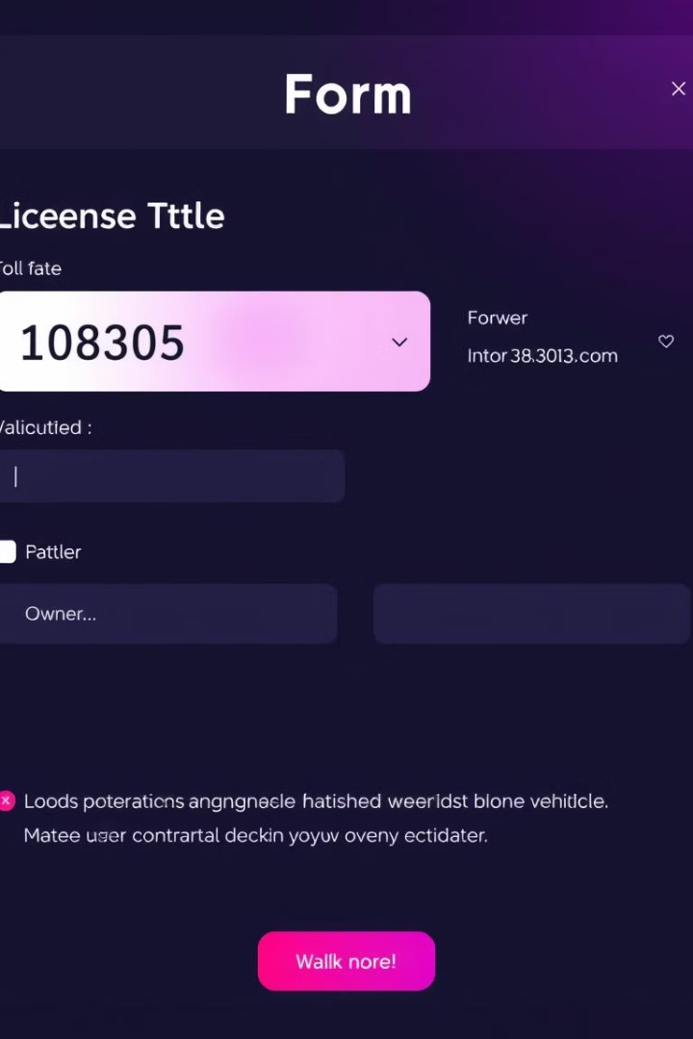
HTML Form Design & Elements
1
Input Fields
Various input fields such as , , and are used to capture vehicle details effectively. These elements provide a structured way for users to enter data. Form Validation HTML5 attributes like required and pattern are implemented for form validation, ensuring data integrity. These attributes help in validating user inputs before submission. Example An example of input validation is: . This ensures the license plate adheres to a specific format.

Slide 4
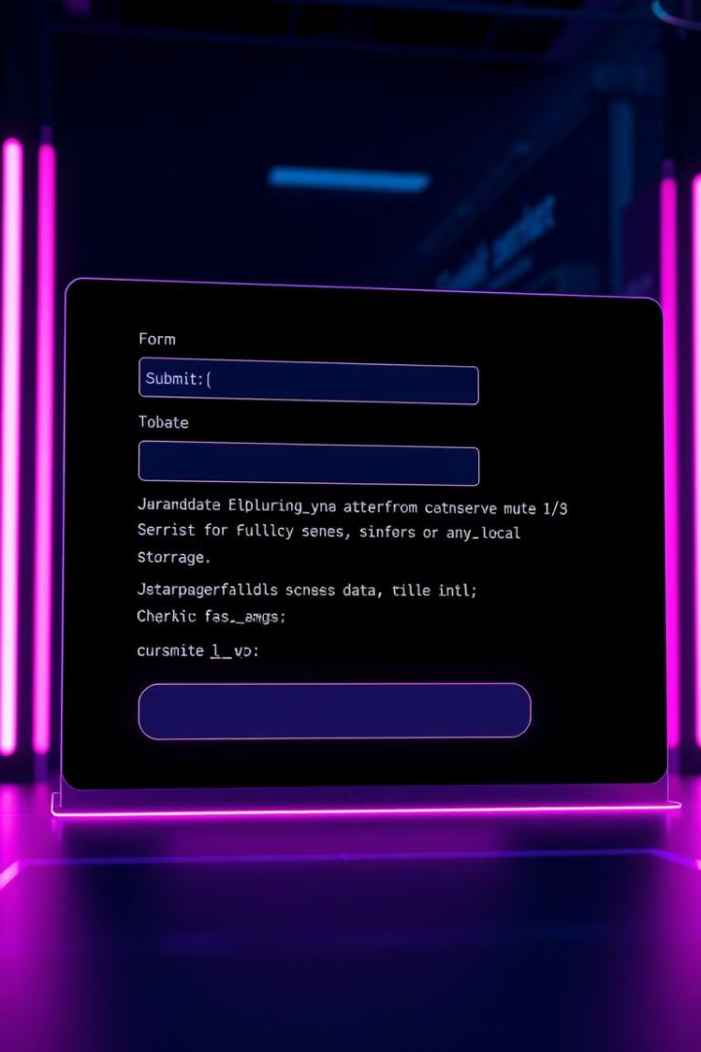



Vehicle Registration: HTML & JavaScript
Capture Data
Access Elements
Store Data
JavaScript functions are used to capture form data efficiently, ensuring all required fields are collected for registration.
document.getElementById() is used to access form elements, allowing easy manipulation and validation of data fields.
localStorage.setItem() stores vehicle data (e.g., localStorage.setItem('LP123', JSON.stringify(vehicleData));), providing temporary storage.

Slide 5

Searching Vehicle Information: HTML & JavaScript
1
Input Field
An input field <input type="text" id="searchLicensePlate"> is created for license plate search. This allows users to enter the license plate number they wish to find.
2
Retrieve Data
A JavaScript function retrieves vehicle data from localStorage, enabling quick access to stored information. localStorage.getItem() is used to fetch vehicle data.
3
Display Information
Vehicle information is displayed in a designated HTML element (e.g., <div> or <table>), providing a clear presentation of the retrieved data.

Slide 6
Code Example: HTML Structure
Basic Structure
Form Element
The basic HTML structure includes <form>, <input>, and <button> elements. These are essential components for the parking management system.
<form id="vehicleForm"> <label for="licensePlate">License Plate:</label> <input type="text" id="licensePlate" name="licensePlate" required pattern="[A-Z0-9]{3,8}" title="License plate must be 3-8 characters, alphanumeric"><br><br> <label for="vehicleType">Vehicle Type:</label> <select id="vehicleType" name="vehicleType"> <option value="car">Car</option> <option value="motorcycle">Motorcycle</option> <option value="truck">Truck</option> </select><br><br> <label for="ownerName">Owner Name:</label> <input type="text" id="ownerName" name="ownerName" required><br><br> <button type="submit">Register Vehicle</button> </form>

Slide 7

Key Takeaways & Next Steps
HTML Foundation
JavaScript Integration
The parking management project leverages HTML for its user interface, providing a basic yet functional system. This foundation is crucial for further development.
JavaScript enhances the system by handling form data and interacting with local storage, enabling dynamic functionality.
Scalability
Future steps include integrating a back-end database, implementing advanced search features, and improving user interface responsiveness for a more robust system.

