Slide 1
DEEP LEARNING MINI PROJECT · 23I006
Field-Robust Paddy and Crop Disease Recognition with Lightweight Vision Transformers for Edge Deployment
Team 13
Chandru K (23I315) · Soma Prasanth R (23I362)
Sriram R (23I365) · Varadharaj R (23I369)
Department of Information Technology, PSG College of Technology
Notes:
Introduce the team and the one-line story: we distil a lightweight transformer into MobileNetV3 for field images, and we measure honestly where that helps and where it does not. Our headline: it helps on PlantDoc, but no model survives a change of rice variety.

Slide 2
Models that work in the lab fail in the field
35%
of India's annual crop yield is lost to plant diseases, and lab-trained models cannot classify real-scenario images [1].
4.2 M
parameters in MobileNetV3-Large, small enough for a phone [4], [5], but a small CNN loses accuracy on hard field images.
6.6×
more operations for MobileViT-S than for MobileNetV3-Large, and about 3–4× slower on CPU (own measurements).
Notes:
Motivation. Viva: why edge deployment? Farmers use phones in the field with poor connectivity. The 6.6x and 3-4x numbers are ours: 1.416 vs 0.215 GMACs, and CPU latency 82-91 ms vs 20-29 ms on a shared Colab CPU (noisy, not on-device).

Slide 3
Two research questions
RQ1
How much of a lightweight ViT's accuracy on field images can a MobileNetV3 student recover through distillation under field-style distortion?
RQ2
Does the recovered accuracy survive a change of rice variety?
No new distillation loss is claimed. A standard one is adapted to field images, and where it helps and where it does not is measured.
Notes:
Gap: distillation into small students is established (refs 12-16, including AgriKD and a 2026 preprint), and lab-to-field studies exist (10, 11), but few works test whether a distilled student survives a change of variety within one crop. Be explicit that the contribution is a controlled measurement, not a new loss. Viva: what is novel? The asymmetric clean-teacher / distorted-student setup, the variety-shift protocol and the honest negative result.

Slide 4
Two field datasets
Paddy Doctor subset [14]
PlantDoc (cropped) [1]
10,407 images 10 classes
2,576 images 27 classes
Smartphone photos from paddy fields near Tirunelveli, Tamil Nadu, 480×640. Each image has a rice variety and crop age.
Non-lab images of 13 species. Official test folder untouched; 15% of train becomes validation.
Train / val / test: 7,457 / 1,506 / 1,444
Train / val / test: 1,989 / 351 / 236
The full 16,225-image Paddy Doctor release needs an IEEE DataPort subscription, so the public 10,407-image Kaggle subset of the same collection is used.
Notes:
Be upfront about the deviation: Paddy Doctor subset, not the full release. PlantDoc test has only 236 images so its margin of error is about +/-6 points. PlantDoc and Paddy share no classes, so a direct cross-dataset test is impossible; the variety shift is our substitute.

Slide 5
Splits that keep near-duplicates together
8,442
2,978
25
groups after linking images within pHash Hamming distance 4
images (29%) sit in groups of two or more
images in the largest group
Variety-shift split
Train and validate on variety ADT45 (6,992 images, 67%). Test on all 3,415 images of the other nine varieties. All ten classes appear in the test set.
Notes:
Rubric item: no leakage. Paddy photos are often several shots of the same leaf, so we hash every image (pHash), link near-duplicates, and use a stratified group split so a group never straddles train and test. Variety and disease are correlated in this subset (e.g. 83% of normal leaves are ADT45), which is why we built the variety-shift test. Note: the PlantDoc train/test duplicate check output was not received at the time of writing; if it shows overlap, remove those images and rerun.

Slide 6
Clean teacher, distorted student
Clean image x
resized to 224×224
Teacher (frozen)
MobileViT-S (PlantDoc), EfficientFormer-L1 (Paddy)
Soft labels
softmax(z_t / T), T = 4
Distorted view x̃
blur, rotation, shadows, occlusion
Student
MobileNetV3-Large, used at test time
Loss
(1−α)·CE_w + α·T²·KL, α = 0.5
Field-style augmentation: crop scale 0.35–1.0, rotation up to 25°, brightness/contrast 0.5, Gaussian blur (p 0.3), random erasing (p 0.5). Label smoothing 0.1 and square-root class weights in CE_w.
Notes:
Core idea: the teacher judges the clean image, so it tells the student what the label should look like even when the student's view is degraded. Loss = (1-alpha) * weighted CE(student on distorted view, y) + alpha * T^2 * KL(softmax(z_t/T) | softmax(z_s/T)). alpha=0.5 and T=4 were not tuned. In the variety-shift experiment the teacher is retrained on ADT45 only so test varieties cannot leak through the teacher. Not implemented: feature-consistency loss, gradient-reversal variety head, int8 quantisation; no result uses them.

Slide 7
Three baselines, one training recipe
Model | Params (M) | GMACs | CPU (ms) | PlantDoc acc / F1 | Paddy acc / F1
MobileNetV3-Large [4] | 4.2 | 0.215 | 20–29 | 56.8 / 55.4 | 93.9 / 93.4
MobileViT-S [6] | 4.9 | 1.416 | 82–91 | 72.9 / 71.1 | 93.6 / 93.2
EfficientFormer-L1 [7] | 11.4 | 1.290 | 66–75 | 68.2 / 67.1 | 95.2 / 95.1
On PlantDoc both transformers beat MobileNetV3 by 12–16 F1 points; on Paddy all three are within two points.
Seed 42; AdamW 5e-4, one-cycle, 224×224, 12 epochs (PlantDoc) and 8 (Paddy), Colab T4. Accuracy and macro-F1 in %.
Notes:
Table I of the paper. ImageNet-pretrained timm models. Accuracy/F1 in percent. Test-set margins: PlantDoc about +/-6 points (236 images), Paddy about +/-1.2 (1,444). CPU latency is the median of 30 single-image passes on a shared Colab CPU and varied by up to 10 ms between runs, so we report ranges; it is not on-device.

Slide 8
Distillation closes about 40% of the gap
≈ 40%
of the gap to the teacher recovered, (62.1 − 56.0) / (71.1 − 56.0)
Same 0.215 GMACs as the baseline: 6.6× fewer operations than the teacher, nothing added at inference.
Macro-F1 (%), PlantDoc test, three seeds for the student.
Notes:
Headline result (RQ1). Gap closed = (62.1 - 56.0) / (71.1 - 56.0), about 40%. Distillation beat the baseline in all three seeds by 5 to 7 F1 points. Be honest in viva: the seed spread does not include the sampling error of a 236-image test set, so the result is consistent across seeds but not proven. The teacher was trained once (seed 42).

Slide 9
Ablation: the gain comes from distillation
Configuration | Acc (%) | Macro-F1 (%) | F1 per seed (42 / 43 / 44)
(a) Baseline | 56.9 ± 2.3 | 56.0 ± 1.7 | 55.4 / 57.9 / 54.6
(b) + field augmentation (seed 42) | 56.8 | 55.8 | 55.8
(c) + distillation | 61.6 ± 0.5 | 61.1 ± 1.1 | 60.1 / 61.1 / 62.2
(d) + distillation + field aug. | 63.7 ± 0.9 | 62.1 ± 1.0 | 61.1 / 63.2 / 62.1
Teacher MobileViT-S (seed 42) | 72.9 | 71.1 | 71.1
Field augmentation alone changes nothing (55.8 vs 55.4) and adds about one F1 point on top of distillation, inside the seed spread.
Notes:
Rubric: ablation and multiple runs. Mean +/- sample standard deviation over seeds 42, 43, 44. Row (b) is a single seed. Viva: why is augmentation not helping? On PlantDoc the training images are already field-like, and the cropped dataset is small; we did not test further reasons, and we say so.

Slide 10
Paddy in-distribution: nothing to gain
Configuration | Acc (%) | Macro-F1 (%)
MobileNetV3 baseline | 93.9 | 93.4
+ field augmentation | 91.0 | 90.9
+ distillation + field augmentation | 90.1 | 89.8
Teacher EfficientFormer-L1 | 95.2 | 95.1
Augmentation lowered macro-F1 by 2.5 points and distillation by a further 1.1, within the margin.
Validation F1 was still rising at epoch 8, and the teacher is only 1.7 F1 points above the student, so there is little to distil. Whether longer training closes the gap was not tested.
Seed 42, 8 epochs.
Notes:
Report this as a negative result. Seed 42 only, 8 epochs. Do not claim the reasons; the paper says they are untested.

Slide 11
Change the rice variety and every model collapses
90%+ → 34–42%
accuracy on seen vs unseen varieties. Chance is about 10%.
The transformer holds up about 3 F1 points better than the CNN; distillation gives no gain.
Macro-F1 (%). Train on ADT45, test on 3,415 images of nine other varieties, seed 42.
Notes:
Answer to RQ2: no. Likely contributors, stated as untested: the ADT45-only teacher scores only 34.5 F1 on the other varieties so it cannot pass on robustness it lacks; and disease and variety are correlated, so a model can partly learn variety or crop age instead of the lesion. Validation on ADT45 cannot reveal this. Margin on 3,415 images is about +/-1.7 points of accuracy.

Slide 12
MixStyle and α tuning: no reliable gain
PlantDoc macro-F1, 3 seeds
Unseen varieties, macro-F1, seed 42
Configuration | Macro-F1
(c) distillation, α = 0.5 | 61.1 ± 1.1
(e) + MixStyle [23], α = 0.5 | 62.9 ± 1.8
(f) + MixStyle, α = 0.7 | 62.1 ± 2.2
Model | Macro-F1
MobileNetV3 baseline | 31.5
+ MixStyle | 30.1
+ MixStyle + distillation | 31.7
EfficientFormer-L1 (teacher) | 34.5
α sweep, seed 42, test F1: 56.4 / 60.1 / 62.8 / 65.3 for α = 0.3 / 0.5 / 0.7 / 0.9. Validation picks 0.7.
Differences are inside the seed spread. Distillation stays the claim; style mixing is a negative result.
Notes:
Extension experiments. MixStyle (Zhou et al., ICLR 2021) is an existing technique: it mixes channel-wise feature mean/std between images in the batch at two early stages of MobileNetV3, training only, no inference cost. Our contribution is testing it inside clean-teacher distillation. PlantDoc: with alpha 0.5 it beat plain distillation on all three seeds (+1.1 to +2.6 F1) but with alpha 0.7 the seeds are mixed, and the differences are about one standard deviation, so we do not claim a gain. Alpha sweep (one seed): validation F1 peaks at 0.7 while test F1 keeps rising to 65.3 at 0.9; we choose on validation only, and the sweep was not repeated across seeds. Variety shift: MixStyle alone 30.1, MixStyle plus distillation 31.7 vs baseline 31.5, so no robustness gain. Viva: why report this? Honest negative result; shows the variety gap is not fixed by simple style randomisation.

Slide 13
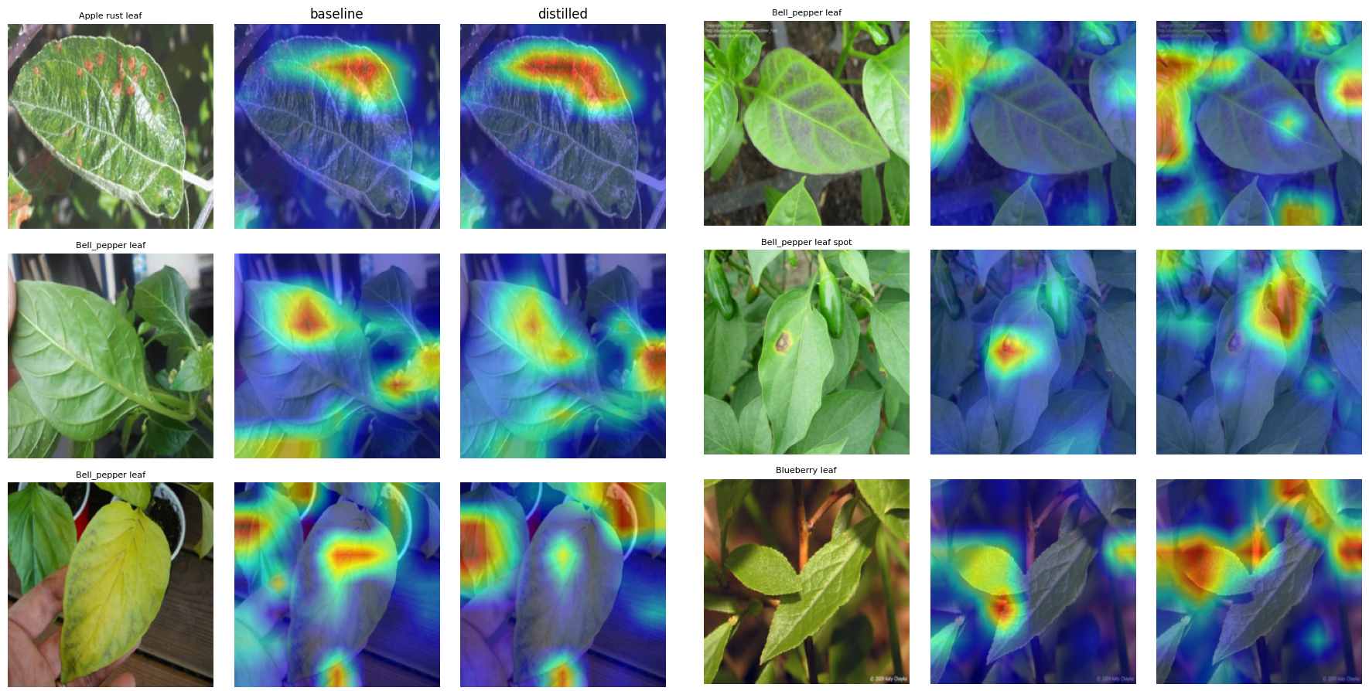
What the attention maps show
Distillation does not make the maps more lesion-focused.
In the leaf spot image (row 5) the baseline hits the lesion; the distilled student moves off it.
Rows 2–4 and 6: both students also respond to neighbouring leaves and background.
Six test images the baseline got wrong and the distilled student got right. Per row: input, baseline, distilled. Grad-CAM [25], last block of MobileNetV3-Large.
Notes:
Six PlantDoc test images the baseline got wrong and the distilled student got right (target layer: last block of MobileNetV3-Large). Left column of each panel is the input, then baseline, then distilled. Honest reading: row 1 distilled map is broader; row 5 baseline localises the lesion better than the distilled model; rows 3, 4 and 6 the distilled maps spread over background and neighbouring leaves. So distillation fixes predictions but we cannot claim better lesion localisation. Viva: Grad-CAM shows where the model looks, not proof of why it decides; six examples are anecdotal.

Slide 14
Limitations
Small test sets, few seeds.
PlantDoc has 236 test images; Paddy and variety-shift runs use one seed.
Untuned and short.
α = 0.5, T = 4 and epoch counts were not tuned; Paddy ran 8 epochs.
Subset and downsizing.
10,407 of 16,225 Paddy Doctor images, resized to 320–384 px.
Not on a phone.
CPU latency is from a shared Colab CPU; no int8 or on-device test.
Planned but not done.
Consistency loss, variety-adversarial training and quantisation.
No cross-dataset test.
PlantDoc and Paddy share no classes; variety shift is the substitute.
Notes:
Own the limitations before the examiner raises them. This is the honest-reporting slide.

Slide 15
Conclusion
RQ1
Distillation lifts the MobileNetV3 student from 56.0 to 62.1 macro-F1 on PlantDoc, about 40% of the gap to the teacher, at 0.215 GMACs.
RQ2
No. Under a change of rice variety every model falls to 29–35 macro-F1; MixStyle and α tuning did not change that. An in-distribution Paddy score should not be read as field readiness.
Next
Gradient-reversal head against the variety label, view-consistency loss, variety-balanced training, int8 quantisation with on-device latency.
Notes:
Close with the take-home: distillation helps on field-style images, robustness to unseen varieties is still open. Likely viva questions: why these three baselines (a small CNN and two lightweight transformers with different designs); why macro-F1 (rare classes count equally); why 29-35 F1 on variety shift if accuracy is 34-42 (macro-F1 penalises collapsed classes); what would you do with more time (the future-work list).

Slide 16
Key references
[1] D. Singh et al., “PlantDoc: A dataset for visual plant disease detection,” CoDS-COMAD, 2020.
[4] A. Howard et al., “Searching for MobileNetV3,” ICCV, 2019, pp. 1314–1324.
[5] A. T. Khan et al., “Plant disease detection model for edge computing devices,” Front. Plant Sci., 2023.
[6] S. Mehta and M. Rastegari, “MobileViT,” ICLR, 2022.
[7] Y. Li et al., “EfficientFormer: Vision transformers at MobileNet speed,” NeurIPS, 2022.
[8] G. Hinton, O. Vinyals, J. Dean, “Distilling the knowledge in a neural network,” 2015.
[14] A. Petchiammal et al., “Paddy Doctor: A visual image dataset for automated paddy disease classification,” CODS-COMAD, 2023.
[23] K. Zhou et al., “Domain generalization with MixStyle,” ICLR, 2021.
[25] R. R. Selvaraju et al., “Grad-CAM,” ICCV, 2017.
Numbers match the reference list in the paper (25 entries).

