Slide 1



ORION 1.0
Problem Statement ID: ORION-PS-03
Problem Statement Title: SylvaSense
Team ID: [ FILL THIS IN ]
Team Name: Order of One

Slide 2

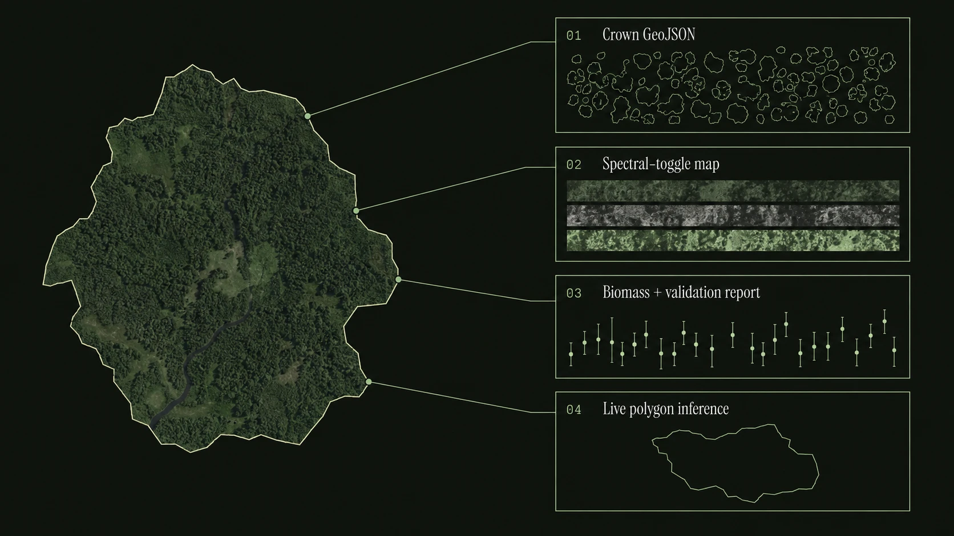
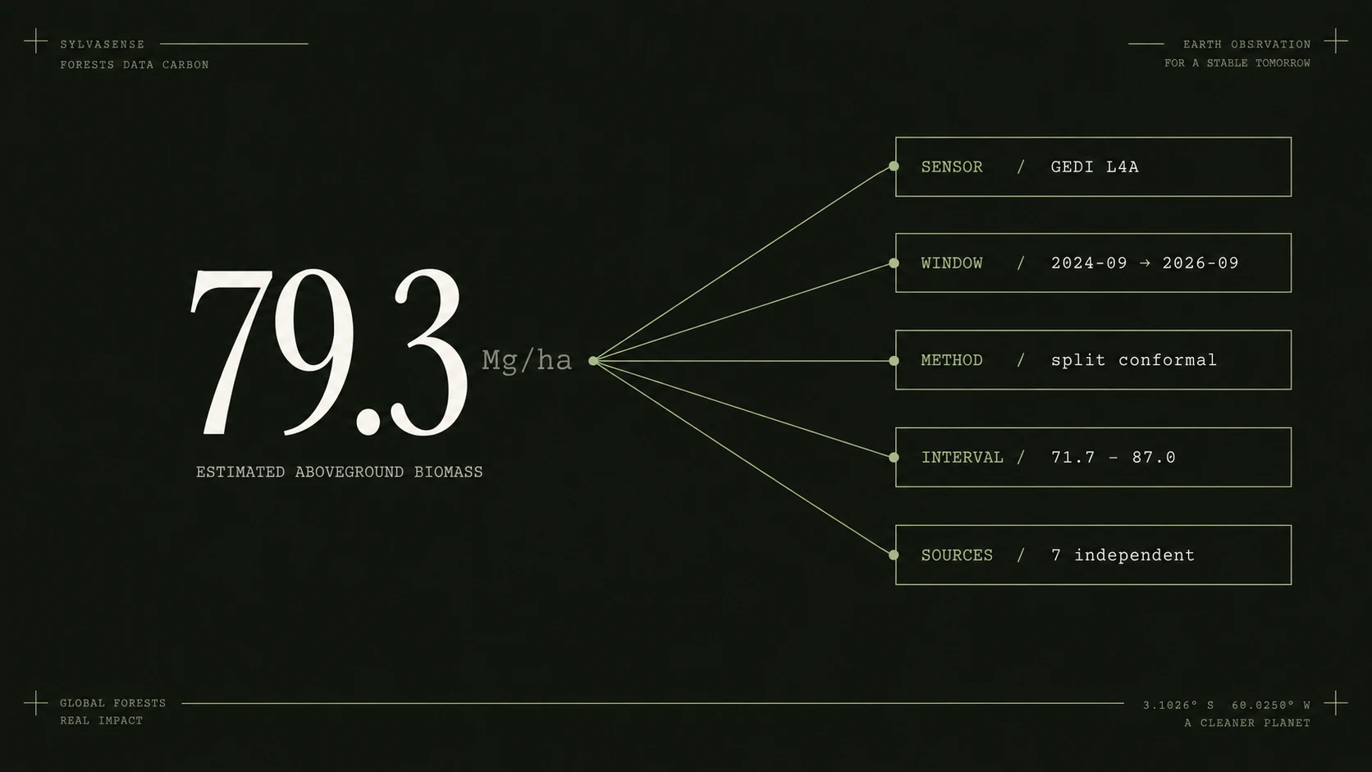
Proposed Solution
SYLVASENSE
From canopy
to carbon.
One polygon in. Four kinds of evidence out.
Every number carries its uncertainty.
Crown GeoJSON
01
Per-tree polygons, each with a confidence score
Spectral-toggle map
02
Optical, radar and structure in one frame
Biomass + validation report
03
Mg/ha with an interval that is checked
Live polygon inference
04
Draw an area; evidence returns with its sources
Four outputs from one request • Live system, first results on 6 sites • Live demo: [ PASTE YOUR URL ]
02

Slide 3
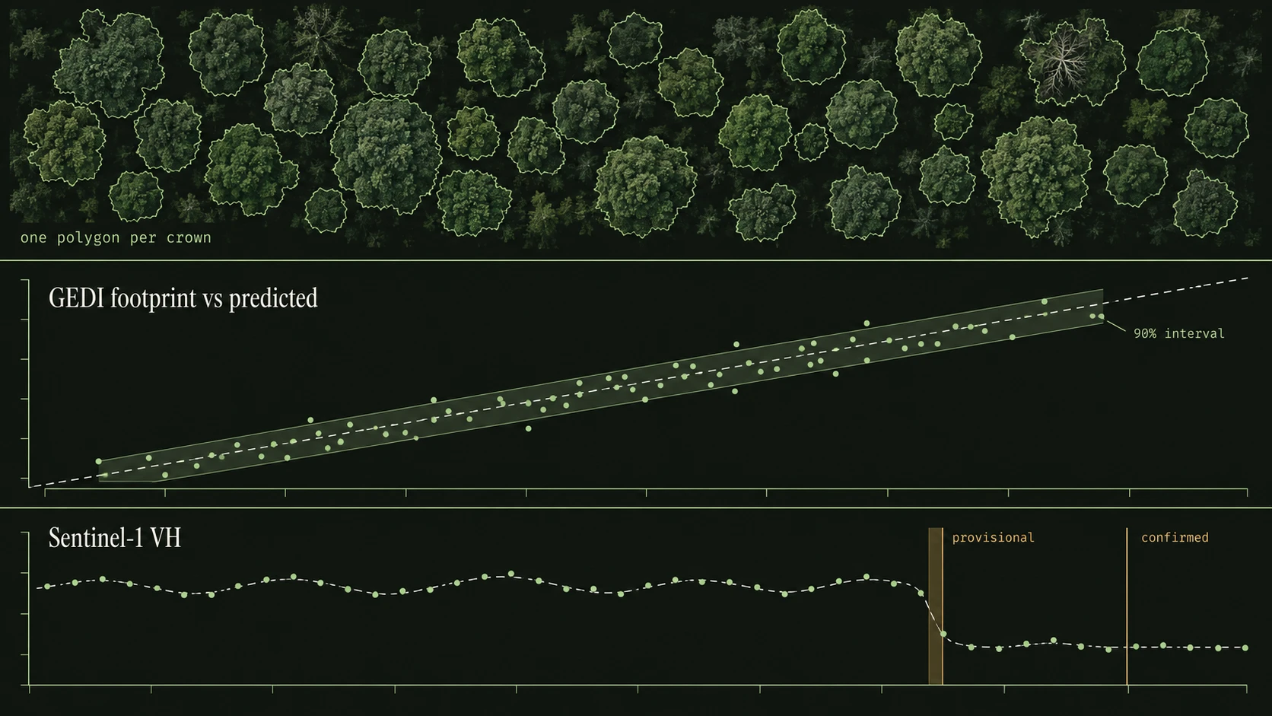
Technical Approach
Three scales. One pipeline.
CROWNS / FINE AERIAL IMAGERY
Mask2Former + Swin-S
0.1 m NEON RGB, tiled and merged
Every mask checked against the canopy height model
BIOMASS / OPTICAL + SAR + LIDAR
Gradient boosting + split conformal
GEDI footprints are the calibration target
Coverage measured on held-out ground, not assumed
CHANGE / MULTI-YEAR OBSERVATIONS
Harmonic baseline + Bayesian confirmation
A drop must persist before it is called a detection
Below its power threshold the detector reports nothing
AGB = Σ density × area | Aboveground carbon = AGB × CF
Mg/ha × ha = Mg • CF starts at 0.47; refine by forest type [10] • Crown / biomass / change methods: [2–8]
03

Slide 4
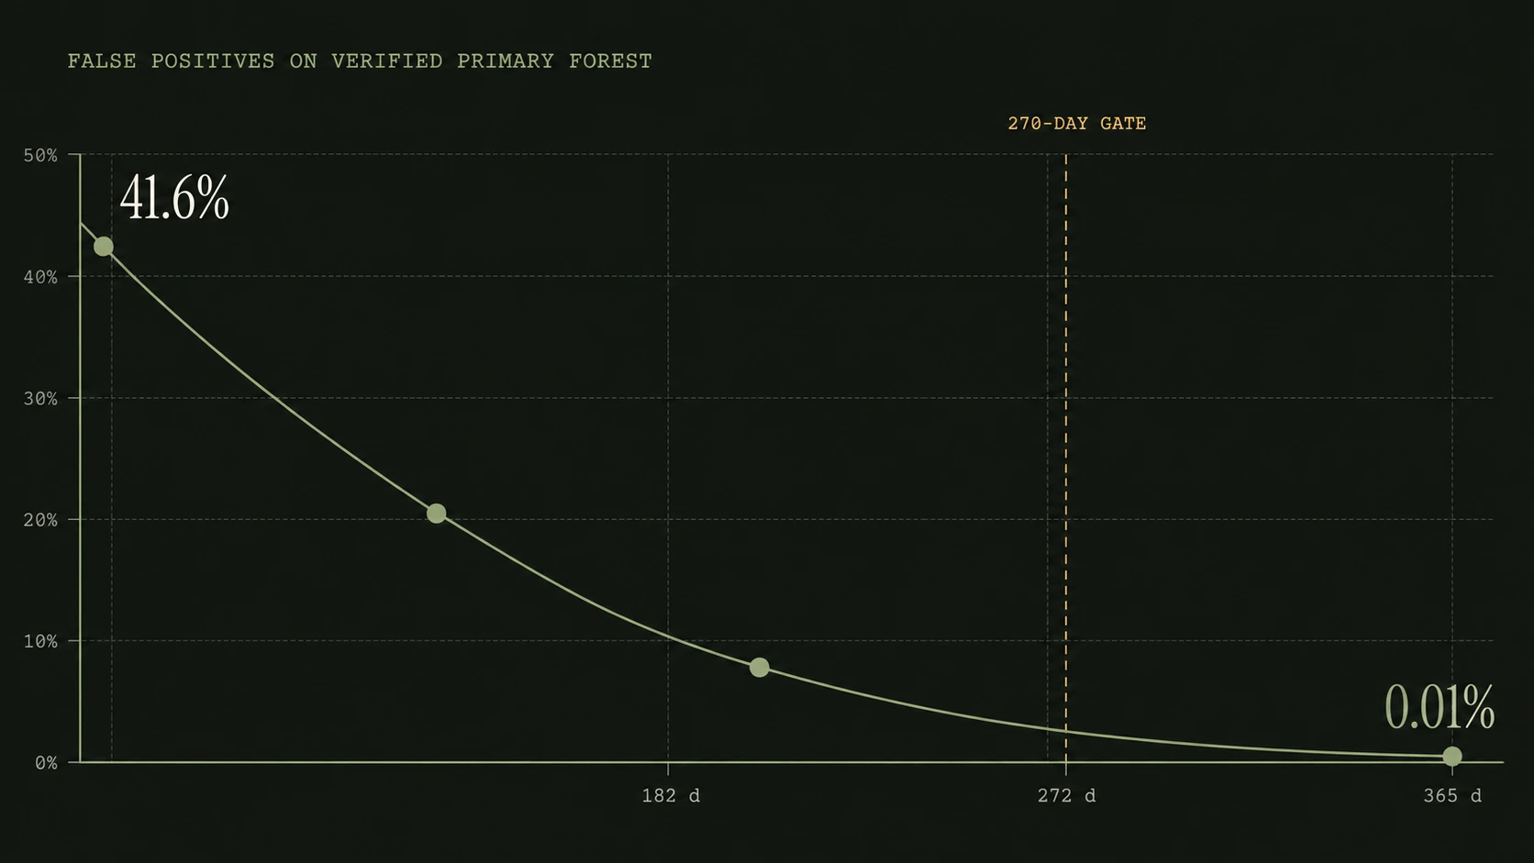
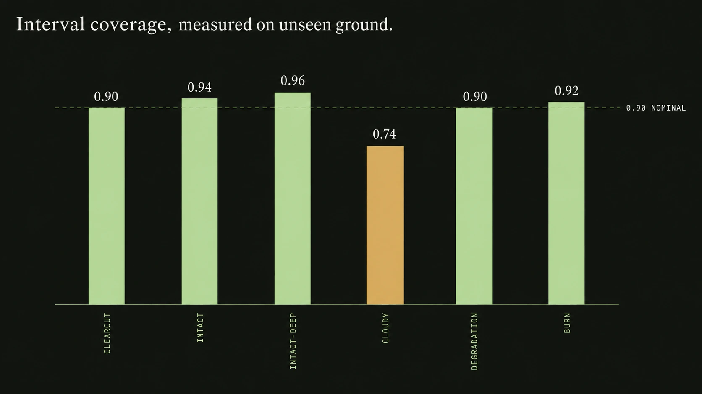
Feasibility & Viability
Three gates. Already passing.
01 VERIFIED THE DATA
6 sites audited on 3 independent layers
2 of 5 candidates failed the audit and were rejected
02 EARNED THE MODEL CHOICE
Spatially-blocked folds, never a random split
Neighbouring footprints are one observation, not two
03 MEASURED THE TRADE-OFFS
False positives on primary forest: 0.01–0.02%
Coverage holds on unseen blocks — and one site fails, visibly
41.6% → 0.01%
A 365-day window was confirming a national park as cleared.
Persistence is a question about time. The gate is now a span.
Measured on 6 sites, 2024–2026 • 60 automated tests • Rondônia, Brazil
04

Slide 5
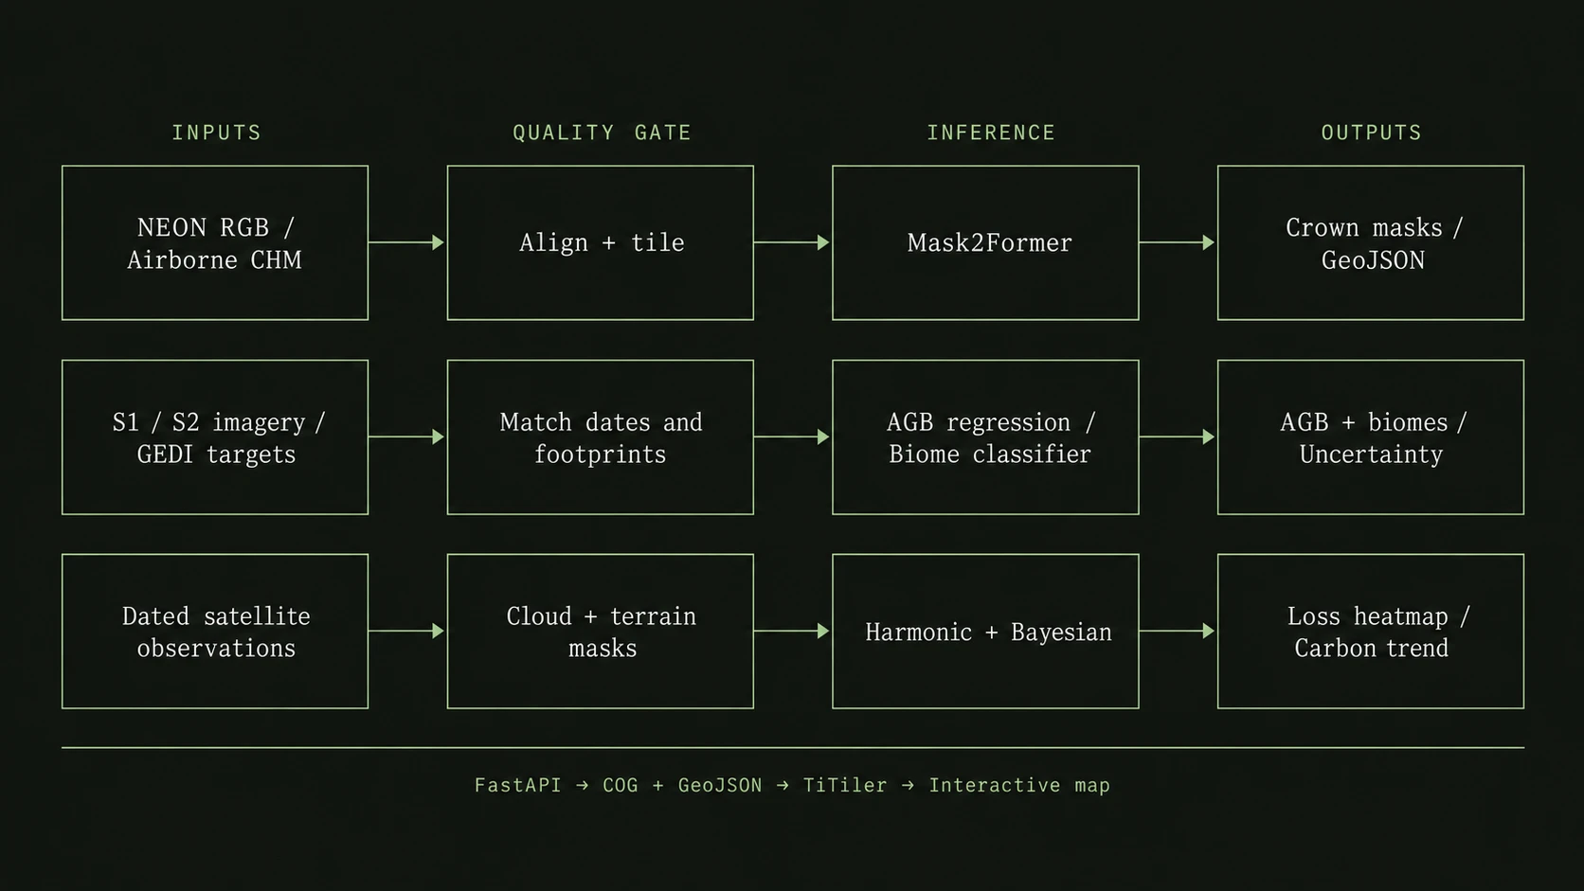
Architecture Diagram
One polygon. Three coordinated paths.
Planned architecture • Separate crown and regional scales • Biome labels: RESOLVE [9] • Every output retains date and model version
05

Slide 6
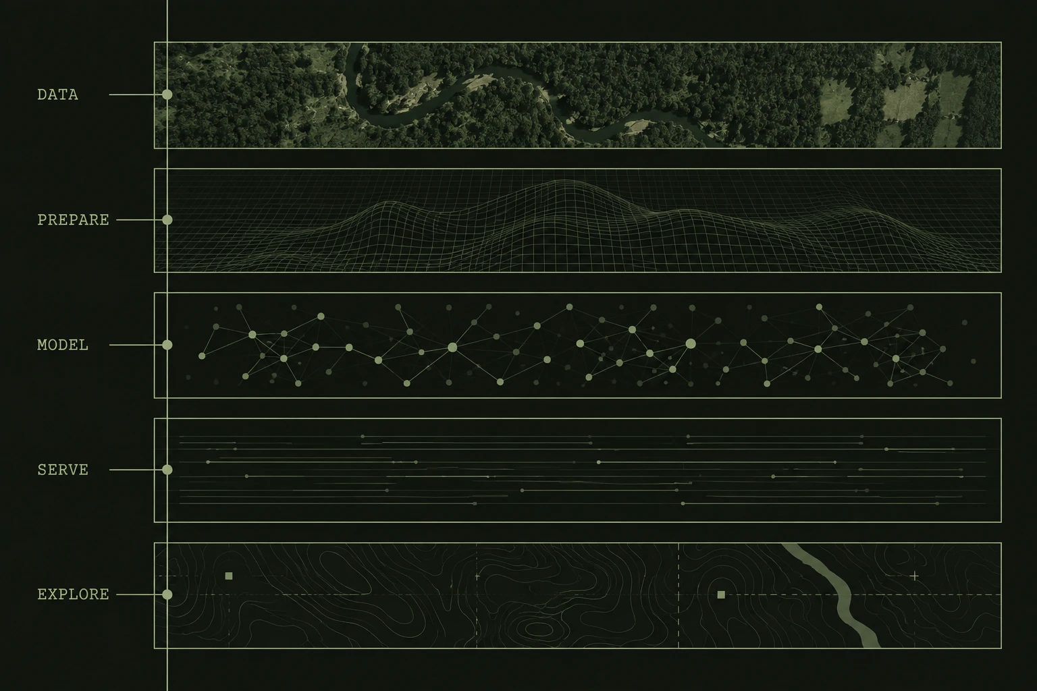
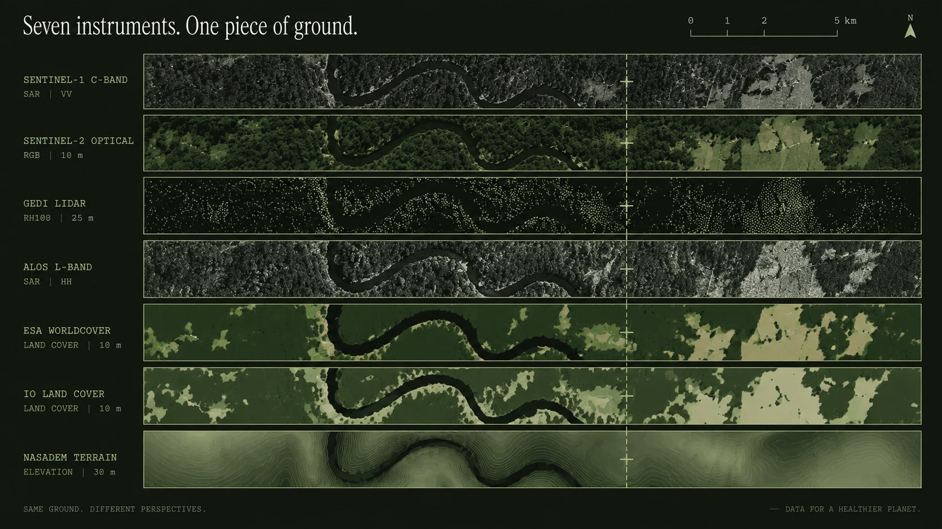
Tech stack
DATA
Earth Engine · Planetary Computer · GEDI
PREPARE
Rasterio · GDAL · GeoPandas · odc-stac
MODEL
PyTorch · Mask2Former · split conformal
SERVE
FastAPI · Redis / Celery · Docker
EXPLORE
TiTiler · Mapbox GL JS · deck.gl
Windowed COG reads. Cached reports.
Cold report 151–222 s · cached 3–23 ms
7 sources, each free to fail alone
Prescribed stack, with task queues and COG tile serving added for practical inference [1,7,8]
06

Slide 7
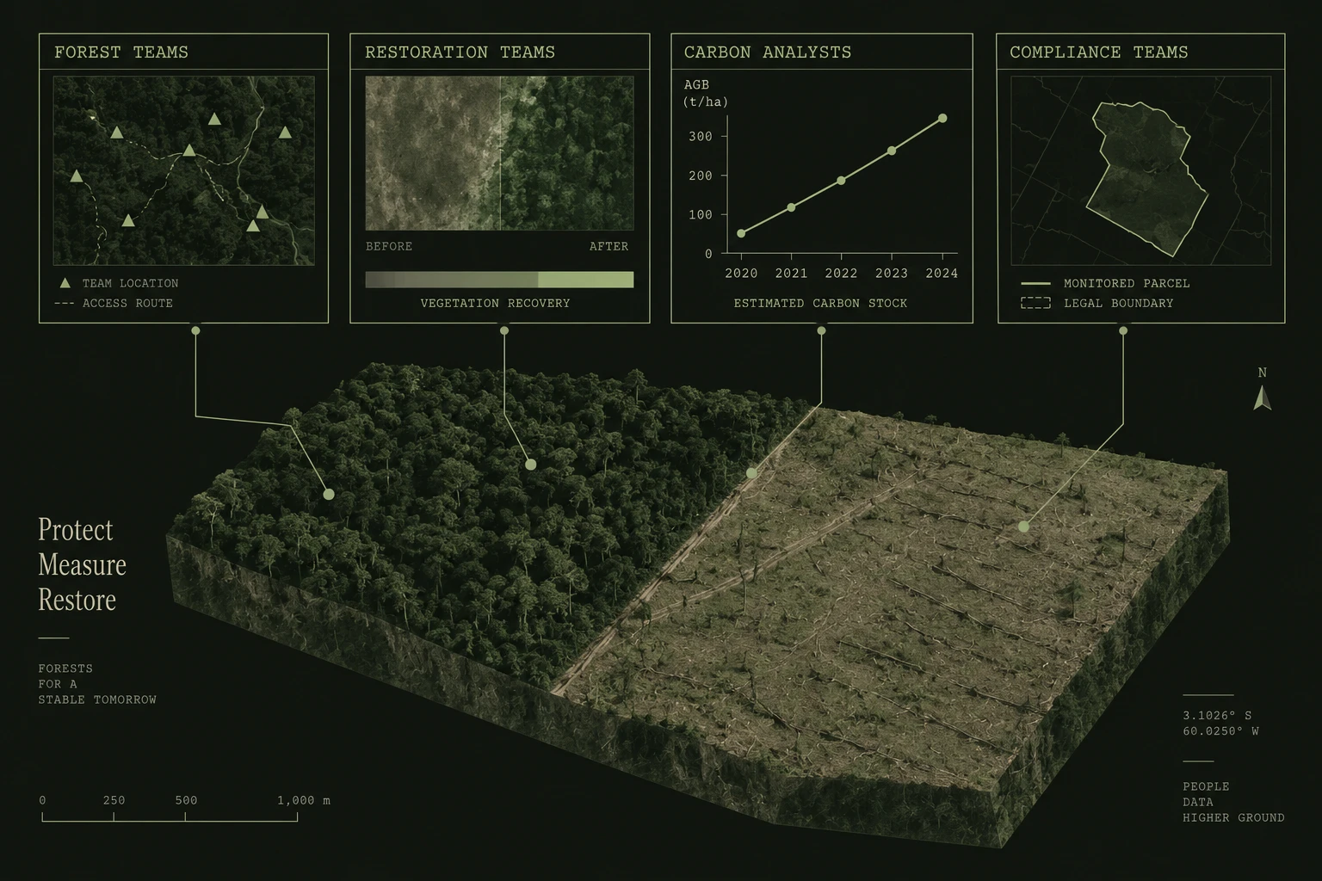
Impact & Benefits
Evidence for
every forest decision.
FOREST TEAMS
Prioritise persistent loss alerts
Confirmed and provisional kept apart
RESTORATION TEAMS
Track canopy and biomass trends
Against a measured 2020 baseline
CARBON ANALYSTS
Trace stock change with its interval
Bias-adjusted area, not pixel counts
COMPLIANCE TEAMS
Evidence for EUDR, due Dec 2026
ESA WorldCover 2020 is the cut-off layer
Stock change is not credited sequestration [10] • Field verification remains essential
07

Slide 8
Research & References
Official scope + submission rules
Crown segmentation benchmark
01
06
ORION PS-03 · Microsoft Club SIST
Detectree2 · Ball et al., 2023
Satellite observations
Quantile biomass regression
02
07
Sentinel-1 processing
Sentinel-2 resolution
XGBoost · official quantile objective
Biomass reference targets
Time series + raster serving
03
08
NASA GEDI L4A · footprints + quality
Earth Engine CCDC
TiTiler
Crown-scale data
Biome labels
04
09
NEON 0.1 m RGB
NEON 1 m CHM
RESOLVE ecoregions · Dinerstein et al., 2017
Mask2Former + crown evidence
Biomass-to-carbon formulation
05
10
Cheng et al., 2022
Nakada et al., 2026 preprint
IPCC 2006 · Forest Land · Table 4.3
Primary references • Accessed 20 September 2026 • Synthetic 3D illustrations • First results measured on 6 sites
08

