Slide 1
Operating System Architecture
1000 meters view…

Slide 2
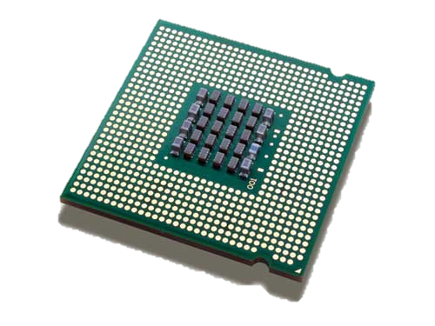
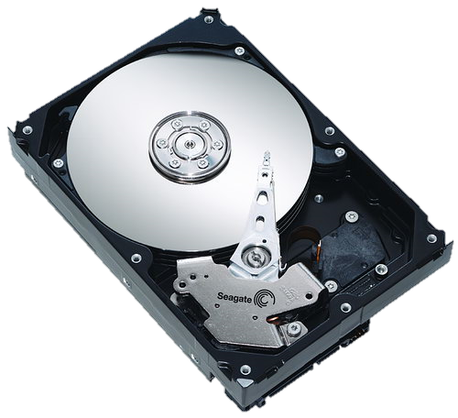
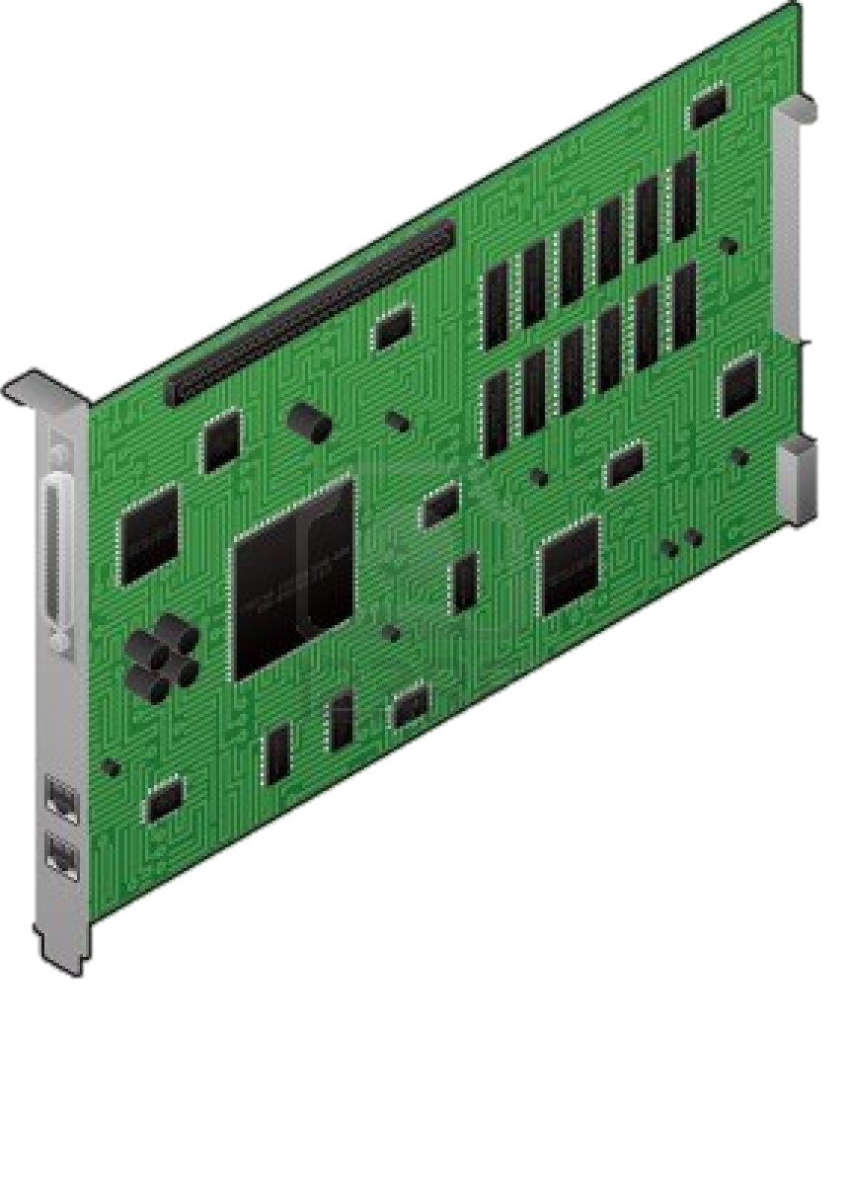
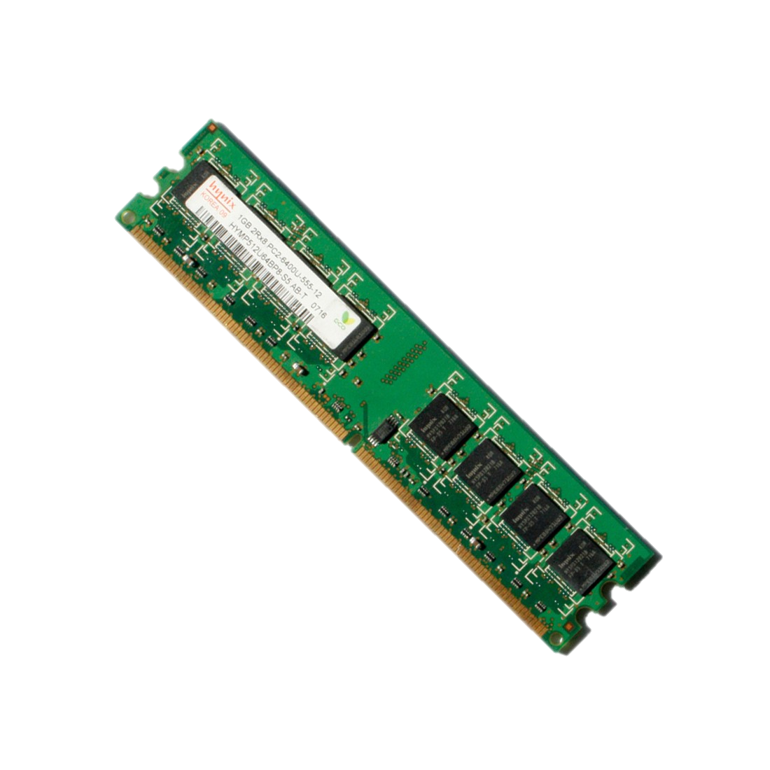
Operating System
Controls hardware resources
  CPU
  Memory
  Network
  Storage
  More…
Developer point of view
  Provides application programming interfaces
  Provides common services
User point of view
  Operating system is there to execute programs

Slide 3
Operating System Categories
Desktop
  Windows
  Linux
  MacOS
  More…
Server
  Linux
  Windows
  Unix – BSD, AIX, HPUX..
  More…
Mobile
  Android
  IOS
  More…
Embedded
  Windows CE
  Minix
  Linux
  More…
Real-time (RTOS)
  QNX
  RTLinux
  Windows CE
  More…
More…

Slide 4
Modern OS High Level Design
User
Space
User Applications
Operating System
Services
Core Libraries
Kernel
Space
OS Kernel
Kernel Modules / Drivers
Memory Manager
Syscall
Handler
VFS
Filesystems
Video Devices
Keyboard and Mouse
Network Manager
I/O Manager
Process
Scheduler
Storage
Devices
Network Devices
USB
Hardware

Slide 5
What is a Process
Represents an instance of a running program
OS create a process to run a program
Starting an application creates a process

Slide 6
What is a Deamon or Service?
A Deamon is a long running process that operates in background
  Provides specific function that is designed to require no user intervention
  Can be configured to start when the operating system is started
  Also known as Service in Windows
Example of deamons:
  Web Server (Apache, Nginx, IIS)
  Database Server (MySql, MongoDB, MSSQL)
  More…

Slide 7
Multitasking
CPU Core == Single Task
  Only one process can be executing at any one time on a single CPU core
What is Multitasking
  Allow multiple processes to share same CPU and other system resources
Multitasking operating system
  OS switches between processes to give the appearance of many processes executing simultaneously
Cooperative vs Preemptive
  cooperative multitasking
    processes decide for how long it keeps the CPU
  preemptive multitasking
    processes are not in control for how long they are going to use the CPU

Slide 8
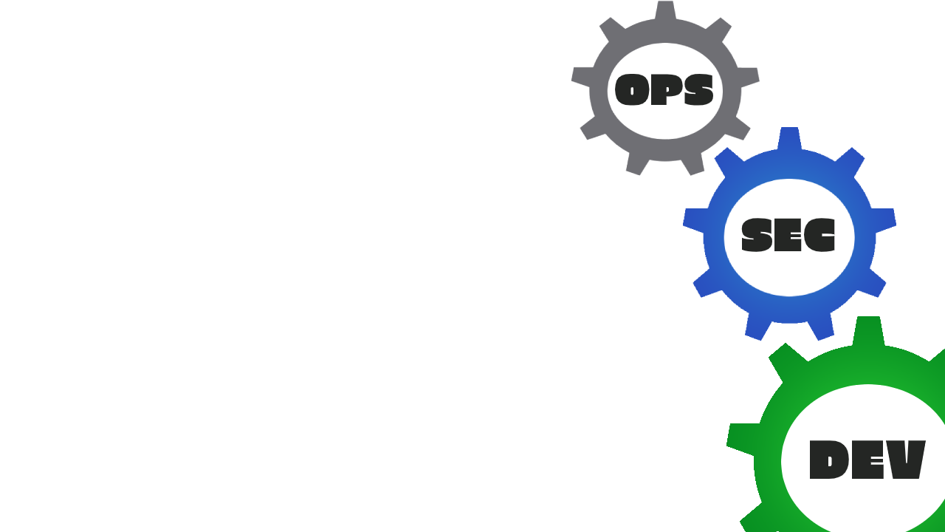
Protection Rings (a.k.a. Isolation Rings)
Protects data and functionality from faults
Hardware-enforced by CPU
CPU microcode
Applications
3
2
Isolation
1
OS Kernel
Nginx
0
Redis

Slide 9
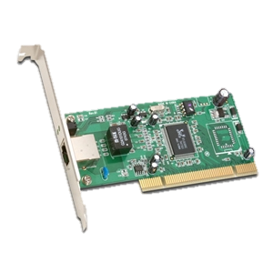
What is a Module or Driver?
Device
  A device is a unit of hardware that performs a special function and is attached to a computer.
Kernel module or Device Driver
  A device driver is a small software program that operates or controls a particular type of device that is attached to a computer.

Slide 10
How does the OS know which driver to use?
Device identification string
  The computer devices have a set of registers that identify the vendor and the device model
  The OS uses those IDs to identify the attached devices and to select the suitable drivers for them
Example of device identification string:
  PCI VEN_10E8&DEV_4750

