Slide 1
Virtualization

Slide 2
Virtualization
Virtualization is a term that refers to various techniques, methods or approaches of creating a virtual version of something.

Slide 3
Virtualization Types
Hardware Virtualization
Container Virtualization
Application Virtualization
Presentation Virtualization
More…
Nowadays you can see the term Virtualization everywhere. Most of the time this is just a marketing trick!

Slide 4
Hardware Virtualization
Virtual Machines

Slide 5
Hardware Virtualization
Virtual Machine (VM) acts like a real computer
  operating system
  applications
Hypervisor
  The software that creates and manages the virtual machines
We also use the terms
  Guest OS
  Host OS

Slide 6
Full Virtualization
Guest OS is not aware it is virtualized
Guest OS requires no modification
Virtual Machine has all standard components
  Virtual processors
  Memory
  Network Adapters
  Virtual Disks

Slide 7
Para virtualization
Guest OS is modified
Guest OS is aware that it is running on a hypervisor
Guest OS does not communicate directly with the hardware, but with the hypervisior
All privileged instructions are replaced with direct calls to the hypervisior

Slide 8
What we use today?
Full or Para Virtualization

Slide 9
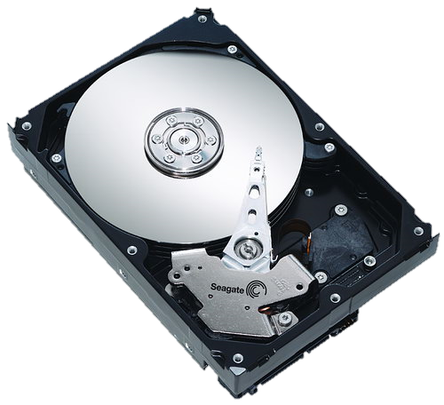
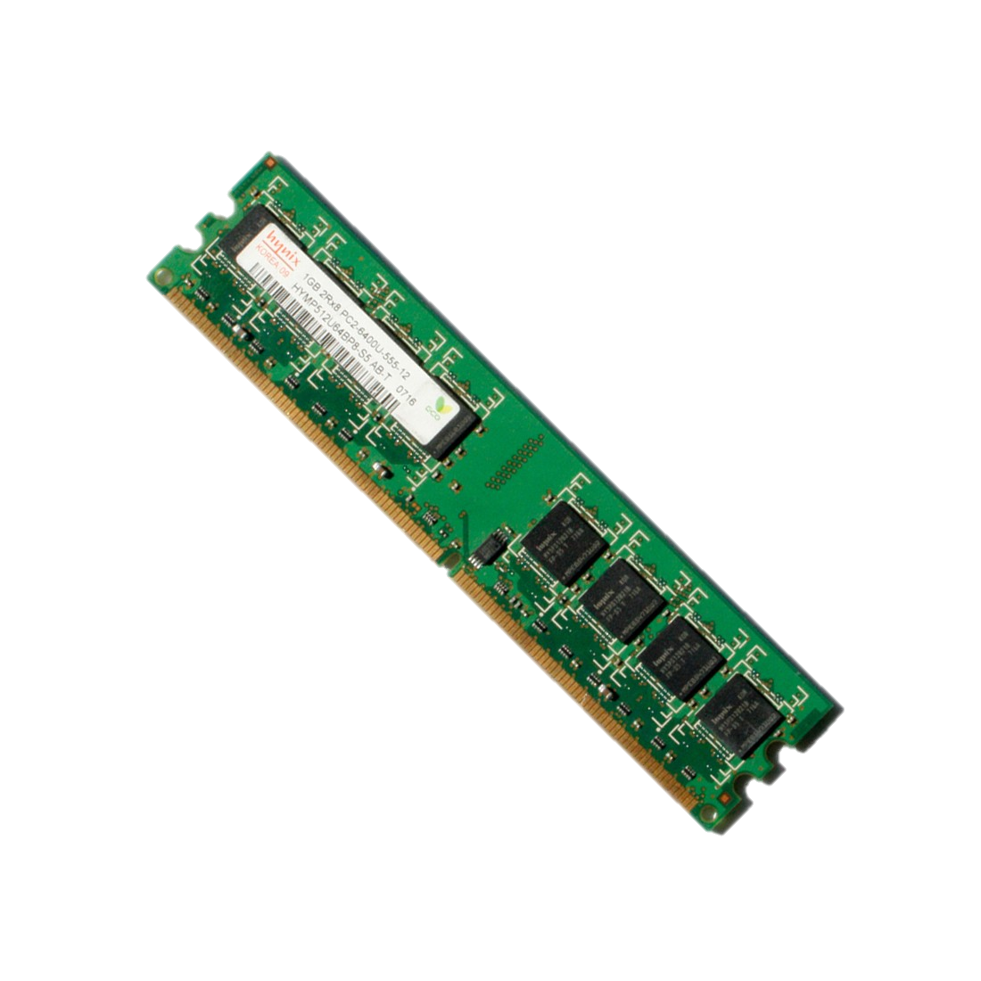
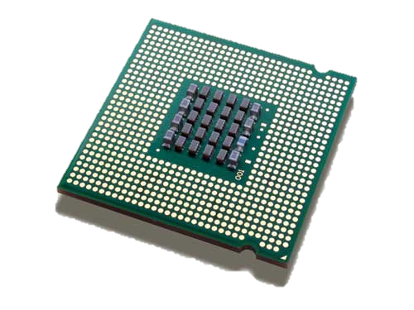
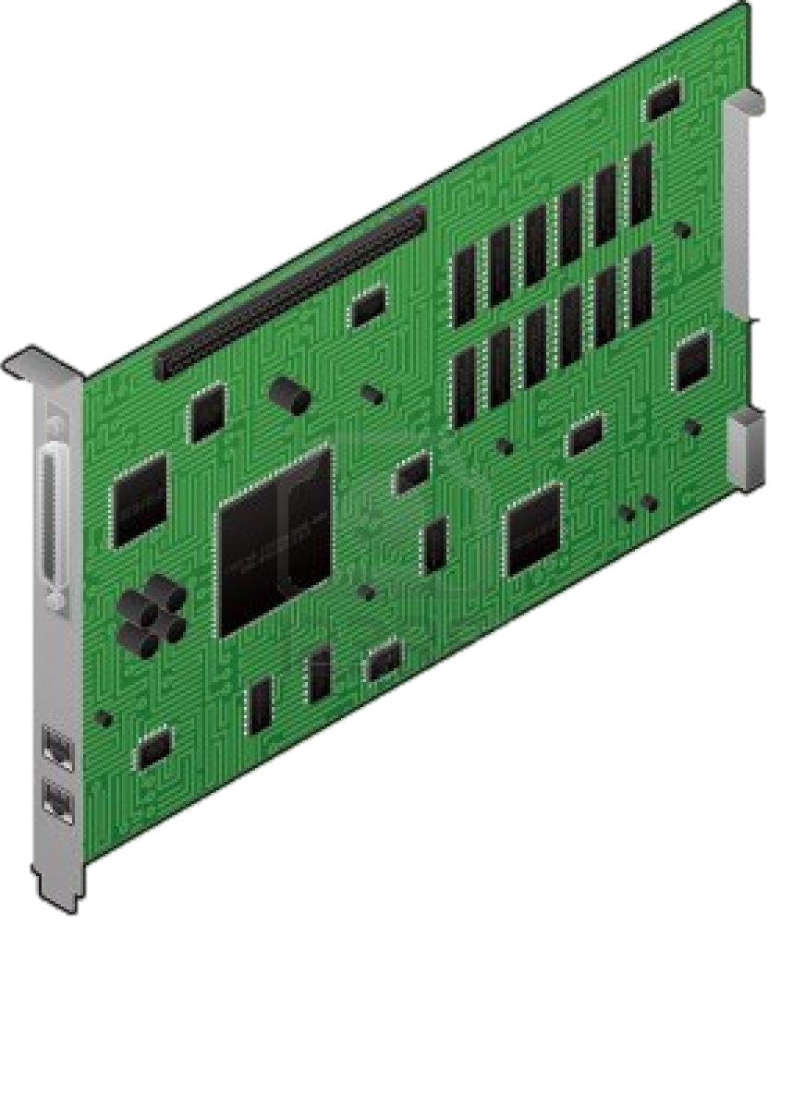
Hardware assisted virtualization
Approach that enables efficient full virtualization using help from hardware capabilities
Applications
Applications
Applications
…
Ring 3
Linux
Windows
BSD
…
Ring 0
Hypervisor
Ring - 1
Hardware

Slide 10
Hardware assisted virtualization G1
The modern CPU’s include hardware assisted virtualization
  Intel-VT
  AMD-V
Introduced first in 2005 (Intel-VT)
Makes it possible to support unmodified guests
  No emulation
  No instructions translation

Slide 11
Hardware assisted virtualization G2
Second Level Address Translation (SLAT)
  Intel VT Extended Page Tables (NPT)
  AMD-V Rapid Virtualization Indexing (RVI)

Slide 12
Hardware assisted virtualization G3
Nested Virtualization?
PCI Express Virtualization?
  Makes one device “look” like multiple devices
  Virtual devices appear completely independent

Slide 13
So what we use today?
Hardware assisted virtualization!
But wait! That’s not all.
  We also use para-virtualized devices
  Para-virtualized devices are optimized virtual devices designed for Virtualization
    Decrease I/O latency
    Increase I/O throughput
    Provide near bare-metal performance
    Needs special device drivers
Conclusion – The Virtualization today
  We use combination of full and para virtualization
  OS is not modified since we use the effective hardware assisted virtualization
    CPU and Isolation rings
    Memory Management
  We use special para-virtualized devices and drivers to provide effective I/O performance
    Storage
    Networking
    Etc.

Slide 14
Example of Hypervisors
VMWare ESXi
Hyper-V
KVM
XEN
VirtualBox

