Slide 1
Cloud Computing
The big picture

Slide 2
What is cloud computing?

Slide 3
Problems with classic datacenters
Data centers capacity
Hardware is not utilized efficiently
Legacy hardware and systems
Application compatibility issues
Cross vendor interoperability
Complex processes and management
A lot of experts are required (e.g. Network, Storage, Backup, OS)

Slide 4
The Era of Cloud Computing
Computing resources provided as a service
Natural evolution and adoption of
Existing technologies
Existing paradigms

Slide 5


Utility Services
Available to the customer as needed
Charges for specific usage
Maximize the efficient use of resources
Minimize associated costs
Billing reporting

Slide 6
How Cloud Computing can help?
Cloud services
Server consolidation
Service or application isolation
Simplified service deployment
Simplified service management
Increased service and application availability
Hybrid technologies can run on one consistent platform

Slide 7
Behind The Scene
Hardware Infrastructure
Virtualization
Management stacks
Automation stacks
Programing APIs

Slide 8
Cloud Classifications and Service Models
Classification
Public
Private
Hybrid
Service Models
Infrastructure as a service (IaaS)
Platform as a service (PaaS)
Software as a service (SaaS)
And more…

Slide 9

Cloud Computing Today
Cloud Computing has reached a maturity that leads it into a productive phase​
Nowadays Cloud Computing is integral concept in IT​
More innovations because of Cloud​
Increased development for the Cloud

Slide 10
Good Cloud Platform
Self-Service
API automation
Flexible billing model
Flexible billing reporting
Dynamic workload balancing
Provisioning services
Role-based administration
Monitoring and Reporting
Integration with other systems

Slide 11
Public Cloud Platforms
2020 Q3
AWS – 32%
Azure – 19%
Google Cloud – 7%
Alibaba – 6%
Others – 37%

Slide 12
Private Cloud Platforms
A lot of vendors
VMWare
IBM and RedHat
DELL
Oracle
BMC
Citrix
HP
Cisco
Microsoft
More…
What is the problem with those platforms
Mainly focused on Virtual Machines (IaaS)
Do not provide real cloud native experience
Very hard to maintain and support
Not so good APIs
Missing and or bad support for tools like terraform, cdk, ansible and etc.

Slide 13
Hybrid Cloud Platforms
AWS Outposts
Azure Stack
Google Anthos
More…

Slide 14
Cloud Native vs Traditional Workloads
Software
(e.g. Database, Object Storage)
Software
(e.g. Database, Object Storage)
Core Management
Monitoring, Backup, etc.
Core Management
Monitoring, Backup, etc.
OS
OS
Virtualization Platform
Virtualization Platform
Hardware
Hardware

Slide 15
Amazon Web Services

Slide 16
Welcome to AWS
Amazon Web Services
The most broadly adopted cloud platform
Offering over 200 fully featured services
Largest community of customers and partners
Who is using AWS?
Fastest-growing startups
Largest enterprises
Leading government agencies
Global and distributed cloud infrastructure
26 geographic regions
84 Availability Zones

Slide 17
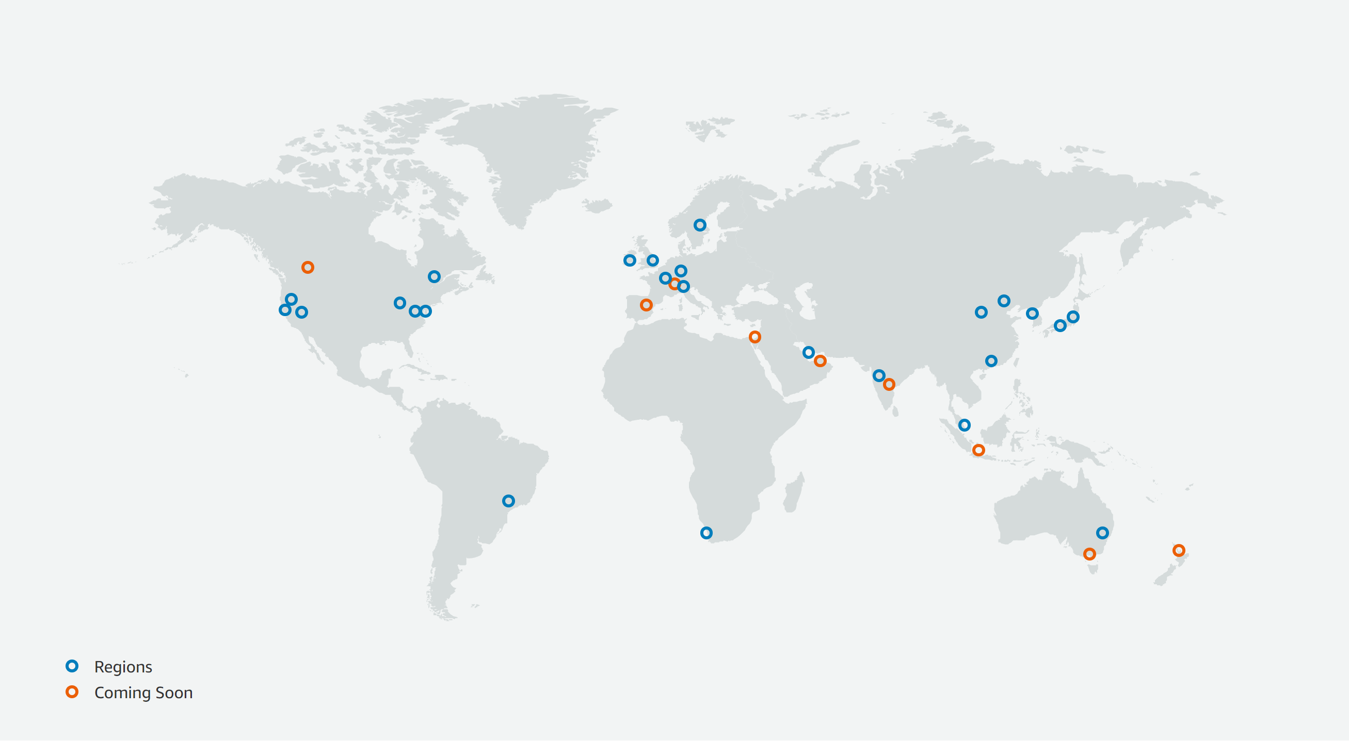
AWS Regions
https://aws.amazon.com/about-aws/global-infrastructure/

Slide 18
Important AWS Definitions
High Availability
Accessible when you need it
Fault Tolerance
Ability to withstand a certain amount of failure and still remain functional
Scalability
Ability to easily grow in size, capacity, and/or scope when required
Elasticity (Elastic):
Ability to grow when required and to reduce in size when resources are no longer needed

Slide 19






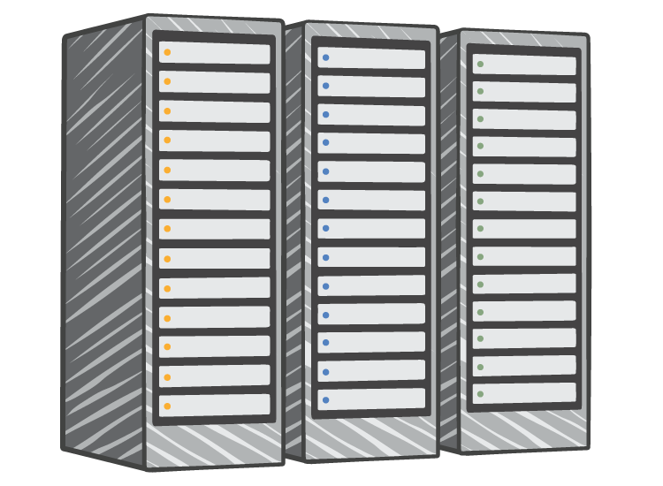




AWS vs On-Premisses
On-Premises Infrastructure
Amazon Web Services
Security
Firewalls
ACLs
Administrators
Security Groups
Network ACLs
Identity Access Management
Networking
Network
Router
Network Pipeline
Switch
Elastic Load Balancing
Amazon VPC
On-Premises Servers
Servers
VPC
Amazon Machine Image
Amazon EC2 Instances
DAS
SAN
NAS
Storage and Database
RDBMS
Elastic Block Store
Elastic File System
Amazon S3
Amazon RDS

Slide 20
























Core AWS Services
Amazon EC2
AWS Lambda
Amazon VPC
Amazon Route 53
Amazon S3
Amazon EBS
Auto Scaling
Amazon Elastic Container Service
Amazon CloudFront
Amazon SQS
AWS Direct Connect
Elastic Load Balancing
Amazon Elastic Container Registry
Amazon
Cloud Watch
Key Management Service
Amazon DynamoDB
Amazon Elastic File System
Amazon SNS
AWS
Identity and Access Management
Cloud Trail
AWS Directory
Services
Amazon ElastiCache
Amazon Redshift
Amazon RDS

Slide 21
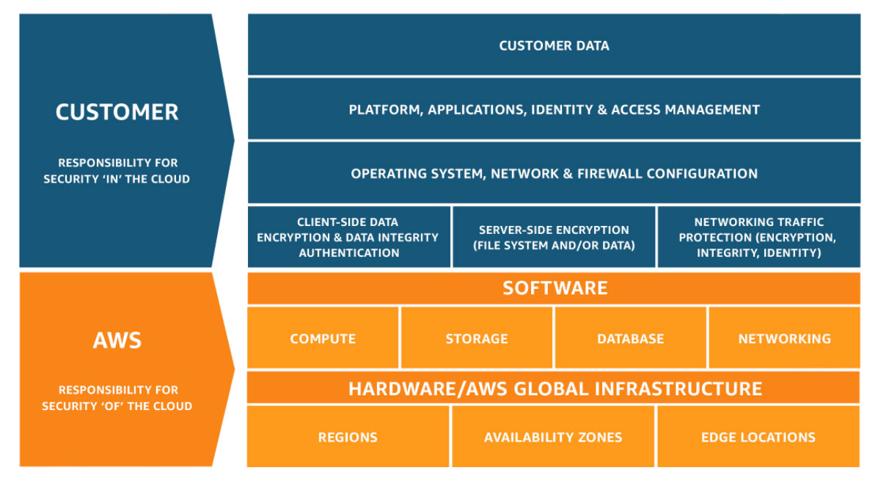
Shared Responsibility Model

