Slide 1
Cloud Computing
The big picture

Slide 2
What is cloud computing?

Slide 3
Problems with classic datacenters
Data centers capacity
Hardware is not utilized efficiently
Legacy hardware and systems
Application compatibility issues
Cross vendor interoperability
Complex processes and management
A lot of experts are required (e.g. Network, Storage, Backup, OS)

Slide 4
The Era of Cloud Computing
Computing resources provided as a service
Natural evolution and adoption of
  Existing technologies
  Existing paradigms

Slide 5


Utility Services
Available to the customer as needed
Charges for specific usage
Maximize the efficient use of resources
Minimize associated costs
Billing reporting

Slide 6
How Cloud Computing can help?
Managed services
Cost effective solutions
Server consolidation
Service or application isolation
Simplified service deployment
Simplified service management
Increased service and application availability
Automatic scalability
Service automation

Slide 7
Behind The Scene
Hardware Infrastructure
Virtualization
Containers
Management stacks
Automation stacks
Programming APIs
Web User Interface

Slide 8
Cloud Classifications and Service Models
Classification
  Public
  Private
  Hybrid
Service Models
  Infrastructure as a service (IaaS)
  Platform as a service (PaaS)
  Software as a service (SaaS)
  And more…

Slide 9
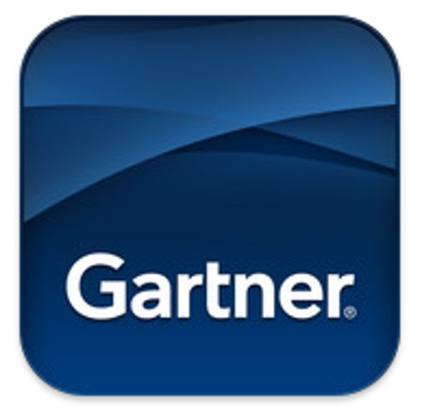
Cloud Computing Today
Cloud Computing has reached a maturity that leads it into a productive phase​
Nowadays Cloud Computing is integral concept in IT​
More innovations because of Cloud​
Increased development for the Cloud

Slide 10
Good Cloud Platform
Managed Services
API automation
Self-Service – UI, CLI, API
Flexible billing model (pay-as-you-go)
Flexible billing reporting
Dynamic workload balancing
High-Availability and Scalability
Role-based administration
Monitoring and Reporting
Integration with other systems

Slide 11
Public Cloud Platforms
2022 Q1
  AWS – 33%
  Azure – 21%
  Google Cloud – 8%
  Alibaba – 6%
  Others – 32%

Slide 12
Private Cloud Platforms
A lot of vendors
  DELL
  VMWare
  IBM and RedHat
  Oracle
  BMC
  Citrix
  HP
  Cisco
  Microsoft
  More…
What is the problem with those platforms
  Mainly focused on Virtual Machines (IaaS)
  Do not provide real cloud native experience
  Very hard to maintain and support
  Not so good or mising APIs
  Missing and or bad support for tools like terraform, cdk, ansible and etc.

Slide 13
Hybrid Cloud Platforms
AWS Outposts
Azure Stack
Google Anthos
More…

Slide 14
Cloud Native vs Traditional Workloads
Software
(e.g. Database, Object Storage)
Software
(e.g. Database, Object Storage)
Core Management
Monitoring, Backup, etc.
Core Management
Monitoring, Backup, etc.
OS
OS
Virtualization Platform
Virtualization Platform
Hardware
Hardware

