Slide 1
Jenkins
Leading open source automation server for CICD

Slide 2
What is CICD?
Continues Integration
Coding philosophy and set of practices
Development teams implement small changes
Push code to version control repositories frequently
Every commit triggers a build
Source code testing and quality checks
Continues Delivery
Picks up where continuous integration ends
Automates the delivery of applications to selected environment
Releases to production as early as possible
Makes releases small and easy to troubleshoot
Manual approval step for release to production
Continues Deployment
One step further than continuous delivery
Every code change is released to your customers
No human intervention
Only a failed test will prevent a new change to be deployed

Slide 3
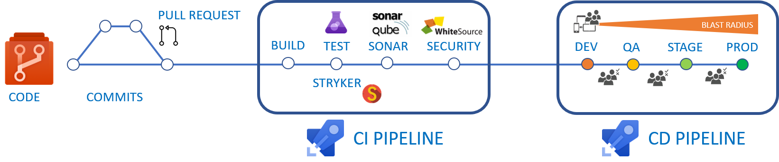
CICD Pipeline
Developer commit code to git branch
A build job is triggered on every commit
Build software
Run tests
Run static code and security analyses
Run coverage and quality checks
Release software to environment
This Photo by Unknown Author is licensed under CC BY-SA

Slide 4
Git Branch and Pull Request
2
Code Change
3
Create pull request
1
Crate Branch
4
Merge to main
main
1
4
Crate Branch
Merge to main
3
Create pull request
2
Code Change

Slide 5
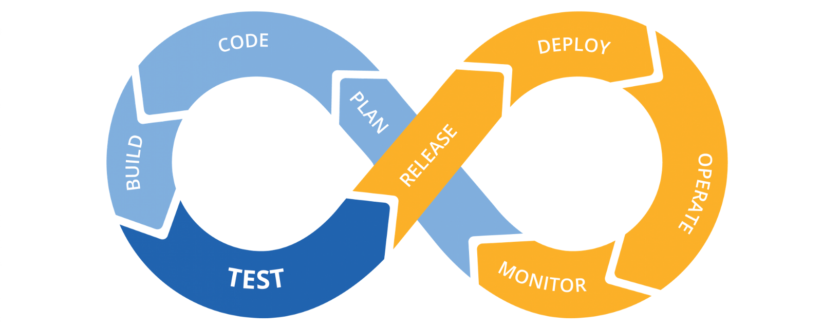
Continues process…
This Photo by Unknown Author is licensed under CC BY-SA-NC

Slide 6
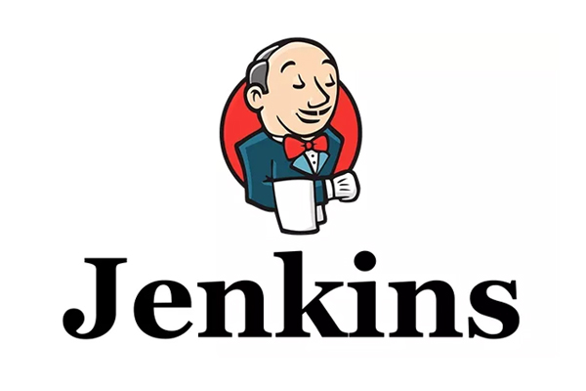
What is Jenkins?
Free and open source automation server
Leading open source automation server
Automates CICD processes
Java based software
Integrates with git and other VCS
Extensible platform (hundreds of plugins)
Multi platform
Distributed platform using agents
Linux and Windows agents
Group agents by labels

Slide 7
Run Jenkins in docker (9 simple steps)
docker run –d –p 80:8080 –p 50000:50000 --name=jenkins jenkins/jenkins.lts
docker logs jenkins
Get initial setup password from the log
Open your browser and enter the server name/ip
Enter the initial setup password
Install suggested plugins
Enter admin user and password
Create Jenkins pipeline job
Enjoy your Jenkins setup

Slide 8
Jenkins Plugins
Extend Jenkins functionality
Jenkins core plugins
Jenkins community plugins
Jenkins external vendor plugins
700+ Plugins

Slide 9
Main Components
Controller – the main Jenkins server
Agent/Node – additional Jenkins servers used to run builds
Cloud – run dynamic agents in a Kubernetes cluster
Job – unit of work
View – defined collection(list) of jobs
Folder – organizational unit for jobs
Secret – store sensitive information like password, private keys, etc.

Slide 10
Jenkins Pipeline
Jenkinsfile (describe pipeline using Jenkins Pipeline DSL)
stage: starts a new pipeline stage
agent: selects node for execution based on label
checkout: checkouts code from SCM
sh: executes shell command
bat: executes windows command line
More…
Define pipeline as code
Declarative definition
Store pipeline definition with your app

Slide 11
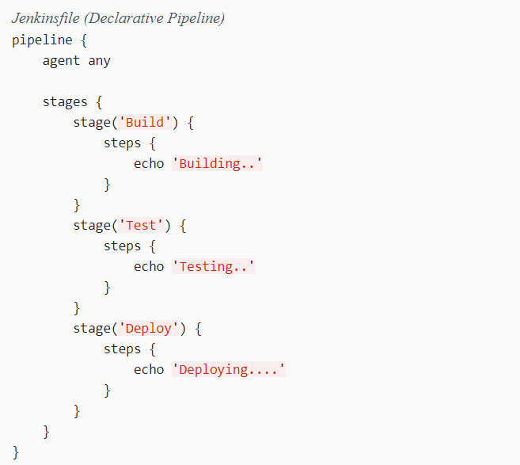
Jenkinsfile (Declarative Pipeline)
https://www.jenkins.io/doc/book/pipeline/syntax/

Slide 12
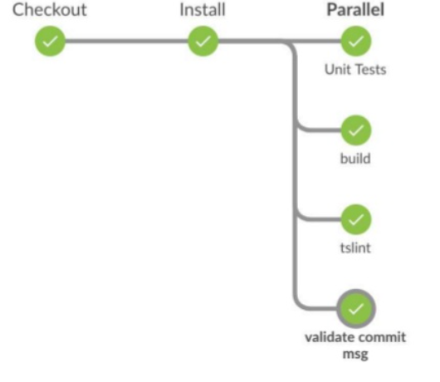
Jenkins Blue Ocean Plugin
Modern look and feal for Jenkins
Better pipeline visualization
Easy to use

Slide 13
Free Courses
https://www.udemy.com/course/jenkins-for-beginners-n/

