Slide 1
Amazon Web Service
AWS Overview

Slide 2
What is Amazon Web Services?

Slide 3
Welcome to AWS
Amazon Web Services
The most broadly adopted cloud platform
Offering over 200 fully featured services
Largest community of customers and partners
Who is using AWS?
  Fastest-growing startups
  Largest enterprises
  Leading government agencies
Global and distributed cloud infrastructure
  27 geographic regions
  87 Availability Zones

Slide 4
























Core AWS Services
Amazon EC2
AWS Lambda
Amazon VPC
Amazon Route 53
Amazon S3
Amazon EBS
Auto Scaling
Amazon Elastic Container Service
Amazon CloudFront
Amazon SQS
AWS Direct Connect
Elastic Load Balancing
Amazon Elastic Container Registry
Amazon
Cloud Watch
Key Management Service
Amazon DynamoDB
Amazon Elastic File System
Amazon SNS
AWS
Identity and Access Management
Cloud Trail
AWS Directory
Services
Amazon ElastiCache
Amazon Redshift
Amazon RDS

Slide 5
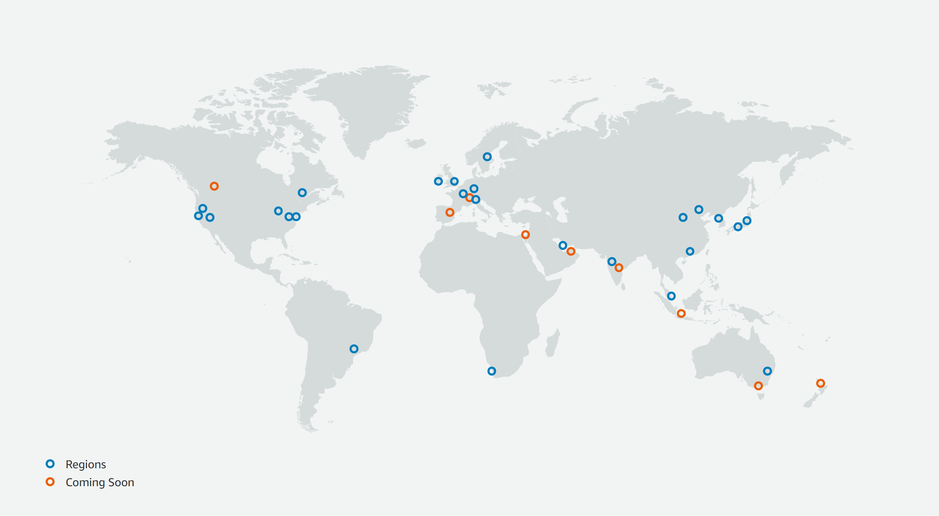
AWS Regions
https://aws.amazon.com/about-aws/global-infrastructure/

Slide 6
AWS Availability Zones
Availability Zone (AZ)
One or more discrete date centers
  Redundant power supply
  Redundant Networking
  Interconnected with high-bandwidth and low-latency
  Fault tolerant
  Scalable
  Encrypted Traffic
  Not more than 100 km (60 miles)

Slide 7
Important AWS Definitions
High Availability
  Accessible when you need it
Fault Tolerance
  Ability to withstand a certain amount of failure and still remain functional
Scalability
  Ability to easily grow in size, capacity, and/or scope when required
Elasticity (Elastic):
  Ability to grow when required and to reduce in size when resources are no longer needed

Slide 8





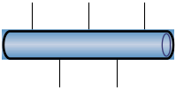



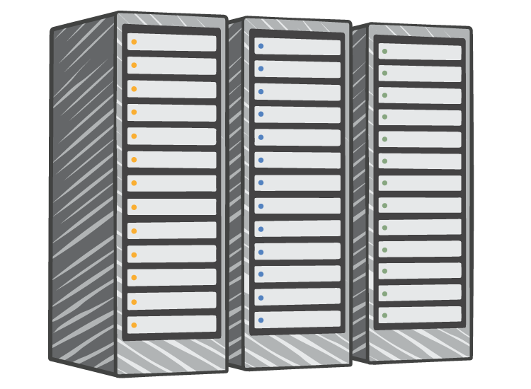






AWS vs On-Premisses
On-Premises Infrastructure
Amazon Web Services
Security
Firewalls
ACLs
Administrators
Security
Groups
Network ACLs
Identity Access
Management
Networking
Network
Router
Network Pipeline
Switch
Elastic
Load Balancing
Amazon VPC
On-Premises
Servers
Servers
VPC
Amazon
Machine Image
Amazon EC2 Instances
DAS
SAN
NAS
Storage and
Database
RDBMS
Elastic
Block Store
Elastic
File System
Amazon S3
Amazon RDS

Slide 9
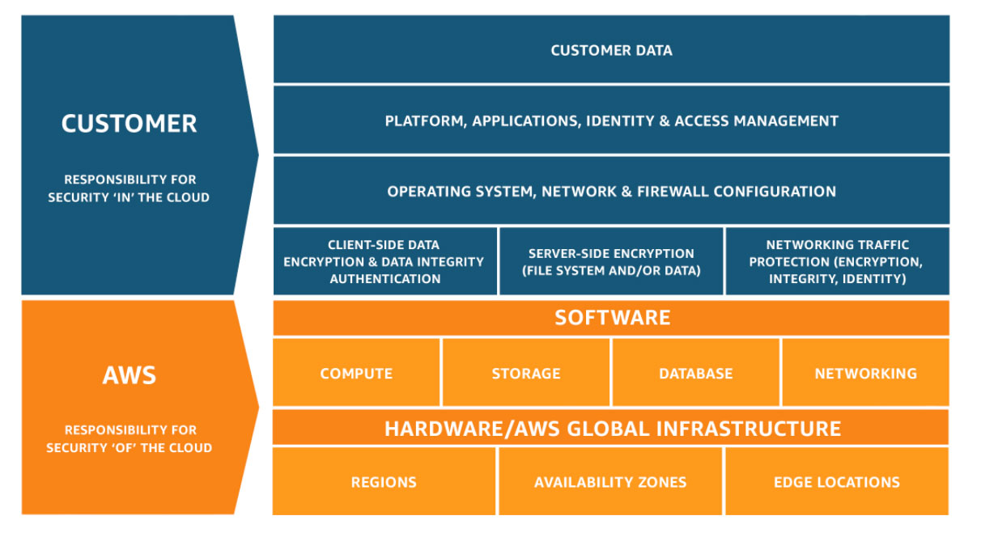
Shared Responsibility Model

Slide 10
Create Personal Free Tier AWS Account

Slide 11
Free Tier
Free AWS resources
  For learning
  For proof of concepts
  For small projects
Offers
  12 Months Free
  Always free
  Free Tries
Credit or Debit card
  Free tier services (up to their limits) are not charged
  Everything else is charged

Slide 12
Budget Alert
Create an budget (e.g. 10$ per month)
Configure alert (e.g. 80% of your budget)

Slide 13
Interacting with AWS Services

Slide 14
AWS Console
Users can use their browsers to access AWS
Web Application
Mobile version is also available

Slide 15
AWS CLI
Command Line Interface (CLI)
Command line access for admins and advanced users

Slide 16
AWS APIs and AWS SDK
Programming access to manage AWS services
Application Programming Interfaces (Web Services)
Software Development Kid
  Wrapper of the APIs
  Available for many languages
  Python, GO, JavaScript, .NET, etc.

Slide 17
Other tools
Many tools integrate and interact with AWS
Example
  Terraform
  Ansible

Slide 18
Elastic Cloud Computing (EC2)

Slide 19
Elastic Cloud Computing (EC2)
Virtual Machine like experience in AWS
Scalable computing capacity
Foundation for many other services
One of the first AWS services

Slide 20
Core Concepts in EC2
Instance Type
  Wide selection to fit different use cases
  Comprise varying combinations of CPU, memory, storage, and networking
  General Purpose, Compute Optimized, Memory Optimized, Storage Optimized, etc.
Amazon Machine Image (AMI)
  Template for EC2 instances
  Operating System
  Operating System + Additional Software

Slide 21
Purchase Options (EC2)
On-Demand Instances
  Pay, by the second, for the instances that you launch.
Reserved Instances
  Make commitment to a consistent instance configuration
  Available for a term of 1 or 3 years.
  Includes the instance type and region
Spot Instances
  Request unused instances
  Very cheap
  Not reliable
More...

Slide 22
Auto Scaling
Maintain EC2 and application availability
Automatically add or remove EC2 instances (based on condition)
Integrated with Elastic Load Balancing

Slide 23
Simple Storage Service (S3)

Slide 24
Simple Storage Service (S3)
Object storage as a Service
Store data objects in S3 Bucket
High Available (Stores data in multiple AZs)
Allow access to objects using URL endpoint
Provides different classes for different use cases
Can serve static web site content

Slide 25
Simple Queue Service

Slide 26
Simple Queue Service (SQS)
Message Queue
High Available
Fully managed
AWS SDK

Slide 27
Simple Notification Service

Slide 28
Simple Notification Service (SQS)
Pub/Sub Messaging
High Available
Fully managed
AWS SDK
HTTP/EMAIL/SMS

Slide 29
AWS Lambda

Slide 30
AWS Lambda
Run functions without provisioning or managing servers
Pay only for the compute time you consume
No charge when your code is not running

Slide 31
Elastic Container Service

Slide 32
AWS Elastic Container Service (ECS)
AWS proprietary container orchestration service
Eliminates the need to install and manage container orchestration software
Supports docker
Highly scalable and Highly Available

Slide 33
Elastic Container Registry

Slide 34
AWS Elastic Container Registry (ECR)
Fully-managed Docker container registry
Eliminates the need to operate your own container registry
Highly available and scalable architecture
Scaling internally the underlying infrastructure
You pay only for
  The amount of data
  Data transfer

Slide 35
Elastic Kubernetes Service

Slide 36
AWS Elastic Kubernetes Service
Managed Kubernetes (Container Orchestration)
Eliminates the need to install and manage Kubernetes
Highly scalable and Highly Available

Slide 37
Relational Database Service

Slide 38
Relational Database Service (RDS)
Managed relational database service
Cost-eﬃcient and resizable capacity
Database instance types
  PostgreSQL
  MySQL
  MariaDB
  OracleDB
  Microsoft SQL Server
Automating time-consuming administration tasks
  Provisioning
  Patching
  Backups

Slide 39
Amazon Aurora

Slide 40
Amazon Aurora
Fully managed by Amazon Relational Database Service
MySQL and PostgreSQL compatible relational database engine
  Five times faster than standard MySQL
  Three times faster than standard PostgreSQL
Automates time-consuming administration tasks
  Provisioning/Scalability
  High Availability
  Patching
  Backups
Fault-tolerant and self-healing storage (up to 128TB per DB)
Replication across three Azs
Aurora Global Database
  Multi-Region Primary/Secondary setup
  Zero data loss planned downtime

Slide 41
Amazon DynamoDB

Slide 42
Amazon DynamoDB
Fully managed NoSQL database
Key-Value and Document database
Multiregion and multimaster
Highly Scalable
  10 trillion requests per day
  > 20 million requests per second
Automates time-consuming administration tasks
  Provisioning/Scalability
  High Availability
  Patching
  Backups
Used by many innovative companies like Airbnb, Redﬁn

Slide 43
Amazon Elastic Cache

Slide 44
Amazon Elastic Cache
Fully managed in-memory cache service
Supports two engines
  Redis – a fast, open source, in-memory key-value data store
  Memcached - a fast, open source, in-memory object caching system

Slide 45
Amazon Route53

Slide 46
Amazon Route53
Fully managed DNS Service
Highly available and scalable
Eﬀectively connects to infrastructure running in AWS
  EC2
  ELB/ALB
  S3
Health checks
Geo DNS
More...

Slide 47
Amazon VPC

Slide 48
Virtual Private Cloud (VPC)
Virtual network isolation in AWS
Provision a logically isolated resources in different VPS
Example:
  Public facing services
  Backend service
  Databases
Supports IPv4 and IPv6

Slide 49
Elastic Load Balancing (ELB)

Slide 50
Elastic Load Balancing
Managed load balancing service
Distributes incoming application traffic across multiple targets
Supports different targets
  Amazon EC2 instances
  Containers
  IP addresses
Types of load balancers
  Application Load Balancer – Layer 7 - HTTP and HTTPS traffic
  Network Load Balancer – Layer 4 – TCP traffic
  Classic Load Balancer – Legacy load balancer for EC2-Classic

