Slide 1
Networking
Understanding Network Infrastructure

Slide 2
Network Components
Data
Client
Server
Peer
Network adapter
Network Media
Network Devices

Slide 3
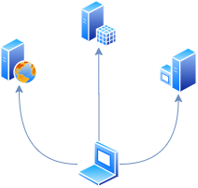
Server vs Client
Server
Computer that provides shared resources and serves client requests
Client
Computer that sends requests to other computers in the network
<number>

Slide 4
OSI vs TCP/IP

Slide 5
OSI Model
Open Systems Interconnection model
Conceptual/Reference model
Defines generic network communication processes
Layers communicate (pass information) with the layers above and below them
Gives people “jargon” with which to talk about data processing over a network
7
Application
6
Presentation
5
Session
4
Transport
3
Physical
Network
2
Physical
Data-Link
1
Physical
Physical

Slide 6
TCP/IP Model
Transmission Control Protocol/Internet Protocol
Developed prior to the OSI model
Developed by Department of Defense (DoD) in 1960s
Based on standard protocols
The “de facto” standard
7
Application
Application
6
Presentation
5
Session
4
Transport
Transport
3
Internet
Network
2
Physical
Network Interface
Data-Link
1
Physical
Physical

Slide 7
Transport Protocols (Layer 4)
Transmission Control Protocol (TCP)
Connection oriented
Establish connection before data can be sent
Uses Three-way handshake
Reliable and Error-checked
Error detection algorithm
Order algorithm
User Datagram Protocol (UDP)
Simple
Minimum of protocol mechanisms
Minimum latency
Not connection oriented
Good for applications that do not require reliable data stream service
Application developers must implement reliability on application layer
But Wait! There is more…
Stream Control Transmission Protocol (SCTP)
Datagram Congestion Control Protocol (DCCP)

Slide 8
Sockets and Ports
Combination of protocol, port number, source and destination IP address
Client
Source IP
10.20.30.40
Source
Port
24381
Listen on
Port
80
Server
Destination IP
10.20.30.1

Slide 9
Well known application protocols
HTTP
SMTP
SMTP Server to SMTP Server delivery
SMTP Client to SMTP Server delivery
POP3
IMAP
DNS
DHCP
FTP
SSH
RDP
VNC
NTP

Slide 10
IP Addressing

Slide 11
What is an IP Address?
Internet Protocol Address
Numerical label
Each device in TCP/IP network has an IP address
Displayed in human-readable notation
IPV4 - 172.16.254.1
IPV6 - 2001:db8:0:1234:0:567:8:1 (human-readable :D)
IP versions
IPV4
32 bits
First deployed in 1983 (ARPANET)
IPV6
128 bits
First deployed in ~2000
Today, we use both versions of the IP simultaneously

Slide 12
IANA
Internet Assigned Numbers Authority (IANA)
Global standardization organization (Located in US)
Oversees global IP address allocation
IPV4 and IPV6
IANA delegates allocations of IP address blocks to regional Internet registries
Each RIR allocates addresses for a different area of the world
IANA manages the global registry of the BGP Autonomous System Numbers (ASNs)
Manages the data in the root DNS nameservers
No more IPV4 public addresses…

Slide 13
IPV4 Addresses
32 Bits
11000000101010000001111000101000
4 groups of 8 bits (Octet)
11000000.10101000.00011110.00101000
Decimal base
192.168.30.40

Slide 14
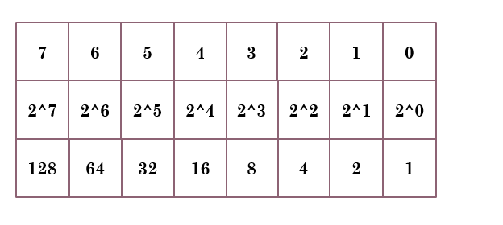
IPV4 Calculation
1
1
0
0
0
0
0
0
1
0
1
0
1
0
0
0
0
0
0
1
1
1
1
0
0
0
1
0
1
0
0
0
1*128 + 1*64
1*128 + 1* 32 + 1*8
1*16 + 1*8 + 1*4 + 1*2
1*32 + 1*8
192
168
30
40

Slide 15
Subnet mask (IPV4)
Also known as netmask
Solves some of the problems of classful addressing
Consists of 32 bits
Sequence of ones (1) followed by a block of zeros (0)
Ones - indicate bits used for the network prefix
Zeros - designates the host identifier
CIDR alternate method of representing subnet mask
Count of the number of network bits prefixed with “/” – 192.0.2.130/24
 | Binary form | Dot-decimal notation
IP Address | 11000000.00000000.00000010.10000010 | 192.0.2.130
Subnet mask | 11111111.11111111.11111111.00000000 | 255.255.255.0
Network prefix | 11000000.00000000.00000010.00000000 | 192.0.2.0
Host identifier | 00000000.00000000.00000000.10000010 | 0.0.0.130

Slide 16
IPV6
128 bits
0010000000000001000011011011100000000000000000000010111100111011 0000001010101010000000001111111111111110001010001001110001011010
8 groups of 16 bits
0010000000000001 0000110110111000 0000000000000000 0010111100111011 0000001010101010 0000000011111111 1111111000101000 1001110001011010
HEX base 16 bits
2001:0DB8:0000:2F3B:02AA:00FF:FE28:9C5A
Removing leading zeros
2001:DB8:0:2F3B:2AA:FF:FE28:9C5A
No subnet mask
Prefix Length or just prefix
Similar to CIDR in IPV4
No broadcast

Slide 17
DHCP
Dynamic Host Configuration Protocol
Dynamically assigns network configuration
Reducing the need for manual network administration
From home networks to big enterprise
DORA
Discover package is sent to every device in the network (Broadcast)
DHCP
Client
1. Discover
DHCP
Server
2. Offer
3. Request
4. Acknowledge

Slide 18
DNS
Domain Name System
Hierarchical naming structure - www.my.website.example.com
Decentralized architecture
Essential component of the Internet
Main goal
Translates human-readable domain names to the numerical IP addresses
Components
Name servers
Zones
Resolvers
Records
A
PTR
CNAME
MX
NS
More…

Slide 19
Wired vs Wireless
IEEE
IEEE 802.3 – Ethernet networks
IEEE 802.11 – Wireless local area networks

Slide 20
Network Adapter
Converts instructions from upper layers into
Electrical signals
Optical signals
Wireless waves
Converts the received signals into meaningful data for the upper layers

Slide 21

Hub and Switch
Hub
You can find such devices in a museum
Simple signal repeater
Supports multiple ports
Star wiring and central point of wiring
Layer 1 device
Switch
Same functions as Hub + more
Intelligent signal repeater
Understand the source and destination address
Repeats signals only to proper destination ports
Layer 2
Some switches support Layer 3 and Layer 4 features
Enhanced Switch
Router capabilities
Firewall capabilities
QoS

Slide 22
VLAN
Network traffic isolation
Groups physical or virtual devices in a logical network
Flexible management
No need to rewire network
No need to move devices

Slide 23
Overlay Netwokrs
Similar to VLAN but for big scale
A logical network built on top of a physical network
Cloud providers use overlay networks to isolate tenants
Overlay links are tunnels through the underlying physical network
Many overlay networks may coexist at once
Over the same underlying physical network
And providing its own isolation and services

Slide 24
Router
Layer 3
Routes traffic between networks
Routes traffic based on routing table
Manages routing tables by routing protocols

Slide 25
Routing Protocols
OSPF
BGP
IS-IS
IGRP
EIGRP
RIP

Slide 26
Internet
The Internet is a system of interconnected networks that spans the globe

Slide 27
Intranets and Extranets
Intranets are:
A group of services hosted on a network
A private structure
Internet-like service provision
Extranets are:
Similar services to Intranet
Exposed to networks outside of the Intranet
Services that require extra security measures

Slide 28
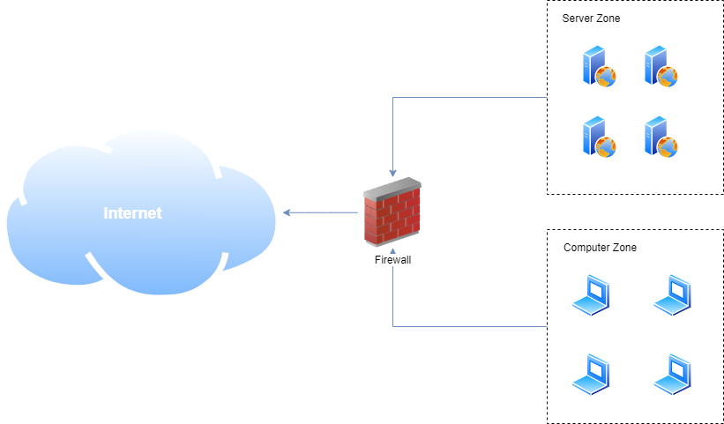
Firewall
A firewall is used to protect a private network from security risks inherent to connecting to an untrusted network
Rule based filtering
Anti-Virtus (AV) based filtering

Slide 29
IDS and IPS
Intrusion Detection System
Monitoring the events occurring in your network
Analyzing traffic for signatures that match known cyberattacks
Analyzing traffic for anomalies
Intrusion Prevention System
the process of performing intrusion detection and then stopping the detected incidents

Slide 30
VPN
Virtual Private Network
Method of extending a private network across public networks
Encryption is a common part of VPN
VPN Use Cases
Remote users
Mobile users
Site-to-Site

Slide 31
Proxy and Reverse Proxy Servers
Proxy servers
Cache information
Category based filtering
Anti-Virtus (AV) based filtering
Artificial Intelligent (AI) based filtering
Auditing and logging
Reverse proxy servers
Controlling web traffic
Securing web traffic
Offload HTTPS
Inspect traffic
Allow load balancing

Slide 32
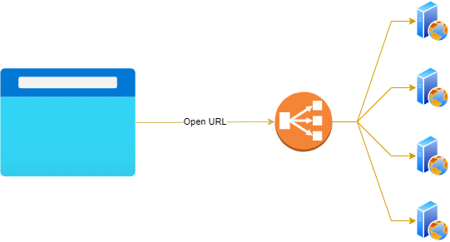
Load Balancer

Slide 33
Web Services

Slide 34
Web Services
The era before the Web Services
Inter-process communication (IPC)
Using pipes, shared memory, message queues, semaphores/mutex, COM, etc.
Inter-process communication over network
Using sockets, DCOM, RPC, CORBA, RMI, etc.
HTTP - the “de facto” web services transport protocol
Exchange objects and messages through HTTP protocol
Foundation of the World Wide Web
Universally accepted
Firewall friendly
Secure (HTTPS)
Variety of tools and languages

Slide 35
SOAP and REST
SOAP
Simple Object Access Protocol
Strict rules to prepare request and response
Web Services Description Language (WSDL)
Relies heavily on XML
“Legacy”
REST
Representational State Transfer
Not very restrictive
Closer to Web in design philosophy
URI based
HTTP Verbs
HTTP Status codes
Variety of data formats (XML, JSON, YAML, etc)
Foundation for Microservices

Slide 36
SOAP Example
HTTP/1.1 200 OK
Date: Fri, 22 Nov 2013 21:09:44 GMT
Server: Apache/2.0.52 (Red Hat)
SOAPServer: SOAP::Lite/Perl/0.52
Content-Length: 566
Connection: close
Content-Type: text/xml; charset=utf-8
<?xml version="1.0" encoding="UTF-8"?>
<SOAP-ENV:Envelope xmlns:xsi="http://www.w3.org/2001/XMLSchema-instance"
xmlns:SOAP-ENC="http://schemas.xmlsoap.org/soap/encoding/"
xmlns:SOAP-ENV="http://schemas.xmlsoap.org/soap/envelope/"
xmlns:xsd="http://www.w3.org/2001/XMLSchema"
SOAP-ENV:encodingStyle="http://schemas.xmlsoap.org/soap/encoding/">
<SOAP-ENV:Body>
<namesp1:easter_dateResponse xmlns:namesp1="http://www.stgregorioschurchdc.org/Calendar">
<s-gensym3 xsi:type="xsd:string">2014/04/20</s-gensym3>
</namesp1:easter_dateResponse>
</SOAP-ENV:Body>
</SOAP-ENV:Envelope>

Slide 37
REST Example
GET http://server/employees HTTP/1.1
Host: server
User-Agent: Client
HTTP/1.0 200 OK
Content-Type: application/json
Content-Length: 291
Access-Control-Allow-Origin: *
Server: Werkzeug/0.14.1 Python/3.6.7
Date: Thu, 28 Feb 2019 09:57:01 GMT
[
{
"id": 1,
"name": "John Doe",
"status": "enabled",
"lastAction": "enable",
"lastActionReason": "Hire new Python Developer."
},
{
"id": 2,
"name": "Doe Johnson",
"status": "disabled",
"lastAction": "disable",
"lastActionReason": "Left the company."
}
]

