Slide 1
Security
Understanding security

Slide 2
Defense in Depth
DiD

Slide 3
Defense in Depth
Defense in depth is a concept used in Information Security
Multiple layers of security controls
National Security Agency (NSA)
Inspired by a military strategy

Slide 4
Defense in Depth Layers
Policies, procedures and awareness
Define security policies and procedures
Educate people about the security
Alarm systems, guards, locks,
video surveillance
Physical Security
Firewall devices, VPN quarantine,
IDS and IPS
Network segmentation, IDS and IPS
Perimeter Network
OS hardening, update management,
Antivirus management, auditing
Application hardening, MFA, audit
Internal Network
Authorization control, encryption, backup
Host
Application
Data

Slide 5
Common Attacks
Eavesdropping / Sniffing
Denial-of-service (DoS) and Dynamic Denial-of-Service (DDoS)
Port scanning
Replay Attacks
Man-in-the-middle
Social engineering
Backdoor creation
E-mail address theft / phishing attack
Email and Instant messaging
Exploiting product/code vulnerabilities
Exploiting third party dependencies
Exploiting new technologies

Slide 6
Cryptographic
Method of protecting information and communications
Mitigate – Eavesdropping and Man-in-the-middle attacks

Slide 7
Hash Functions
Mathematical algorithms
Generate a fixed-length result
Always the same from a given input
Summary of the original data
One-way algorithm
Example
Hello Mr. Born! - 7f2a0177f4d55500563881000e9b18af
hello Mr. Born! - ff38c3c9dcf2891a19e8164843a408e3
Hello Mr. Born - 897cacdc19b5bb20898f926ad8dbc05b
Hello Mr. Born, - 4b42f584469d23d01d45e1dcf49837e3

Slide 8
Encryption
Way of scrambling data
Only authorized parties can understand the information
Types
Symmetric Encryption
Asymmetric Encryption

Slide 9




Symmetric Encritpion
Encrypt
Decrypt
Sh@RDk3Y
Sh@RDk3Y

Slide 10
Asymmetric Encryption
Encrypt
Decrypt
Key1
Key2

Slide 11
Asymmetric Encryption
Public key = (n, e) = (33, 3)
Private key = (n, d) = (33, 7)
Message = (m) = 7
EncryptedText (c) = m^e mod n = 7^3 mod 33 = 13
decryptedText = c^d mod n = 13^7 mod 33 = 7

Slide 12
Digital Certificates
Electronic document
Prove the ownership of a public key
Includes
Public key
Information about the identity of its owner (subject)
Digital signature of the certificate issuer
Validity information
Additional information
Purpose
Encrypt data
Sign data

Slide 13
Public Key Infrastructure (PKI)
Set of hardware, software, policies, processes, and procedures required to issue, manage, distribute, use, store, and revoke digital certificates and public-keys
Certificate Authorities (CAs)
Issue the digital certificates
Use self signed certificate
You send them your public key and metadata
Trusted vs untrusted certificate authority

Slide 14
DevSecOps, CI/CD and Version Control Systems
Mitigate product/code and third-party dependency vulnerabilities

Slide 15
What is DevSecOps
DevOps
Culture
Practices and Processes
Tools
DevSecOps
DevOps + Security mindset
It is not a job position – DevSecOps Engineer == Anti-Pattern
Team or Community effort
Implement control validation in the path to production PIPELINE
Usually integrated with Version Control System (VCS)
DevSecOps and CI/CD == Best Friends
Static Code Analysis
Third Party dependencies scanning – Security, Licensing and more.
Artifacts vulnerability scanning
Automation:
Reduce the risk of human errors
Effectives
Reliability
Scalability

Slide 16
Version Control System (VCS)
Practice of tracking and managing changes to software code
Nowadays, we use them to store the definitions of our infrastructure as code
Also known as source control system
It keeps track of every modification to the code in a special kind of database
Most of the version control systems today support branches
Isolated copy of code in the version control system
Branches allow parts of software to be developed in parallel without interference
There is usually one main branch (originating branch/upstream branch)
Branches can be integrated, merging the changes from one branch to another

Slide 17
Git
Distributed version control system
Free and open source
The De facto standard (Almost all projects use Git today)
Easy to learn
Created by Linus Torvalds in 2005

Slide 18
Why Distributed Version Control System?
Remote repository
Commit
Commit
Commit
Commit
Local repository
git clone
git clone
Local repository
Commit
Commit
Commit
Commit
Commit
Commit
Commit
Commit

Slide 19
Git commit vs push
Remote repository
git push
Commit
Commit
Commit
Commit
Local repository
git commit
git add
Commit
Commit
Commit
Commit
Commit

Slide 20
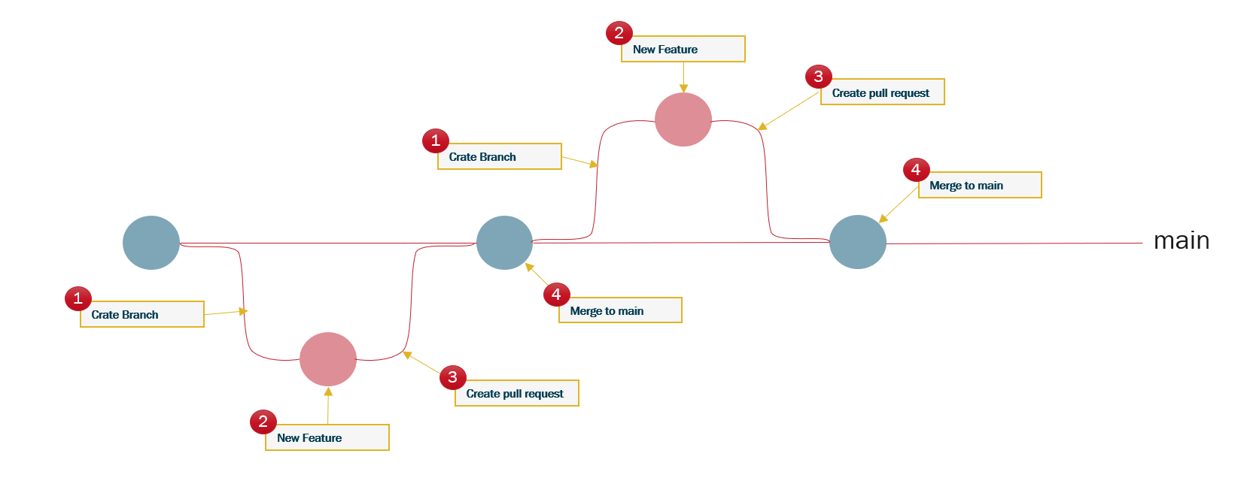
Branch Protections Ideology

Slide 21
Why DevSecOps and CI/CD
Continues Integration
Coding philosophy and set of practices
Push code to version control repositories
Every push triggers a build
Source code is tested, and security scanned
Artifact is produced
Continues Delivery/Deployment
Picks up where continuous integration ends
Automates the delivery of artifacts (procedure by CI)

