Slide 1
RedHat IPA/FreeIPA Identity Management
Understanding FreeIPA

Slide 2
RedHat IDM – IPA and FreeIPA
RedHat IdM
Red Hat Enterprise Linux provides a centralized and unified way to manage identity stores, authentication, policies, and authorization policies in a Linux-based domain.
FreeIPA
Upstream version of RedHat IdM IPA

Slide 3

What is FreeIPA
Integrated Identity and Authentication solution for Linux and UNIX
FreeIPA is a domain controller for Linux and Unix machines
Central Identity and Policy management
Open Source (GPLv3)
RedHat Project
Standard Protocols
Easy of use and manage

Slide 4
FreeIPA goals
Single source for Identities
Single-Sign-On / Single-Password
Single point of Access Management
Highly Availability

Slide 5
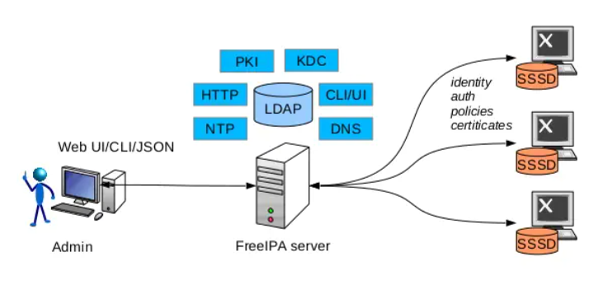
FreeIPA Diagram

Slide 6
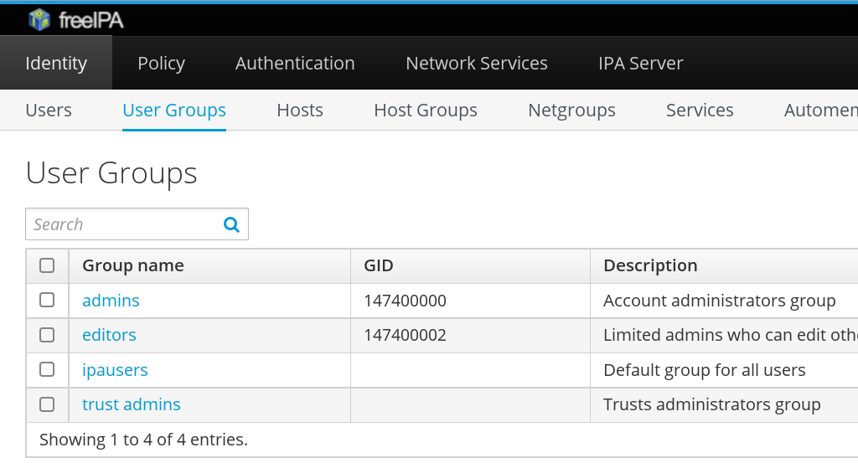
FreeIPA UI

Slide 7
Protocols and Technologies
DNS
(BIND)
System Security Services Daemon (SSSD)
DogTag certificate system
(MIT)
Kerberos
ntpd
Python
Directory Server (LDAP, 389)
Apache Web Server
Linux (RHEL/CENTOS/FEDORA)

Slide 8
Identity
User
Groups
Hosts
Hostgroups
Services
Certificates

Slide 9
Policy
Access Control Lists (ACL)
Host Based Access Control
SUDO Rules
Automount
SELinux User Maps
Cross Domain Trusts

Slide 10
Extensible Management Interfaces
CLI
Web UI
XMLRPC API
JSONRPC API
Python SDK

Slide 11
Active Directory Integration
Supports native Active Directory Forest Trust between FreeIPA and ADDS
Minimum Windows Server 2008 R2 level

Slide 12
Fleet Commander
Desktop configuration tool
Plugin/Extension for FreeIPA
Broadly comparable to Windows Group Policy Objects (GPO)
Gnome settings (GSettings)
Network Manager settings
LibraOffice settings

Slide 13
FreeIPA Workshop
In this workshop you will learn how to
Deploy FreeIPA servers
Enroll client machines
Define and manage user and service identities
Set up access policies
More
https://github.com/freeipa/freeipa/tree/master/doc/workshop

