Slide 1
Operating System Architecture
1000 meters view…

Slide 2
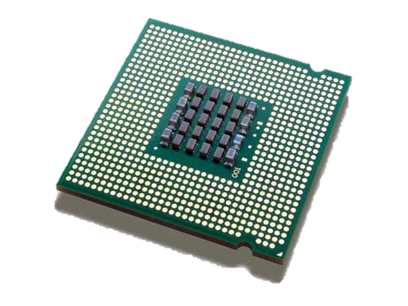
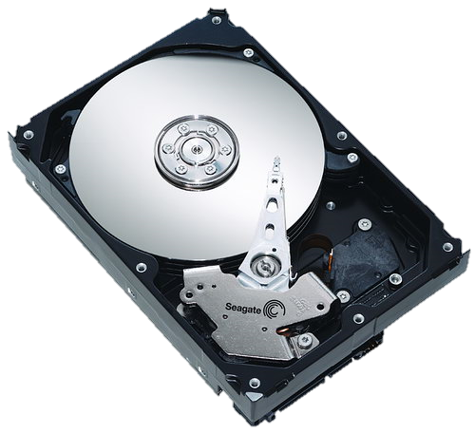
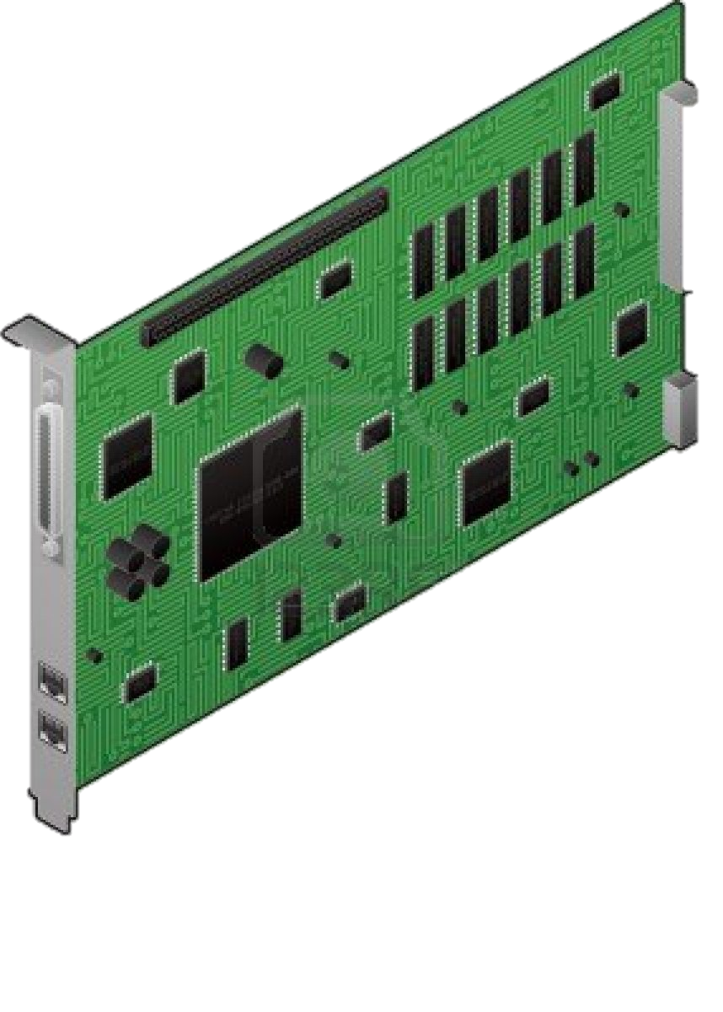
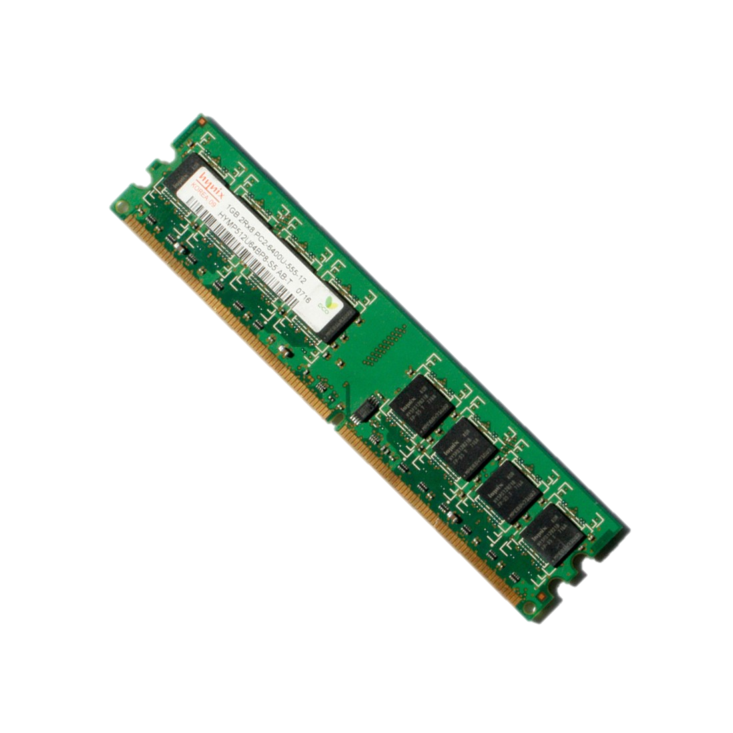
Operating System
Controls hardware resources
CPU
Memory
Network
Storage
More…
Developer point of view
Provides application programing interfaces
Provides common services
User point of view
Operating system is there to execute programs

Slide 3
Operating System Categories
Desktop
Windows
Linux
MacOS
More…
Server
Linux
Windows
Unix – BSD, AIX, HPUX..
More…
Mobile
Android
IOS
More…
Embedded
Windows CE
Minix
Linux
More…
Real-time (RTOS)
QNX
RTLinux
Windows CE
More…
More…

Slide 4
Modern OS High Level Design
User
Space
User Applications
Operating System
Services
Core Libraries
Kernel
Space
OS Kernel
Kernel Modules / Drivers
Memory Manager
Syscall
Handler
VFS
Filesystems
Video Devices
Keyboard and Mouse
Network Manager
I/O Manager
Process
Scheduler
Storage
Devices
Network Devices
USB
Hardware

Slide 5
What is a Process
Represents an instance of a running program
OS create a process to run a program
Starting an application creates a process

Slide 6
What is a Deamon or Service?
A Deamon is a long running process that operates in background
Provides specific function that is designed to require no user intervention
Can be configured to start when the operating system is started
Also known as Service in Windows
Example of deamons:
Web Server (Apache, Nginx, IIS)
Database Server (MySql, MongoDB, MSSQL)
More…

Slide 7
Multitasking
CPU Core == Single Task
Only one process can be executing at any one time on a single CPU core
What is Multitasking
Allow multiple processes to share same CPU and other system resources
Multitasking operating system
OS switches between processes to give the appearance of many processes executing simultaneously
Cooperative vs Preemptive
cooperative multitasking
processes decide for how long it keeps the CPU
preemptive multitasking
processes are not in control for how long they are going to use the CPU

Slide 8
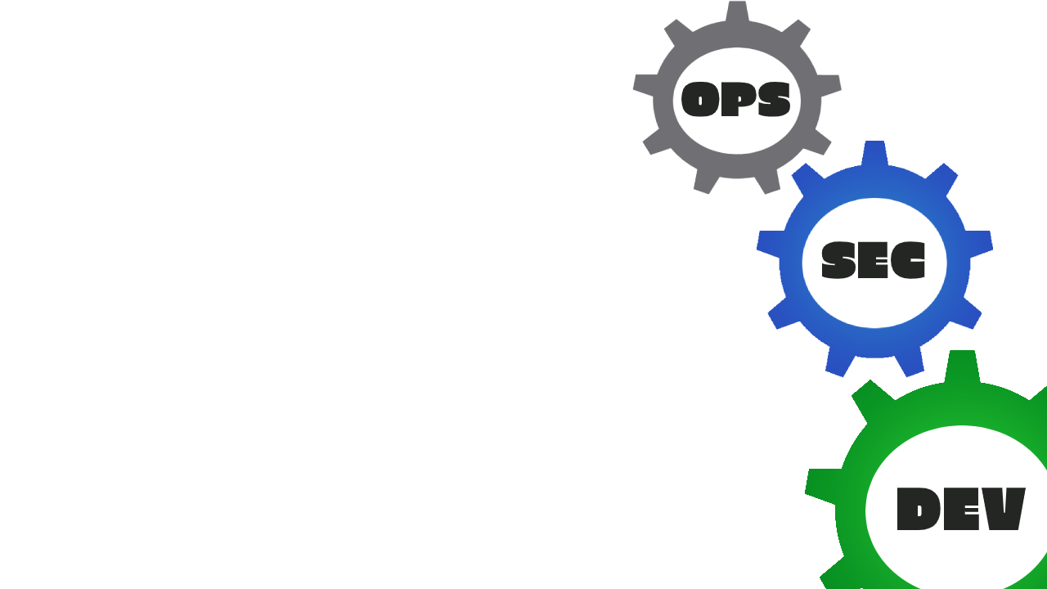
Protection Rings (a.k.a. Isolation Rings)
Protects data and functionality from faults
Hardware-enforced by CPU
CPU microcode
Applications
3
2
Isolation
1
OS Kernel
Nginx
0
Redis

Slide 9
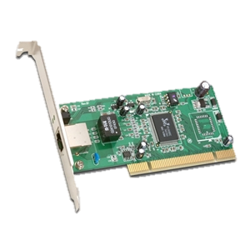
What is a Module or Driver?
Device
A device is a unit of hardware that performs a special function and is attached to a computer.
Kernel module or Device Driver
A device driver is a small software program that operates or controls a particular type of device that is attached to a computer.

Slide 10
How does the OS know which driver to use?
Device identification string
The computer devices have a set of registers that identify the vendor and the device model
The OS uses those IDs to identify the attached devices and to select the suitable drivers for them
Example of device identification string:
PCI\VEN_10E8&DEV_4750

Slide 11
Virtualization

Slide 12
Virtualization
Virtualization is a term that refers to various techniques, methods or approaches of creating a virtual version of something.

Slide 13
Virtualization Types
Hardware Virtualization
Container Virtualization
Application Virtualization
Presentation Virtualization
More…
Nowadays you can see the term Virtualization everywhere. Most of the time this is just a marketing trick!

Slide 14
Hardware Virtualization
Virtual Machines

Slide 15
Hardware Virtualization
Virtual Machine (VM) acts like a real computer
operating system
applications
Hypervisor
The software that creates and manages the virtual machines
We also use the terms
Guest OS
Host OS

Slide 16
Full Virtualization
Guest OS is not aware it is virtualized
Guest OS requires no modification
Virtual Machine has all standard components
Virtual processors
Memory
Network Adapters
Virtual Disks

Slide 17
Para virtualization
Guest OS is modified
Guest OS is aware that it is running on a hypervisor
Guest OS does not communicate directly with the hardware, but with the hypervisior
All privileged instructions are replaced with direct calls to the hypervisior

Slide 18
What we use today?
Full or Para Virtualization

Slide 19
Hardware assisted virtualization
Approach that enables efficient full virtualization using help from hardware capabilities
Applications
Applications
Applications
…
Ring 3
Linux
Windows
BSD
…
Ring 0
Hypervisor
Ring - 1
Hardware

Slide 20
Hardware assisted virtualization G1
The modern CPU’s include hardware assisted virtualization
Intel-VT
AMD-V
Introduced first in 2005 (Intel-VT)
Makes it possible to support unmodified guests
No emulation
No instructions translation

Slide 21
Hardware assisted virtualization G2
Second Level Address Translation (SLAT)
Intel VT Extended Page Tables (NPT)
AMD-V Rapid Virtualization Indexing (RVI)

Slide 22
Hardware assisted virtualization G3
Nested Virtualization?
PCI Express Virtualization?
Makes one device “look” like multiple devices
Virtual devices appear completely independent

Slide 23
So what we use today?
Hardware assisted virtualization!
But wait! That’s not all.
We also use para-virtualized devices
Para-virtualized devices are optimized virtual devices designed for Virtualization
Decrease I/O latency
Increase I/O throughput
Provide near bare-metal performance
Needs special device drivers
Conclusion – The Virtualization today
We use combination of full and para virtualization
OS is not modified since we use the effective hardware assisted virtualization
CPU and Isolation rings
Memory Management
We use special para-virtualized devices and drivers to provide effective I/O performance
Storage
Networking
Etc.

Slide 24
Example of Hypervisors
VMWare ESXi
Hyper-V
KVM
XEN
VirtualBox

Slide 25
Containers
a.k.a. OS-Level Virtualization

Slide 26
Containers
Form of operating system virtualization
OS Kernel creates multiple isolated user space instances
Process from one user space sees only it’s space
Process from one user space “cannot” affect process of another user space
This makes them more lightweight and portable than VMs
The “de facto” standard for modern microservices architecture
Serios vulnerabilities have been reported many times with container isolation mechanisms. There is always a risks of container escape vulnerability. This makes then less secure than virtual machines and not preferred approach for some use cases.

Slide 27
Containers
Namespace isolation
Process tree
Networking
User IDs
File Systems
IPC
Resource limitation
CPU
Memory
I/O
Network
Container
Container
Container
APP A
APP B
APP C
Libs
Libs
Libs
Operating System
Hardware

Slide 28
Brief History of Containers
1979 - Chroot
2000 - FreeBSD Jails
2001 - Linux VServer
2004 - Solaris Containers
2005 - Open VZ (Open Virtuozzo)
2007 - Control groups (cgroups)
2008 - LXC (LinuX Containers)
2013 – Docker
2015 – Kubernetes
2016 – Windows Native Containers
More…

Slide 29
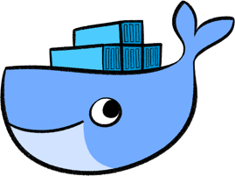
Docker
Standardized packaging for software
Simplify building, shipping, running apps
Isolate apps from each other
Share the same OS kernel
Works for all major Linux distributions
Open Source platform
Container
Container
Container
SQL
WebApp
Rest Service
Libs
Libs
Libs
Operating System
Hardware

Slide 30




Docker components
Docker Image
The basis of a Docker container. Represents a full application
Docker Container
The standard unit in which the application service resides and executes
Docker Engine
Creates, ships and runs Docker containers on physical or virtual
Registry Service (Docker Hub(Public) or Docker Trusted Registry(Private))
Cloud or server-based storage and distribution service for your images

