Slide 1
MSTSpatial: A Merge Sort Tree Based Index For Spatio-Temporal Range Queries
Course Project
DS 256: Scalable Systems for Data Science
Indian Institute of Science, Bengaluru

Slide 2
Introduction (Context)
Data characterized by high volume and high velocity with the rise of IoT and “location-aware” devices/sensors.
Analytics based on extracting value by quantifying the position, trajectory, and behavior of people and objects

Slide 3
Introduction (Motivation)
Efficient querying of spatio-temporal datasets in both time and space resources is important for:
    improving the accuracy of data processing
    data pre-processing for running analytics efficiently
Spatio-temporal query though costly in time, is a basic yet fundamental operation.

Slide 4
Key Contributions
A novel Merge Sort Tree based index on spatio-temporal points for efficient storage in Apache Spark
Using the index for answering Spatio-temporal range queries efficiently
A promising display of results with a naive baseline on a large dataset with 20 Million Points, creating room for further comparisons with existing work in the domain

Slide 5
Related Works (Hadoop based frameworks)
SpatialHadoop: extension of Hadoop MapReduce from spatial datasets.
The problem we aim is motivated from the Spatio-Temporal Range Query in Spatial Hadoop
SQL extension for higher-level abstraction - Pigeon

Slide 6
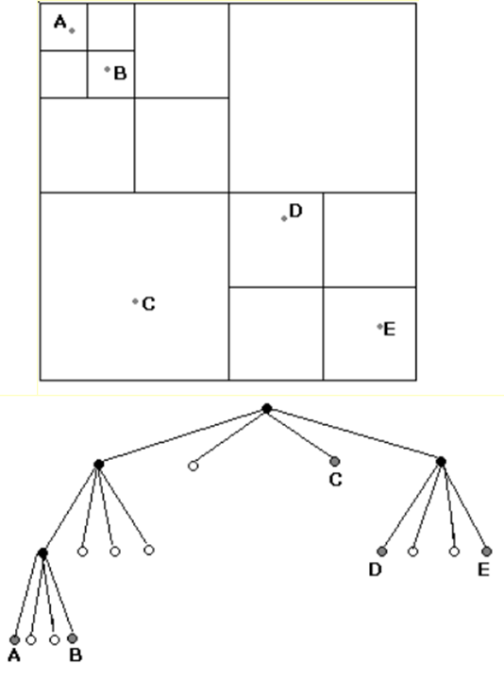
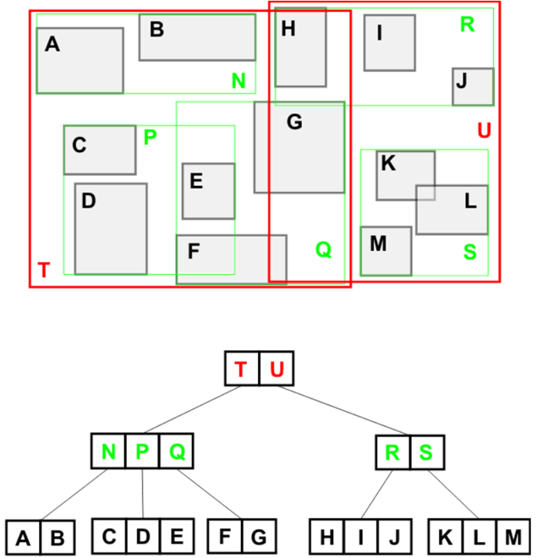
GeoSpark … SpatialRDD … Local Indexing
R-tree Quad-tree
https://cglab.ca/~cdillaba/comp5409_project/R_Trees.html https://www.cs.umd.edu/~mount/Indep/Ransom/index.htm

Slide 7
Apache Sedona … SpatialRDD … Local Indexing
R-tree Quad-tree
https://cglab.ca/~cdillaba/comp5409_project/R_Trees.html https://www.cs.umd.edu/~mount/Indep/Ransom/index.htm

Slide 8
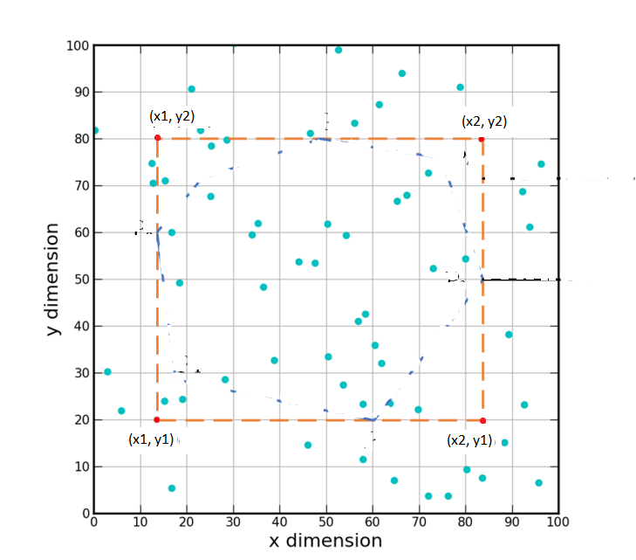
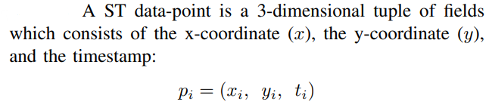
Problem Definition of Spatio-Temporal Query
To find all the spatial data points within the Bounding Rectangle (BR) at a given time instant.
Query Form: Qi = (ti, x1, x2, y1, y2)

Slide 9
Preliminary Details and Assumptions
All queries are known before hand
The total number of distinct bounding rectangles in the queries is a moderately small number
Last, for the time instance, we process every point on a per day basis at the granularity of 1 second:
    Every timestamp in some given time zone is subtracted from a reference time '00:00:00'

Slide 10
Methodology
Input Points in the Dataset: (xi,yi,ti)
Global Index: ti % numberOfPartitions
Local Index: Merge Sort Tree based Local Index
Structure of Datapoint at local Index: [For All Distinct Ti: {Map Containing the Mapping from {DISTINCT BOUNDING RECTANGLE IN QUERIES -> Count of Spatio-Temporal Points} for each distinct bounding rectangle }

Slide 11
Algorithm For Local MST Based Index
Every partition initially has a part of the dataset, i.e. Spatio-Temporal Points (xi,yi,ti), and the distinct bounding rectangles' data of the form (x1j,x2j,y1j,y2j)
Group by Ti
Now, for every Ti: we have a separate 2D space set of points (x_t_i, y_t_i)
Next, sort points w.r.t x_t_i
For given bounding rectangle in each time instance, (x1,x2,y1,y2): Filter out initial contenders for points by using binary search on the points array sorted w.r.t x_t, we search for the smallest index with x_t_i >= x1 and largest index such that x_t_i <= x2. Let these indices be L,R
Finally in the sorted points array, we need to compute in index range [L,R], number of points with y_t_i >= y1 and y_t_i <= y2
We build a Merge Sort Tree for every distinct Ti to answer queries for all L,Rs for all Bounding Rectangles efficiently

Slide 12
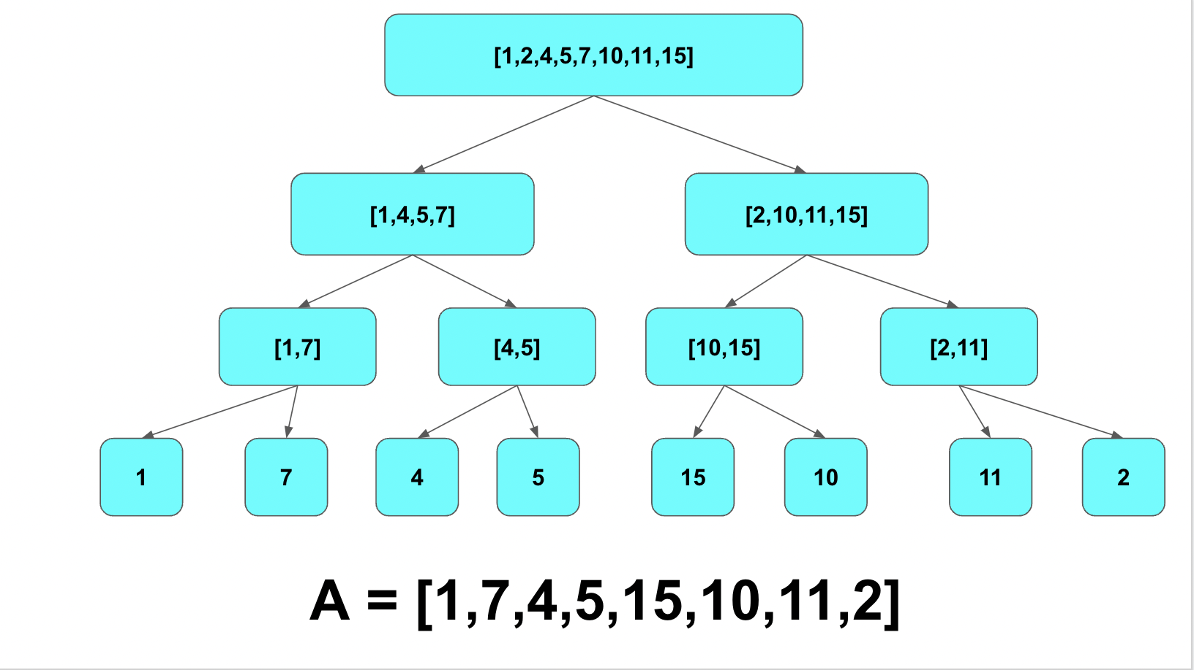
Merge Sort Tree

Slide 13
Answering The STRQ
Input Query: Qi = (ti, x1, x2, y1, y2)
Using (ti % numberOfPartitions), just load the respective partition for the given ti, hence pruning rest of the data
At every partition, we have the following structure stored
  For all distinct timestamps and all distinct bounding rectangles from the queries, we have a map of the form: {boundingRectangle: spatioTemporalPointCount}
Just a 2-way loop-up in the local partition data, first look-up w.r.t ti, then in the map, look-up w.r.t bounding rectangle (x1, x2, y1, y2)

Slide 14

Experiments
Experimental Setup
      Experiments performed on Turing Cluster
      24 compute nodes, 8 cores and 32GB RAM each
      1 Head Node, 6 cores and 48 GB RAM
  Datasets Used

Slide 15
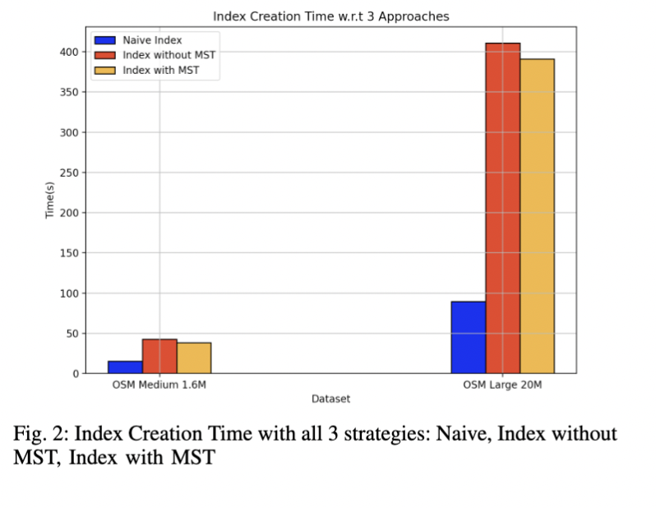
Evaluation And Results
Index Creation Time For 3 strategies
  Naive
  Index without MST
  Index with MST
Key Takeaways
  Naïve Index has the least index creation time because of no pre-processing
  Not much gain due to MST due to lesser width bounded rectangles in our queries
  Hypothesize promising gains with increase in size of bounded rectangles in queries

Slide 16
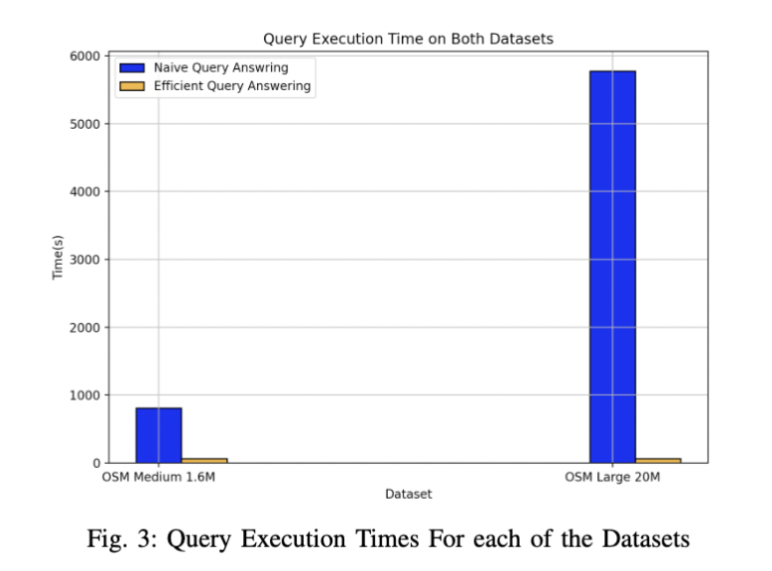
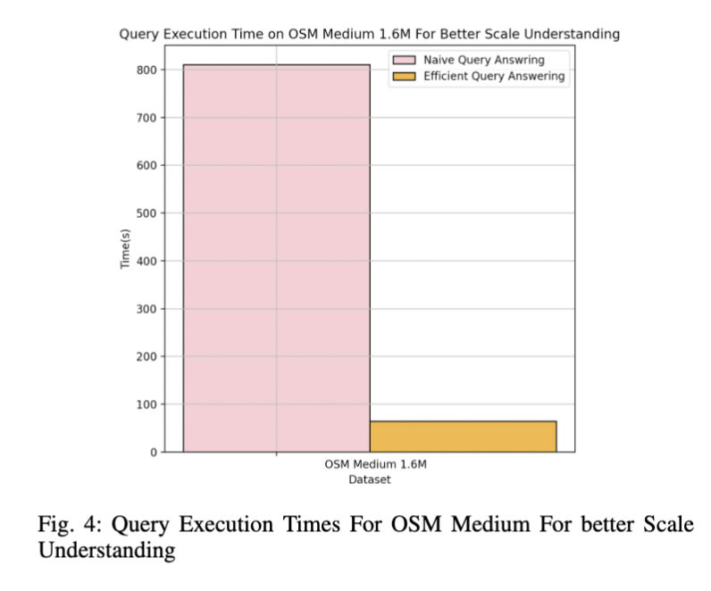
Query Execution Times
  Observed 100x Speedup on OSM Large
  For constant number of queries MSTSpatial takes constant time, irrespective of the dataset size
    Explained by single partition lookup for every query

Slide 17
Conclusion and Future Works
Compare performance with existing platforms, and possibly out-perform them
Segment trees open routes to Point updates and range updates, paving path for incremental analysis
Extend the features of MSTSpatial to offer another class of problems: Trajectory Analysis
We successfully implemented a novel index for answering STRQ, and achieved a 100x speedup compared to the baseline
To conclude , MSTSpatial is certainly a promising framework for geo-spatial data analysis

Slide 18
Thank you.

