Slide 1




Decision Support System
P r o j e c t M o n i t o r i n g 6
Project Guide:-
Dr. Parminder Kaur

Slide 2





Contents
Till Last Project monitoring
ML Model.
Deployment in the Android application
Deployment in the Web Application
Chat bot for Homemade methods
Screenshots of Website (Login Page)
Output
Conclusion and Future Scope

Slide 3
Till Project Monitoring 5
Learned factors influencing Crop selection.
Weather Forecasts.
Learning economical conditions of farmers including land holding.
Learning Different types of soils.
Creating the ML model to detect the soil type.
Creating a web Model.
Creating an Android Application

Slide 4
ML Model
We have created a ML model which takes soil image as a input
and predicts the Soil type of the farm.
We have created this model using keras library.
We deployed this model in the android application as well as
Web application.
Deployment in the Android application is done through the tensor flow lite model
Deployment in the Web application is done through the Flask.

Slide 5
ML Model
At the first time we created a model which is consist of 4 major
soil types namely alluvial, black ,clay, red soil.
We gathered around 900 images of these 4 types.
Now our latest ml model consist of 10 different Indian soil types.
Different Indian soil types are namely Alluvial, Black, red, Clay,
Saline, Clay, Black, Mountain, Dessert, laterite.

Slide 6
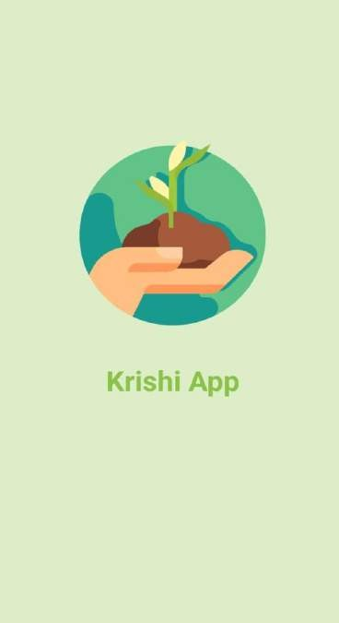
Deployment in the Android Application
We have created a ML model which takes soil image as a input and predicts the Soil type of the farm.
Deployment of this Ml model in the android application
is done through the tensor flow lite model.
Currently The android application is consist of the login and registration for user, soil health analysis, soil type identifier and weather forecast

Slide 7
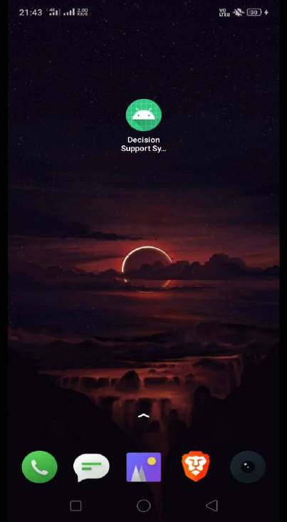
Android Application

Slide 8
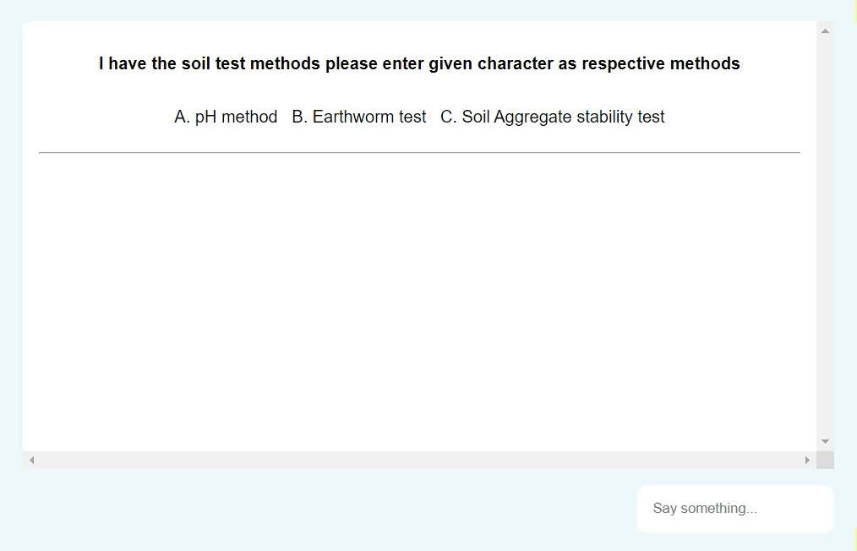
Chat Bot for Homemade Methods

Slide 9
Deployment in Web Application
We have created a ML model which takes soil image as a input
and predicts the Soil type of the farm.
Deployment of this Ml model in the Web application is done through the Flask library.
Web Application also consist of home made methods to improve
soil health.
Currently The Web application is consist of the soil health analysis, soil type identifier and weather forecast

Slide 10
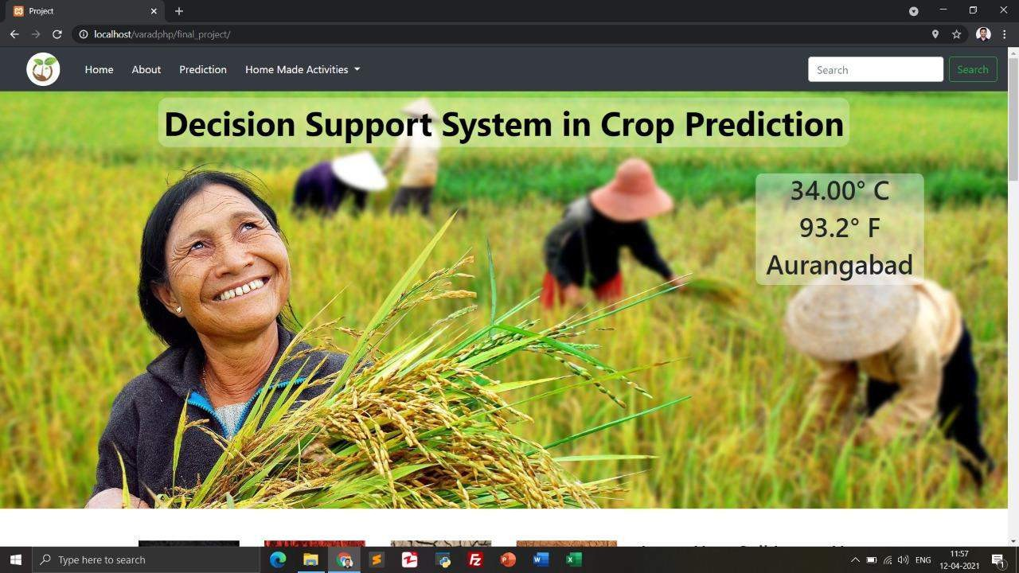
Output: Web Application

Slide 11
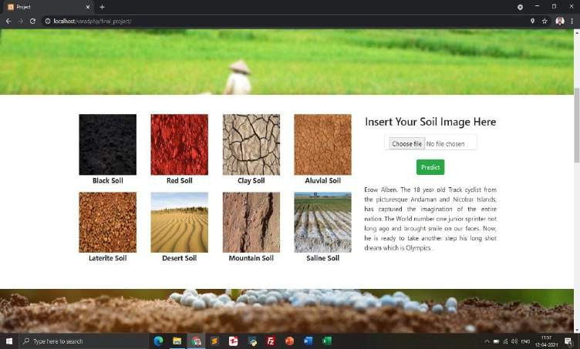
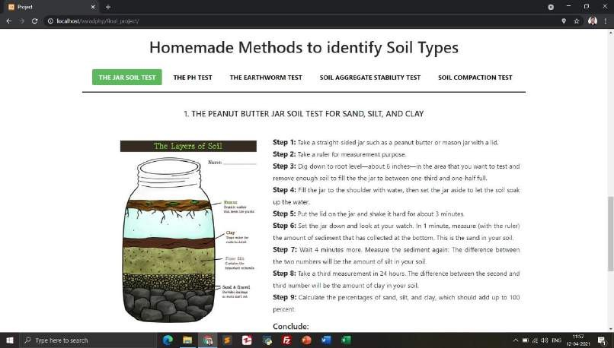
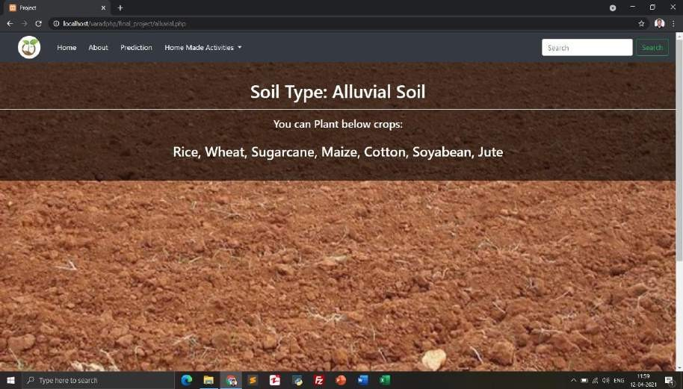

Slide 12
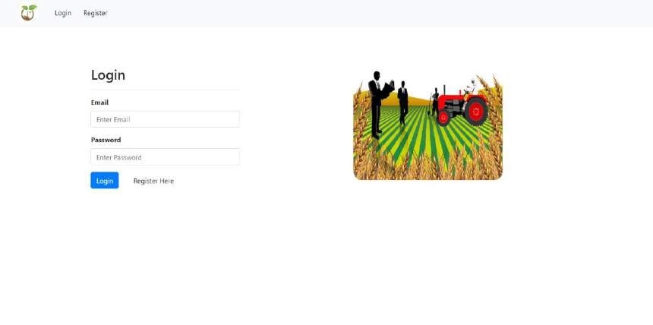
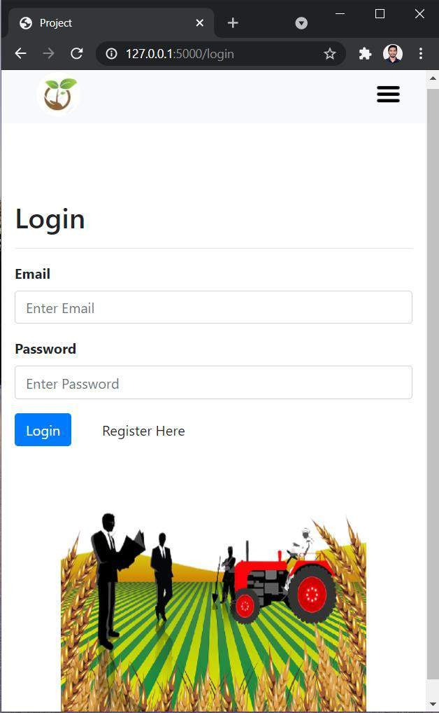
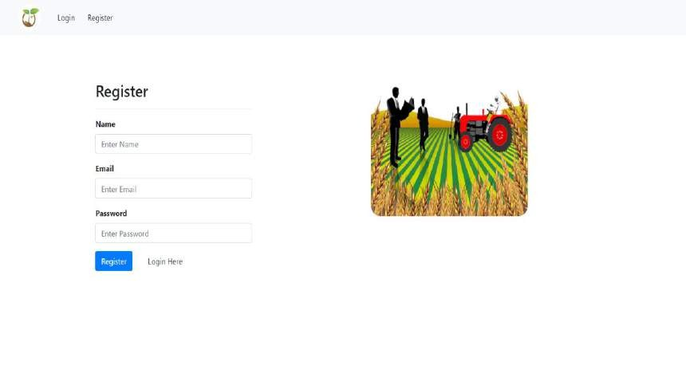

Slide 13
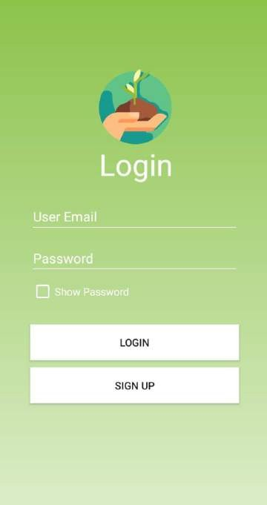
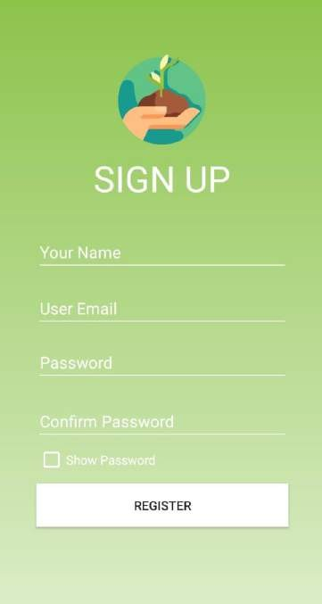
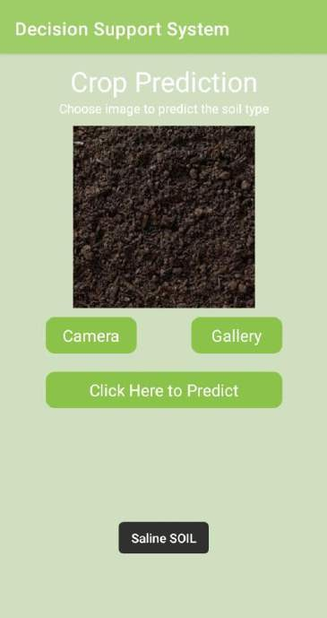
Output: Android App

Slide 14
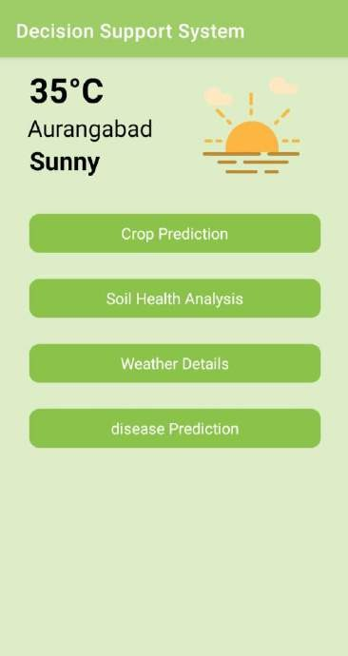
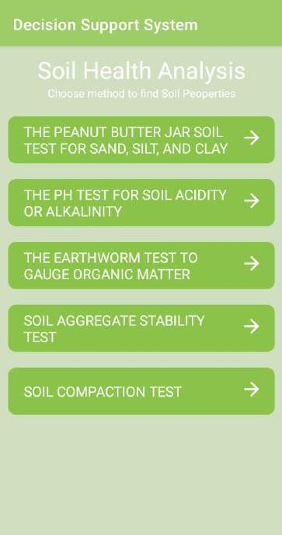
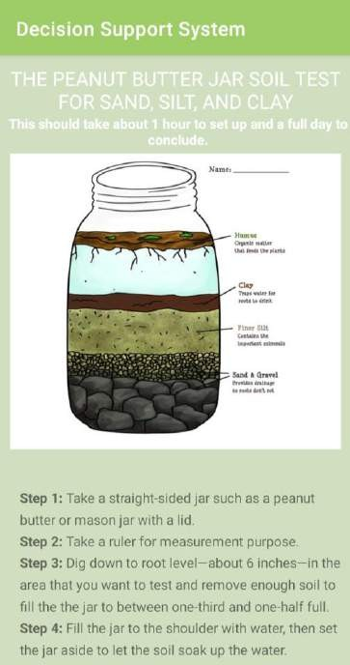

Slide 15




Conclusion and Future Scope
•
We have built a portal and application for the Farmers in collaboration with maker's lab which would help them to get assistance regarding crop cultivation strategies, primarily for the services of prediction, recommendation, and information of crops, weather forecast and soil analysis.
In Future we recommend optimum decisions for crops to be cultivated by farmers based on several parameters and help them make an informed decision throughout cultivation such as disease prediction, irrigation management, pesticides to be used, locust attacks, emergency weather alerts, and many more.
•

Slide 16
Resources
▪
▪
▪
https://ncert.nic.in/ncerts/l/kegy106.pdf https://www.tensorflow.org/tutorials/keras/classification
https://www.analyticsvidhya.com/blog/2020/09/integrating-machine-learning- into-web-applications-with-flask/
https://towardsdatascience.com/building-a-web-application-to-deploy-machine- learning-models-e224269c1331
▪

Slide 17

Thank You

