Slide 1


CMPE 202 Software Systems Engineering January 28 Class Meeting
Engineering Extended Studies San Jose State University Spring 2026 Instructor: Ron Mak
www.cs.sjsu.edu/~mak

Slide 2
Today
Introduction
Recursion
Towers of Hanoi puzzle
The Fibonacci recursion disaster
Break
Quicksort
Recursion with dynamic backtracking
The Eight Queens puzzle
Solving Sudoku puzzles

Slide 3
Contact Info
ron.mak@sjsu.edu
Office hours
Up to one hour in person after each class. Online by appointment.
Website
Faculty webpage: http://www.cs.sjsu.edu/~mak/
Class webpage: http://www.cs.sjsu.edu/~mak/CMPE202/
Syllabus
Lecture notes
Example code
Assignments

Slide 4
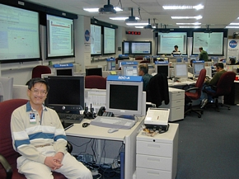
Short Bio
Lecturer at San Jose State University since Spring 2008
Department of Computer Science
Department of Applied Data Science
Department of Computer Engineering
Engineering Extended Studies
Formerly
Senior Scientist at the NASA Ames Research Center and JPL
Research Staff Member IBM Research
Software Strategist Lawrence Livermore National Lab
Software developer, project lead, engineering manager, etc. at various Silicon Valley companies
http://www.cs.sjsu.edu/~mak/
Mission Control, Jet Propulsion Laboratory (JPL) NASA Mars Exploration Rover Mission

Slide 5
Goals of the Course
The primary goal of the course
is to become a much better programmer.

Slide 6
Outline of the Course
Recursion and backtracking
Introduction to multithreading
The software development path
It’s an iterative process!
Design the right application
Requirements
Design the application right
Good class design
Design principles
Design patterns

Slide 7
Course Learning Outcomes
CLO 1: Software design and development process: Use an approach to software development consisting of multiple design-code-test iterations. Model design with UML diagrams.
CLO 2: Requirements gathering and analysis: Gather the requirements for a software application, distinguish between functional and nonfunctional requirements, and express the requirements in the form of use cases. Analyze the requirements to derive the initial set of classes.

Slide 8
Course Learning Outcomes, cont’d
CLO 3: Design principles: Practice good design principles, including single responsibility, open-closed, code to the interface, Law of Demeter, and Liskov Substitution Principle.
CLO 4: Design patterns: Learn major “Gang of Four” design patterns and recognize when it is appropriate to apply them.
CLO 5: Recursion and backtracking: Design elegant solutions to certain types of programming problems using powerful recursion and backtracking techniques.

Slide 9
Course Learning Outcomes, cont’d
CLO 6: Introduction to multithreading: Use multithreading where appropriate to achieve runtime concurrency.

Slide 10
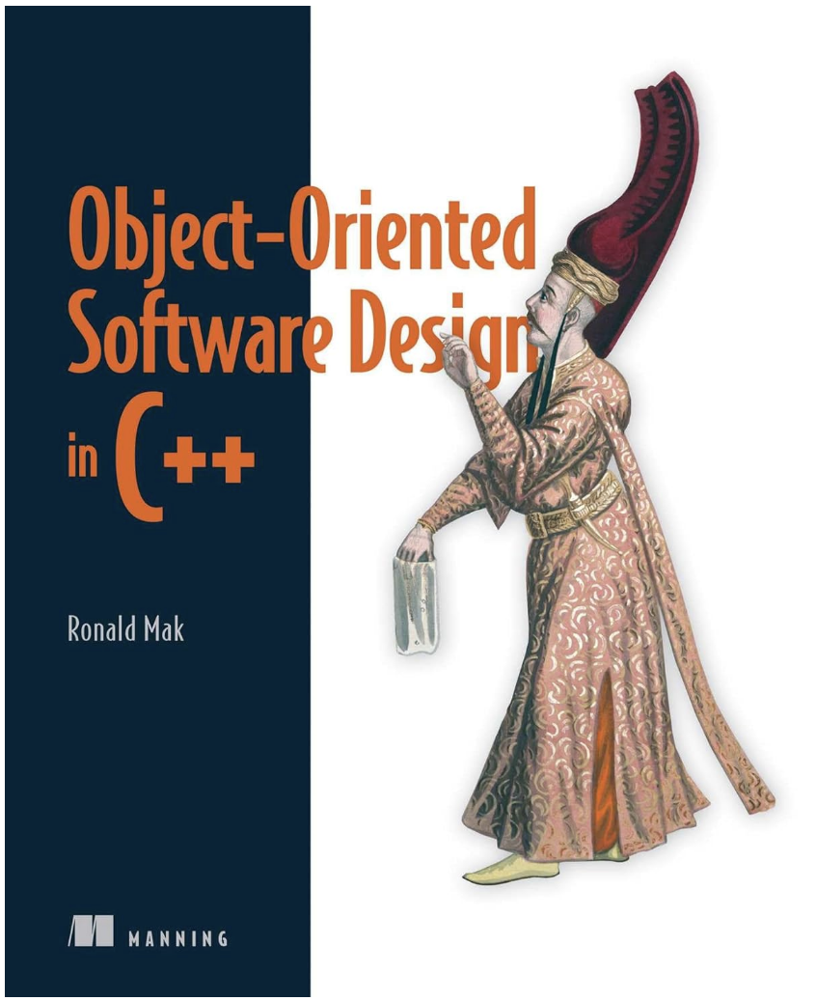
Based on My Book
Published in 2024 and available for purchase (recommended but not required) at:
https://www.manning.com/books/object-oriented-software-design-in-c-plus-plus?ar=true&lpse=A
and Amazon.

Slide 11
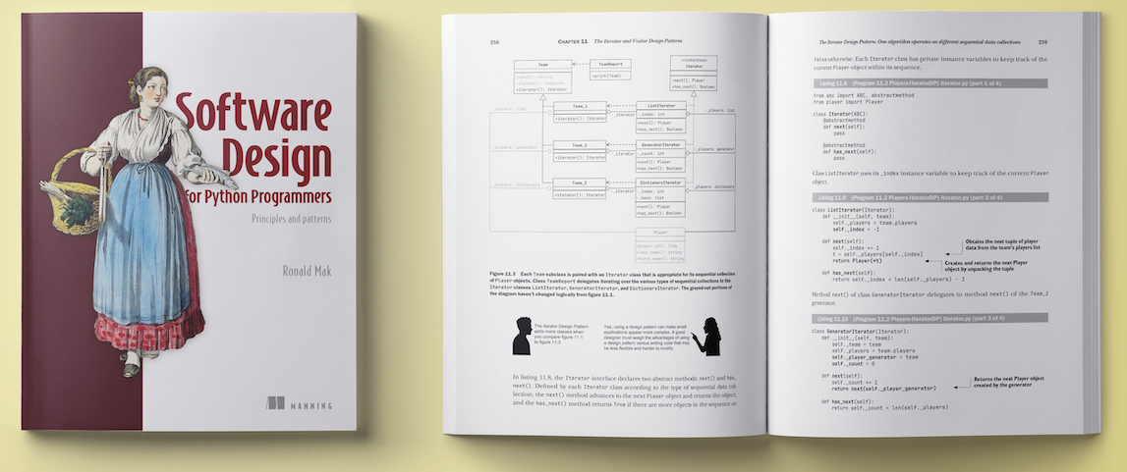
A Newer (and Better) Version
Improved text and figures.
Examples are in Python.
Currently half price at https://mng.bz/dXZ1 Use coupon code PBMak2

Slide 12
Project Teams
Assignments will be done by small project teams.
Form your own teams of 3 or 4 members each.
Choose your team members wisely!
It’s important to gain experience working with others on a team project.
Be sure you’ll be able to meet and communicate with each other and work together well.
No moving from team to team.

Slide 13
Project Teams, cont’d
Each team member will receive the same score on each team assignment and team project.
Submit your team information to Canvas (under “Assignments/Miscellaneous”) by Tuesday, February 3 at 10:00 PM:
Your team name.
A list of team members, student IDs, and email addresses.
cc all team members in an email to ron.mak@sjsu.edu with subject “CMPE 202 team”.
Only one student per team needs to submit and email team information.

Slide 14
Team Project
A semester-long design project to develop an application chosen by the team.
Team assignments during the semester will enable you to incrementally improve software design.
Demonstrate the application to the class at the end of the semester.
Each team will write a short report (8 - 10 pp.)
Include a high-level architecture description with UML diagrams.
Explain how the application is well-designed.

Slide 15
Individual Responsibilities
You are personally responsible for participating and contributing to your team’s work, and for understanding each part of the work for every assignment whether or not you worked on that part.

Slide 16
Postmortem Assessment Report
At the end of the semester, each student will individually turn in a short (one page) report:
A brief description of what you learned in the course.
An assessment of your personal accomplishments for your project team.
An assessment of the contributions of each of your project team members.
This report will be seen only by the instructor.

Slide 17
Your Individual Overall Class Grade
35% assignments*
30% project*
15% midterm**
20% final**
* team score
** individual score
During the semester, keep track of your progress in Canvas.
At the end of the semester, students clustered about the median score will get the B+ grade.
Higher and lower grades will then be assigned based on how the scores cluster above and below the median.
Therefore, your final class grade will be based primarily on your performance relative to the other students in the class.
Your final class grade will be adjusted up or down depending on your
level and quality of participation,
as reported by your
teammates’ postmortem reports.

Slide 18
Recursion
Recursion is a powerful programming technique.
For appropriate types of problems, it can often produce simple and elegant solutions that are difficult to solve otherwise.
Some would claim the solutions are “magical”.
However, it is often misunderstood and avoided by less-experienced programmers.
Recursion requires a different way of thinking about how to design a programming solution to a problem.

Slide 19
Recursion, cont’d
The key idea behind recursion is that we solve a programming problem by dividing it into a smaller but similar problem that we can solve the same way.
Solving the smaller problem leads to the solution of the larger problem.
Keep dividing a problem into smaller and smaller similar problems until the problem is so small that its solution is obvious and immediate.
This smallest problem is called a base case of the recursion.

Slide 20
Recursion, cont’d
Having the solution to the base case enables us to solve the next smallest problem, which in turn enables us to solve the next-to-the-next smallest problem, etc.
Keep “unwinding” the recursion until the original problem is solved.

Slide 21
Recursion vs. Iteration
We can compare recursion to this for loop:
for (int i = INITIAL_VALUE; i < LIMIT_VALUE; i++) ...
 | for loop | Recursion
Initial condition | i = INITIAL_VALUE | The original problem.
Repeated updating | i++ | Repeatedly divide the problem into smaller but similar problems whose solutions will solve the original problem.
Terminating condition | i >= LIMIT_VALUE | The problem is so small that its solution is immediate and obvious (a base case).

Slide 22
Recursive Function
A C++ function is recursive if it calls itself.
It calls itself to solve the smaller but similar problem.
A call to itself is a recursive call.
Like any other call, a recursive call of a function has its separate values for its local variables.
To avoid infinite recursion, each call must approach the base case.
At the base case, the function returns the obvious and immediate value without making another recursive call.

Slide 23
Examples of Recursive Functions
We’ll start with recursive functions that solve some simple programming problems.
These are examples to teach recursion.
The programming problems they solve are actually much better solved with traditional iteration.
Later, we’ll look at problems that are much easier and more elegantly solved by recursion.

Slide 24
Largest Value
Find the largest value in a nonempty vector of values.
Recursive idea: Compare the first element of the vector to the largest value found in the rest of the vector, which is shorter.
Base case. A vector consisting of a single element: the immediate and obvious solution is that element.
Simpler case. A shorter vector. Each recursive call must shorten the vector so that it approaches the base case.
We will solve this problem with recursive function largest() that is passed a vector.
Shorten the vector by removing the first element. Then make a recursive call on the rest of the vector, which is shorter.

Slide 25
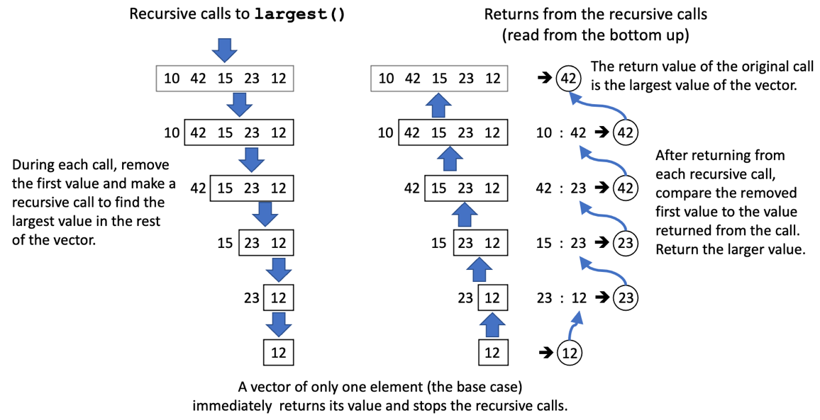
Largest Value, cont’d
Base case

Slide 26
Largest Value, cont’d
15.1/largest.cpp
int largest(vector<int> v)
{
// Base case.
if (v.size() == 1) return v[0];
// Remove and save first value.
int first_value = v[0];
v.erase(v.begin());
// Recursive call on the shorter vector:
// Return the largest value
// of the rest of the vector.
int largest_of_rest = largest(v);
// Return the larger of: (a) the saved value, or
// (b) the largest value of the rest of the vector.
return first_value > largest_of_rest ? first_value
: largest_of_rest;
}

Slide 27
Reverse Vector
Reverse the order of the elements of a nonempty vector.
Recursive idea: Remove the first element of the vector, recursively reverse the rest of the vector, which is shorter, and then append the first element at the end.
Base case: ???
Simpler case: ???

Slide 28
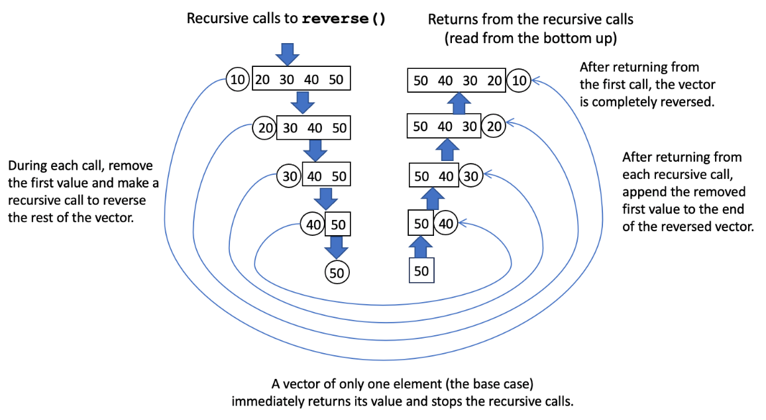
Reverse Vector, cont’d

Slide 29
Reverse Vector, cont’d
15.2/reverse.cpp
void reverse(vector<int>& v)
{
// Base case.
if (v.size() == 1) return;
// Remove and save first value.
int first_value = v[0];
v.erase(v.begin());
// Recursive call on the shorter vector:
// Reverse the rest of the vector.
reverse(v);
// Append the saved value to the end
// of the reversed vector.
v.push_back(first_value);
}

Slide 30
Exercise: Member of
Is value x in a nonempty vector of integers?
Recursive idea: Is x is equal to the head of the vector, OR is x a member of the rest of the vector?
Base case: ???
Simpler case: ???
The vector: 30 10 50 80 60 12 40 20 70
50 is in the vector.
65 is not in the vector.
80 is in the vector.
47 is not in the vector.
MemberOf.cpp

Slide 31
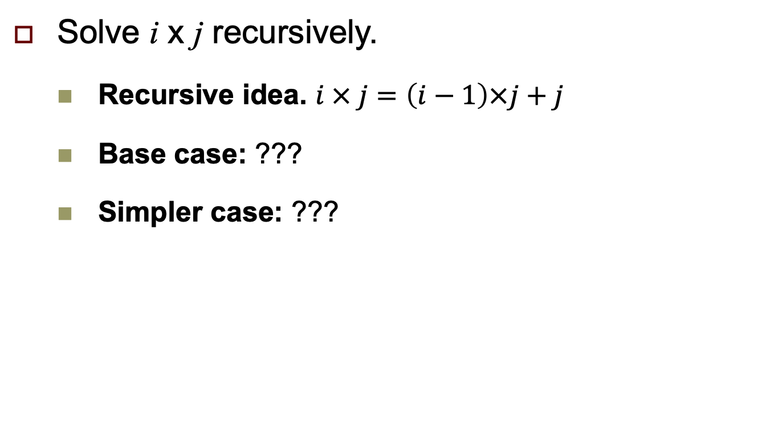
Exercise: Recursive Multiplication
Solve i x j recursively.
Recursive idea. $i × j=\left(i−1\right)×j+j$
Base case: ???
Simpler case: ???
Multiply.cpp

Slide 32
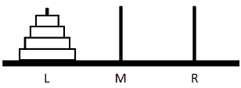
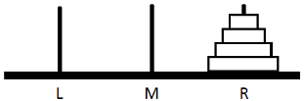
Towers of Hanoi
A puzzle consisting of a tower of disks stacked in size order on the source pin L:
The goal is to move all the disks to the destination pin R:
Rules:
Move only one disk at a time.
Never put a larger disk on top of a smaller disk.
Use the third pin (initially M) as a temporary location to move a disk.

Slide 33
Towers of Hanoi, cont’d
What is the base case?
What is the simpler case?

Slide 34
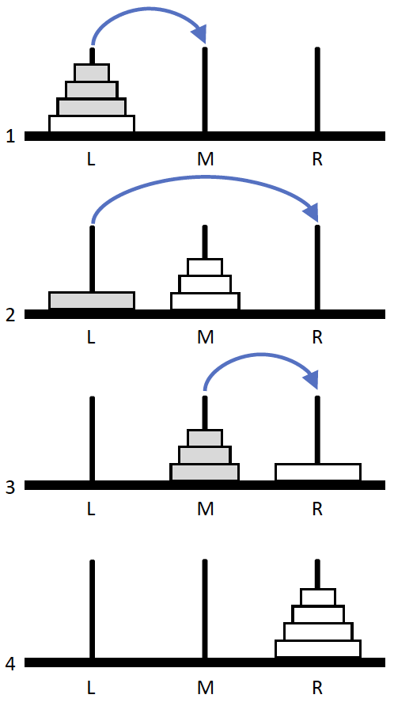
Towers of Hanoi, cont’d
Conceptual solution with 4 disks:
Recursively move the top 3 disks (fewer disks) from the source pin L to the temporary pin M.
Move the largest disk from the source pin L
to the destination pin R (base case of 1 disk).
Recursively move the 3 disks from the temporary pin L to the destination pin R.
Solved!

Slide 35
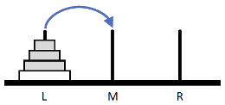
Towers of Hanoi, cont’d
Move only one disk at a time.
Never put a larger disk on top of a smaller disk.
Use the third pin as a temporary location to move a disk.
But how can we move three disks (a simpler case than four disks) according to the rules?
We do it recursively!
Three disks is a smaller number of disks that’s closer to the base case of one disk.

Slide 36
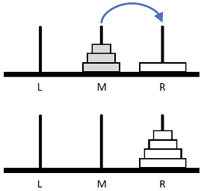
Towers of Hanoi, cont’d
To move 3 disks (such as from M to R):
Recursively move 2 disks from the source pin M to the temporary pin L.
Move 1 disk from the source pin M to the destination pin R.
Recursively move 2 disks from the temporary pin L to the destination pin R.
Use recursive calls to move two disks.
The pins L, M, and R each changes roles being the source, temporary, or destination pin during the calls.

Slide 37
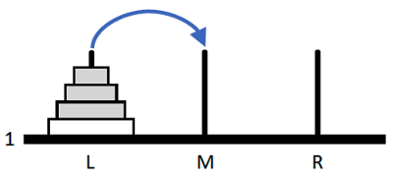
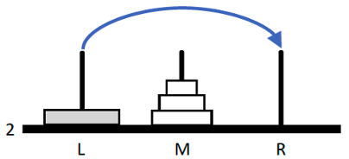
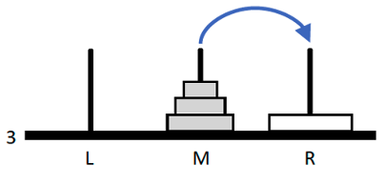
Towers of Hanoi, cont’d
void solve(const int n,
const char source,
const char temporary,
const char destination)
{
if (n == 1)
{
// Base case: Move a single disk.
cout << "Move " << source << " ==> " << destination
<< endl;
}
else
{
// Solve for 1 fewer disk: n - 1
solve(n - 1, source, destination, temporary);
solve(1, source, temporary, destination);
solve(n - 1, temporary, source, destination);
}
}
solve(4, L, M, R)
15.3/towers.cpp
solve(3, L, R, M)
solve(1, L, M, R)
solve(3, M, L, R)
The Towers of Hanoi puzzle is very difficult to solve without recursion!

Slide 38
Fibonacci
The well-known Fibonacci sequence starts with 0 and 1, and each subsequent value is the sum of the two previous values:
Can we use a recursive algorithm to generate this sequence?
0, 1, 1, 2, 3, 5, 8, 13, 21, 34, 55, 89, 144, ....

Slide 39
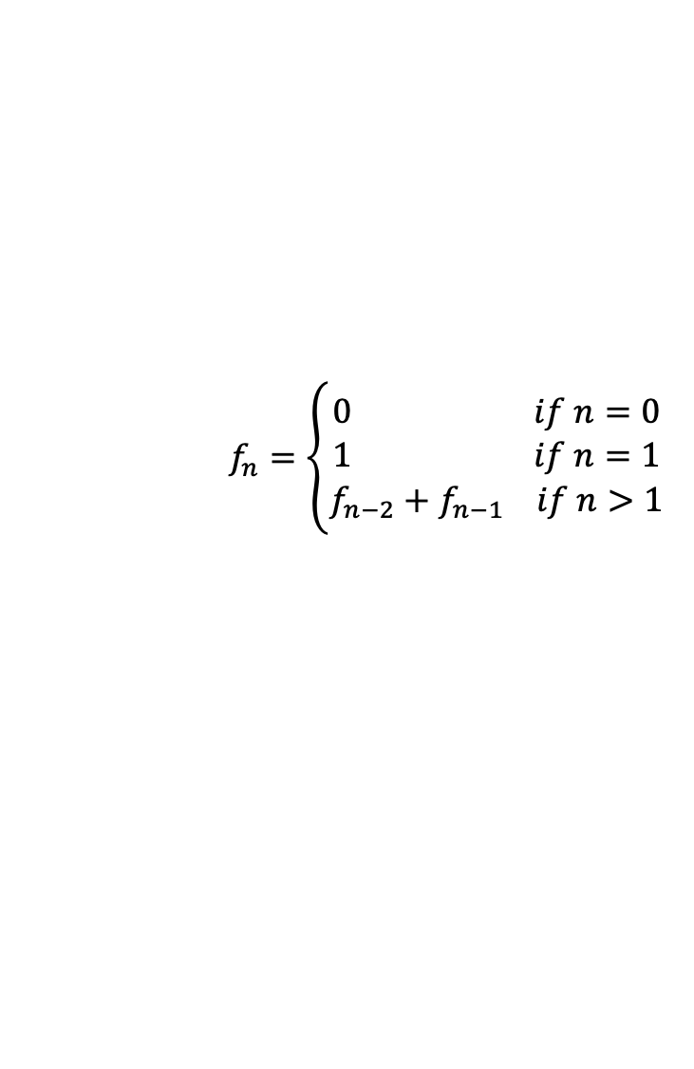
Fibonacci, cont’d
We can program the Fibonacci sequence from its recursive mathematical definition:
15.6/fibonacci.cpp
long f(const int n)
{
if (n == 0) return 0;
else if (n == 1) return 1;
else return f(n-2) + f(n-1);
}
$$f_{n}=\left\{\begin{aligned}0 if n=0 \\ &1 if n=1 \\ f_{n−2}+f_{n−1} if n>1\end{aligned}\right.$$

Slide 40
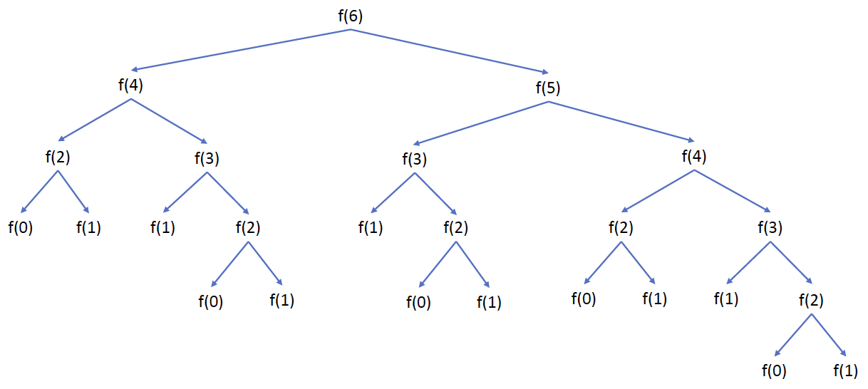
Fibonacci, cont’d
Recursive Fibonacci bogs down!
It’s best programmed iteratively.
Recursion is a powerful tool, but use it appropriately.
Improper use of recursion can cause very bad performance.

Slide 41
Break

Slide 42
Quicksort
Quicksort is an extremely efficient recursive sorting algorithm.
Invented in 1961, it is reputed to be the “most elegant” algorithm in computer science.
A “divide and conquer” type algorithm that relies on two operations to sort an array:
For each subarray (initially the entire array), select a pivot element and use it to partition the subarray into two smaller subarrays.
Recursively apply the algorithm to each of the two smaller subarrays.

Slide 43
Example Partitioning Operation
Choose the middle element of the subarray as the pivot element:
Partition the subarray into two smaller subarrays by moving all the values less than or equal to the pivot to the left and all the values greater than the pivot to the right.
Partitioning places the pivot element in its correct position when the entire subarray is eventually sorted:
Therefore, after each partitioning operation, at least one element (the pivot element) is sorted to its correct position.
6 15
16
21 26 32 34 51 61 61 76

Slide 44
How to Partition a Subarray
Choose one element of the array to be the pivot element. In our examples, we’ll choose the element at or near the middle (line A). .
Park the pivot element out of the way be swapping it with the rightmost element of the array (line B). Set variable i to the element index of the leftmost element and variable j to be the index of the element just to the left of the parked pivot element.
Move i to the right (i.e., increment i) while the value of the i ^{th} element is less than or equal to the pivot value. It is passing over values that are already on the correct side of the pivot. element. i might not move at all.
Move j to the left (i.e., decrement j) while the value of the j ^{th} element is greater than the pivot value (line C). It is passing over values that are already on the correct side of the pivot. j might not move at all.
After i and j have both stopped moving, if i < j, swap the i ^{th} and j ^{th} element values (line D).
Repeat steps 3, 4, and 5 (lines E through I) until j crosses i. Swap back in the value of the i ^{th} element with the pivot element that we had parked earlier at the right.
The array is now partitioned into two subarrays on both sides of the pivot element.

Slide 45
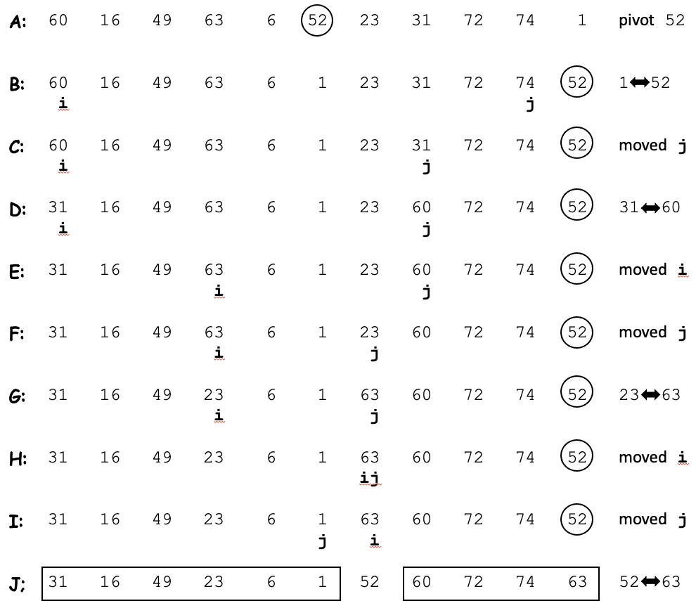
How to Partition a Subarray, cont’d
Choose pivot value 52 in the middle and swap with the rightmost value.
Goal: Move values <= the pivot value 52 to the left and values > the pivot value to the right.
Success: The array is partitioned into two subarrays on either side of the pivot.

Slide 46
Quicksort, cont’d
int Quicksort::partition(const int left_index, const int right_index)
{
int middle_index = (left_index + right_index)/2;
int pivot_value = data[middle_index];
swap_values_at(middle_index, right_index);
int i = left_index - 1;
int j = right_index;
while (i < j)
{
do
{
i++;
} while ((i < right_index) && (data[i] < pivot_value));
do
{
j--;
} while ((j >= left_index) && (data[j] > pivot_value));
if (i < j) swap_values_at(i, j);
}
swap_values_at(i, right_index);
return i;
}
Partition the array delimited by left_index and right_index.
Choose the pivot element.
Park the pivot element.
Loop until j crosses i.
Move i to the right while data[i] < the pivot value.
Move j to the left while data[j] > the pivot value.
Swap data[i] and data[j].
Swap the pivot element back in.
Return the pivot index.
15.5/Quicksort.cpp

Slide 47
Quicksort, cont’d
15.5/Quicksort.h
class Quicksort
{
public:
Quicksort(int * const d, const int s) : data(d), size(s) {};
void sort() { sort(0, size-1); } // start with the entire array
bool verify_sorted();
private:
int *data;
int size;
void sort(const int left_index, const int right_index);
int partition(const int left_index, const int right_index);
void swap_values_at(const int index1, const int index2);
friend ostream& operator <<(ostream& ostr, const Quicksort& q);
};

Slide 48
Quicksort, cont’d
Sorting a subarray:
Partition the subarray into two smaller subarrays.
Recursively sort each subarray.
The base case: ???
The simpler case: ???

Slide 49
Quicksort, cont’d
void Quicksort::sort(const int left_index, const int right_index)
{
int subarray_size = right_index - left_index + 1;
if (subarray_size < 2) return;
if (subarray_size == 2)
{
if (data[left_index] > data[right_index])
{
swap_values_at(left_index, right_index);
}
}
else
{
int pivot_index = partition(left_index, right_index);
sort(left_index, pivot_index - 1);
sort(pivot_index + 1, right_index);
}
}
Base case: size 0 or 1
Base case: size 2
Recursively sort the left subarray.
Recursively sort the right subarray.
15.5/Quicksort.cpp

Slide 50
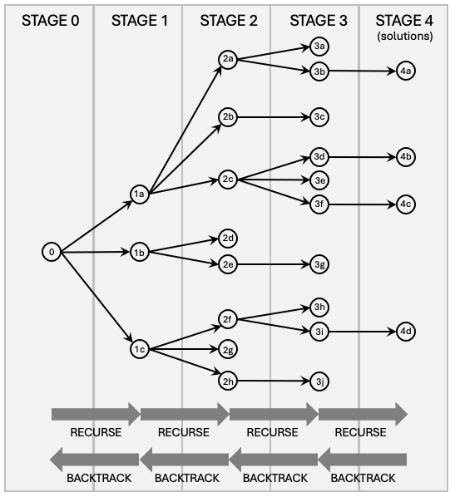
Dynamic Backtracking + Recursion
Dynamic backtracking is the ability of a running program to recursively try a solution path and then backtrack to recursively try a different path.

Slide 51
Dynamic Backtracking + Recursion, cont’d
The figure shows a decision tree for an example problem where we search for solutions using recursion and backtracking. Each node represents a step from which there can be several (including no) solution paths. The figure suggests grouping the steps into stages. We start at step 0.
The steps in stage 4 represent solutions to the problem.
At each step, we go from one stage to the next by taking a solution path. This operation of taking a solution path from one step to the next is recursive because at the next step, we perform the same operation, but the remaining path is shorter and closer to a base case.
A base case is reaching a step from which there are no solution paths, such as steps 2d and 3c in the figure. Then we backtrack to the previous step and take the next solution path from there. For example, after reaching step 2d, we backtrack to step 1b and try the next path from there, starting at step 2e. After reaching step 3c, we backtrack twice to step 1a, and from there, we try the next path starting at step 2c. Even after reaching a solution in stage 4, we can backtrack to search for more solutions, eventually back to starting step 0 where we try all its remaining solution paths. Or we can stop in stage 4 if we only want one solution.

Slide 52
Dynamic Backtracking + Recursion , cont’d
Classic example problem: the Eight Queens
Place eight chess queens on a chessboard so that no queen can attack another.
Including reflections and rotations, there are 92 solutions.
Q . . . . . . .
. . . . . . Q .
. . . . Q . . .
. . . . . . . Q
. Q . . . . . .
. . . Q . . . .
. . . . . Q . .
. . Q . . . . .

Slide 53
Eight Queens
Solve a column at a time, left to right.
Search each safe square of the current column.
A safe square for a queen is one where she won’t be attacked by existing queens in columns to the left.
Recursively search for solutions in columns to the right.
After searching for solutions from a safe square, backtrack and try the next safe square of the current column.
After searching from all the squares of a column, return to the previous column and do a backtrack there.

Slide 54
Eight Queens, cont’d
Function is_safe_position() is passed the row and column indexes for a queen’s square and checks whether she can be attacked from columns to the left.
If a safe square is found, recursive function find_solutions() checks the columns to the right to search for solutions. Then backtrack to check the next safe square.
Base case. ???
Simpler case. ???
15.7/Queens.cpp

Slide 55
Sudoku
We can use the same recursion + backtracking technique to solve a Sudoku puzzle.
It will be a brute-force solution.
At each cell, successively try the numbers 1 through 9.
Starting at the upper left corner, go left to right, row by row down to the lower right corner.
For each number number in a cell, recursively check ahead if that number will yield a solution. If not, backtrack to the next number. Backtrack to the previous cell after trying all nine numbers.
Base case. ???
Simpler case: ???
15.8/Sudoku.cpp

Slide 56
Assignment #1 (individual)
Compute the squares of integers ≥ 1 using a simple recursive formula.
What is the recursive idea?
What is the base case?
What is the simpler case?
Use recursion with backtracking to find the least-cost path through a network.
What is the recursive idea?
What is the base case?
What is the simpler case?
How is backtracking used?

Slide 57
Reminder
Submit your team information to Canvas (under “Assignments/Miscellaneous”) by Tuesday, February 3 at 10:00 PM.

