Slide 1


CMPE 202 Software Systems Engineering February 11 Class Meeting
Engineering Extended Studies San Jose State University Spring 2026 Instructor: Ron Mak
www.cs.sjsu.edu/~mak

Slide 2
Today
Go over Assignment #2
Introduction to multithreaded programming, cont’d
The Dining Philosophers problem
Well-designed software
Code examples
Object-oriented design
Break

Slide 3
Today, cont’d
Backtracking from bad decisions during development
Leaking changes
Application development example

Slide 4
The Dining Philosophers Problem
Another classic multithreading problem!
Five Chinese philosophers are seated at a round table with a central bowl of chow mein.
Each has a small individual bowl.
Between each philosopher is a single chopstick.
Two chopsticks are required for a philosopher to fill his individual bowl and to eat the noodles.
When both chopsticks on either side of a philosopher are free, he takes both to use.
Otherwise, the philosopher must wait until both of his neighbors finishes eating.

Slide 5
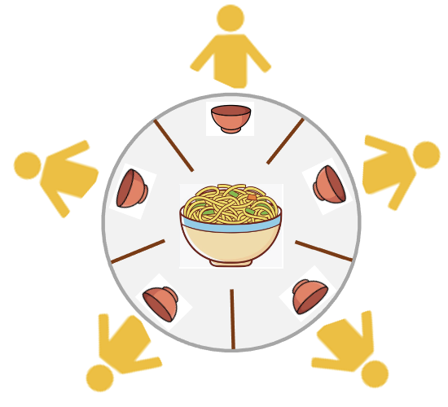
The Dining Philosophers Problem, cont’d
A philosopher must be able to pick up both chopsticks at once.
He cannot pick up one, hold it, and wait for the other.
Until the central bowl is empty, each philosopher is in this loop: thinking — waiting — filling bowl — eating
Wait if necessary before filling his bowl and eating.
Thinking and eating take a random amount of time.

Slide 6
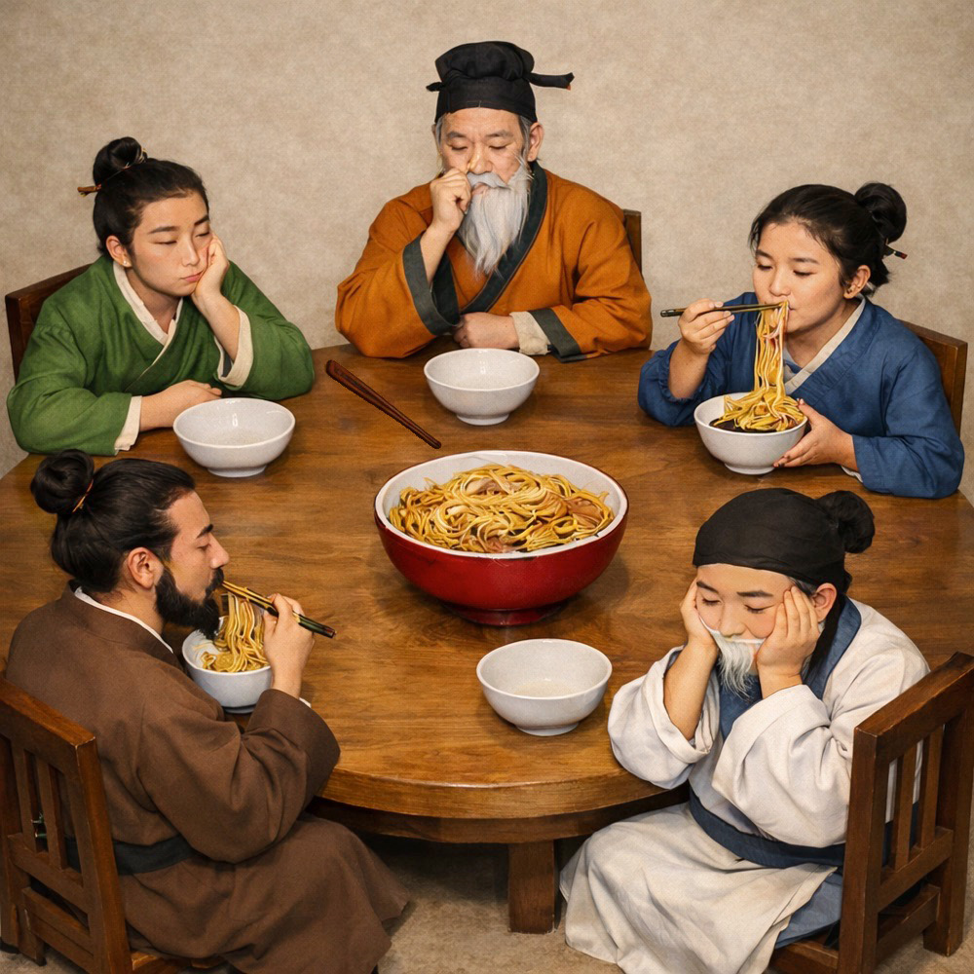
The Dining Philosophers Problem, cont’d
There are many simulation solutions on the web.
How would you simulate it?
Understand how my simulation works.
What are potential problems with it?
DiningPhilosophers.zip
Image generated by ChatGPT and modified with Photoshop.

Slide 7
Well-Designed Software
Meets its requirements. It does what it’s supposed to do.
Is reliable. It passes its tests with fewer bugs.
Does what its developers expect. When we call a function or create an object, we should not be surprised by the result.
Does not have hidden runtime performance problems.

Slide 8
Well-Designed Software, cont’d
Is flexible and scalable. When requirements change, it is easy to add new features without increasing the complexity of the software.
Enables developers to work together better and to recover quicker from bad design decisions.
Is maintainable. Well-designed code is more understandable by future developers.

Slide 9
Well-Designed Software, cont’d
Uses good design techniques that improve the software, such as by simplifying code and removing repeated code.
Employs appropriate design patterns that are industry-proven models for solving common software architecture problems.

Slide 10
Well-Designed Software, cont’d
Saves time and costs overall. Good design results in fewer mistakes and major do-overs during development. Any extra time spent upfront to do good design for a sustainable application will be compensated by decreased maintenance time and costs after deployment, and potentially a longer lifespan.
Is better code that you can be proud to develop.
Unfortunately, programming classes taught in schools often teach very bad habits.

Slide 11
Badly Designed Code Example #1
1.1/Car.h
1.1/Driver.h
class Car
{
public:
void step_on_brake();
void insert_key();
void turn_key();
void step_on_accelerator();
};
class Driver
{
public:
Driver(Car& c) : car(c) {}
void start_car()
{
car.step_on_brake();
car.insert_key();
car.turn_key();
car.step_on_accelerator();
}
private:
Car car;
};
But now we want a car with a more modern starter.

Slide 12
Badly Designed Code Example #1, cont’d
We want a car with a more modern starter.
class Car
{
public:
void step_on_brake();
void insert_key();
void turn_key();
void press_start_button();
void step_on_accelerator();
};
class Driver
{
public:
Driver(Car& c) : car(c) {}
void start_car()
{
car.step_on_brake();
car.insert_key();
car.turn_key();
car.press_start_button();
car.step_on_accelerator();
}
private:
Car car;
};
Making changes to class Car means we’ll also have to make changes to class Driver.

Slide 13
Badly Designed Code Example #1, cont’d
The changes we made in class Car “leaked” into class Driver.
Good software design helps to prevent such leaks by reducing dependencies among classes.
How would you improve this code?

Slide 14
Badly Designed Code Example #2
class AutomobileApp
{
public:
void accelerate();
void adjust_headlights();
void apply_brakes();
void change_oil();
void change_tires();
void check_brakes();
void check_tires();
void rotate_tires();
void shut_off_engine();
void start_engine();
void tuneup_engine();
void turn_left();
void turn_right();
void vacuum_car();
void wash_car();
void wax_car();
This code is too complex!
It tries to do too much.
How would you fix it?
1.2/AutomobileApp.h
private:
Brake brakes[4];
Engine engine;
Oil engine_oil;
Direction heading;
Headlight headlights[4];
int speed;
Soap soap;
Tire tires[4];
Vacuum vacuum_cleaner;
CarWax wax;
};

Slide 15
Badly Designed Code Example #3
1.3/Pet.h
Suppose we have the statement
We’ve hardcoded pet to point only to a Cat object.
But what if later we want pet to point to a Dog object instead?
Inflexible code! How would you improve it?
class Pet
{
// ...
};
class Cat : public Pet
{
// ...
};
class Dog : public Pet
{
// ...
};
Cat *pet = new Cat();

Slide 16
Badly Designed Code Example #4
1.4/Date.h
class Date
{
public:
Date(int y, int m, int d) : year(y), month(m), day(d) {}
string date_string() const
{
return MONTH_NAMES[month] + " " + to_string(day)
+ ", " + to_string(year);
}
private:
const string MONTH_NAMES[12] =
{
"JAN", "FEB", "MAR", "APR", "MAY", "JUN",
"JUL", "AUG", "SEP", "OCT", "NOV", "DEC"
};
int year, month, day;
};
Actually:
OCT 2, 2023
A bad surprise!
How would you fix this code?
What would these
statements print?
Date date(2023, 9, 2);
cout << date.date_string() << endl;
?
SEP 2, 2023

Slide 17
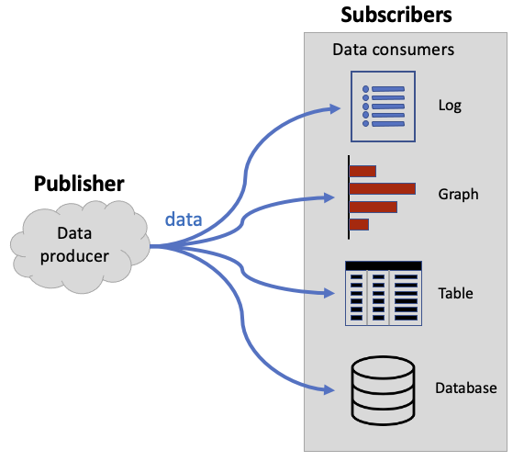
A Software Architecture Example
A publisher component produces data that are consumed by various subscriber components.
How would you design a good architecture if you want:
The subscriber components must work independently of each other.
Each subscriber component must know whenever the publisher component has new data.
The publisher component doesn’t care what the subscriber components do with the data that it produces.
It should be easy to add new subscriber components and to remove subscriber components that are no longer needed.

Slide 18
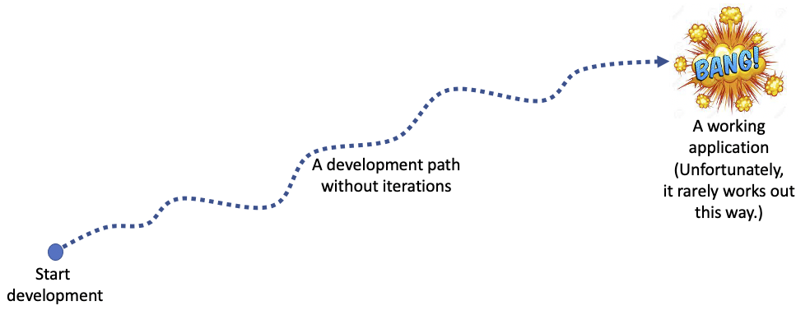
Good Design Doesn’t Come Easily
It takes practice and experience to develop well-designed applications.
It often requires multiple design-code-test iterations, design trade-offs, and backtracking from poor design decisions.
Long coding marathons without iterations rarely produce a working application at the end.
The “Big Bang” almost never occurs!

Slide 19
Object-Oriented Design: Encapsulation
It’s all about using classes (C++ in our case).
Combine data (member variables) and related functionality (member functions).
Public and private members.
At run time, instantiate objects from a class.
An object’s state at run time is defined by the values of its member variables.
An object undergoes a state change whenever the values of its member variables change.

Slide 20
Encapsulation, cont’d
Encapsulation also contains and isolates changes in an application.
Prevents leaking changes!

Slide 21
Object-Oriented Design: Abstraction
Ignore irrelevant details and pay attention only to what’s important to develop our application.
We can have different levels of abstraction.
Proper use of abstraction can reduce code complexity.

Slide 22
Object-Oriented Design: Inheritance
Create subclasses (child classes) from a superclass (parent or base class).
The superclass passes state information (in the form of member variables) and behavior (in the form of member functions) to the subclasses.
Each subclass can add its own additional state and behavior.
Each subclass can override (replace) any inherited state or behavior.
Another way to reduce code complexity.

Slide 23
Object-Oriented Design: Polymorphism
Different subclass objects have a common superclass, and you have a pointer to a subclass object.
If you use the pointer to call a member function, polymorphism determines dynamically at run time which member function (i.e., from which subclass object) to call.
Increases code flexibility.
Yet another way to reduce code complexity.

Slide 24
Break

Slide 25
Backtrack from Bad Design Decisions
Mozart was a musical genius who could compose an entire symphony in his head and write it down to paper with few edits.
Are you a programming genius?
The journey to a well-designed application is often a bumpy one, with wrong turns and dead ends that require backtracking and rewriting.

Slide 26
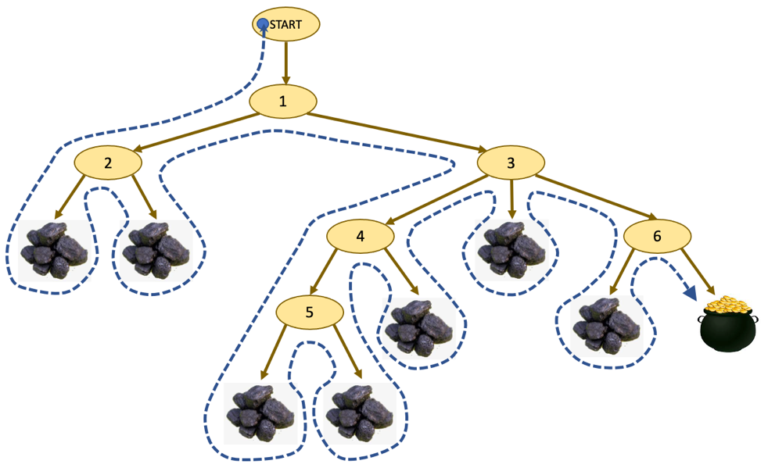
Backtrack from Bad Design Decisions, cont’d
Each branch of the tree is a development path that either leads to a successful application (the pot of gold) or to a dead end (lumps of coal).
If we took a dead-end branch, we must back up to the previous decision node and take another branch.
After exhausting all possible branches at a node, we must back up again to the next higher node.
We hope eventually to find a path to a successfully completed application.
A decision tree

Slide 27
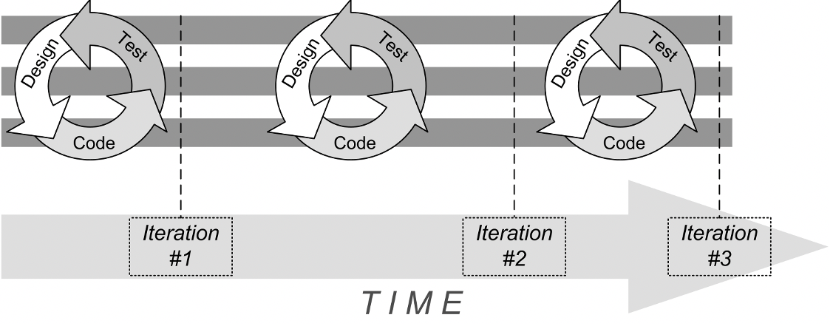
Backtrack from Bad Design Decisions, cont’d
How does this work in practice?
Modern agile software development practice advocates that development should progress in a series of iterations.
Each design-code-test iteration can be a trip down one branch of the decision tree.
The iterations can vary in the amount of time, from as little as a few hours to around two weeks. If an iteration lasts longer than that, it’s probably trying to accomplish too much.

Slide 28
Don’t Let Changes Leak Out
Woe to the programmer who discovers that making changes to one part of an application then requires changes to other parts!
In the worst case, major portions of the application, if not the entire application, will require rewriting.
A major goal of good software design is to encapsulate code that can change so that the changes don’t affect other parts of the application.

Slide 29
Where Do Changes Come From?
The requirements change.
The requirements state what our application must do or allow its users to do.
Requirements may change both during development and after the application is “finished”.
We change our mind about design during development.
We add new features (or remove unneeded ones) from a completed application.

Slide 30
An Application Development Example
Book catalogue application
We want to develop an application that stores a list of books and allows a user to search for books that match the user’s target attributes.

Slide 31
Book Catalogue Application Requirements
A user must be able to add fiction books and their attributes to the catalogue.
The attributes for each book shall be the book title and the author’s last and first names.
A user must be able to search for books that match the user’s target attribute values.
Searches for books shall depend on matching any number of target attributes.
String matches of the book titles and authors’ first and last names must be case insensitive.
A user must be able to specify any number of don’t-care (wildcard) target attributes. Each don’t-care attribute must by default match the corresponding attribute in all books in the catalogue.
The remaining target attributes must match exactly.

Slide 32
Warning
Possible bad design decisions ahead!

Slide 33
Iteration #1: Initial Cohesive Classes
Classes
Book.h
Catalogue.h
Catalogue.cpp
Program2.1-Books1
All the code examples use the 2020 version of C++. The following two commands specify the 2020 standard and will compile, link, and run program 2.1 in a Linux terminal window using the GNU C++ compiler or in a MacOS terminal window using the Apple Clang C++ compiler:
g++ -std=c++20 *.cpp -o books ./books
The equivalent commands in a Microsoft Windows “Developer Command Prompt for VS” window using the Visual Studio C++ compiler:
cl *.cpp /EHs /std:c++20 *.cpp /link /out:books.exe books

Slide 34
Iteration #1, cont’d
The Single Responsibility Principle (SRP)
A well-designed class is cohesive, meaning that it has only a single primary responsibility. A poorly designed class has too many responsibilities.
A cohesive class with a clear responsibility is easy to use — there should be no doubt what its purpose is.
A cohesive class is easy to maintain — all its member functions and member variables serve a single primary purpose.

Slide 35
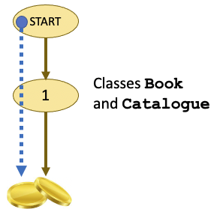
Iteration #1, cont’d
Apparently, our application fulfills its requirements.
Well-designed classes, too?

Slide 36
Iteration #2: A New Attributes Class
More requirements!
The attributes for each fiction book shall include its publication year and its genre.
The book genres shall be ADVENTURE, CLASSICS, DETECTIVE, FANTASY, HISTORIC, HORROR, ROMANCE, and SCIFI.
Classes
Book.h
Attributes.h
Catalogue.h
Catalogue.cpp
Program2.2-Books2

Slide 37
Iteration #2, cont’d
Strings vs. Enumeration Types
Whenever there is a limited set of values, such as for the genre, an enumeration type is preferable to using a string type. With strings, we must worry about case-sensitive versus case-insensitive comparisons. If we have a typo or a misspelling in a string, the resulting runtime logic error may be hard to detect.
Comparisons of enumeration constant values during run time are very efficient, and the compiler will catch a misspelling of an enumeration constant before the application runs.

Slide 38
Iteration #2, cont’d
Because the book attributes can change as the requirements change, we encapsulate the changes by putting them in a separate Attributes class.
The Encapsulate What Varies Principle
Good software design separates code that can vary from code that won’t vary. Encapsulating the code that can vary isolates it from the rest of the program. Then when changes occur to the encapsulated code, those changes won’t “leak out” and cause other code to change. A common way to encapsulate code that can vary is to put it in a class by itself.

Slide 39
Iteration #2, cont’d
Member function is_match() of the Attributes class does the work of matching book attributes for a book search.
Member function find() of class Catalogue is now much simpler.
The Delegation Principle
Move functionality out of one class (the requester) into another more suitable class (the delegate) to make the two classes more cohesive. The requester class commonly has a member variable that points to the delegate class. A particular member function in the delegate class implements the work to be done on behalf of the requester class. The requester class generally should have no dependencies on how the delegate class does that work. At run time, an object of the requester class can request the work by calling that member function on an object of the delegate class.

Slide 40
Iteration #2, cont’d
Class Catalogue is now loosely coupled with class Attributes because we’ve minimized the dependences of Catalogue on Attributes.
Class Catalogue doesn’t know the specific attributes that class Attributes maintains or how it matches the attributes.
Classes Book and Attributes are also loosely coupled with each other: class Attributes doesn’t know that its objects are stored by Book objects, and class Book also doesn’t need to know how class Attributes is implemented.

Slide 41
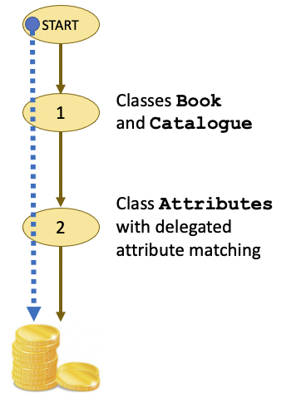
Iteration #2, cont’d
How are we doing so far?

Slide 42
Iteration #3: More Books and Attributes
Still more requirements!
It must be possible to add cookbooks and their attributes to the catalogue.
The attributes for a cookbook must include its region.
The regions shall be CHINA, FRANCE, INDIA, ITALY, MEXICO, US, and UNSPECIFIED.
Classes
Book.h
Attributes.h
Catalogue.h
Catalogue.cpp
Program2.3-Books3
Cookbook.h
CookbookAttrs.h
Fiction.h
FictionAttrs.h

Slide 43
Iteration #3, cont’d
The Open-Closed Principle
Closing a class to modification provides stability — programmers will always know what that code does and how to use it. But keeping it open for extensions in the form of subclasses allows adding functionality beyond what the closed superclass provides.
The Open-Closed Principle supports loose coupling and encapsulation. For example, a Shape superclass can hide how it stores coordinates. But it can have subclasses such as Rectangle and Circle that extend functionality by displaying the various shapes, but the subclasses are not dependent on how the coordinates are stored. If it ever becomes necessary to change the coordinates code in the superclass, the subclasses will inherit the changes but not require any code modifications.

Slide 44
Iteration #3, cont’d
The Code to the Interface Principle
If a class has several subclasses, our code should have the flexibility to work with any of the subclasses at run time. For example, if a Shape superclass has subclasses Rectangle and Circle, coding to a specific implementation is poor design:
Rectangle *rect = new Rectangle(); // poor design! rect->display();
Variable rect can only work with Rectangle shapes. But if instead we code to the interface (superclass Shape in this example):
Shape *shape = new Rectangle(); shape->display();
Variable shape can work with Rectangle shapes, but it can also work with Circle shapes:
shape = new Circle(); shape->display();
Coding to the interface relies on polymorphism. Which display() member function is invoked at run time in this example depends on the type of object (Rectangle or Circle) that variable shape is pointing to.

Slide 45
Iteration #3, cont’d
Checking and Converting Pointer Types in C++
Consider the overloaded Catalogue::find() member function that receives the FictionAttrs parameter. We declared pointer variable Book *book in the for loop that iterates over Book objects in vector booklist. Since booklist contains pointers to Book objects, during each iteration of the loop, variable book will point to an object instantiated from one of the Book subclasses. If the variable is pointing to a Fiction book object, then the call to dynamic_cast<>() in the statements
Fiction *fiction = dynamic_cast<Fiction *>(book);
if (fiction != nullptr) ...
will convert the Book pointer to a Fiction pointer, and therefore pointer variable fiction will point to a Fiction object. But if variable book is pointing instead to a Cookbook object, the dynamic cast will return nullptr. Therefore, this call to dynamic_cast<>() performs both pointer type checking and pointer type conversion. We use the other call to dynamic_cast<>() to check and convert an Attributes pointer to a FictionAttrs pointer.

Slide 46
Iteration #3, cont’d
Problem: Too much duplicated code!
Each kind of book requires a pair of Book and Attributes subclasses.
Each kind of book requires an overloaded add() member function and an overloaded find() member function in class Catalogue. These functions have similar code.
Each find() member function requires a dynamic_cast<>() call to ensure it will check the right kind of book, and another dynamic_cast<>() call to convert a pointer to the right kind of attributes. Otherwise, these member functions have similar code.

Slide 47
Iteration #3, cont’d
If our application needs to manage more kinds of books, we will have an increase of subclasses, duplicate code, and runtime type checks and conversions.
Example: How-to instructional books each with a subject attribute.

Slide 48
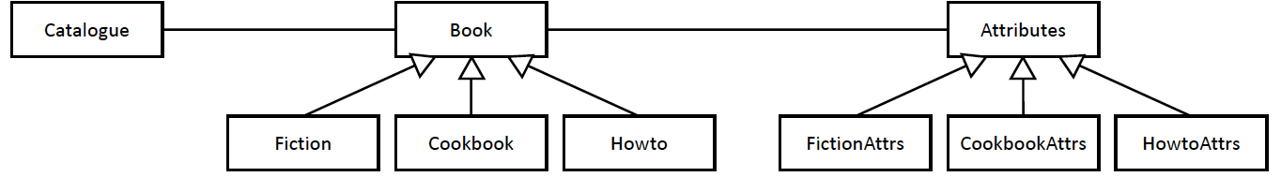
Iteration #3, cont’d
The current situation:
Kind of book | Classes | Attributes
all books | Book, Attributes | title, last, first
fiction | Fiction, FictionAttrs | year, genre
cookbook | Cookbook, CookbookAttrs | region
how-to | Howto, HowtoAttributes | subject

Slide 49
Iteration #3, cont’d
The Don’t Repeat Yourself (DRY) Principle
Repeated code is often a sign of poor design. Not only does repeated code enlarge the size of a program, but that code also makes the program harder to maintain. If you need to make a change to the code that’s repeated, you’ll need to make the same change to multiple copies of the code. You run the risk of missing a copy or inadvertently changing copies differently.
One way to eliminate repeated code is to share only one copy of it as a separate function or as a separate cohesive class.

Slide 50
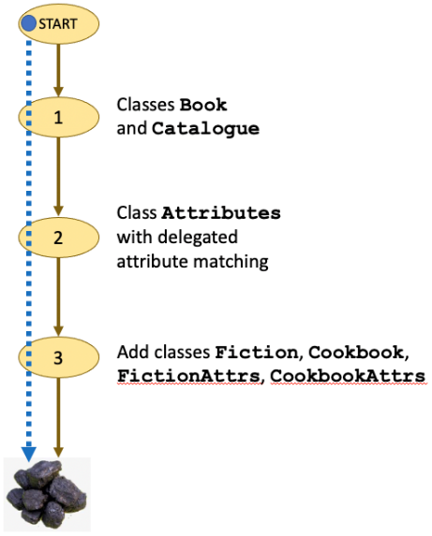
Iteration #3, cont’d
After this third iteration, we must admit that using subclasses to handle changes in the requirements for books and attributes was a poor design decision that won’t scale well if there are more kinds of books.
Time to backtrack!

Slide 51
Iteration #4: A Better Design
Recall that in object-oriented programming, an object undergoes a state change whenever the values of its member variables change. Member functions implement behavior.
Subclasses Fiction and Cookbook have little to do with state or behavior.
They aren’t necessary.
Class Book alone ought to be sufficient.

Slide 52
Iteration #4, cont’d
Subclasses FictionAttrs and CookbookAttrs represent very similar behaviors, primarily performing attribute matching during book searches.
However, they have different member variables for their respective attributes.
Is there a way to have the Attributes class alone handle all the different attributes and eliminate its subclasses?
An Attributes object associated with any kind of Book object would have to store the name and value of each attribute, such as Genre:DETECTIVE and Region:INDIA.

Slide 53
Iteration #4, cont’d
Whenever there are name-value pairs, we should consider the map data structure from the standard template library (STL).
An STL map contains name-value pairs, where the name serves as the key to retrieve the paired value.
Therefore, the pairs in a map are usually called key-value pairs.
When we declare a map, we must specify both the datatype of the keys and the datatype of the values.

Slide 54
Iteration #4, cont’d
Classes
Attributes.h
Attributes.cpp
Book.h
Catalogue.h
Catalogue.cpp
Key.h
Values
Genre.h
Kind.h
Region.h
Subject.h
Program2.4-Books4
Key | Datatype of paired value
TITLE | string
LAST | string
FIRST | string
YEAR | int
GENRE | enum class Genre
REGION | enum class Region
KIND | enum class Kind
SUBJECT | enum class Subject

Slide 55
Iteration #4, cont’d
Because the value of the key-value pairs have different datatypes, we must declare the value of the map to be a variant type:
Corresponding to each variant type is a type index that identifies each variant type.
2.4/Attributes.h
typedef variant<int, string,
Kind, Genre, Region, Subject> AttributeValue;
typedef map<Key, AttributeValue> AttributeMap;
enum type_indexes
{
INT_INDEX, STRING_INDEX,
KIND_INDEX, GENRE_INDEX, REGION_INDEX, SUBJECT_INDEX
};

Slide 56
Iteration #4, cont’d
Make sure we never create an invalid Attributes object!
Attributes::Attributes(AttributeMap *pairs) : attribute_map(pairs)
{
for (AttributeMap::iterator it = pairs->begin();
it != pairs->end(); it++)
{
Key key = it->first;
int index = it->second.index();
switch (key)
{
case Key::YEAR:
assert(index == INT_INDEX); break;
case Key::TITLE:
case Key::LAST:
case Key::FIRST:
assert(index == STRING_INDEX); break;
case Key::KIND:
assert(index == KIND_INDEX); break;
case Key::GENRE:
assert(index == GENRE_INDEX); break;
case Key::REGION:
assert(index == REGION_INDEX); break;
case Key::SUBJECT:
assert(index == SUBJECT_INDEX); break;
}
}
}
2.4/Attributes.cpp

Slide 57
Iteration #4, cont’d
Defensive Programming
Well-designed applications practice defensive programming to guard against programming errors. Functions should create only proper objects from their parameter values.
Perform runtime checks of function parameter values to ensure that no invalid values are being passed in.
However, to keep the example programs in this class short, their functions generally do not have parameter checking.

Slide 58
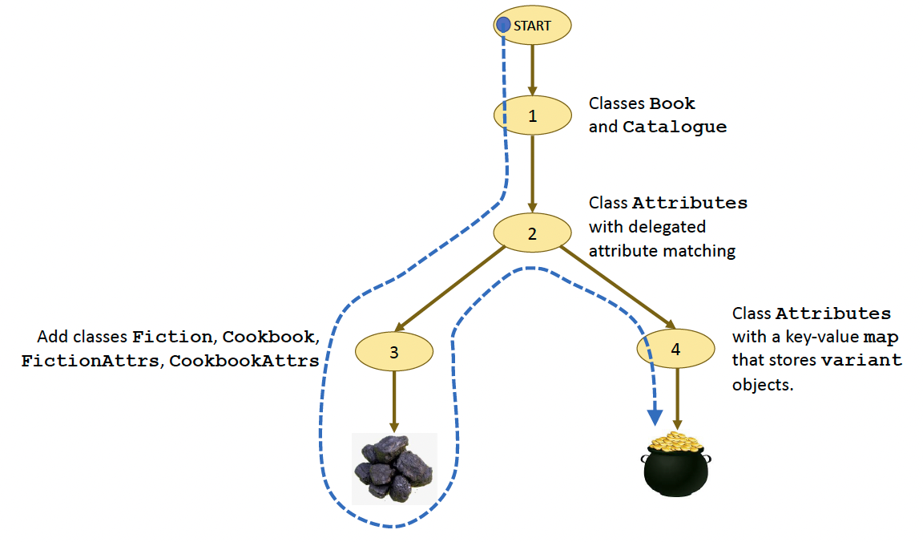
Iteration #4, cont’d
It took one backtrack, but we arrived at a much better design that’s more flexible and scalable.

Slide 59
Key Takeaways
It usually takes several development iterations to achieve a well-designed program. Be willing to backtrack from bad design decisions.
The Single Responsibility Principle (SRP) states that a class should be cohesive and have only one primary responsibility.
The Encapsulate What Varies Principle states that code that can vary should be isolated to keep its changes from causing other code to change.
The Delegation Principle states that one class performs work on the behalf of another class, where the work belongs in a more suitable cohesive class.

Slide 60
Key Takeaways, cont’d
The Principle of Least Knowledge states that classes should not “know” about each other’s implementation, and so the classes are loosely coupled with few if any dependencies on each other.
The Open-Closed Principle states that a class should be closed for modification but open for extension to provide both stability and flexibility.
The Code to the Interface Principle states that for runtime flexibility, we should not write code that can work only with a specific subclass but use polymorphism and write code that can work with multiple subclasses.

Slide 61
Key Takeaways, cont’d
The Don’t Repeat Yourself (DRY) Principle states that well-designed code does not contain duplicate copies of code.
OOP is important for good application design, but it’s not a panacea to all design problems. Be smart about how to apply its concepts. For example, do not create too many subclasses unnecessarily and thereby make your application too complex.
Using better data structures can simplify complex code.

