Slide 1


CMPE 202 Software Systems Engineering February 25 Class Meeting
Engineering Extended Studies San Jose State University Spring 2026 Instructor: Ron Mak
www.cs.sjsu.edu/~mak

Slide 2
Today
UML diagrams to document class design
Aggregation and composition
Superclasses and subclasses
The Design Specification
Break
A Date class
The Law of Demeter
The importance of hiding class implementations
Lambda expressions
Field trip to the
Computer History Museum
Saturday March 14

Slide 3
Build the Right Application Right
Functional and nonfunctional requirements
Build the right application
Customers validate
Good class design
Build the application right
Developers verify
Challenges to good design:
change
complexity
Software V&V

Slide 4
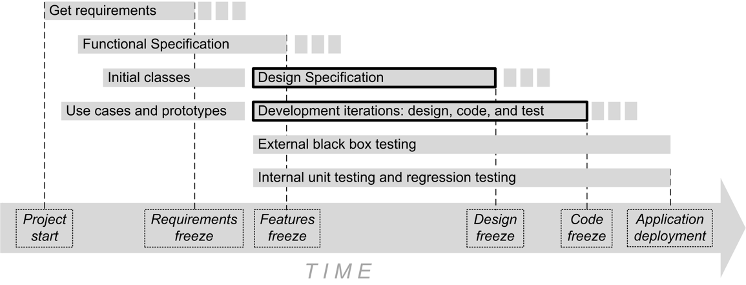
When Does Design Occur?
Most of the application design occurs during the development iterations.

Slide 5
Two Important Goals for Good Class Design
Cohesion
A well-designed class should have only one primary responsibility.
Adhere to the Single Responsibility Principle.
Loose coupling
Classes have minimal dependencies on each other.
Class A is dependent on class B if class A has references to class B.
Adhere to the Principle of Least Knowledge.

Slide 6
Example: Not Cohesive
class AutomobileApp
{
public:
void accelerate();
void adjust_headlights();
void apply_brakes();
void change_oil();
void change_tires();
void check_brakes();
void check_tires();
void rotate_tires();
void shut_off_engine();
void start_engine();
void tuneup_engine();
void turn_left();
void turn_right();
void vacuum_car();
void wash_car();
void wax_car();
private:
Brake brakes[4];
Engine engine;
Oil engine_oil;
Direction heading;
Headlight headlights[4];
int speed;
Soap soap;
Tire tires[4];
Vacuum vacuum_cleaner;
CarWax wax;
};
Too many state and behavior responsibilities!
Violates the Single Responsibility Principle
Automobile operation
state: brakes, engine, heading, speed
behavior: accelerate, apply brakes, shut off engine, start engine, turn left, turn right
Automobile maintenance
state: engine oil, headlights, tires
behavior: adjust headlights, change oil, change tires, check brakes, check tires, rotate tires, tuneup engine
Automobile cleaning
state: soap, vacuum cleaner, wax
behavior: vacuum car, wash car, wax car
4.1/AutomobileApp.h

Slide 7
Example: Cohesive
4.2/AutomobileApp.h
class Automobile
{
public:
void accelerate();
void apply_brakes();
void shut_off_engine();
void start_engine();
void turn_left();
void turn_right();
private:
Brake brakes[4];
Direction heading;
Headlight headlights[4];
int speed;
Tire tires[4];
};
Responsible for operating the car.

Slide 8
Example: Cohesive, cont’d
4.2/AutomobileApp.h
Responsible for car maintenance.
class Garage
{
public:
Garage(Automobile *c) : car(c) {}
void adjust_headlights();
void change_oil();
void change_tires();
void check_brakes();
void check_tires();
void rotate_tires();
void tuneup_engine();
private:
Automobile *car;
Oil new_oil;
vector<Tire> new_tires;
};

Slide 9
Example: Cohesive, cont’d
4.2/AutomobileApp.h
Responsible for cleaning the car.
class CarWash
{
public:
CarWash(Automobile *c) : car(c) {}
void vacuum_car();
void wash_car();
void wax_car();
private:
Automobile *car;
Soap soap;
Vacuum vacuum_cleaner;
CarWax wax;
};

Slide 10
Example: Loose Coupling
2.4/Catalogue.h
class Catalogue
{
public:
void add(Attributes * const attrs);
vector<Book *> find(const Attributes& target_attrs) const;
private:
vector<Book *> booklist;
};
Principle of Least Knowledge
Class Catalogue does not know how classes Attributes and Book are implemented.
Classes Attributes and Books can change without affecting class Catalogue.`

Slide 11
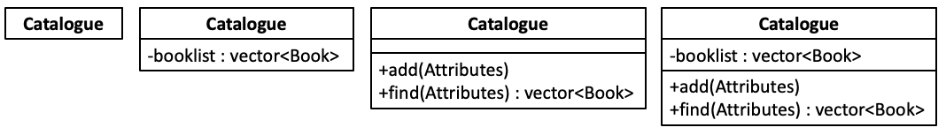
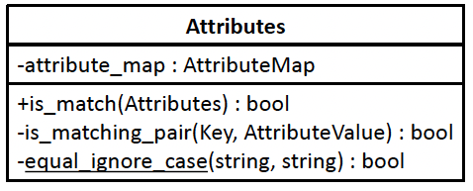
UML Diagrams Document Class Design
Various ways to draw a class diagram.
Depends on how much information to show.
Prefix + indicates public, - indicates private.
class name (mandatory)
member variables (optional)
member functions (optional)
Free UML drawing tool created by a former SJSU computer science professor: https://horstmann.com/violet/index.html

Slide 12

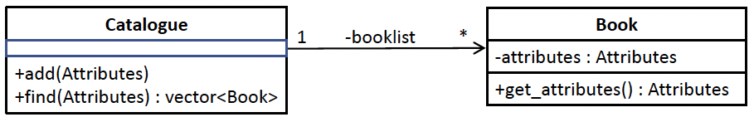
UML Diagrams Document Class Relationships
Dependency is the most basic relationship.
Example: Class Catalogue depends on class Book, but class Book does not depend on class Catalogue.
We can show more information.
Member variable booklist of class Catalogue points to a Book object, and so we use it to label the dependency arrow and don’t repeat it in the list of other member variables.

Slide 13

Class Relationships, cont’d
We can specify a transient dependency.
Class A has a member function f that has a parameter or a local variable that references class B.
However, class A does not have a member variable that references class B.
The relationship is transient because it exists only during a call to function f.
Example: Class Catalogue has add() and find() member functions that each has an Attributes parameter, but class Catalogue itself has no Attributes member variable.

Slide 14
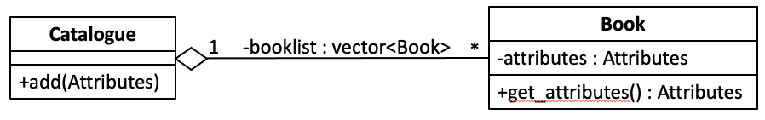
Class Relationships, cont’d
Class A aggregates class Class B if class A contains an object of Class B, such as by having a member variable that points to the object.
Example: Class Catalogue has a member variable that’s a vector which aggregates Book objects.
Cardinality: One Catalogue object can aggregate many (0, 1, or more) Book objects.

Slide 15
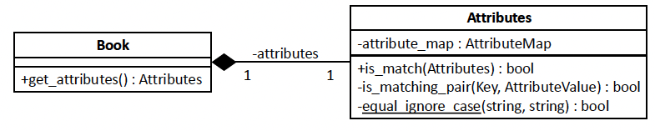
Class Relationships, cont’d
Composition is a stronger form of aggregation.
According to the logic of the application, the object that’s a part of the composition cannot exist outside of its container.
Example: An Attributes object cannot exist without being contained in a Book object.
Example: A Book object can exist without being contained in a Bookshelf object.

Slide 16
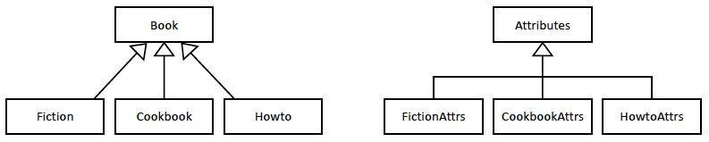
Class Relationships, cont’d
A superclass is a generalization of its subclasses.
Examples: Two common ways to draw the diagrams.

Slide 17
Abstract Classes
A C++ class is abstract if it contains at least one abstract (pure virtual) member function.
Example:
An abstract member function has no implementation in the abstract class.
The abstract class can also have member variables and non-abstract member functions.
An abstract class can implement its non-abstract member functions.
Subclasses can override the implementations.
virtual void start_engine() = 0;

Slide 18
Abstract Classes, cont’d
If a class is abstract, we cannot instantiate it.
We cannot create an object directly from an abstract class, only from its subclasses.
Any subclass of an abstract class must implement each abstract member function.
Otherwise, the subclass is itself also abstract.

Slide 19
Example: Abstract Class
4.3/MotorVehicle.h
class MotorVehicle
{
public:
virtual ~MotorVehicle() {}
virtual void start_engine() = 0;
virtual void stop_engine() = 0;
virtual void accelerate()
{
cout << "vehicle accelerates"
<< endl;
}
virtual void turn_left()
{
cout << "vehicle turns left"
<< endl;
}
virtual void turn_right()
{
cout << "vehicle turns right"
<< endl;
}
virtual void apply_brakes()
{
cout << "vehicle applies brakes"
<< endl;
}
virtual void drive()
{
start_engine();
accelerate();
turn_left();
turn_right();
apply_brakes();
stop_engine();
cout << endl;
}
private:
Brake brakes[4];
Engine engine;
Direction heading;
int speed;
};
If a class has subclasses, its destructor should be virtual.
Make a member function virtual to enable polymorphism.

Slide 20
Example: Abstract Class, cont’d
class Car : public MotorVehicle
{
public:
virtual ~Car() {}
private:
virtual void start_engine() override
{
cout << "car starts engine"
<< endl;
}
virtual void stop_engine() override
{
cout << "car stops engine"
<< endl;
}
};
class Truck : public MotorVehicle
{
public:
virtual ~Truck() {}
private:
virtual void start_engine() override
{
cout << "truck starts engine"
<< endl;
}
virtual void stop_engine() override
{
cout << "truck stops engine"
<< endl;
}
virtual void turn_left() override
{
cout << "truck turns left"
<< endl;
}
virtual void turn_right() override
{
cout << "truck turns right"
<< endl;
}
};
4.3/Car.h
Both subclasses must implement the abstract methods start_engine() and stop_engine().
Note: Optional override keyword.
4.3/Truck.h

Slide 21
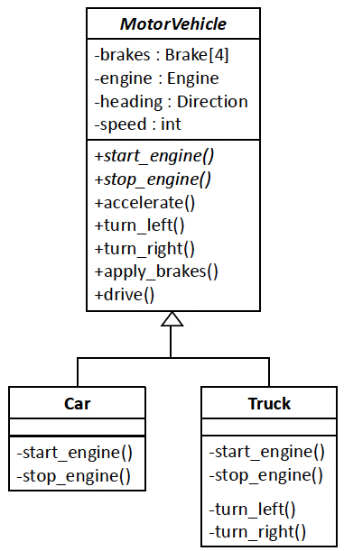
Example: Abstract Class, cont’d
abstract class
4.3/tester.cpp
int main()
{
MotorVehicle *mv;
mv = new Car();
mv->drive();
mv = new Truck();
mv->drive();
return 0;
}
abstract member functions
Output:
car starts engine
vehicle accelerates
vehicle turns left
vehicle turns right
vehicle applies brakes
car stops engine
truck starts engine
vehicle accelerates
truck turns left
truck turns right
vehicle applies brakes
truck stops engine

Slide 22
The override Keyword
When a subclass overrides a member function of its superclass, we can add the optional override specifier to the function header.
That tells the compiler to check that the overridden superclass member function is virtual and that the subclass member function has the same signature.
A common bug is to think we’re overriding a member function, but we accidentally misspelled it.
Virtual functions enable polymorphism.

Slide 23
Function Signature
The signature of a function consists of:
the function’s name
the number, datatypes, and order of its parameters (but not the names of the parameters)
qualifiers such as const
The return datatype is not part of the signature.

Slide 24
Interface Classes
An interface class is a superclass that contains only abstract member functions and no member variables.
Therefore, if a class implements the interface, it must implement each member function of the interface, otherwise the class is abstract.
An interface describes common behaviors of the implementing classes without specifying how to implement the behaviors.
A good way to manage change and complexity.

Slide 25
Example: Interface Class
class MotorVehicleInterface
{
public:
virtual void start_engine() = 0;
virtual void stop_engine() = 0;
virtual void accelerate() = 0;
virtual void apply_brakes() = 0;
virtual void turn_left() = 0;
virtual void turn_right() = 0;
virtual void drive() = 0;
};
4.4/MotorVehicleInterface.h

Slide 26
Example: Interface Class, cont’d
4.4/Car.h
class Car : public MotorVehicleInterface
{
public:
virtual ~Car() {}
virtual void drive() override
{
start_engine();
accelerate();
turn_left();
turn_right();
apply_brakes();
stop_engine();
cout << endl;
}
private:
virtual void start_engine() override
{
cout << "car starts engine" << endl;
}
virtual void stop_engine() override
{
cout << "car stops engine" << endl;
}
virtual void accelerate() override
{
cout << "car accelerates" << endl;
}
virtual void turn_left() override
{
cout << "car turns left" << endl;
}
virtual void turn_right() override
{
cout << "car turns right" << endl;
}
virtual void apply_brakes() override
{
cout << "car turns applies brakes"
<< endl;
}
Brake brakes[4];
Engine engine;
Direction heading;
int speed;
};

Slide 27
Example: Interface Class, cont’d
4.4/Truck.h
class Truck : public MotorVehicleInterface
{
public:
virtual ~Truck() {}
virtual void drive() override
{
start_engine();
accelerate();
turn_left();
turn_right();
apply_brakes();
stop_engine();
cout << endl;
}
private:
virtual void start_engine() override
{
cout << "truck starts engine" << endl;
}
virtual void stop_engine() override
{
cout << "truck stops engine" << endl;
}
virtual void accelerate() override
{
cout << "truck accelerates" << endl;
}
virtual void turn_left() override
{
cout << "truck turns left" << endl;
}
virtual void turn_right() override
{
cout << "truck turns right" << endl;
}
virtual void apply_brakes() override
{
cout << "truck turns applies brakes"
<< endl;
}
Brake brakes[4];
Engine engine;
Direction heading;
int speed;
}

Slide 28
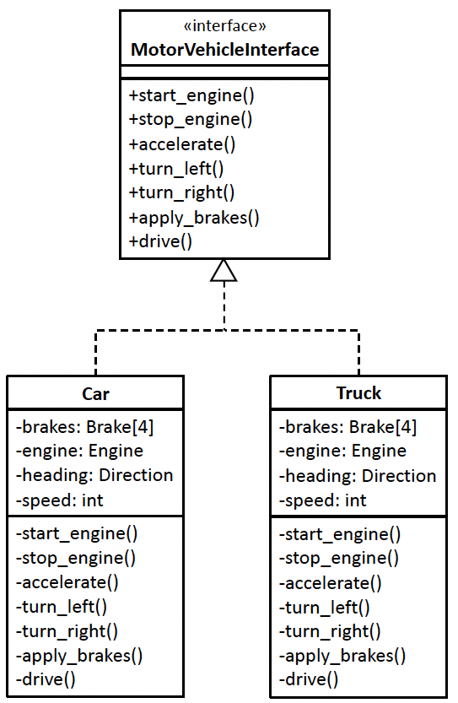
Example: Interface Class, cont’d
4.4/tester.cpp
Unchanged main:
int main()
{
MotorVehicle *mv;
mv = new Car();
mv->drive();
mv = new Truck();
mv->drive();
return 0;
}
Note: <<interface>>
No slanted font for names.
Use a dashed arrow to show implementing an interface.
Output:
car starts engine
car accelerates
car turns left
car turns right
car turns applies brakes
car stops engine
truck starts engine
truck accelerates
truck turns left
truck turns right
truck turns applies brakes
truck stops engine

Slide 29
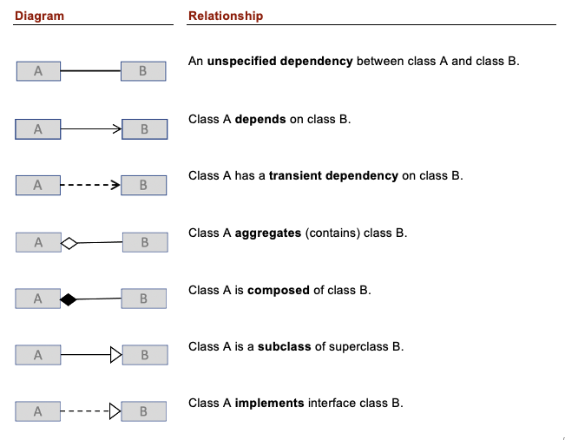
UML Class Relationships Summary

Slide 30
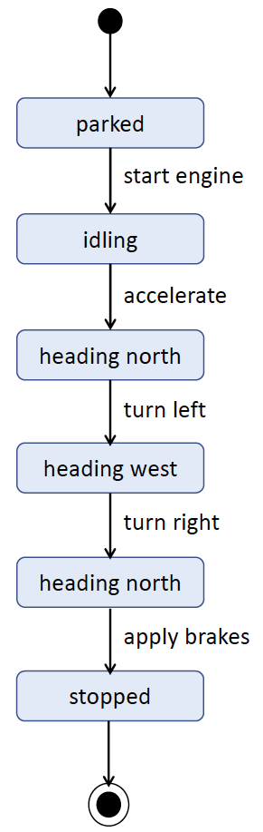
UML State Diagram
A UML state diagram provides dynamic runtime information.
It focuses on a single object and how it changes state at run time in response to events defined by its behaviors.
Each rounded box represents a state.
Each arrow represents a transition from one state to another.
Each arrow has a label that indicates the event that causes the transition.

Slide 31
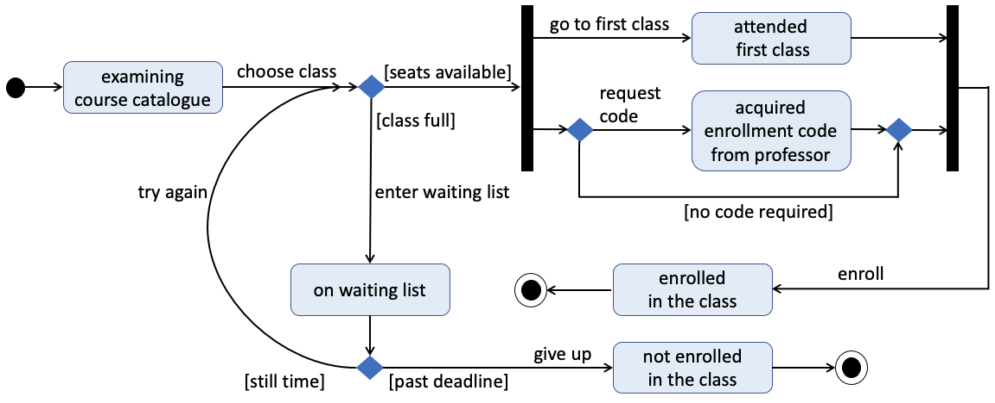
UML State Diagram, cont’d
A more complex example:
The filled-in diamonds are decision branch and merge points.
The heavy bars indicate where the transitions fork and join.

Slide 32
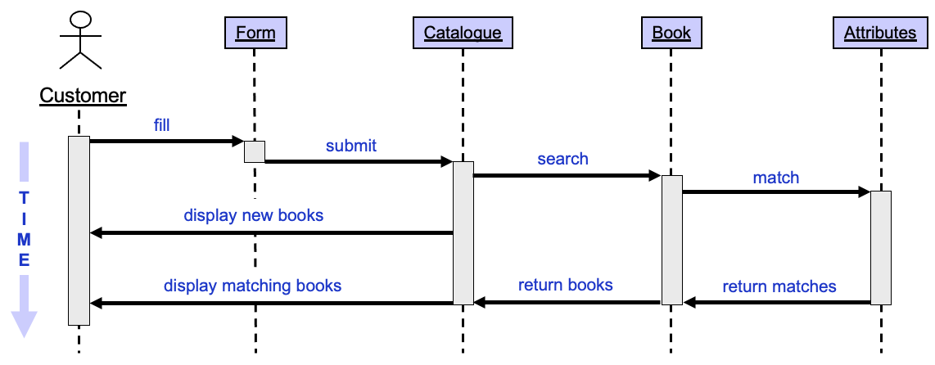
UML Sequence Diagram
Search for books
At a high level, a sequence diagram shows the runtime interactions among the objects during a use case.
More dynamic runtime information.

Slide 33
UML Sequence Diagram, cont’d
The stick figure at the top left represents the customer.
The boxes long the top of the diagram to the right of the stick figure represent objects instantiated from the classes
By convention, each class name is underlined to indicate that it’s an object instantiated from the class.
Time proceeds from top to bottom.
The customer and each object has a lifeline represented by a dashed vertical line.
Each vertical rectangle on a lifeline represents the time during which the customer or object is active in the use case.
The labeled horizontal arrows represent the interactions among the objects.
The objects implement these interactions with calls to member functions.

Slide 34
The Design Specification
A technical document created by the development team to describe and justify the design of the application.
Meant to be read by the current and future developers of the application.
Contains implementation details.
UML class, state, and sequence diagrams.
Software organizations determine the format and contents.
May have other names, such as Internal Maintenance Specification.

Slide 35
Internal Test Plan
The Design Specification may include an Internal Test Plan.
A unit test run by developers can target and stress a particular piece of code.
For example: Pass different parameter values to a member function of a class and verify the return values.
Regression testing: Rerun unit tests after code changes to ensure the code did not “regress”.
Testing verifies that the application was built right.

Slide 36
Break

Slide 37
The Principle of Least Knowledge
Also called the Law of Demeter.
Class A has minimal dependencies on class B if class A has little or no knowledge of how class B is implemented.
A class should hide its implementation.
“Hidden” means inaccessible.
Hidden implementation code is effectively encapsulated.
Make changes to the hidden implementation of a class without affecting any other code that uses the class.

Slide 38
Public vs. Private Members of a Class
A good rule of thumb: A class should make all its member variables and functions private except for members that need to be accessed by other classes.
Old saying: “Once public, always public.”
If you make a member variable or member function public, you might not be able to change it to private later without forcing rewrites of code that use the member variable or member function.

Slide 39
Example: A Date Class
Develop a Date class that allows us to perform date arithmetic:
What is the date n days from this date, where n can be positive (for a date after this date) or negative (for a date before this date)?
How many days are there from this date to another date?
We will take three iterations to arrive at a solution that is both correct and efficient.
Hidden implementations will be important.
Date arithmetic can be complex!

Slide 40
A Date Class, cont’d
April, June, September, November each has 30 days.
February has 28 days, except in leap years when it has 29 days.
All other months have 31 days.
Years that are divisible by 4 are leap years, except that after 1582, years divisible by 100 but not 400 are not leap years.
There is no year 0. Year 1 CE is preceded by year 1 BCE (year -1).
During the switchover to the Gregorian calendar, ten days were dropped. The next date after October 4, 1582 was October 15, 1582.

Slide 41
A Date Class, cont’d
Iteration #1: Date arithmetic with loops
5.2/Date.h
5.2/Date.cpp
5.2/main.cpp
Lots of things are going to go wrong with this application!

Slide 42
A Date Class, cont’d
Iteration #2: Julian day numbers
5.3/Date.h
5.3/Date.cpp
5.3/main.cpp

Slide 43
A Date Class, cont’d
Julian Day Number
Astronomers use Julian day numbers to identify days rather than using the year, month, and day of the month. A Julian day number counts the number of days since noon on January 1, 4713 BCE of the Gregorian calendar, and so that day at noon has Julian day number 0. Because it takes hours of the day into account, a Julian day number can have a fractional part, but it’s whole at noon. The sixteenth century historian Josephus Justus Scaliger invented the concept, and he named it after his father Julius.
There are complicated algorithms for converting between a day’s Julian day number and its corresponding Gregorian year, month, and day of the month. The algorithms in the following application are from Numerical Recipes, the Art of Scientific Computing, 3rd edition, by William H. Press et al., Cambridge University Press, 2007.
A useful conversion milepost is Julian day number 2,440,000 which corresponds to the Gregorian date May 23, 1968.

Slide 44
A Date Class, cont’d
Iteration #3: A hybrid approach with lazy evaluation
5.4/Date.h
5.4/Date.cpp
5.4/main.cpp
The Lazy Evaluation Principle
If at run time we don’t need the result of a calculation immediately, then we should be “lazy” and postpone the calculation until we need the result.
This principle is especially useful to improve performance if the calculation is expensive or time-consuming.

Slide 45
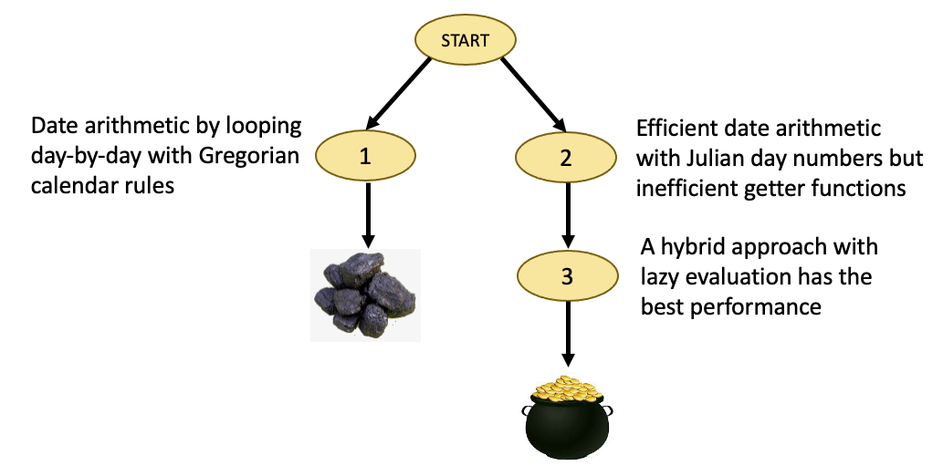
A Date Class, cont’d

Slide 46
Public Setter Functions
Our Date class so far it is immutable.
There are no public setter functions.
Once we’ve constructed a Date object at run time with year, month, and day of the month values, there is no way to change its state.
We can make yet another version of the Date class that allows selective access to another part of its implementation, the Julian day number.
Add public getter function get_julian() and public setter function set_julian().
5.5/Date.h
5.5/Date.cpp
5.5/main.cpp

Slide 47
Dangerous Public Setter Functions
Suppose we now provide still more public setter functions:
set_year(), set_month(), and set_day()
Is it always a good idea to provide public setter functions?
Do we need to practice stronger defensive programming?
How would you fix this?
5.6/Date.h
5.6/Date.cpp
5.6/main.cpp

Slide 48
Rules from the Law of Demeter
The Law of Demeter prescribes several rules that help us design proper loosely coupled classes.
By following these rules, we avoid designing a class that has certain problematic dependencies on another class.
Basic idea: A class should only call member functions of objects that are “close” to it.

Slide 49
Rules from the Law of Demeter, cont’d
Suppose class A has member function afunc() and class B has member function bfunc():
Function afunc() can call function bfunc() on a class B object if class A aggregates the B object (i.e., class A has a member variable whose value is that class B object or a pointer to that class B object).
Function afunc() can call function bfunc() on a class B object if the B object was passed as an argument to afunc().
Function afunc() can call function bfunc() on a class B object if afunc() instantiated the B object.
Function afunc() should not call function bfunc() on a class B object that was returned by a call on another object’s member function.
For programmers who are real sticklers about loose coupling!

Slide 50
Rules from the Law of Demeter, cont’d
5.7/DemeterAuto.h
class Sparkplug
{
public:
void replace()
{
/* replace sparkplug */
}
};
class Engine
{
public:
Sparkplug *get_sparkplug() const
{
return plug;
}
void replace_sparkplug()
{
plug->replace();
}
private:
Sparkplug *plug;
};
class DemeterAuto
{
public:
void service_sparkplug(Sparkplug *plug)
{
plug->replace();
}
void maintain_auto()
{
engine.replace_sparkplug();
Sparkplug *plug1 = engine.get_sparkplug();
plug1->replace();
Sparkplug *plug2 = new Sparkplug();
plug2->replace();
}
private:
Engine engine;
};
YES (Rule 2): plug is a parameter of service_sparkplug()
YES (Rule 1): engine is a member of class DemeterAuto
NO (Rule 4): plug1 points to an object returned by the Engine object
YES (Rule 3): plug2 points to an object instantiated by maintain_auto()
YES (Rule 1): plug is a member variable of class Engine

Slide 51
How Well Did We Hide Implementation?
Example application: Storing employee records.
Class Employee records an employee’s birthdate via a one-to-one aggregation with class Date.
An Employee object must be immutable by a regular user of the application. After we’ve created an object, the employee’s id, name, and birthdate should not be changeable by such a user.
Private member variables employee_id, name, and birthdate are in the hidden state implementation.
Class Employee has no public setter functions.

Slide 52
Hide Implementation? cont’d
5.8/Employee.h
class Employee
{
public:
Employee(long id, string name, Date *bdate)
: employee_id(id), name(name), birthdate(bdate) {}
Date *get_birthdate() const { return birthdate; }
friend ostream& operator <<(ostream& os, const Employee& emp);
private:
long employee_id;
string name;
Date *birthdate;
};
inline ostream& operator <<(ostream& os, const Employee& emp)
{
os << "Employee #" <<emp.employee_id << endl;
os << " Name: " << emp.name << endl;
os << " Birthdate: "; emp.birthdate->print(); os << endl;
return os;
}

Slide 53
Hide Implementation? cont’d
5.8/tester.h
Output:
int main()
{
Date *date1 = new Date(2000, 1, 10);
Employee mary(1234567890, "Mary", date1);
cout << mary << endl;
int julian1 = date1->get_julian();
date1->set_julian(julian1 + 366);
cout << mary << endl;
Date *date2 = mary.get_birthdate();
int julian2 = date2->get_julian();
date2->set_julian(julian2 + 365);
cout << mary << endl;
return 0;
}
Employee #1234567890
Name: Mary
Birthdate: 1/10/2000
Employee #1234567890
Name: Mary
Birthdate: 1/10/2001
Employee #1234567890
Name: Mary
Birthdate: 1/10/2002
Oops! The Employee object was not immutable!

Slide 54
Hide Implementation? cont’d
To ensure class Employee remains immutable:
The class constructor should store a copy of the Date object that is passed to it.
The getter function should return a pointer to a copy of the embedded Date object.
class Employee
{
public:
Employee(long id, string name, Date *bdate)
: employee_id(id), name(name),
birthdate(new Date(*bdate)) {}
long employee_id;
string name;
Date *get_birthdate() const { return new Date(*birthdate); }
...
private:
Date *birthdate;
};
Output:
5.9/Employee.h
Employee #1234567890
Name: Mary
Birthdate: 1/10/2000
Employee #1234567890
Name: Mary
Birthdate: 1/10/2000
Employee #1234567890
Name: Mary
Birthdate: 1/10/2000

Slide 55
Assignment #2
Write a Design Specification.
Well-defined classes.
UML class diagrams.
Describe your good class design.
Discuss your encapsulation of potential changes.
Free UML drawing tools
Violet: http://horstmann.com/violet/
StarUML: http://staruml.sourceforge.net/en/
Team assignment, due March 4.
Be creative! You will not be asked to write the code. You will not be held to this design for your semester project.

Slide 56
Lambda Expressions
Person.h
enum class Gender { M, F };
class Person
{
public:
Person(string f, string l, Gender g)
: first(f), last(l), gender(g) {}
virtual ~Person() {}
string first;
string last;
Gender gender;
};
inline ostream& operator <<(ostream& outs, Person &p)
{
outs << " {" << "first=" << p.first << ", last=" << p.last
<< ", gender=" << (p.gender == Gender::F ? "F" : "M") << "}";
return outs;
}

Slide 57
Lambda Expressions, cont’d
lambda1.cpp
void init(vector<Person>& v)
{
v.push_back(Person("Marie", "Curie", Gender::F));
v.push_back(Person("Agatha", "Cristie", Gender::F));
v.push_back(Person("Barack", "Obama", Gender::M));
v.push_back(Person("Tom", "Cruise", Gender::M));
v.push_back(Person("Julia", "Child", Gender::F));
v.push_back(Person("Ron", "Mak", Gender::M));
}
bool is_male(const Person &p)
{
return p.gender == Gender::M;
}
bool is_C(const Person &p)
{
return p.last[0] == 'C';
}

Slide 58
Lambda Expressions, cont’d
lambda1.cpp
vector<Person> select(const vector<Person> people,
bool matches(const Person &p))
{
vector<Person> selected;
for (const Person& p : people) if (matches(p)) selected.push_back(p);
return selected;
}
int main()
{
vector<Person> people;
init(people);
cout << "Males:" << endl;
vector<Person> males = select(people, is_male);
for (Person& p : males) cout << p << endl;
cout << endl << "Last name starts with C:" << endl;
vector<Person> cs = select(people, is_C);
for (Person& p : cs) cout << p << endl;
}
Did we really need to create separate function definitions for is_male() and is_c() if all we’re going to do is pass their references as arguments to a call to function select()?

Slide 59
Lambda Expressions, cont’d
Males:
{first=Biden, last=Joe, gender=M}
{first=Tom, last=Cruise, gender=M}
{first=Ron, last=Mak, gender=M}
Last name starts with C:
{first=Marie, last=Curie, gender=F}
{first=Agatha, last=Cristie, gender=F}
{first=Tom, last=Cruise, gender=M}
{first=Julia, last=Child, gender=F}

Slide 60
Lambda Expressions, cont’d
int main()
{
vector<Person> people;
init(people);
cout << "Males:" << endl;
vector<Person> males = select(people,
[] (const Person &p) -> bool
{
return p.gender == Gender::M;
});
for (Person& p : males) cout << p << endl;
cout << endl << "Last name starts with C:" << endl;
vector<Person> cs = select(people,
[] (const Person &p) -> bool
{
return p.last[0] == 'C';
});
for (Person& p : cs) cout << p << endl;
}
Instead, directly pass the bodies of unnamed functions as lambda expressions.
What’s this for?
lambda2.cpp

Slide 61
Lambda Expression with Capture
A lambda expression can “capture” variables that are in its scope to use inside its body.
Capture either by value or by reference inside [].
If you pass a lambda expression that does capturing to a function, then the function’s corresponding formal parameter must use std::function.
Instead of:
Use:
vector<Person> select(const vector<Person> people, bool matches(const Person &p));
vector<Person> select(const vector<Person> people,
function<bool(const Person &p)> matches)

Slide 62
Lambda Expression with Capture, cont’d
lambda3.cpp
vector<Person> select(const vector<Person> people,
function<bool(const Person &p)> matches)
{
vector<Person> selected;
for (const Person& p : people) if (matches(p)) selected.push_back(p);
return selected;
}

Slide 63
Lambda Expression with Capture, cont’d
lambda3.cpp
int main()
{
int count = 0;
vector<Person> people;
init(people);
cout << "Males:" << endl;
vector<Person> males = select(people,
[&count] (const Person &p) -> bool
{
if (p.gender == Gender::M)
{
count++;
return true;
}
else return false;
});
for (Person& p : males) cout << p << endl;
cout << count << " persons" << endl;
. . .

Slide 64
Lambda Expression with Capture, cont’d
lambda3.cpp
. . .
count = 0;
cout << endl << "Last name starts with C:" << endl;
vector<Person> cs = select(people,
[&count] (const Person &p) -> bool
{
if (p.last[0] == 'C')
{
count++;
return true;
}
else return false;
});
for (Person& p : cs) cout << p << endl;
cout << count << " persons" << endl;
}

Slide 65
Lambda Expression with Capture, cont’d
Males:
{first=Biden, last=Joe, gender=M}
{first=Tom, last=Cruise, gender=M}
{first=Ron, last=Mak, gender=M}
3 persons
Last name starts with C:
{first=Marie, last=Curie, gender=F}
{first=Agatha, last=Cristie, gender=F}
{first=Tom, last=Cruise, gender=M}
{first=Julia, last=Child, gender=F}
4 persons
predicate: A Boolean function whose return value depends on the values of its parameters.
Example: Function matches in these examples.

Slide 66
Unofficial Field Trip
Computer History Museum in Mt. View
http://www.computerhistory.org/
Provide your own transportation to the museum.
Saturday, March 14, 11:30 AM
Special free admission for my students.
Meet in the front lobby for your free pass.
Stay as long as you like, until closing time
Do a self-guided tour of the Revolution exhibit.
Experience a fully restored IBM 1401 mainframe computer from the early 1960s in operation.

Slide 67
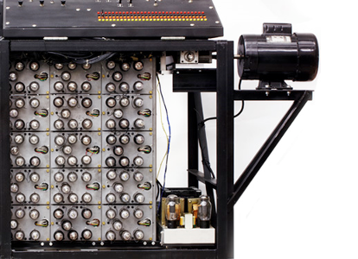
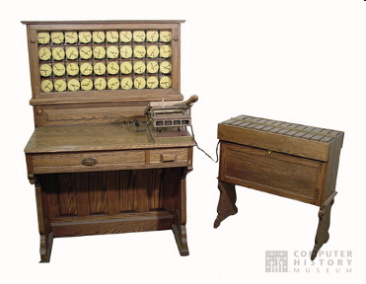
Unofficial Field Trip, cont’d
See the extensive Revolution exhibit!
Walk through a timeline of the First 2000 Years of Computing History.
Historic computer systems, data processing equipment, and other artifacts.
Small theater presentations.
Hollerith
Census
Machine
Atanasoff-Berry
Computer

Slide 68
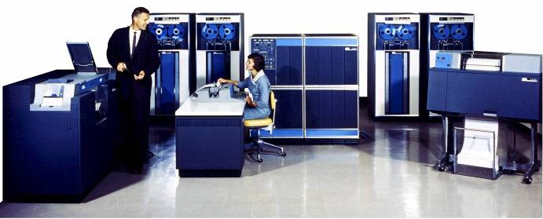
Unofficial Field Trip, cont’d
IBM 1401 computer, fully restored and operational.
A small transistor-based mainframe computer.
Extremely popular with small businesses in the late 1950s through the mid 1960s
Maximum of 16K bytes of memory.
800 card/minute card reader (wire brushes).
600 line/minute line printer (impact).
6 magnetic tape drives, no disk drives.

Slide 69
Unofficial Field Trip, cont’d
Information on the IBM 1401:
General info: http://en.wikipedia.org/wiki/IBM_1401
My summer seminar: http://www.cs.sjsu.edu/~mak/1401/
Restoration: http://ed-thelen.org/1401Project/1401RestorationPage.html

