Slide 1


CMPE 202 Software Systems Engineering March 4 Class Meeting
Engineering Extended Studies San Jose State University Spring 2026 Instructor: Ron Mak
www.cs.sjsu.edu/~mak

Slide 2
Today
The Open-Closed Principle
Don’t surprise users
The vexatious C++ vectors
Programming by contract
Break

Slide 3
Today, cont’d
Overriding vs. overloading
The Liskov Substitution Principle
Choosing “is-a” vs. “has-a”
Code to the Interface with a factory function
Computer History Museum Visit: Sat. March 14

Slide 4
The Open-Closed Principle
We should close a class against modification but open it for subclassing.
It assumes that we are confident that a class has captured all the common attributes and behaviors of a set of objects and therefore the design of that class should not change.
For code stability and hidden implementation.
Make the member variables and member functions of the superclass private.
Hide how we implement the common parts of the state and behavior inherited by its subclasses.

Slide 5
The Open-Closed Principle, cont’d
Every mammal has a weight and a height, and it must eat and perform, and sleep. Sleep is optional and can involve snoring.
Therefore, we close this superclass.
But we open the class for extension as humans and cats.
Mammal
-weight: double
-height: double
+eat()
+perform()
#sleep()
-snore()
Human
Cat
-year: int
-genre: Genre
-fur_factor: double
+eat()
+perform()
-shed()
+eat()
+perform()
-needs_glasses(): bool
-read_book()
5.10/Mammal.h
5.10/Mammals.h
5.10/main.cpp
Protected members of a class (marked with a # in a UML class diagram) can be accessed by the class itself and by its subclasses, but they are inaccessible by any other classes.

Slide 6
The Principle of Least Astonishment
Poor software design can cause surprises.
We don’t want to surprise our customers with applications that don’t behave as expected.
We don’t want to surprise developers (including ourselves) with code that doesn’t work as expected.
The Principle of Least Astonishment
There should be few, if any, surprises for programmers (including ourselves) who use our code. Surprises can cause logic and runtime errors and make code difficult to maintain.
Notes:
START HERE.

Slide 7
Misnamed Functions
We can surprise callers of a function if we give it a misleading name.
Example: Class SortedList is a subclass of vector<int>, and it contains a list of integers that is known to be sorted.
The class has a static member function merge() that takes three SortedList parameters, list1 and list2 to merge and merged_list to contain the merged values.
Could there be a hidden surprise?
6.5/SortedList.h
6.5/SortedList.cpp
6.5/main.cpp

Slide 8
Poor Performance
Another bad surprise is poor runtime performance due to often-hidden inefficient programming.
Example: In class SortedList, we can rename its static member function merge() to a clearer name merge_and_deduplicate().
Its running time grows exponentially as the lengths of the two vector parameters grow linearly.
That’s due to the way we removed the duplicate values.
Can we also improve the function’s performance?
6.6/SortedList.h
6.6/SortedList.cpp
6.6/main.cpp

Slide 9
Poor Performance, cont’d
The refactored version of the merge function scales well. As the lengths of the two SortedList objects increase linearly, the function’s run time increases approximately linearly in proportion.
Refactoring
We refactor code by redesigning it to improve it in some way, such as making it perform more efficiently, but without changing its functionality or how to use it. Refactoring is a common operation during development iterations.

Slide 10
The Vexatious Performance of C++ Vectors
Vectors from the Standard Template Library are more convenient to use than arrays.
An STL vector internally manages a hidden dynamic array to store its elements.
We can insert an element anywhere into a vector or append elements at its end.
We can delete any element from the vector.
We don’t need to write code to keep track of a vector’s storage requirements because the vector automatically adjusts the size of its internal dynamic array as we insert, append, and delete elements.
But we can inadvertently incur some nasty performance problems.

Slide 11
C++ Vectors, cont’d
Example: An application stores appointment dates in an STL vector.
For each appointment, it appends a Date object to the end of the vector<Date> dates.
It also removes Date objects from the vector.
6.7/Date.h
6.7/Date.cpp
6.7/Appointments.h
6.7/main.cpp

Slide 12
C++ Vectors, cont’d
Surprise! As the dates vector grows larger, the application’s performance degrades.
Can we show how an STL vector operates?
6.8/Date.h
6.8/Date.cpp
6.8/Appointments.h
6.8/main.cpp

Slide 13
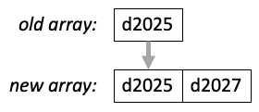
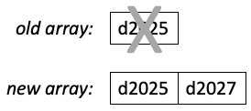
C++ Vectors, cont’d
To append element d2027 to a vector, the C++ runtime system must “grow” the vector by allocating a new longer internal dynamic array.
It must copy objects from the old array to the new:
Then it must deallocate objects in the old array.
calls to the copy constructor
call to the destructor

Slide 14
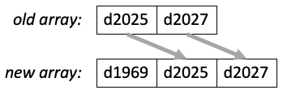
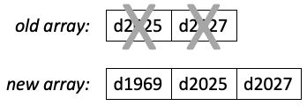
C++ Vectors, cont’d
Similarly, to insert element d1969 into a vector, the C++ runtime system must “grow” the vector by allocating a new longer internal dynamic array.
It must copy objects from the old array to the new:
Then it must deallocate objects in the old array.
calls to the copy constructor
calls to the destructor

Slide 15



C++ Vectors, cont’d
To remove an element from a vector:
First deallocate the object being removed:
Replace the removed object with a copy of the following object:
Deallocate the original following object:
Repeat the last two steps down through the rest of the vector.
call to the destructor
call to the assignment operator
call to the destructor

Slide 16
C++ Vectors, cont’d
Refactor! Use pointers instead:
vector<Date *> dates;
...
vector<Date *> get_dates() const;
void append(Date * const date);
void insert(const int index, Date * const date);
6.9/Date.h
6.9/Date.cpp
6.9/Appointments.h
6.9/tester.cpp
The C++ Standard Vector Class
A standard C++ std::vector class manages an internal dynamic array whose storage automatically grows at run time as needed, which makes vectors convenient for programmers to use. The vector class uses strategies to reduce the need to create a new dynamic array every time new elements are added. We can call its reserve() member function to pre-allocate a vector of a given size. When the vector must create a new internal dynamic array to accommodate the addition of new elements, it chooses an optimal amount to make the new array’s size longer than the old array’s size. Then subsequent additions of elements might not require creating new arrays.

Slide 17
“The Big Three”
“The Big Three”
A C++ class’s destructor, copy constructor, and copy assignment operator are known as “The Big Three”. The rule of thumb says that if you need to explicitly implement any one of them rather than use the default, you should implement all three.
With the addition of the move constructor and the move assignment operator, we have “The Big Five”.
See https://www.feabhas.com/sites/default/files/2016-06/Rule%20of%20the%20Big%20Five.pdf

Slide 18
Programming by Contract
One way to eliminate surprises in a class that we write is to include, in effect, a contract for programmers who use the class.
For a member function, state explicitly what preconditions must be true when a caller calls the function.
State explicitly what postconditions the caller can expect to be true when the function returns.
State explicitly what is the class invariant.
The Programming by Contract terms “precondition” and “postcondition” are similar to the terms in use case descriptions.

Slide 19
Programming by Contract, cont’d
A class invariant must remain true for the class’s objects at run time before and after every call to a member function.
It may be violated temporarily by an object undergoing mutation.
The class invariant ensures that there are never any objects left in an invalid state.

Slide 20
Programming by Contract, cont’d
Programming by Contract
The concept of programming by contract was first proposed by the object-oriented programming pioneer Bertrand Meyer. His Eiffel programming language had constructs that allowed a programmer to define preconditions, postconditions, and invariants, and the language checked at run time that they were true. This was especially helpful while debugging a program. The checks could be turned off when the application is deployed so that they don’t hurt performance.

Slide 21
Programming by Contract, cont’d
C++ language does not have native support for programming by contract.
However, we can still implement its concepts using existing features of the language.
While it’s probably overkill to use contracts on every class of an application, it may be wise to use them on the most critical classes.

Slide 22
Example: Programming by Contract
Class CircularBuffer has a private dynamic array of a given capacity that holds integer elements.
Private member variable buffer points to the array.
Private member variable capacity is the maximum number of elements the buffer can hold.
Private member variable count keeps track of how many elements are currently in the buffer.
Private member function class_invariant() computes the class invariant and returns true if the invariant holds or false otherwise.

Slide 23
Example: Programming by Contract, cont’d
6.10/CircularBuffer.h
class CircularBuffer
{
public:
CircularBuffer(const int cap);
~CircularBuffer() { delete[] buffer; }
int get_count() const { return count; }
void add(const int value);
int remove();
private:
int capacity;
int head, tail;
int count;
int *buffer;
bool class_invariant() const;
};

Slide 24
Example: Programming by Contract, cont’d
Two critical private member variables:
Private member variable head is the index of the head element (the next one to remove).
Member function remove() increments head.
Private member variable tail is the index of the tail position (where to add a new element).
Member function add() increments tail.
Member variables head and tail each “wraps” to the other end of the buffer when it exceeds the capacity.
The class invariant is
$$0 ≤head <capacity AND 0 ≤tail <capacity$$

Slide 25
Example: Programming by Contract, cont’d
$$0 ≤head <capacity AND 0 ≤tail <capacity$$
6.10/CircularBuffer.cpp
/**
* @invariant (0 <= head < capacity) and (0 <= tail < capacity)
*/
bool CircularBuffer::class_invariant() const
{
return (0 <= head) && (head < capacity)
&& (0 <= tail) && (tail < capacity);
}
/**
* Constructor
* @parm cap the capacity of the buffer.
* @postcondition the buffer is empty.
*/
CircularBuffer::CircularBuffer(const int cap)
: capacity(cap), head(0), tail(0), count(0),
buffer(new int[capacity])
{
assert(class_invariant()); // CHECK INVARIANT
}

Slide 26
Example: Programming by Contract, cont’d
6.10/CircularBuffer.cpp
/**
* Add a new value to the tail of the buffer.
* @parm value the value to add.
* @precondition the buffer is not full.
* @postcondition the buffer is not empty.
*/
void CircularBuffer::add(const int value)
{
assert(count < capacity); // PRECONDITION: not full
buffer[tail] = value;
tail = (tail + 1)%capacity;
count++;
assert(count > 0); // POSTCONDITION: not empty
assert(class_invariant()); // CHECK CLASS INVARIANT
}

Slide 27
Example: Programming by Contract, cont’d
6.10/CircularBuffer.cpp
/**
* Remove a value from the head of the buffer.
* @return the removed value.
* @precondition the buffer is not empty.
* @postcondition the buffer is not full.
*/
int CircularBuffer::remove()
{
assert(count > 0); // PRECONDITION: not empty
int value = buffer[head];
head = (head + 1)%capacity;
count--;
assert(count < capacity); // POSTCONDITION not full
assert(class_invariant()); // CHECK CLASS INVARIANT
return value;
}

Slide 28
The Precondition Principle
The Precondition Principle
The precondition of a function is a condition (a Boolean expression) that must be true when we call the function. According to programming by contract, if the precondition of a function is true and we call the function, the function must guarantee that it will behave properly. It is the responsibility of the caller to check the precondition before making the call. If the precondition is false but we call the function anyway, the function is not required to behave in a manner suitable or convenient for the caller.
If the precondition is for a member function of a class, then the class must provide some public means for the caller to check the validity of the precondition. Because it’s the caller’s responsibility to do so, the function has no obligation to check whether the precondition is met.

Slide 29
The Precondition Principle, cont’d
In class CircularBuffer, the precondition to calling member function add() is that the buffer is not full.
The test program first calls member function get_count() to check that the count is less than CAPACITY.
The program doesn’t try to add if the buffer is full.
If the precondition is true, add() must properly add the value to the tail of the buffer and advance member variable tail.

Slide 30
The Precondition Principle, cont’d
Since it’s the caller’s responsibility to check the precondition of a function, function add() is not obligated to check it.
The function is not required behave in a manner suitable to the caller if it is called when the precondition of a function is not met.
It can proceed to add the new value to the buffer, thereby overwriting an existing value.
It can not add the new value, but instead do nothing or print an error message.
It can abort the program.

Slide 31
The Precondition Principle, cont’d
In class CircularBuffer, the precondition to calling member function remove() is that the buffer is not empty.
The test program again first calls function get_count() to check that the count is not 0.
The program doesn’t try to remove if the buffer is empty.
If the precondition is true, the remove() must properly remove a value from the head of the buffer, advance member variable head, and return the removed value.

Slide 32
The Precondition Principle, cont’d
Since it’s the caller’s responsibility to check the precondition of a function, function remove() is not obligated to check it.
The function is not required behave in a manner suitable to the caller if it is called when the precondition of a function is not met.
It can proceed to remove a value from the buffer, thereby potentially returning a value that had previously been returned.
It can not remove a value, but instead do nothing, print an error message, or return a dummy value.
It can abort the program.

Slide 33
The Postcondition Principle
The Postcondition Principle
The postcondition of a function is a condition (a Boolean expression) that must be true when the function returns. According to programming by contract, if a function was called when its precondition was met, it is the responsibility of the function to meet its postcondition before returning.
We can assume that if we called a function and it returned, it behaved properly, and that the postcondition is true. This relieves us from the obligation to do an error check after the call. (Of course, we still can check.)

Slide 34
The Postcondition Principle, cont’d
In class CircularBuffer, if we call member function add() after confirming that its precondition is met, then the function must successfully add the new value to the buffer, and thereafter the buffer cannot be empty.
Before the function returns it must ensure that the postcondition is true.
It checks its postcondition that member variable count must be greater than zero.
In this example, the function aborts the program if the postcondition isn’t met.

Slide 35
The Postcondition Principle, cont’d
In class CircularBuffer, if we call member function remove() after confirming that its precondition is met, then the function must successfully add the new value to the buffer, and thereafter the buffer cannot be full.
Before the function returns it must ensure that the postcondition is true.
It checks its postcondition that member variable count must be less than capacity.
In this example, the function aborts the program if the postcondition isn’t met.

Slide 36
The Postcondition Principle, cont’d
In an actual application, a function would somehow try a different way to meet its postcondition rather than simply aborting the program.
A possible action is to throw an exception if a problem occurred.
That would change the function’s contract.
The postcondition would then be that the function either succeeded or it threw an exception.

Slide 37
The Class Invariant
The Class Invariant Principle
The class invariant is a condition (a Boolean expression) involving the class’s state implementation that must be true after each object is created at run time (i.e., after each constructor call). It must remain true each time after an object is mutated by a setter function or any other function that changes the object’s state.
The class invariant ensures that no invalid objects are created and that no object ever enters an invalid state.
Typically, the class invariant consists of the class’s member variables.

Slide 38

The Class Invariant, cont’d
$$0 ≤head <capacity AND 0 ≤tail <capacity$$
Is this a valid class invariant?
When an object is first created, member variables head and tail are each set to 0 which satisfies the $0 ≤$ parts of the invariant.

Slide 39
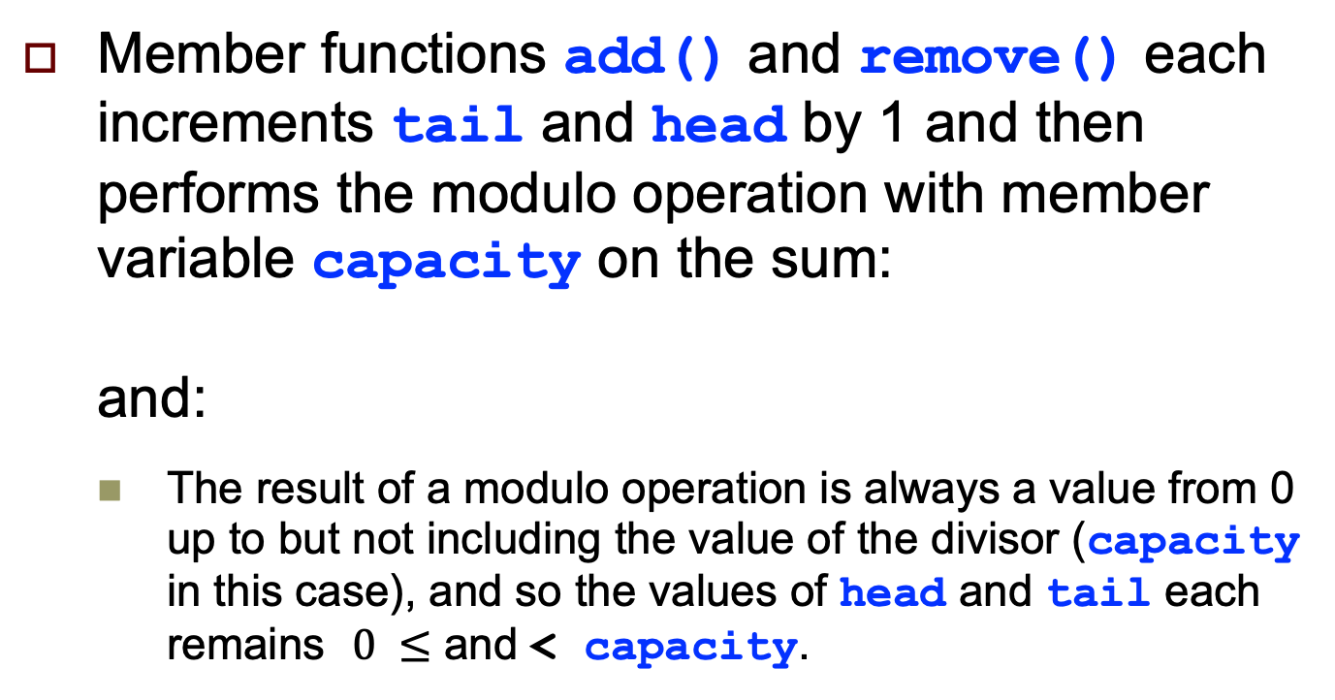
The Class Invariant, cont’d
$$0 ≤head <capacity AND 0 ≤tail <capacity$$
Member functions add() and remove() each increments tail and head by 1 and then performs the modulo operation with member variable capacity on the sum: and:
The result of a modulo operation is always a value from 0 up to but not including the value of the divisor (capacity in this case), and so the values of head and tail each remains $0 ≤$ and < capacity.
(tail + 1)%capacity
(head + 1)%capacity

Slide 40
The Class Invariant, cont’d
The class invariant can be violated while an object’s state is changing.
For example, in function add(), had we written the value of tail can briefly equal the value of capacity before the modulo operation occurs.
However, the class invariant must be true again before the function returns.
tail = tail + 1;
tail = tail%capacity

Slide 41
The Class Invariant, cont’d
Finding an appropriate invariant for a class can be challenging. The class invariant we chose for class CircularBuffer alone is not sufficient to ensure that the buffer will operate correctly.
For example, it by itself does not guarantee that the values of member variables head and tail do not cross each other. (That’s the job of the pre- and postconditions.)

Slide 42
Proving a Program to be Correct
Theoretically, if we can specify the proper class invariants and the preconditions and postconditions for each member function in every class of a program, we can “prove” that the program is correct.
In practice, however, this is very difficult for all but the simplest programs.
Famous computer scientist Don Knuth once said about a program he had written, “Beware of bugs in the above code; I have only proved it correct, not tried it.” (https://www-cs-faculty.stanford.edu/~knuth/faq.html)

Slide 43
Break

Slide 44
Function Overriding vs. Overloading
Function overriding involves superclasses and their subclasses.
A member function of a subclass overrides a member function of the superclass if the two functions have the same signature.
The signature of a function consists of its function name and the number, datatype, and order of its parameters.
The names of the parameters and the datatype of the return value are not included in the signature.

Slide 45
Overriding
Use function overriding when you want a subclass object to have similar but not exactly the same behavior as a superclass object.
The subclass’s overriding member function implements the desired subclass behavior.
GeneralTax
-GENERAL_RATE: double = 0.10
7.1/Taxes.h
+amount_owed(income: double): double
return GENERAL_RATE*income
7.1/tester.cpp
LocalTax
-LOCAL_RATE: double = 0.05
+amount_owed(earnings: double): double
return LOCAL_RATE*income
MaxTax
-LOCAL_RATE: double = 0.05
+amount_owed(earnings: double): double
return LOCAL_RATE*amount
+ GeneralTax.amount_owed(amount)

Slide 46
Overloading
Function overloading occurs when two or more functions in the same scope have the same name but otherwise different signatures.
Overload a set of functions when they are so strongly related that it doesn’t make sense to invent a different name for each function.
Member functions of a class or standalone functions.
The C++ compiler knows which overloaded function to invoke based on the call’s arguments.

Slide 47
Overloading, cont’d
Use function overloading for well-designed applications in these situations:
The functions perform conceptually similar operations:
The functions perform the same operation and produce identical results:
The functions perform equivalent operations:
void print(Textfile f); // print to standard out
void print(Textfile f, PDF p); // print to a PDF
void draw_circle(int x, int y, double radius);
void draw_circle(Point p, double radius);
vector<Book *> search(Genre g, int year, string title);
vector<Book *> search(Region r, string title);

Slide 48
Overloading, cont’d
Function overloading is very common.
The + operator is an example of operator overloading.
If its two arguments are integer or real values, the operator returns their sum by performing arithmetic addition.
But if the two arguments are string values, the operator returns a string value equal to the value of the second string “added” to the end of the value of the first string by performing string concatenation.
The square root function sqrt() in the standard math library is overloaded.
We can pass it a double, float, or long argument value, and it will compute and return the argument’s square root as a double.

Slide 49
Overloading, cont’d
Overload the << operator to print Kind values:
The the << operator will output the value of Kind variable k to cout:
Depending on the value of k, the output will be the string "fiction", "cookbook", or "howto".
enum class Kind
{
FICTION, COOKBOOK, HOWTO
};
inline ostream& operator <<(ostream& ostr, const Kind& k)
{
switch (k)
{
case Kind::FICTION: ostr << "fiction"; break;
case Kind::COOKBOOK: ostr << "cookbook"; break;
case Kind::HOWTO: ostr << "howto"; break;
}
return ostr;
}
cout << k << endl;

Slide 50
The Liskov Substitution Principle
When we create applications with a class hierarchy of superclasses and their subclasses, we must design the subclasses right to achieve a well-designed application.
Inheritance is one of the main concepts of object-oriented programming.
The Liskov Substitution Principle helps ensure properly designed subclasses for a superclass.
Named after object-oriented programming pioneer and professor Barbara Liskov of the Massachusetts Institute of Technology (MIT).

Slide 51
The Liskov Substitution Principle, cont’d
The Liskov Substitution Principle
Wherever there is a superclass object in a program, we should be able to substitute an object from one of its subclasses. In other words, we should be able to replace each occurrence of a superclass object in the source code with an object from one of its subclasses. This substitution should be possible because an object that is an instance of a subclass object is also an instance of the superclass.
If we designed the subclasses properly, after we make such a substitution, the program should run without logic or runtime errors, although it may produce different but meaningful results. Subclasses that violate this design principle were designed improperly.

Slide 52

The Liskov Substitution Principle, cont’d
Example violation: In a badly designed version of the CircularBuffer class, we’ll implement the buffer as a vector, and we’ll make a subclass of vector<int>.
7.2/CircularBuffer.h
class CircularBuffer : public vector<int>
{
public:
CircularBuffer(const int cap);
void add(const int value);
int remove();
friend ostream& operator <<(ostream& ostr,
CircularBuffer& buffer);
private:
int capacity;
int head, tail;
int count;
};

Slide 53
The Liskov Substitution Principle, cont’d
Invalid operations become possible.
7.2/main.cpp
Contents: 10 20 30 40 50
Contents: 10 99 30 40 50
Remove 10
Remove 99
Contents: 30 40 50
Contents: 40 50 libc++abi.dylib: terminating with uncaught exception [CA]of type std::out_of_range: vector
int main()
{
CircularBuffer buffer(SIZE);
for (int value = 10; value <= 50; value+=10)
{
buffer.add(value);
}
cout << buffer << endl;
buffer.at(1) = 99; // INVALID!!!
cout << buffer << endl;
cout << "Remove " << buffer.remove() << endl;
cout << "Remove " << buffer.remove() << endl;
cout << buffer << endl;
buffer.erase(buffer.begin() + 1); // INVALID!!!
cout << buffer << endl;
return 0;
}

Slide 54
The Liskov Substitution Principle, cont’d
A circular buffer is logically not a vector.
We cannot substitute a subclass CircularBuffer object for a superclass vector<int> object because we can’t use vector operations on a circular buffer.
Fix the program by making CircularBuffer not a subclass of vector<int>, but instead make CircularBuffer class have a member variable that is a vector<int>.
Class CircularBuffer is not a vector; it has a vector.

Slide 55
The Liskov Substitution Principle, cont’d
7.3/CircularBuffer.h
class CircularBuffer
{
public:
CircularBuffer(const int cap);
void add(const int value);
int remove();
friend ostream& operator <<(ostream& ostr,
CircularBuffer& buffer);
private:
int capacity;
int head, tail;
int count;
vector<int> buffer;
};

Slide 56
The Liskov Substitution Principle, cont’d
CircularBuffer::CircularBuffer(const int cap)
: capacity(cap), head(0), tail(0), count(0)
{
buffer.reserve(capacity);
for (int i = 0; i < capacity; i++) buffer.push_back(0);
}
void CircularBuffer::add(const int value)
{
buffer.at(tail) = value;
tail = (tail + 1)%capacity;
count++;
}
int CircularBuffer::remove()
{
int value = buffer.at(head);
head = (head + 1)%capacity;
count--;
return value;
}
7.3/CircularBuffer.cpp

Slide 57
“Is-a” vs. “Has-a” Class Relationships
Good class design requires choosing between “is-a” (inheritance) and “has-a” (aggregation) relationships, or using a good combination of the two.
Example: A cat is a mammal.
Example: A cat has a tail.

Slide 58
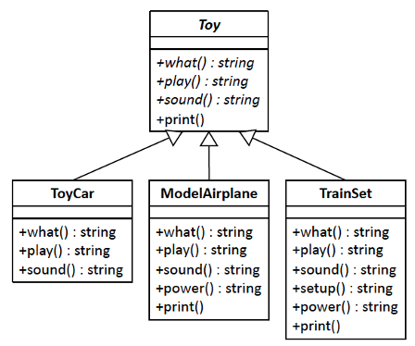
Example: Toys Application
Example children’s toys application.
What is it: toy car, model airplane, and train set.
Each toy has play action behavior (roll it on the floor or fly it in the air) and sound behavior (engine noises or the choo-choo sound).
Version 1: Use inheritance for “is-a” relationships.
7.4/Toy.h
7.4/main.cpp
Problems with this version?

Slide 59
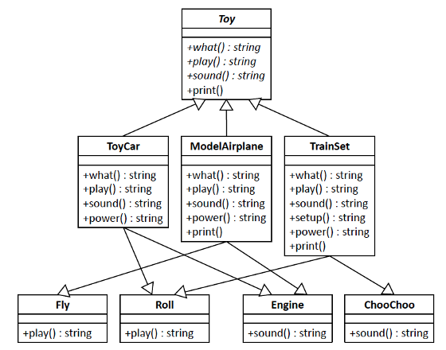
Example: Toys Application, cont’d
Version 2: Multiple inheritance
7.5/Sound.h
7.5/PlayAction.h
7.5/Toy.h
7.5/main.cpp
Problems with this version?

Slide 60
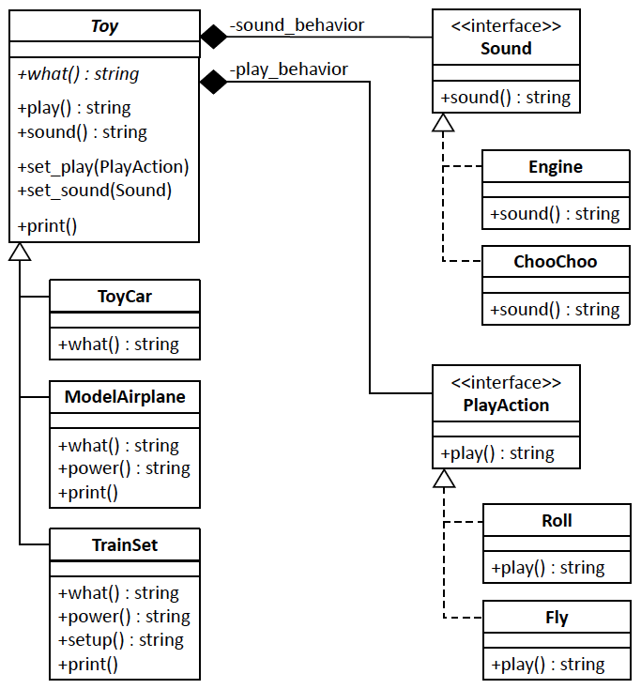
Example: Toys Application, cont’d
Version 3: Inheritance + Aggregations (compositions)
No code duplication.
Sound and play action behaviors are not hardcoded in the source code.
7.6/Sound.h
7.6/PlayAction.h
7.6/Toy.h
7.6/main.cpp

Slide 61
Favor Composition over Inheritance Principle
The Favor Composition over Inheritance Principle
A design that uses composition (“has-a” relationships where classes aggregate other classes) is often better than inheritance (“is-a” relationships of subclasses to superclasses). Inheritance is determined by the source code and therefore hardcodes behavior. Composing behaviors at run time is much more flexible. Composition also makes it easier to share code and reduce duplication.
Because “has-a” relationships often involve delegation, the principal is also called the Favor Delegation over Inheritance Principle.

Slide 62
Use a Factory Function
Code such as is inherently inflexible because variable toy is hardcoded to only point to a TrainSet object.
Using the Code to the Interface Principle:
But this code still isn’t as flexible as it can be.
What if during a different run of the application, we need to initialize variable toy to a different Toy object?
TrainSet *toy = new TrainSet(new Roll(), new ChooChoo());
Toy *toy = new TrainSet(new Roll(), new ChooChoo());

Slide 63
Use a Factory Function, cont’d
To allow choosing the Toy object at run time, use a factory function:
7.7/ToyFactory.h
enum class Kind { CAR, AIRPLANE, TRAIN };
class ToyFactory
{
public:
static Toy *make(const Kind kind)
{
switch (kind)
{
case Kind::CAR:
return new ToyCar(new Roll(), new Engine());
case Kind::AIRPLANE:
return new ModelAirplane(new Fly(), new Engine());
case Kind::TRAIN:
return new TrainSet(new Roll(), new ChooChoo());
default: return nullptr;
}
}
};

Slide 64
Use a Factory Function, cont’d
Now we have the flexibility to determine at run time which Toy object to create depending on the value of variable kind.
7.7/main.cpp
Output:
int main()
{
Kind kind = Kind::AIRPLANE;
Toy *toy = ToyFactory::make(kind);
toy->print();
delete toy;
return 0;
}
MODEL AIRPLANE
play: fly it
sound: Rrrr RRrr
power: wind up
7.7/Sound.h
7.7/PlayAction.h

Slide 65
Use a Factory Function, cont’d
The Factory Principle
If a program creates different objects at run time, we can encapsulate calls to new in a factory function. The value of a parameter passed to the factory function determines which object to create and return. The objects that a factory function can create are usually from subclasses of a common supertype .
Using a factory function gives us the flexibility to determine at run time what type of object to create.
We can implement a factory function as a function of a factory class that is related to the supertype, or the factory function can be a function of the supertype itself. The factory function is often static.

Slide 66
Unofficial Field Trip
Computer History Museum in Mt. View
http://www.computerhistory.org/
Provide your own transportation to the museum.
Saturday, March 14, 11:30 AM
Special free admission for my students.
Meet in the front lobby for your free pass.
Stay as long as you like, until closing time
Do a self-guided tour of the Revolution exhibit.
Experience a fully restored IBM 1401 mainframe computer from the early 1960s in operation.

Slide 67
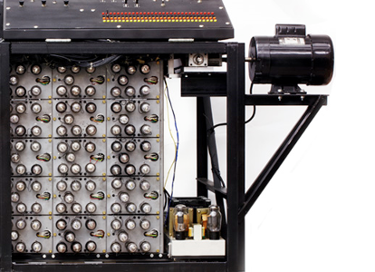
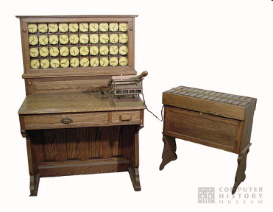
Unofficial Field Trip, cont’d
See the extensive Revolution exhibit!
Walk through a timeline of the First 2000 Years of Computing History.
Historic computer systems, data processing equipment, and other artifacts.
Small theater presentations.
Hollerith
Census
Machine
Atanasoff-Berry
Computer

Slide 68
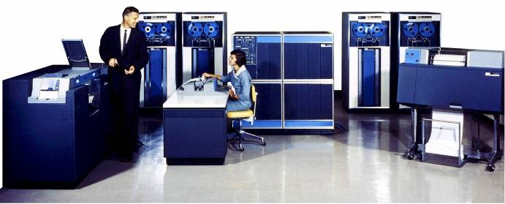
Unofficial Field Trip, cont’d
IBM 1401 computer, fully restored and operational.
A small transistor-based mainframe computer.
Extremely popular with small businesses in the late 1950s through the mid 1960s
Maximum of 16K bytes of memory.
800 card/minute card reader (wire brushes).
600 line/minute line printer (impact).
6 magnetic tape drives, no disk drives.

Slide 69
Unofficial Field Trip, cont’d
Information on the IBM 1401:
General info: http://en.wikipedia.org/wiki/IBM_1401
My summer seminar: http://www.cs.sjsu.edu/~mak/1401/
Restoration: http://ed-thelen.org/1401Project/1401RestorationPage.html

