Slide 1


CMPE 202 Software Systems Engineering March 11 Class Meeting
Engineering Extended Studies San Jose State University Spring 2026 Instructor: Ron Mak
www.cs.sjsu.edu/~mak

Slide 2
Today
Midterm exam
Break
GUI-based programming with Qt

Slide 3
Unofficial Field Trip
Computer History Museum in Mt. View
http://www.computerhistory.org/
Provide your own transportation to the museum.
Saturday, March 14, 11:30 AM
Special free admission for my students.
Meet in the front lobby for your free pass.
Stay as long as you like, until closing time
Do a self-guided tour of the Revolution exhibit.
Experience a fully restored IBM 1401 mainframe computer from the early 1960s in operation.

Slide 4
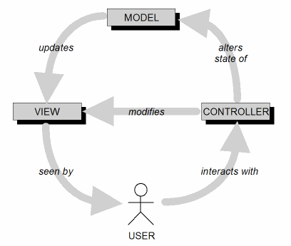
Model-View-Controller Architecture (MVC)
MVC is an ideal architecture for GUI applications.
Design goal: Identify which application components are model, view, or controller.
A user cannot directly modify the model.

Slide 5
MVC Implementation: Loose Coupling
Keep the implementations of the three object types separate.
Cohesive classes!
Each type of object does not depend on how the other types are implemented.
Loosely coupled classes!
Your application is
easier to develop and maintain
faster to develop
more robust (resilient to runtime errors)

Slide 6
MVC Model Objects
Model objects represent the persistent information maintained by your application.
The information can be kept in memory, in files, or in a database.

Slide 7
MVC View Objects
View objects represent user interface components.
Input components such as text fields, buttons, menus, checkboxes, and radio buttons.
In each use case, users interact with at least one view object.
A view object collects information from users in a form that the model and controller objects can use.

Slide 8
MVC Controller Objects
Controller objects coordinate the model and view objects.
Often have no physical counterpart in the real world.
Dispatches information from the view objects to the model objects.
This is how user-entered data can update the model.

Slide 9
Software Frameworks
A software framework consists of a set of cooperating classes.
These classes implement the essential mechanisms for a particular problem domain.
Example: Qt 6 is a C++ software framework for multi-platform GUI programming.
A framework imposes a structure on the design and development of applications.
It has classes and API that implement the structure.
It is more than simply a library.

Slide 10
Software Frameworks, cont’d
A programmer builds an application by:
Subclassing framework classes.
Adding new classes that provide custom functionality.
Inversion of control
The framework controls the execution flow.
The programmer registers callback functions, mostly as event handlers, with the framework.
The framework invokes the callback functions at the appropriate times, such as in response to events.
Example event: The user clicks a button.

Slide 11
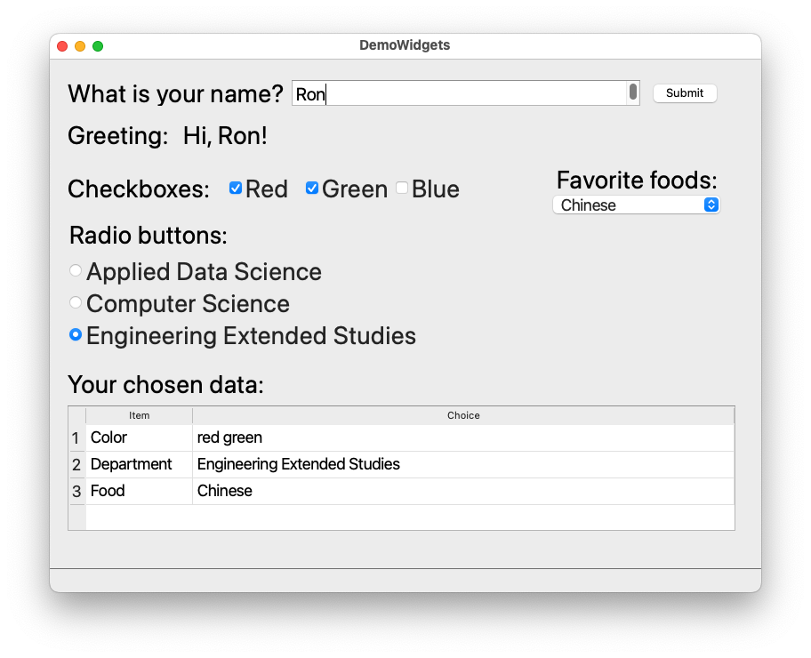
Demo Qt 6 Widgets Application

Slide 12
Free Qt 6 for Education
https://doc.qt.io/qt-6/qt-edu-for-developers.html
Tool: Qt Creator
Generate desktop C++ GUI-based applications.
Drag-and-drop GUI design tool.
IDE for C++.
Generate multi-platform applications.

Slide 13
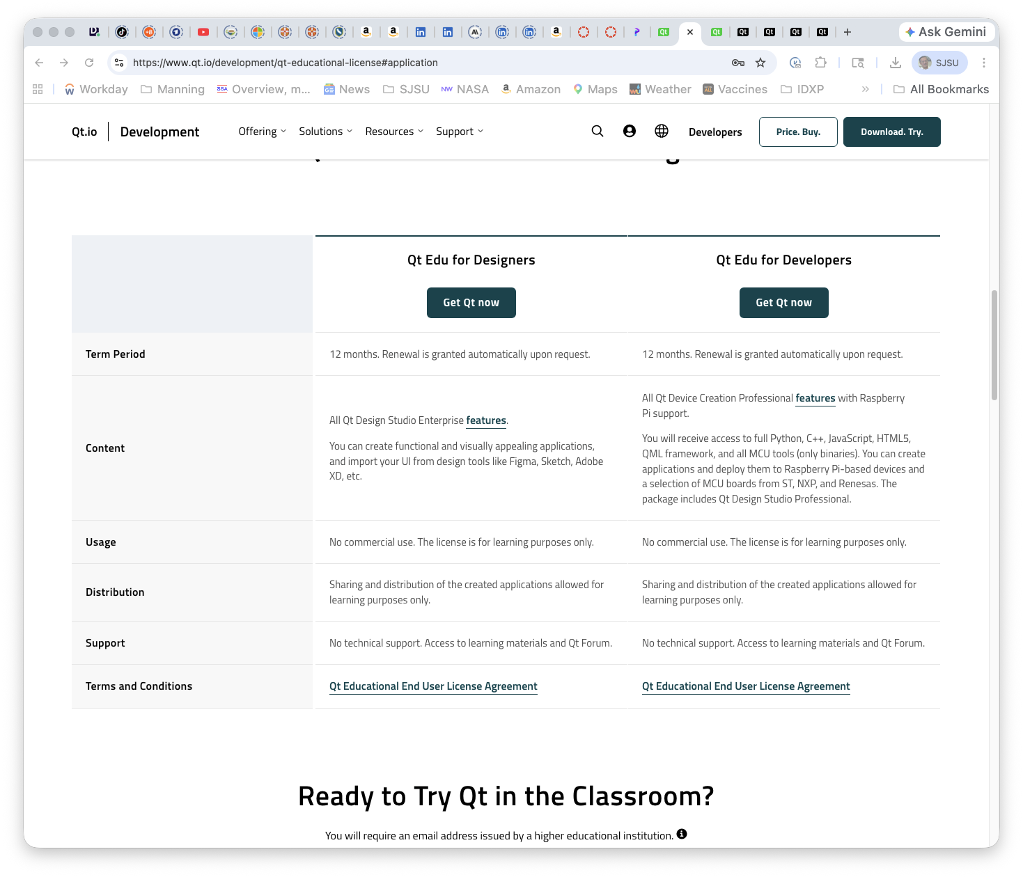
Install Qt 6
You want Qt Edu for Developers

Slide 14
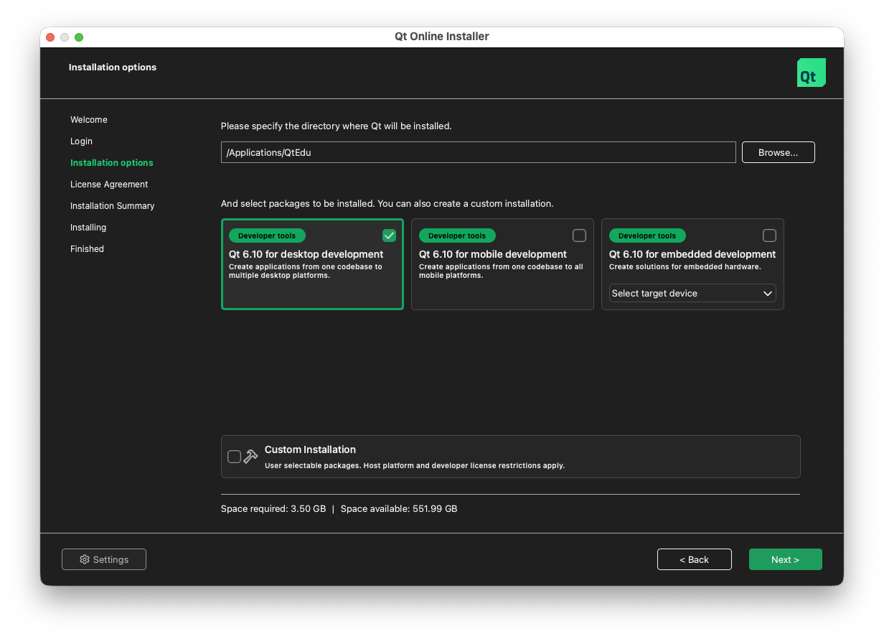
Install Qt 6, cont’d
When installing, be sure to select the “Qt 6.10 for desktop development” option.

Slide 15
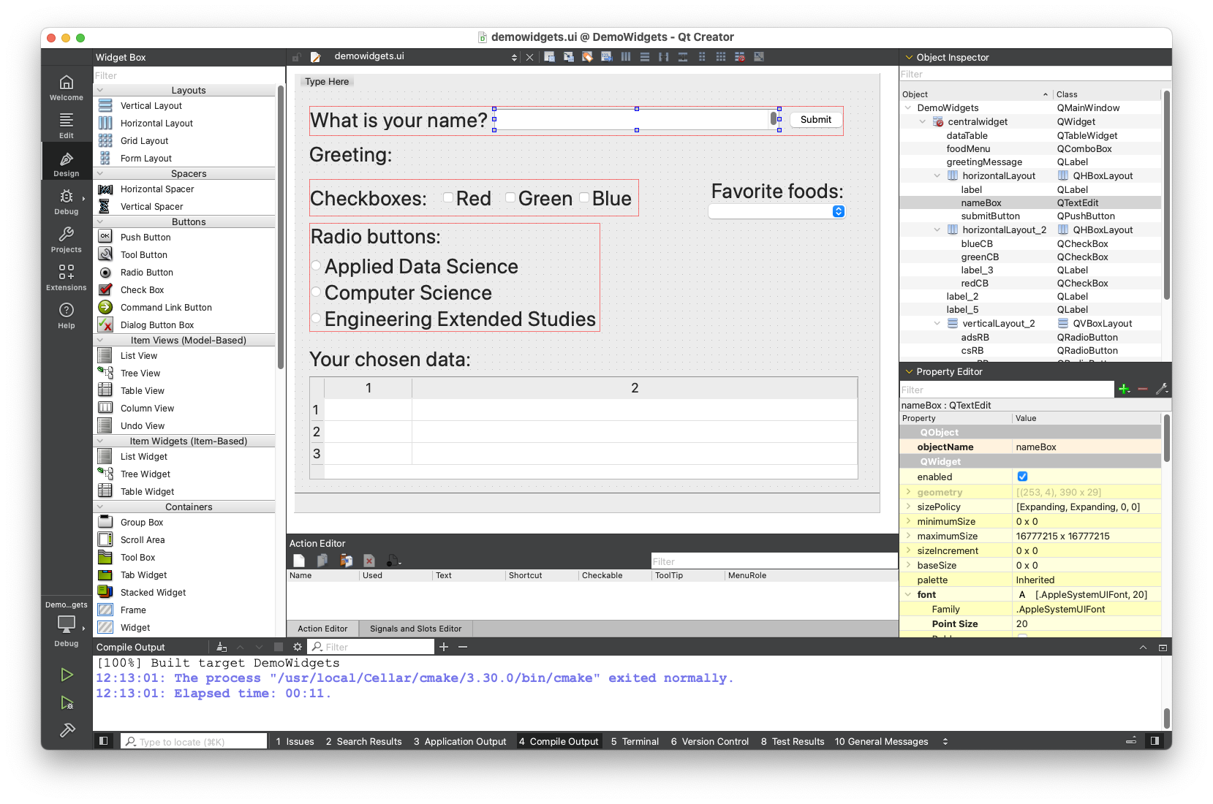
Qt Creator

Slide 16
Assignment #5
Recreate the demo widgets app.
Or something much cooler!
Individual assignment.
Tutorial to build a Qt desktop app: https://doc.qt.io/qtcreator/creator-writing-program.html

