Slide 1


CMPE 202 Software Systems Engineering March 18 Class Meeting
Engineering Extended Studies San Jose State University Spring 2026 Instructor: Ron Mak
www.cs.sjsu.edu/~mak

Slide 2
Today
Go over midterm answers
Template Method Design Pattern
Break
Strategy Design Pattern
Assignment #6

Slide 3
Midterm Question 1
Recursive Greatest Common Divisor (GCD):
What is the base case?
How does each recursive call approach the base case?
int gcd(int a, int b) { return b == 0 ? a : gcd(b, a%b); }
b == 0
The argument a%b becomes smaller (i.e., closer to 0) with each call.

Slide 4
Midterm Question 2
Explain how a design that uses the Code to the Interface Principle has more flexibility.
No hardcoding of the source.
Uses polymorphism to allow changes during run time.

Slide 5
Midterm Question 3
Explain precisely any relationships between
the Department and Student classes
the Student and Schedule classes
the Department and Schedule classes
Each department aggregates zero or more students.
Each student composes a schedule.
Each department can have transient dependencies on schedules.

Slide 6
Midterm Question 4
The class has too many responsibilities. Therefore, refactor it into smaller cohesive classes. For example:
class Coding { void iterative_design_code_test(); }; class Testing { void regression_testing(); void black_box_testing(); void unit_testing(); }; class Deployment { void deploy_application(); }; class Maintenance { void maintain_application(); };
class Requirements { public: void gather_requirements(); void analyze_requirements(); void validate_requirements(); void write_functional_spec(); }; class Design { void create_UML_diagrams(); void write_design_spec(); void initial_class_design(); void create_prototype(); };

Slide 7
Midterm Question 5
Towers of Hanoi recursive calls:
Base case:
Approach to the base case:
Arguments change order:
solve(n - 1, source, destination, temporary); solve(1, source, temporary, destination); solve(n - 1, temporary, source, destination);
When the number of disks to move is 1.
n - 1 is closer to the base case.
The pins take on different roles during each recursive call.

Slide 8
Midterm Question 6
Recursive frequency counter:
int count(vector<int> values, int target) { if (values.size() == 0) return 0; else { int first_value = values[0]; values.erase(values.begin()); return (first_value == target ? 1 : 0) + count(values, target); } }
Base case: Vector size is 0.
Remove and save the first value.
Return the target value’s frequency count in the rest of the vector. Add 1 if the first value is equal to the target value.

Slide 9
Design Patterns
Design patterns take our object-oriented software design skills up to the next level.
They are models from which we can create well-designed solutions to many common software architecture problems.
Software architecture refers to how we structure the code of our application — how we design the classes and subclasses, how they relate to one another, and how they interact at run time.

Slide 10
Design Patterns, cont’d
Design patterns are industry-proven model solutions that are reliable, flexible, and adhere to good design principles.
Not copy-and-paste source code.
Not code we import from libraries.

Slide 11
Design Patterns, cont’d
Design patterns were discovered, not invented.
Over many years, experienced developers encountered common software architecture problems in many software projects.
From the best solutions to these problems, they saw patterns in the design of the classes, the relationships among the classes, and the runtime interactions of their objects.

Slide 12
Design Patterns, cont’d
An experienced programmer can recognize an architecture problem that can be solved with an appropriate design pattern.
Then decide whether to use the pattern as the model to create a solution to the problem.
A design pattern is an abstract model from which we can create a custom solution to a software architecture problem.

Slide 13
The Gang of Four
Design Patterns and the Gang of Four
The concept of design patterns was first popularized by the book, A Pattern Language: Towns, Building, Construction by Christopher Alexander, et al. (Oxford University Press, 1977). This book contained patterns for solving common architectural problems of physical buildings (where to put doors and windows, how many stories, and so on) and how to design neighborhoods.
Four computer scientists, Erich Gamma, Richard Helm, Ralph Johnson, and John Vlissides adapted the concept to solve common architectural problems of object-oriented software. They wrote Design Patterns: Elements of Reusable Object-Oriented Software (Addison-Wesley, 1995). This book is often called the “Gang of Four” (GoF) book. It contains 23 software design patterns organized into three categories: creational patterns, structural patterns, and behavioral patterns.
We’ll cover some of the major patterns during the rest of this semester.

Slide 14
Baseball and Volleyball Game Reports
Suppose a school’s athletics department wants an application that prints a short report after each baseball game and volleyball game.
The baseball report includes some statistics with a simple bar chart about the performance of one team during a game.
Example:
BASEBALL GAME REPORT
11 singles
7 doubles
1 triples
1 homers
....5...10...15...20...25...30
Singles: SSSSSSSSSSS
Doubles: DDDDDDD
Triples: T
Homers: H
End of report

Slide 15
Game Reports, cont’d
The volleyball report includes the winner, the winning score, and how each team scored its points during the rounds of the game.
Example:
VOLLEYBALL GAME REPORT
Winner was Team 2
The winning score was 15 to 11
....5...10...15
1: 2
2: 2
3: 2
4: 1
5: 1
6: 2
7: 1
8: 2
9: 1
10: 1
11: 2
12: 1
13: 2
14: 1
15: 2
16: 2
17: 1
18: 2
19: 1
20: 2
21: 1
22: 2
23: 2
24: 2
25: 1
26: 2
End of report

Slide 16
Desired Design Features
DF 1: The report generation steps are in a fixed order.
DF 2: Corresponding steps between the two reports that are executed the same way should be coded the same way.
DF 3: Corresponding steps between the two reports that are executed differently will have custom code for those steps in each report.
DF 4: There is little or no duplicated code.

Slide 17
Before Using the Template Method DP
Print the report header.
Acquire data from the game.
Analyze the data.
Print the report.
Print the report footer.
VOLLEYBALL GAME REPORT
Winner was Team 2
The winning score was 15 to 11
....5...10...15
1: 2
2: 2
3: 2
4: 1
5: 1
6: 2
7: 1
8: 2
9: 1
10: 1
11: 2
12: 1
13: 2
14: 1
15: 2
16: 2
17: 1
18: 2
19: 1
20: 2
21: 1
22: 2
23: 2
24: 2
25: 1
26: 2
End of report
BASEBALL GAME REPORT
11 singles
7 doubles
1 triples
1 homers
....5...10...15...20...25...30
Singles: SSSSSSSSSSS
Doubles: DDDDDDD
Triples: T
Homers: H
End of report

Slide 18
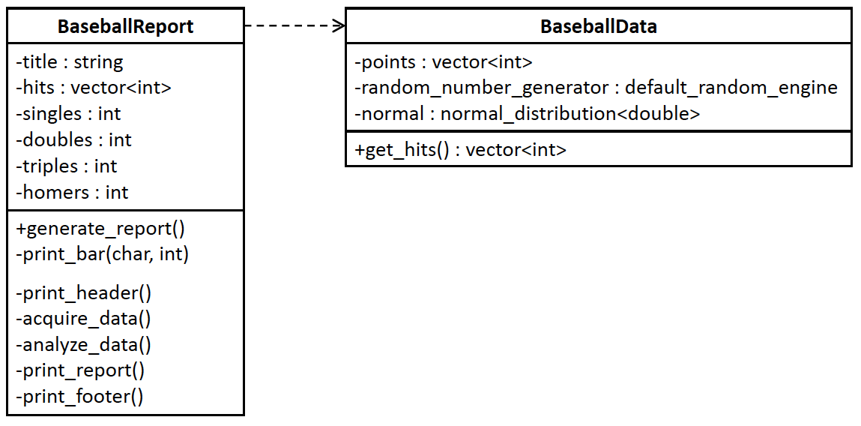

Baseball Report [Before]
8.1/BaseballData.h
8.1/BaseballReport.h
8.1/BaseballData.cpp
8.1/BaseballReport.cpp

Slide 19
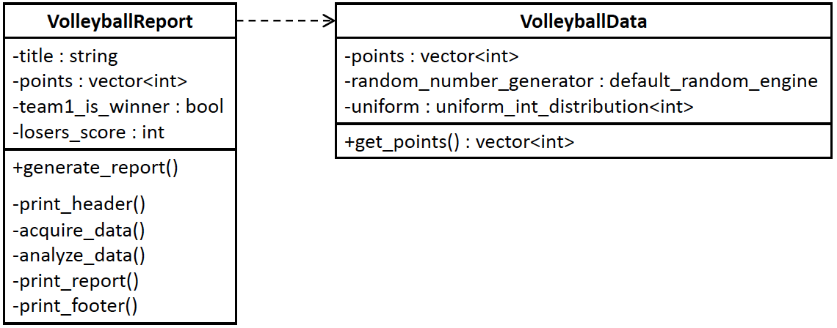
Volleyball Report [Before]
8.1/VolleyballData.h
8.1/VolleyballReport.h
8.1/VolleyballData.cpp
8.1/VolleyballReport.cpp
8.1/main.cpp

Slide 20
Problems with “Before”
Duplicated code. In classes VolleyballReport and BaseballReport, we duplicated the code for member functions print_header() and print_footer() that represent common report generation operations.
Report generation follows the same steps for each sport, and so we’ve also duplicated the code for member function generate_report() in each class.

Slide 21
The Template Method Design Pattern
The Template Method Design Pattern
“Define the skeleton of an algorithm in an operation, deferring some steps to subclasses. Template Method lets subclasses redefine certain steps of an algorithm without changing the algorithm’s structure.” [GoF 325]

Slide 22
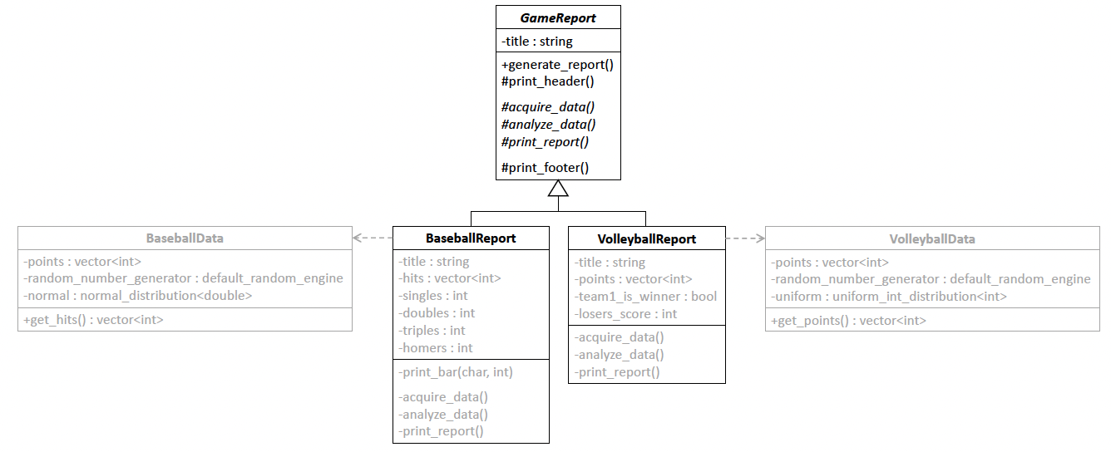

The Template Method Design Pattern, cont’d
8.2/BaseballData.h
8.2/VolleyballData.h
8.2/main.cpp
8.2/BaseballData.cpp
8.2/VolleyballData.cpp
8.2/BaseballReport.h
8.2/VolleyballReport.h
8.2/BaseballReport.cpp
8.2/VolleyballReport.cpp
The superclass GameReport outlines the steps in the proper order for the algorithm to generate
a report. It implements the common steps print_header() and print_footer() and
delegates the remaining steps acquire_data(), analyze_data(), and print_report()
to the BaseballReport and VolleyballReport subclasses. The public template method
generate_report() in the superclass calls the step member functions in the proper order.

Slide 23
Benefits of “After”
Algorithm outline. The GameReport superclass sets the standard for game report generation by declaring member functions that implement the steps of the algorithm. The template method generate_report() calls the member functions steps in the proper order.
Reduced code duplication. Step functions print_header() and print_footer() in the superclass define common behavior, which eliminates code duplication. This supports the Don’t Repeat Yourself Principle. The subclasses define the remaining step functions.

Slide 24
Benefits of “After”, cont’d
Open-Closed Principle. Superclass GameReport follows the Open-Closed Principle. We won’t modify it, but we can extend it with the report subclasses.
Encapsulated steps. The report subclasses follow the Encapsulate What Varies Principle to encapsulate the varying steps to generate game reports.
Cohesive and decoupled classes. Each report subclass is cohesive and decoupled from the other report subclasses.

Slide 25
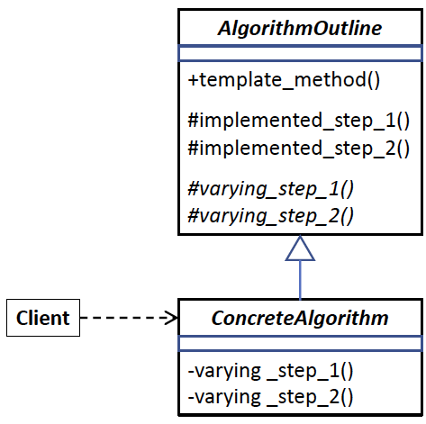
The Template Method DP Generic Model
Design pattern | Applied by the example application
client class | main
superclass AlgorithmOutline | superclass GameReport
subclass ConcreteAlgorithm | subclasses VolleyballReport and BaseballReport
template_method() | generate_report()
common steps | print_header() and print_footer()
varying steps | acquire_data(), analyze_data(), and print_report()

Slide 26
Break

Slide 27
The Strategy Design Pattern
The Strategy Design Pattern provides a model for a software architecture problem that involves a family of algorithms, or several variants of an algorithm, that need to be interchangeable at run time.
A model for a solution that encapsulates each algorithm or algorithm variant, reduces code duplication, and allows us to modify the algorithms independently.
Choose at run time which algorithm to use.

Slide 28
Hardcoding
Hardcoding vs. Runtime Flexibility
“Hardcoding” refers to the code we’ve written it in the source file. When we hardcode, we make decisions when we write the code about how the program will behave at run time. Once we’ve hardcoded, we can’t make changes to the program’s behavior without modifying the code. This may also require extensive retesting and rewriting documentation.
Many of the design patterns provide models for software architectures that have runtime flexibility so that the application can make behavior decisions when it’s running. For example, the Strategy Design Pattern enables an application to choose which algorithm to use based on a logical decision. Our testing and documentation should cover all the algorithms before we deploy the application. A well-designed architecture can also minimize code changes if we later add new algorithms or modify existing ones.

Slide 29
Three Sports
An application involves three sports: baseball, football, and volleyball.
For each sport, we need to execute an algorithm to recruit players and an algorithm to reserve a venue.

Slide 30
Desired Design Features
DF 1: Each sport implements code for both algorithms.
DF 2: It should be straightforward to add or delete sports.
DF 3: It should be straightforward to add, delete, or modify algorithms for the sports.
DF 4: It should be possible to make algorithm choices at run time.
DF 5: It should be possible for sports to share algorithms, such as one for reserving a particular venue.

Slide 31
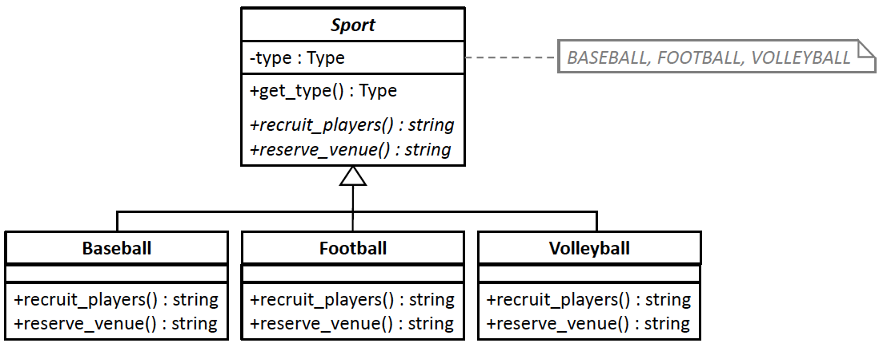
Sports [Before]
8.3/Sport.h
8.3/Sports.h
8.3/tester.cpp

Slide 32
Problems with “Before”
Duplicated code. For example, the statement block representing a venue algorithm is repeated several times. This will be a major problem with more sports or if the algorithms have more complex behaviors.
Lack of encapsulation. If, for example, the stadium is unavailable and the sports that use it must have a different venue, we’ll need to change the code in multiple places.
{ return "stadium"; }

Slide 33
Problems with “Before”, cont’d
Hard to reuse code that ought to be shared. If another sport needs the stadium venue, we can’t easily reuse that code without duplicating it.
Hardcoded players and venues that will require rewriting code to change.

Slide 34
The Strategy Design Pattern
The Strategy Design Pattern
“Define a family of algorithms, encapsulate each one, and make them interchangeable. Strategy lets the algorithm vary independently from clients that use it .” [GoF 315 ]

Slide 35
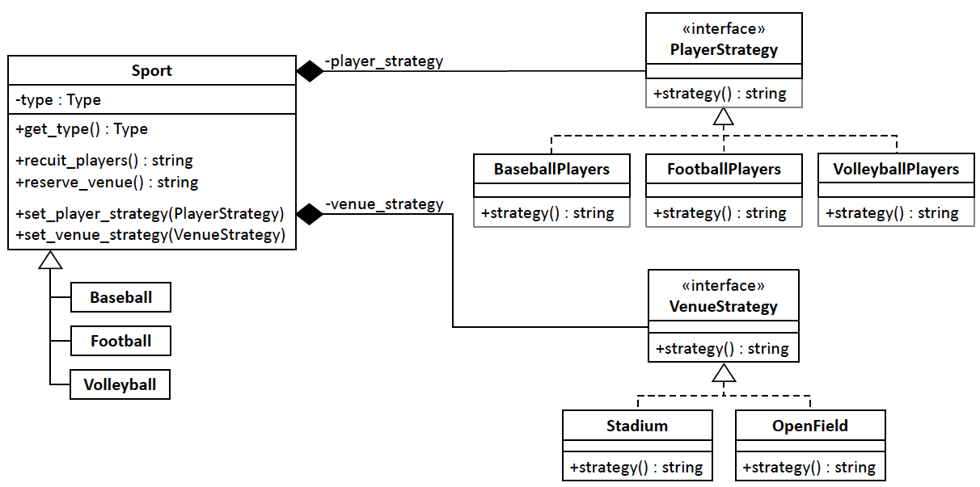
The Strategy Design Pattern, cont’d
8.4/VenueStrategy.h
8.4/PlayerStrategy.h
8.4/Sport.h
8.4/Sports.h
8.4/Tester.cpp
The player family of algorithms implement the PlayerStrategy interface, and the venue family of algorithms implement the VenueStrategy interface. Class Sport uses “has-a” relationships to aggregate the algorithms. Each player and venue algorithm has a strategy() member function. The Baseball, Football, and Volleyball subclasses are now much simpler, and each one sets the player_strategy and venue_strategy member variables of the Sport superclass.

Slide 36
Benefits of “After”
Reusable shared code, such as subclass Stadium, which follows the Don’t Repeat Yourself (DRY) Principle. Both the baseball and football teams play in the stadium.
Encapsulated algorithms in the player and venue classes. It will be possible to make changes to these interchangeable algorithms without modifying the other classes. This is the Encapsulates What Varies Principle.
The Open-Closed Principle for superclass Sport. The class is closed to changes, but we can extend it with subclasses. We can add and remove sports without affecting the superclass.

Slide 37
Benefits of “After”, cont’d
Favor “has-a” over “is-a” where class Sport aggregates the strategy classes such as BaseballPlayers and Stadium rather than rely on its subclasses to implement the strategies. Class Sport uses the Code to the Interface Principle since its member variables player_strategy and venue_strategy point to the strategy interfaces PlayerStrategy and VenueStrategy, respectively.
Runtime flexibility of supplying strategies for the sports rather than hardcoding them. For example, at run time, we can change a Volleyball object’s venue strategy from OpenField to Stadium.

Slide 38
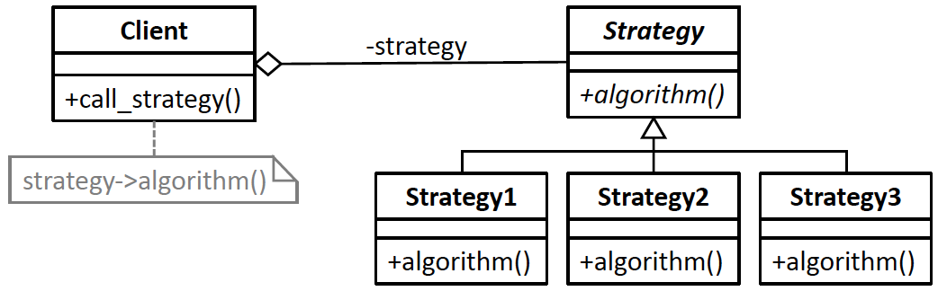
The Strategy Design Pattern Generic Model
Design pattern | Applied by the example application
class Client | superclass Sport
superclass Strategy | interfaces PlayerStrategy and VenueStrategy
subclasses Strategy1, Strategy2, etc. | Classes BaseballPlayers, FootballPlayers, VolleyballPlayers, Stadium, and OpenField
algorithm() | strategy() member functions
strategy->algorithm() | player_strategy->strategy() venue_strategy->strategy()

Slide 39
Template Method vs. Strategy Design Patterns
Template Method relies on inheritance. The outline of algorithm is in the superclass, and the encapsulated parts of the algorithm are in subclasses. Template Method allows the superclass to implement common steps of the algorithm.
Strategy aggregates whole algorithms and makes them interchangeable. Strategy uses composition — the Strategy subclasses (the PlayerStrategy and VenueStrategy subclasses in our example) are composed by the Client class (superclass Sport in our example).
In the Strategy model, the Client class is loosely coupled from the Strategy subclasses. We can add, remove, or update the subclasses later.

Slide 40
Assignment #6: Rock-Paper-Scissors Game
Write a text-based application that plays Rock-Paper-Scissors, computer vs. human.
20 rounds per game
During each round, prompt for the human player’s choice of R, P, or S.
The computer uses one of two algorithms to make its choice:
random: make a random choice
smart: use a simple machine learning algorithm

Slide 41
Assignment #6, cont’d
During the game, after each human’s choice, store the sequence consisting of the last N choices during the game by both players.
For example, N = 5:
The human’s choices are underlined.
Keep a frequency count of the sequences.
For example:
Update the frequencies after each human choice.
PSRSP
RSPSR:1, SPRPP:3, RSPRS:2, RSPSS:4, RSPSP:3, SSRPP:2

Slide 42
Assignment #6, cont’d
During the game, suppose the last N-1 choices were:
What should the computer choose next?
It must predict whether the human will next choose R, P, or S.
Based on the stored frequencies, it should predict that the human will next choose S, because appears more often than or .
Therefore, the computer should choose R.
If a sequence is not in the store, the computer should simply make a random choice.
RSPS
RSPSR:1, SPRPP:3, RSPRS:2, RSPSS:4, RSPSP:3, SSRPP:2
RSPSS
RSPSR
RSPSP

Slide 43
Assignment #6, cont’d
Use iterative development.
Use appropriate design principles.
Use either or both Template Method or Strategy Design Patterns.
Full credit if you can reasonably use both design patterns.

